Slide 1


Samuel Hall
Training slides
Community Based Assessment (CBA) of UNHCR Pockets of Hope (PoH) - ESA24001 (Day 1)
April 2024
Notes:
Main heading: Raleway Bold - size 60 - white
Subheading: Raleway Regular - caps lock - size 24 - white

Slide 2

Agenda Day (Friday, 3rd May)
Time | Activity
2:00-2:30 | Welcome + Introduction
2:30 - 3:30 | Background, Objectives and Study Approach
3:30 - 4.00 | BREAK
4:00 - 4:30 | TORs and responsibilities: training plan and tools
4:30 - 5:00 | Methodology and tool overview

Slide 3
Agenda Day 2 (Saturday, 4th May)
Time | Activity
9:00- 9:30 | Qualitative team: Sampling (Infrastructure and Quant teams to review tools)
10:00 – 11:00 | Qualitative team: Tool Review (Infrastructure and Quant teams to review tools)
11:00 – 11:30 | BREAK
11:30 – 12:30 | Qualitative team: Tool Review (Infrastructure and Quant teams to review tools)
12:30-1:30 | LUNCH
1:30 – 2:00 | Quantitative and Infrastructure team: ODK training (Qual teams to review tools)
2:00 - 4:00 | Quantitative team: Sampling and Tool review (Qual and Infrastructure teams to review tools)
4:00 - 4.20 | BREAK
4.20 - 5.30 | Quantitative team: Tool Review (Qual and Infrastructure teams to review tools)

Slide 4
Agenda Day 3 (Sunday, 5th May)
Time | Activity
9:00- 10:00 | Infrastructure team (Sampling) (Qual team and quant team role play exercises)
9:15 – 11:00 | Infrastructure team (Tool review) (Qual team and quant team role play exercises)
11:00 – 11:30 | BREAK
11:30 – 12:30 | Infrastructure team (Tool review) (Qual team and quant team role play exercises)
12:30-1:30 | LUNCH
1:30 – 2:30 | Qual team: Role play review and best practice techniques (Quant team and infrastructure team tool testing)
2:30 - 4:00 | Qual and infrastructure team: Transcripts and best practice techniques (Quant team and infrastructure team tool testing)
4:00 - 4.20 | BREAK
4.20 - 5.00 | How to take photos

Slide 5
Agenda Day 4 (Monday, 6th May)
Time | Activity
9:00- 10:00 | Quant team Review (Qual team - piloting)
9:00 – 10:00 | Infrastructure team review (Qual team - piloting)
11:00 – 11:30 | BREAK
11:30 – 12:30 | Translating key terminologies (Qual team - piloting)
12:30-1:30 | LUNCH
1:30 – 2:30 | Piloting (All teams)
2:30 - 4:00 | Piloting (All teams
4:00 - 4.20 | BREAK
4.20 - 5.00 | Qual team debrief (Infrastructure and quant - piloting)

Slide 6
Agenda Day 5 (Tuesday, 7th May)
Time | Activity
9:00- 10:00 | Qual team terminology discussion after piloting (Quant and infrastructure team piloting)
10:00 - 11:00 | Quant and infrastructure team piloting (Qual team transcription practice)
11:00 – 11:30 | BREAK
11:30 – 12:30 | Quant and infrastructure team piloting (Qual team transcription practice)
12:30-1:30 | LUNCH
1:30 – 2:30 | Quant and infrastructure team debrief (Qual team transcription practice)
2:30 - 4:00 | Quant and infrastructure team debrief (Qual team transcription practice)
4:00 - 4.20 | BREAK
4.20 - 5.00 | Code of conduct and workplan

Slide 7
TRAINING AGENDA
BACKGROUND AND OBJECTIVES
YOUR TORS AND DAILY RESPONSIBILITIES
REPORTING MECHANISMS
Notes:
Heading: Raleway Bold size 28 - white - always capslock
Text in circles: Raleway Bold size 18 - always capslock & centered
Background colour: #536f88ff

Slide 8
The team
Jonathan Buckley - Samuel Hall: Research lead
Joseph Luka - Samuel Hall Consultant: Project coordinator and field lead
Irene Laurence - Windle Trust: Project Coordinator
Julius Amuda - Windle Trust: Torit Field Coordinator
Robert Ikee - UNHCR: Client and Project Advisor
Florence - UNHCR: Client and Project Advisor
Notes:
This type of slide should be avoided where possible and especially if the slides are going to be presented. Succinct, short sentences are always preferable. Please do not alter text size to fit more/less text on a page - use an additional slide instead.
Heading: Raleway Bold - size 28 - always capslock - #314247
Subheading: Raleway Bold - size 18 - always capslock - #536f88
Body text: Raleway Regular - size 16 - #314247

Slide 9
Introduction to Samuel Hall - Who we are
How to describe Samuel Hall and our work:
“We are a social enterprise that conducts research in countries affected by issues of migration and displacement. Our mandate is to produce research that delivers a contribution to knowledge with an impact on policies, programmes and people. Our thematic pillar approach enables us to conduct empirical primary research and in-house analysis on essential cross cutting issues in hard-to-reach locations. The numerous outcomes of our approach are a tailored implementation of programmes, the creation of innovation methods and tools for field-tested research that can influence better regional and global policies.”
Key elements to remember:
We are not affiliated with any particular government
We do not work with any military
We want to have good relations with our neighbours
We are here to listen to what you have to say
We are mindful of the cultural sensitivities in the area
We do not implement any projects, we conduct research for actionable evidence

Slide 10
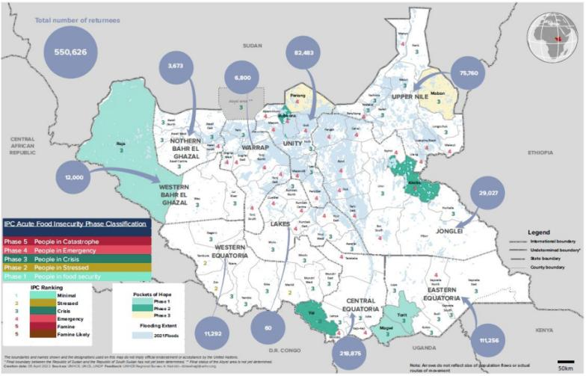
Pockets of Hope (PoH) locations (2022)
Torit and Magwi are agricultural hubs in the Eastern Equatoria region. They have a long history of peace and stability and are home to a number of refugee returnees. The agricultural sector is a major driver of economic growth in these areas.
Yei and Lainya are also agricultural areas, located in the Central Equatoria region. They are known for their coffee production and are also home to a number of natural resources.
Raja is located in the Western Equatoria region. It is a diverse area with a mix of agricultural, pastoral, and mining activities.
Notes:
This type of slide should be avoided where possible and especially if the slides are going to be presented. Succinct, short sentences are always preferable. Please do not alter text size to fit more/less text on a page - use an additional slide instead.
Heading: Raleway Bold - size 28 - always capslock - #314247
Subheading: Raleway Bold - size 18 - always capslock - #536f88
Body text: Raleway Regular - size 16 - #314247

Slide 11
Key concepts
Returnees
A former refugee who has returned from a host country to their country of origin or former habitual residence, spontaneously or in an organised fashion, with the intention of remaining there permanently and who is yet to be fully integrated. Returnees include those returning as part of the operationalisation of the cessation clauses in the 1951 Convention and regional equivalents. The High Commissioner has a protection and solutions mandate for returnees as former refugees.¹
Service Gap
Any issue/gap/challenge that affects the community’s ability to have access to education, healthcare, documentation, legal and police services, road infrastructure, etc.²
Durable Solutions
For internally displaced persons, a durable solution is achieved when internally displaced persons no longer have any specific assistance and protection needs that are linked to their displacement and can enjoy their human rights without discrimination on account of their displacement.³
(1) UNHCR (2024).
(2) Global Wash Cluster (2021)
(3) IOM (2019)

Slide 12
Key Concepts (continued)
Pockets of Hope (POH)
Disputed term coined by UNHCR describing areas that have shown signs of progress and stability despite the ongoing conflict and challenges in the country. It has been argued that these PoH might fail to capture the complexity of the situation in South Sudan.
Service Delivery Indicators (SDI)
This methodology provides a nuanced snapshot of service delivery performance in the sectors of education and health across various countries. The SDI aims to measure the quality and performance of services in these sectors to help nations gauge their progress and pinpoint areas that might need policy interventions.
Geographic Information System (GIS) / Geospatial data
GIS is a system that creates, manages, analyzes, and maps all types of data. GIS connects data to a map, integrating location data (where things are) with all types of descriptive information (what things are like there).
Notes:
Heading: Raleway Bold - size 28 - always capslock - #314247
Subheading: Raleway Bold - size 18 - always capslock - #536f88
Body text: Raleway Regular - size 16 - #314247

Slide 13
Main Research Question
Overarching research question
Do Magwi and Torit counties have the available services to absorb returning populations?
Sub-questions
What is the availability and functionality of infrastructure and services in Magwi and Torit?
What are the perceived access gaps for households in the area?
How can humanitarian programming be best used to support returning population in Magwi and Torit?
Notes:
This type of slide should be avoided where possible and especially if the slides are going to be presented. Succinct, short sentences are always preferable. Please do not alter text size to fit more/less text on a page - use an additional slide instead.
Heading: Raleway Bold - size 28 - always capslock - #314247
Subheading: Raleway Bold - size 18 - always capslock - #536f88
Body text: Raleway Regular - size 16 - #314247

Slide 14
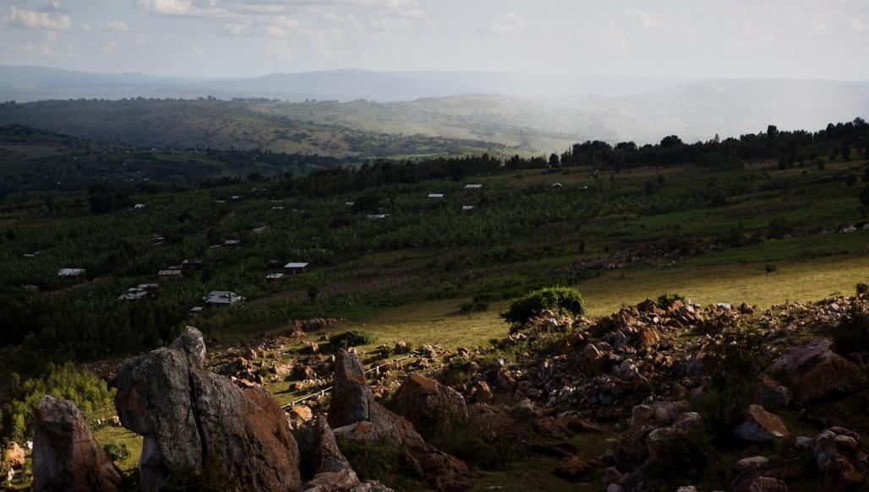

STUDY APPROACH: LOCATIONS, TOOLS & SAMPLING

Slide 15

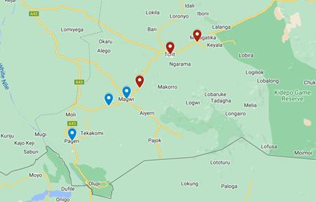
Research Locations
Magwi County:
Three distinct locations:
Magwi Town
Pageri Payam (2 bomas)
Iweri Payam (2 bomas)
Torit County:
Three distinct locations:
Torit Town
Imurok Payam (2 bomas)
Hiyala Payam (2 bomas)

Slide 16
Research Locations
Bomas for assessment:
Chosen because they have the highest returns
Magwi:
Magwi Town
Pageri Payam:
Pageri boma
Motitoruro boma
Iwire Payam:
Abara boma
Owinyikibul boma
Torit:
Torit Town
Imurok Payam:
Hutala boma
Lofiriha boma
Hiyala Payam:
Tirrangora
Nyibira
In the chosen bomas, sampling will start in center of the boma for one day (the main village hub) and then move to outlaying areas the next days until targets are met

Slide 17
Methodology - Mixed methods approach
Household survey:
Quantitative: Sampling 50% returnee households and 50% non-returnee households
Key questions: What are the key service gaps as identified by household?
Qualitative study
Qualitative Sampling officials (boma chiefs, local government, RRC), NGOs, returnees, refugees and host community individuals
Key questions: What are the key actual and perceived service gaps as identified by household?
Infrastructure assessment
Quantitative/Geo-spatial Sampling all the relevant basic services and infrastructure in a given area
Key questions: Which services are actually present?

Slide 18
Methodology - Overall Targets
Assessment | Number
Quantitative: Household Survey (HHS) | 760 (380 in Torit and 380 in Magwi)
Qualitative per PoH: Case studies KIIs FGDs | 20 (10 in Torit and 10 in Magwi) 36 (18 in Magwi and 18 in Torit) 12 (6 in Torit and 6 in Magwi)
Infrastructure mapping: Census of public infrastructures | TDB

Slide 19
Methodology - Magwi targets
Tool | Town or Payam
 | Magwi Town | Pageri Payam | Iweri Payam
Household Survey (HHS) | 130 | 130 | 130
Individual Interviews (case studies) | 2 | 4 | 4
KIIs (government, NGOs, boma chiefs) | 5 | 4 | 4
FGDs | 2 | 2 | 2

Slide 20
Methodology - Torit Targets
Tool | Town or Payam
 | Torit Town | Imurok Payam | Hiyala Payam
Household Survey (HHS) | 130 | 130 | 130
Individual Interviews (case studies) | 2 | 4 | 4
KIIs (government, NGOs, boma chiefs) | 5 | 4 | 4
FGDs | 2 | 2 | 2

Slide 21
DATA COLLECTION AND FIELDWORK TIMELINE
3-6th May
Training
May 27
End Fieldwork
770 Household interviews + 20 Case Studies + 36 structured interviews + 12 FGDs + Infrastructure assessment
Data Collection
9-27th May
Debrief
6-7th May
Piloting of tools
Notes:
This type of slide should be avoided where possible and especially if the slides are going to be presented. Succinct, short sentences are always preferable. Please do not alter text size to fit more/less text on a page - use an additional slide instead.
Heading: Raleway Bold - size 28 - always capslock - #314247
Subheading: Raleway Bold - size 18 - always capslock - #536f88
Body text: Raleway Regular - size 16 - #314247

Slide 22
BACKGROUND AND OBJECTIVES
YOUR TORS AND DAILY RESPONSIBILITIES - TOOLS
REPORTING MECHANISMS
Notes:
Heading: Raleway Bold size 28 - white - always capslock
Text in circles: Raleway Bold size 18 - always capslock & centered
Background colour: #536f88ff

Slide 23
OUR APPROACH TO DATA COLLECTION
Before Data Collection
During Data Collection
After Data Collection
Preliminary literature review
Tools are developed by SH and approved by UNHCR
NRs and enumerators are recruited and contracted
Training takes place 3-7th May
Piloting 6-7th May
Close supervision of the data management by fieldwork coordinators.
Project team to conduct daily checks on field progress and activities.
WhatsApp group with field/project teams to easily communicate and resolve arising issues.
Data will be returned to the project team digitally on a regular/rolling basis for review during the fieldwork phase.
Each transcript validated through a two-step process:
1. Review by Research Assistant and or Project Lead
2. Review by Research Manager and or Project Lead
Data collection tracked through matrix
Approval processes recorded.

Slide 24
ENUMERATORs DAILY RESPONSIBILITIES (1)
Your day to day responsibilities must include the following (facilitated by team leader):
Daily check ins with your fieldwork coordinator.
Morning - these can be brief + done via WhatsApp. Please provide Luka or Julius a short description of what you plan to do that day (who you are interviewing etc)
Evening - This is required before the end of each day of fieldwork. These conversations must be done over the phone and will last a maximum of 15 minutes.
Problem solving: A Whatsapp group will be created and all urgent communication will take place through Whatsapp. Please, contact Luka or Julis as soon as a problem/doubt arises.
NRs will be expected to do the following in writing:
updated the key trackers below:
Fieldwork Tracker for surveys
fill in the fieldwork journals at the end of each working day.

Slide 25
ENUMERATORs DAILY RESPONSIBILITIES (2)
Enumerators have a responsibility to:
Collect quality data according to the set honesty and ethical standards
Report any challenges or problems to the FC and/ or the Lead Researcher – do not let small problems become big!!
Capture photos based on existing ethical procedure
Save and share any and all receipts for fieldwork expenses
FC has a responsibility to:
Respond to enumerators questions and comments in a proactive, appropriate, and respectful manner
Oversee and check data quality and communicate any issues early and respectfully
Collect all receipts and fill out expense report weekly
Submit daily field reports
Submit duly filled questionnaires at the end of each day’s fieldwork
Notes:
This type of slide should be avoided where possible and especially if the slides are going to be presented. Succinct, short sentences are always preferable. Please do not alter text size to fit more/less text on a page - use an additional slide instead.
Heading: Raleway Bold - size 28 - always capslock - #314247
Subheading: Raleway Bold - size 18 - always capslock - #536f88
Body text: Raleway Regular - size 16 - #314247

Slide 26
TOOLS
Household survey:
1x ODK survey - Themes: respondent profile, security, food security, rights and governance, WASH, HLP (housing, land and property), protection, healthcare, education, livelihoods, social cohesion, natural environment, assistance gaps
Qualitative study
2x FGD tools: 1 for returnees and refugees, 1 for host community
1x KII (structured interview tools): for government, local chiefs, NGO workers, etc.
2x Case Study (semi-structured interviews): 1 for returnees and refugees, 1 for host community
Infrastructure assessment
7x infrastructure tools (ODK survey): health facilities, schools, judicial buildings, public buildings, safe spaces, water points, markets (minimum 10 stalls)
7x Structured interview tool: to be held with member of staff
Please study the hard copies!
2
3

Slide 27
Feedback form - here
Each national expert is expected to submit this feedback form after all interviews have been completed and on the basis of the KIIs and SSIs conducted.
This feedback form will be the basis of a discussion with the SH research team, ahead of the submission of the Final Report.
In the feedback form, the researchers are asked to give their recommendations and suggestions, within the country context, which will help in framing the final deliverable for the project.

Slide 28

Any Questions?

Slide 29
Our research connects the voices of communities to change-makers for more inclusive societies.
Notes:
End slide for every presentation
Text = Raleway - size 24 - white

Slide 30
Samuel Hall
Training slides
Community Based Assessment (CBA) of UNHCR Pockets of Hope (PoH) - ESA24001 (Day 2)
April 2024
Notes:
Main heading: Raleway Bold - size 60 - white
Subheading: Raleway Regular - caps lock - size 24 - white

Slide 31
Agenda Day 2 (Saturday, 4th May)
Time | Activity
9:00- 10:00 | Qualitative team: Sampling (Infrastructure and Quant teams to review tools)
10:00 – 11:00 | Qualitative team: Tool Review (Infrastructure and Quant teams to review tools)
11:00 – 11:30 | BREAK
11:30 – 12:30 | Qualitative team: Tool Review (Infrastructure and Quant teams to review tools)
12:30-1:30 | LUNCH
1:30 – 2:00 | Quantitative and Infrastructure team: ODK training (Qual teams to review tools)
2:00 - 4:00 | Quantitative team: Sampling and Tool review (Qual and Infrastructure teams to review tools)
4:00 - 4.20 | BREAK
4.20 - 5.30 | Quantitative team: Tool Review (Qual and Infrastructure teams to review tools)

Slide 32
TRAINING AGENDA
QUALITATIVE: TOOLS AND SAMPLING
QUANT AND INFRASTRUCTURE: ODK
QUANT: TOOLS AND SAMPLING
Notes:
Heading: Raleway Bold size 28 - white - always capslock
Text in circles: Raleway Bold size 18 - always capslock & centered
Background colour: #536f88ff

Slide 33
Methodology - Magwi targets
Tool | Town or Payam
 | Magwi Town | Pageri Payam | Iweri Payam
Individual Interviews (case studies) | 2 | 4 | 4
KIIs (government, NGOs, boma chiefs) | 5 | 4 | 4
FGDs | 2 | 2 | 2

Slide 34
Methodology - Torit Targets
Tool | Town or Payam
 | Torit Town | Imurok Payam | Hiyala Payam
Individual Interviews (case studies) | 2 | 4 | 4
KIIs (government, NGOs, boma chiefs) | 5 | 4 | 4
FGDs | 2 | 2 | 2

Slide 35
DEFINITIONS
WHAT is a RETURNEE, what is a REFUGEE, what is an IDP, what is a ‘HOST’?
a RETURNEE is a South Sudanese national who had been displaced abroad (any neighbouring country or further afield) or within South Sudan and has now come back to their area/South Sudan. This will be most of the people you will find apart from hosts.
a REFUGEE is a foreign national, so could be Sudanese, Ugandan, Congolese, Central African Republic etc who have come to seek refuge in South Sudan. There are some refugees for example from Congo and CAR in the Yei area, in a type of refugee camp, but they can also be settled among the communities. There will probably not be too many in Magwi/Torit, as most refugees from Sudan are in Maban/Wedweil camps at the moment.
an IDP is an internally displaced person, so a South Sudanese who has been displaced from their area and are now temporarily staying/living in another area of South Sudan. This could be in a camp type setting or among community members.
a ‘host’ or local community member is someone who has been living in the area all their lives or for a longer time. They may also have a history of displacement, but have been living in the area for a while or more stable than those recently returned.
In practice of course these categories don’t always work well in the context of South Sudan where all population groups have a history of displacement, And sometimes different categories of people are difficult to distinguish.
Notes:
This type of slide should be avoided where possible and especially if the slides are going to be presented. Succinct, short sentences are always preferable. Please do not alter text size to fit more/less text on a page - use an additional slide instead.
Heading: Raleway Bold - size 28 - always capslock - #314247
Subheading: Raleway Bold - size 18 - always capslock - #536f88
Body text: Raleway Regular - size 16 - #314247

Slide 36
SAMPLING: KEY INFORMANT INTERVIEWS (KIIs)
KEY INFORMANT: STRUCTURED INTERVIEWS
There is only one questionnaire for these kinds of interviewees. Government officials, local leaders, payam/county leaders, women leaders, youth leaders, paramount chiefs/chiefs etc. – generally people in a position of leadership who can tell us something about the area and the dynamics there ‘from an eagle’s eye’ and who know about security issues, administrative issues, returnee dynamics, services etc.
5 in Magwi Town, 4 in Pageri Payam (2 per boma) and 4 in Iwirie Payam (2 per boma)
5 in Torit Town, 4 in Imurok Payam (2 per boma) and 4 in Hiyala Payam (2 per boma)
Notes:
This type of slide should be avoided where possible and especially if the slides are going to be presented. Succinct, short sentences are always preferable. Please do not alter text size to fit more/less text on a page - use an additional slide instead.
Heading: Raleway Bold - size 28 - always capslock - #314247
Subheading: Raleway Bold - size 18 - always capslock - #536f88
Body text: Raleway Regular - size 16 - #314247

Slide 37
SAMPLING: CASE STUDIES
CASE STUDIES: SEMI-STRUCTURED INTERVIEWS
There are 2 questionnaires - there is one questionnaire for returning refugees and IDPs and a different one for the hosts, as for them we ask slightly different questions.
Individual interviews with returnees - they can be returnees from abroad, so returning refugees, or returning people from within South Sudan, e.g. returning IDPs . These questionnaires can also be used for existing IDPs or refugees that are residing/displaced to the area, should you find any in the areas where you interview.
Individual interviews with local community members (non-returnees)
Magwi Town and Torit Town 1x returnee interview and 1x local community member interview in each
Pageri and Iwire payam (2x returnee interview and 2x local community member interview in each boma)
Imurok and Hiyala payam (2x returnee interview and 2x local community member interview in each boma)
Notes:
This type of slide should be avoided where possible and especially if the slides are going to be presented. Succinct, short sentences are always preferable. Please do not alter text size to fit more/less text on a page - use an additional slide instead.
Heading: Raleway Bold - size 28 - always capslock - #314247
Subheading: Raleway Bold - size 18 - always capslock - #536f88
Body text: Raleway Regular - size 16 - #314247

Slide 38
SAMPLING: CASE STUDIES
FOCUS GROUP DISCUSSIONS (FGDS)
2 types of questionnaires – one for an FGD with returnees, and existing IDPs/refugees, and a different one for hosts.
Discussions with up to 5-6 people (you should aim not to have more than that) who should be from the same type (ie. returnees or hosts). Generally separate men and women, also separate returnees and hosts and do focus groups separately.
If you mix groups with men and women the women may not feel comfortable or safe to speak up. Similarly with returnees and hosts – given you are discussing different issues one group might not feel comfortable to share the issues in front of the others.
1x returnee FGD and 1x local community member FGD in each location
Notes:
This type of slide should be avoided where possible and especially if the slides are going to be presented. Succinct, short sentences are always preferable. Please do not alter text size to fit more/less text on a page - use an additional slide instead.
Heading: Raleway Bold - size 28 - always capslock - #314247
Subheading: Raleway Bold - size 18 - always capslock - #536f88
Body text: Raleway Regular - size 16 - #314247

Slide 39
SAMPLING: WORK PLAN MAGWI
Qualitative data collection
Location | Torit | Tori | Torit | Torit | Travel
Researcher | 04.05 | 05.05 | 06.05 | 07.05 | 08.05
EN (FGD) 1 | Training | Training | Training | Pilot | -
EN (KII) 2 + EN (KII) 3 + EN (KII) 4) | Training | Training | Training | Pilot | -
SH research team
Location | Magwi | Travel - Pageri | Pageri - Travel | Iwire | Magwi
Researcher | 09.05 | 10.05 | 11.05 | 12.05 | 13/05
EN (FGD) 1 | 2 FGDs | 1 FGD | 1 FGD | 2 FGD
EN (case study) 2 | 2 | 2 | 2 | 4 | 3
EN (KII) 3 + EN (KII) 4) | 5 KII | 4 KII | 2 KIIs | 4 KII
Location | Magwi | Magwi | Magwi | Magwi | Magwi
Researcher | 14.05 | 15.05 | 16.05 | 17.05 | 18.05
EN (FGD) 1 | Transcripts | Transcripts | Transcripts
EN (KII) 2 + EN (KII) 3 + EN (KII) 4) | Transcripts | Transcripts | Transcripts | Transcripts | Transcripts
SH research team | Transcript review | Transcript review | Transcript review | Transcript review | Transcript review
Notes:
This type of slide should be avoided where possible and especially if the slides are going to be presented. Succinct, short sentences are always preferable. Please do not alter text size to fit more/less text on a page - use an additional slide instead.
Heading: Raleway Bold - size 28 - always capslock - #314247
Subheading: Raleway Bold - size 18 - always capslock - #536f88
Body text: Raleway Regular - size 16 - #314247

Slide 40
SAMPLING: WORK PLAN TORIT
Qualitative data collection
Location | Torit | Tori | Torit | Torit | Hiyala
Researcher | 04.05 | 05.05 | 06.05 | 07.05 | 08.05
EN (FGD) 1 | Training | Training | Training | Pilot | 2 FGDs
En (case study) 2 |  |  |  |  | 4
EN (KII) 2 + EN (KII) 3 + EN (KII) 4) | Training | Training | Training | Pilot | 5 KII
SH research team
Location | Torit | Travel - Imutok | Imutok- Travel | Torit | Torit
Researcher | 09.05 | 10.05 | 11.05 | 12.05
EN (FGD) 1 | 2 FGDs | 1 FGD | 1 FGD | Transcripts
EN (case study) 2 | 2 | 2 | 2
EN (KII) 3 + EN (KII) 4) | 5 KII | 3 KII | 2 KIIs | Transcripts
Location | Torit | Torit | Torit | Torit | Torit
Researcher | 14.05 | 15.05 | 16.05 | 17.05 | 18.05
EN (FGD) 1 | Transcripts | Transcripts
EN (KII) 2 + EN (KII) 3 + EN (KII) 4) | Transcripts | Transcripts | Transcripts | Transcripts
SH research team | Transcript review | Transcript review | Transcript review | Transcript review | Transcript review
Notes:
This type of slide should be avoided where possible and especially if the slides are going to be presented. Succinct, short sentences are always preferable. Please do not alter text size to fit more/less text on a page - use an additional slide instead.
Heading: Raleway Bold - size 28 - always capslock - #314247
Subheading: Raleway Bold - size 18 - always capslock - #536f88
Body text: Raleway Regular - size 16 - #314247

Slide 41
QUALITATIVE TOOLS

Slide 42
Focus Group Discussions
What is a Focus Group Discussion?
Facilitated discussions, held with a small group of people who have specialist knowledge or interest in a particular topic
Enable the research to hear a variety of stories and opinions and spaces of agreement or disagreement
Held with a group of 5 to 6 respondents
Tips and Tricks
First introduce yourself and then have others introduce themselves
Make sure respondents know that every question is voluntary - if they don’t feel comfortable at any point they don’t have to answer
Ensure all members of the focus group have the opportunity to speak equally
Keep the focus group on discussion on topic
Please let participants know you will be recording the focus group and include as much detail in your notes or transcriptions as possible

Slide 43
FGDs TOOLs
The FGD tools includes the following sections:
PART 1 -. Background /returns and integration in the area
PART 2 - Social Cohesion
PART 3 - Security and Protection
PART 4 - Livelihoods
PART 5 - Services and impact of returnees
PART 6 - Durable solutions
PART 7 - Future outlook
Remember! Encourage respondents to talk to each other rather than take turns to provide you with an answer. Try to facilitate group discussions as much as possible.
These tools will require active participation from participants, they will be asked to write down responses to certain prompts during the interview.

Slide 44
Semi-Structured Interviews (SSIs)
What is a Semi-Structured Interview?
An interview technique led by a selection of ‘guiding’ questions. Less structured than a normal interview.
Enable the interviewer or researcher to be more flexible in their approach ie. ask more follow up questions
Tips and Tricks
First introduce yourself and then have the respondent introduce themselves
Ask follow up questions related to the research objectives.
Please let participants know you will be recording the interview and include as much detail in your notes or transcriptions as possible

Slide 45
SSI TOOLs
The SSI tools includes the following sections:
PART 1 -. Returns and integration
PART 2 - Social Cohesion
PART 3 - Security/ stability / Protection
PART 4 - Livelihoods
PART 5 - Basic Services
PART 6 - Durable Solutions /Land/Conflicts
PART 7 - Future outlook

Slide 46
Key informant interviews (KIIs)
What is a Semi-Structured Interview?
A structured interview with a set question list.
Tips and Tricks
First introduce yourself and then have the respondent introduce themselves
Please let participants know you will be recording the interview and include as much detail in your notes or transcriptions as possible

Slide 47
KII TOOLs
The KII tools includes the following sections:
PART 1 -. Returns and integration
PART 2 - Social Cohesion
PART 3 - Security/ stability / Protection
PART 4 - Governance / Administrative capacity
PART 5 - Livelihoods
PART 6 - Basic Services
PART 7 - Movements/Durable Solutions /Land/Conflicts
PART 8 - Future Outlook

Slide 48
KII TOOLs
KEY TERMINOLOGY:

Slide 49
Discussion:
What are the key questions we are looking to answer?
What are the key terminologies that need defining?
What do you think are the main difficulties you will encounter?
How can you overcome them?
Notes:
This type of slide should be avoided where possible and especially if the slides are going to be presented. Succinct, short sentences are always preferable. Please do not alter text size to fit more/less text on a page - use an additional slide instead.
Heading: Raleway Bold - size 28 - always capslock - #314247
Subheading: Raleway Bold - size 18 - always capslock - #536f88
Body text: Raleway Regular - size 16 - #314247

Slide 50
Any Questions?

Slide 51
QUALITATIVE: TOOLS AND SAMPLING
QUANT AND INFRASTRUCTURE: ODK
QUANT: TOOLS AND SAMPLING
Notes:
Heading: Raleway Bold size 28 - white - always capslock
Text in circles: Raleway Bold size 18 - always capslock & centered
Background colour: #536f88ff

Slide 52
USING KOBOCOLLECT
Open the survey data collection software and go into General settings
Go to server
Set the url to: https://kc.kobotoolbox.org
Set the username to: sh_enum1; and password: depEgDus7
4. Go to DOWNLOAD FORM and download : Fill in name!!!
Notes:
This type of slide should be avoided where possible and especially if the slides are going to be presented. Succinct, short sentences are always preferable. Please do not alter text size to fit more/less text on a page - instead use an additional slide.
Heading: Raleway Bold - size 28 - always capslock - #314247
Subheading: Raleway Bold - size 18 - always capslock - #536f88
Body text: Raleway Regular - size 16 - #314247

Slide 53


2. Using Kobocollect: Opening the electronic data collection software
Step 1. Open the survey data collection software.
The software is used for collecting electronic data through mobile phone. It is already installed in the cell phones you have. You just need to click it open.

Slide 54
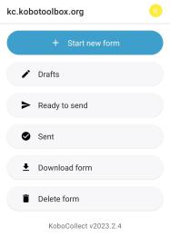
3. Using Kobocollect: Opening the electronic data collection software
Step 2. Open the survey data collection software, you will see the following screen:
Click ‘Start new form’ to select the questionnaire to be filled for the survey.

Slide 55
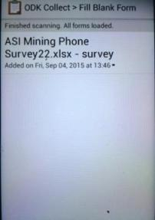
4. Using KOBOCOLLECT: Opening the electronic data collection software
Step 3. Clicking ‘Start New Form’, the following screen will appear where you will choose the relevant questionnaire. Select the questionnaire and the form will open to be filled by you.

Slide 56
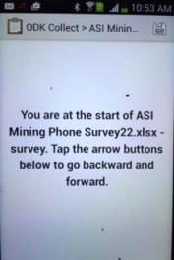
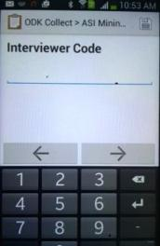
5. Using Kobocollect: Opening the electronic data collection software
Step 4: Enter your interviewer code (i.e. E1, E8, E11…)

Slide 57
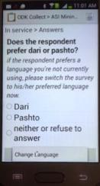
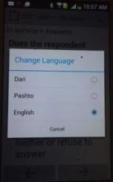
6. Using Kobocollect: Launching the survey
Step 5. Proceed with the Survey.

Slide 58
7. Using Kobocollect: Prompting
When a question is labelled “prompt,” always read through the possible responses.
Prompt ≠ guide toward specific responses. Maintain a neutral tone when reading options.
If questions are labelled “do not prompt” or are not specifically labelled “prompt”, do not read the possible answers. When questions are asking about what respondents think, it is VERY important not to prompt their answers.
If you are not sure if an answer fits one of the options given on the survey, ask for clarification. If it is still unclear write down what the person says separately and ask Jared for advice after you complete the survey.

Slide 59
8. Using ODK: Electronic Data Collection
If the answer to a question is not included as an option and you are asked to specify, first select “other” and second, fill in the answer on next screen.
Example (Screen 1)
1. | Where were you born? | Afghanistan Iran Pakistan Other
Example (Screen 2)
Specify other: _____Germany____

Slide 60
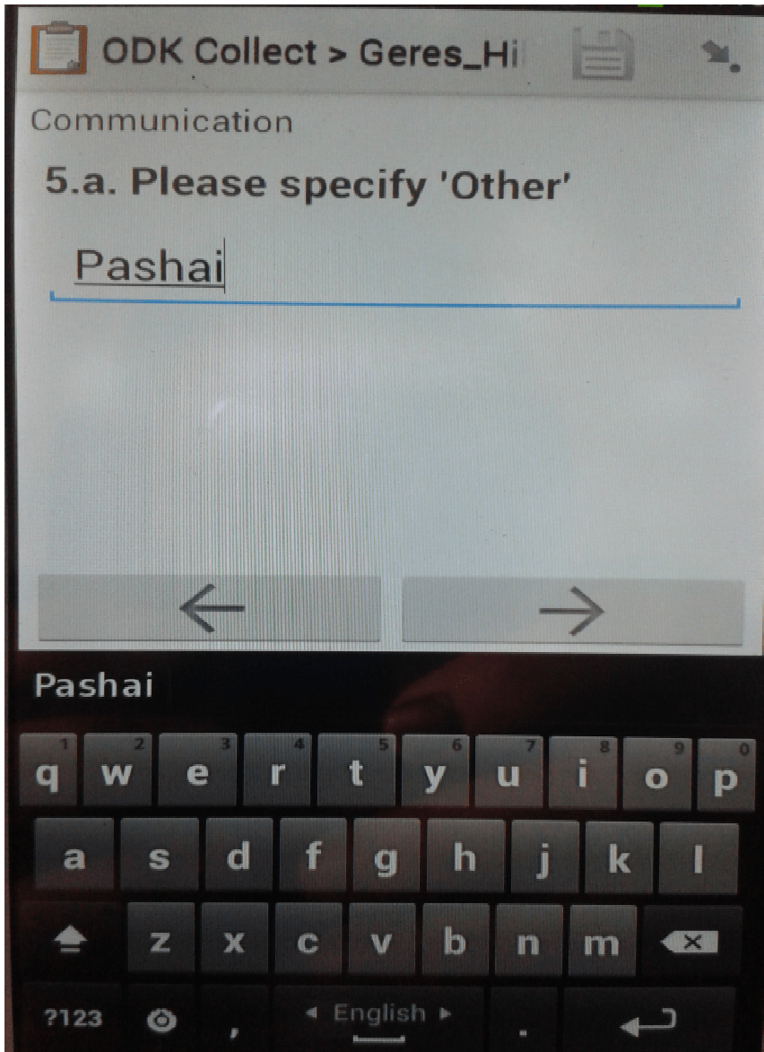
12. Using ODK: Electronic Data Collection
TYPES OF QUESTIONS:
SPECIFY:
Sometimes an answer may require further detail. Be as precise as possible while writing the details. If ‘other’ option is chosen in a question, the following screen will appear to specify it:

Slide 61
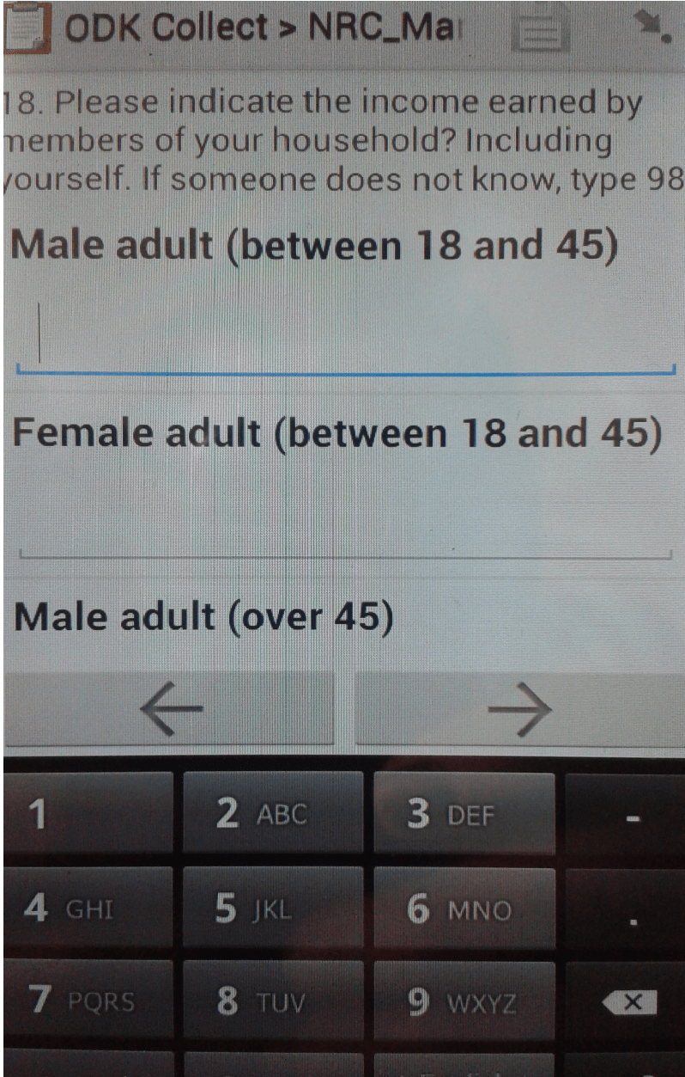
13. Using Kobocollect: Electronic Data Collection
Numeric/text Entry questions: In mobile set, some numeric/text questions will appear as shown here:

Slide 62
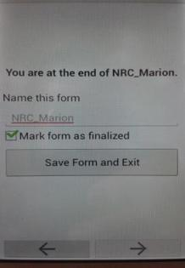
14. Using Kobocollect: Electronic Data Collection
Finalizing and Finishing the questionnaire: Once the form is complete, save and exit the form, and start another form using the procedure explained above. ‘Save and Exit’ screen appears as shown:
The only thing you need to do is click on ‘Save Form and Exit’ to save it.

Slide 63
QUALITATIVE: TOOLS AND SAMPLING
QUANT AND INFRASTRUCTURE: ODK
QUANT: TOOLS AND SAMPLING
Notes:
Heading: Raleway Bold size 28 - white - always capslock
Text in circles: Raleway Bold size 18 - always capslock & centered
Background colour: #536f88ff

Slide 64
Research Locations
Magwi County:
Three distinct locations:
Magwi Town
Pageri Payam (2 bomas)
Iweri Payam (2 bomas)
Torit County:
Three distinct locations:
Torit Town
Imurok Payam (2 bomas)
Hiyala Payam (2 bomas)

Slide 65
Research Locations
Bomas for assessment:
Chosen because they have the highest returns
Magwi:
Magwi Town
Pageri Payam:
Pageri boma
Motitoruro boma
Iwire Payam:
Abara boma
Owinyikibul boma
Torit:
Torit Town
Imurok Payam:
Hutala boma
Lofiriha boma
Hiyala Payam:
Tirrangora
Nyibira

Slide 66
Methodology - Magwi targets
Tool | Town or Payam
 | Magwi Town | Pageri Payam | Iweri Payam
Household Survey (HHS) | 130 | 130 (65 per boma) | 130 (65 per boma)
Methodology - Torit Targets
Tool | Town or Payam
 | Torit Town | Imurok Payam | Hiyala Payam
Household Survey (HHS) | 130 | 130 (65 per boma) | 130 (65 per boma)

Slide 67
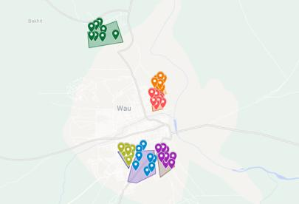
SAMPLING – Household SURVEY
Sampling will be done randomly in geographic clusters
Enumerators will be given a designated area to begin sampling every day, and then will skip households at random intervals to reach the target of 5 interviews per day
In the chosen bomas, sampling will start in center of the boma for one day (the main village hub) and then move to outlaying areas the next days until targets are met
If insufficient number of returnee households are met, snowball sampling may be employed to meet targets

Slide 68
SAMPLING: WORK PLAN MAGWI
Quantitative data collection
Location | Torit | Tori | Torit | Torit | Travel
Researcher | 04.05 | 05.05 | 06.05 | 07.05 | 08.05
SH team |  |  | Survey finalisation | Survey finalisation
EN1 | Training | Training | Training | Pilot
EN2 | Training | Training | Training | Pilot
EN3 | Training | Training | Training | Pilot
EN4 | Training | Training | Training | Pilot
EN5 | Training | Training | Training | Pilot
Location | Magwi | Magwi | Magwi | Magwi
Researcher | 09.05 | 10.05 | 11.05 | 12.05
EN1 | 5 surveys | 5 surveys | 5 surveys | 5 surveys
EN2 | 5 surveys | 5 surveys | 5 surveys | 5 surveys
EN3 | 5 surveys | 5 surveys | 5 surveys | 5 surveys
EN4 | 5 surveys | 5 surveys | 5 surveys | 5 surveys
EN5 | 5 surveys | 5 surveys | 5 surveys | 5 surveys
Location | Magwi | Iwire | Iwire | Iwire | Iwire
Researcher | 15.05 | 16.05 | 17.05 | 18.05 | 19.05
EN1 | 5 surveys | 5 surveys | 5 surveys | 5 surveys | 5 surveys
EN2 | 5 surveys | 5 surveys | 5 surveys | 5 surveys | 5 surveys
EN3 | 5 surveys | 5 surveys | 5 surveys | 5 surveys | 5 surveys
EN4 | 5 surveys | 5 surveys | 5 surveys | 5 surveys | 5 surveys
EN5 | 5 surveys | 5 surveys | 5 surveys | 5 surveys | 5 surveys
Location | Iwire | Travel-Pageri | Pageri | Pageri | Pageri
Researcher | 21.05 | 22.05 | 23.05 | 24.05 | 25.05
EN1 | 5 surveys | 3 surveys | 5 surveys | 5 surveys | 5 surveys
EN2 | 5 surveys | 3 surveys | 5 surveys | 5 surveys | 5 surveys
EN3 | 5 surveys | 3 surveys | 5 surveys | 5 surveys | 5 surveys
EN4 | 5 surveys | 3 surveys | 5 surveys | 5 surveys | 5 surveys
EN5 | 5 surveys | 3 surveys | 5 surveys | 5 surveys | 5 surveys
Location | Pageri | Pageri-Travel
Researcher | 26.05 | 27.05
EN1 | 5 surveys | 3 surveys
EN2 | 5 surveys | 3 surveys
EN3 | 5 surveys | 3 surveys
EN4 | 5 surveys | 3 surveys
EN5 | 5 surveys | 3 surveys
Notes:
This type of slide should be avoided where possible and especially if the slides are going to be presented. Succinct, short sentences are always preferable. Please do not alter text size to fit more/less text on a page - use an additional slide instead.
Heading: Raleway Bold - size 28 - always capslock - #314247
Subheading: Raleway Bold - size 18 - always capslock - #536f88
Body text: Raleway Regular - size 16 - #314247

Slide 69
SAMPLING: WORK PLAN TORIT
Quantitative data collection
Location | Torit | Tori | Torit | Torit | Travel - Imurok
Researcher | 04.05 | 05.05 | 06.05 | 07.05 | 08.05
SH team |  |  | Survey finalisation | Survey finalisation
EN1 | Training | Training | Training | Pilot | 3 surveys
EN2 | Training | Training | Training | Pilot | 3 surveys
EN3 | Training | Training | Training | Pilot | 3 surveys
EN4 | Training | Training | Training | Pilot | 3 surveys
EN5 | Training | Training | Training | Pilot | 3 surveys
Location | Imurok | Imurok | Imurok | Imurok | Imurok-Travel
Researcher | 09.05 | 10.05 | 11.05 | 12.05 | 13.05
EN1 | 5 surveys | 5 surveys | 5 surveys | 5 surveys | 2 surveys
EN2 | 5 surveys | 5 surveys | 5 surveys | 5 surveys | 2 surveys
EN3 | 5 surveys | 5 surveys | 5 surveys | 5 surveys | 2 surveys
EN4 | 5 surveys | 5 surveys | 5 surveys | 5 surveys | 2 surveys
EN5 | 5 surveys | 5 surveys | 5 surveys | 5 surveys | 2 surveys
Location | Hiyalal | Hiyalal | Hiyalal | Hiyalal | Hiyala
Researcher | 14.05 | 15.05 | 16.05 | 17.05 | 18.05
EN1 | 5 surveys | 5 surveys | 5 surveys | 5 surveys | 5 surveys
EN2 | 5 surveys | 5 surveys | 5 surveys | 5 surveys | 5 surveys
EN3 | 5 surveys | 5 surveys | 5 surveys | 5 surveys | 5 surveys
EN4 | 5 surveys | 5 surveys | 5 surveys | 5 surveys | 5 surveys
EN5 | 5 surveys | 5 surveys | 5 surveys | 5 surveys | 5 surveys
Location | Torit | Torit | Torit | Torit | Torit
Researcher | 19.05 | 22.05 | 23.05 | 24.05 | 25.5
EN1 | 5 surveys | 3 surveys | 5 surveys | 5 surveys | 5 surveys
EN2 | 5 surveys | 3 surveys | 5 surveys | 5 surveys | 5 surveys
EN3 | 5 surveys | 3 surveys | 5 surveys | 5 surveys | 5 surveys
EN4 | 5 surveys | 3 surveys | 5 surveys | 5 surveys | 5 surveys
EN5 | 5 surveys | 3 surveys | 5 surveys | 5 surveys | 5 surveys
Notes:
This type of slide should be avoided where possible and especially if the slides are going to be presented. Succinct, short sentences are always preferable. Please do not alter text size to fit more/less text on a page - use an additional slide instead.
Heading: Raleway Bold - size 28 - always capslock - #314247
Subheading: Raleway Bold - size 18 - always capslock - #536f88
Body text: Raleway Regular - size 16 - #314247

Slide 70
Assigning Enumerator ID
Each enumerator has been assigned ID as follows:
E1-
E2-
E3-
E4-
E5-
E6-
E7-
E8-
E9-
E10-
NB: Please remember this! You will need to add at the beginning of each survey.

Slide 71
QUANTITATIVE TOOL

Slide 72
HOUSEHOLD TOOL
The Household tool contains the following sections:
PART 1 -. Respondent Profile
PART 2 - Security and stability
PART 3 - Food Security
PART 4 - HLP
PART 5 - Rights and Governance
PART 6 - WASH and infrastructure
PART 7 - Protection
PART 8 - Healthcare
PART 9 - Education
PART 10 -. Livelihoods and economic integration
PART 11 - Social Cohesion
PART 12 - Natural Environment
PART 13 - Assistance Gaps

Slide 73
Discussion:
What are the key questions we are looking to answer?
What are the key terminologies that need defining?
What do you think are the main difficulties you will encounter?
How can you overcome them?
Notes:
This type of slide should be avoided where possible and especially if the slides are going to be presented. Succinct, short sentences are always preferable. Please do not alter text size to fit more/less text on a page - use an additional slide instead.
Heading: Raleway Bold - size 28 - always capslock - #314247
Subheading: Raleway Bold - size 18 - always capslock - #536f88
Body text: Raleway Regular - size 16 - #314247

Slide 74
Any Questions?

Slide 75
Our research connects the voices of communities to change-makers for more inclusive societies.
Notes:
End slide for every presentation
Text = Raleway - size 24 - white

Slide 76
Samuel Hall
Training slides
Community Based Assessment (CBA) of UNHCR Pockets of Hope (PoH) - ESA24001 (Day 3)
June 2024
Notes:
Main heading: Raleway Bold - size 60 - white
Subheading: Raleway Regular - caps lock - size 24 - white

Slide 77
Agenda Day 3 (Sunday, 5th May)
Time | Activity
9:00- 10:00 | Infrastructure team (Sampling) (Qual team and quant team role play exercises)
9:15 – 11:00 | Infrastructure team (Tool review) (Qual team and quant team role play exercises)
11:00 – 11:30 | BREAK
11:30 – 12:30 | Infrastructure team (Tool review) (Qual team and quant team role play exercises)
12:30-1:30 | LUNCH
1:30 – 2:30 | Qual team: Role play review and best practice techniques (Quant team and infrastructure team tool testing)
2:30 - 4:00 | Qual and infrastructure team: Transcripts and best practice techniques (Quant team and infrastructure team tool testing)
4:00 - 4.20 | BREAK
4.20 - 5.00 | How to take photos

Slide 78
TRAINING AGENDA
INFRASTRUCTURE: TOOLS AND SAMPLING
QUAL BEST PRACTICE AND TRANSCRIPTS
TAKING PHOTOS
Notes:
Heading: Raleway Bold size 28 - white - always capslock
Text in circles: Raleway Bold size 18 - always capslock & centered
Background colour: #536f88ff

Slide 79
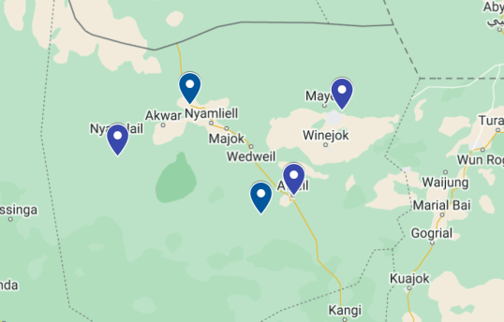
Research Locations
Aweil Town
Aweil North:
Malual North (2 bomas)
Aweil East:
Baac Payam (2 bomas)
Aweil Central:
Nyalath Payam (2 bomas)
Aweil West:
Guemjer East Payam (2 bomas)

Slide 80
SAMPLING: SERVICE AND INFRASTRUCTURE POINTS
Health centres
Hospitals, primary care centres, mobile health centers, etc. (not pharmacies)
Educational facilities
Primary school, secondary school, vocational centers, etc.
Law enforcement and Judicial buildings
Police station, Court house, Legal aid center, Community Security Post
Safe Spaces
Women's centres, shelters, community safe spaces, livelihood support centres
Water points
boreholes, wells, etc.
Market
Minimum 10 stalls
Notes:
This type of slide should be avoided where possible and especially if the slides are going to be presented. Succinct, short sentences are always preferable. Please do not alter text size to fit more/less text on a page - use an additional slide instead.
Heading: Raleway Bold - size 28 - always capslock - #314247
Subheading: Raleway Bold - size 18 - always capslock - #536f88
Body text: Raleway Regular - size 16 - #314247

Slide 81
Methodology - Targets
Every noted infrastructure or service point in:
Aweil Town, Aweil East, Aweil North, Aweil West and Aweil Central:
However, water points only to be sampled in the bomas (the same bomas as qualitative and household surveys are being completed) :
Aweil East:
Baac Payam:
Rum Aker boma
Malual Kuel boma
Aweil West:
Guemjer East Payam:
TBD (must contain Wedweil settlement
TBD
Aweil North:
Malual North:
TBD
TBD
Aweil Central:
Nyalath Payam:
TBD
TBD

Slide 82
INFRASTRUCTURE TOOLS

Slide 83
TOOLS:
Health centres
ODK Tool
Educational facilities
ODK Tool
Law enforcement and Judicial buildings
ODK Tool
Public buildings
ODK Tool
Safe Spaces
ODK Tool
Water points
ODK Tool
Market
ODK Tool
Notes:
This type of slide should be avoided where possible and especially if the slides are going to be presented. Succinct, short sentences are always preferable. Please do not alter text size to fit more/less text on a page - use an additional slide instead.
Heading: Raleway Bold - size 28 - always capslock - #314247
Subheading: Raleway Bold - size 18 - always capslock - #536f88
Body text: Raleway Regular - size 16 - #314247

Slide 84
Discussion:
What are the key questions we are looking to answer?
What are the key terminologies that need defining?
What do you think are the main difficulties you will encounter?
How can you overcome them?
Notes:
This type of slide should be avoided where possible and especially if the slides are going to be presented. Succinct, short sentences are always preferable. Please do not alter text size to fit more/less text on a page - use an additional slide instead.
Heading: Raleway Bold - size 28 - always capslock - #314247
Subheading: Raleway Bold - size 18 - always capslock - #536f88
Body text: Raleway Regular - size 16 - #314247

Slide 85
INFRASTRUCTURE: TOOLS AND SAMPLING
QUAL BEST PRACTICE AND TRANSCRIPTS
TAKING PHOTOS
Notes:
Heading: Raleway Bold size 28 - white - always capslock
Text in circles: Raleway Bold size 18 - always capslock & centered
Background colour: #536f88ff

Slide 86
CONSENT
Please make sure you introduce the purpose of the study clearly at the start and make sure you get informed consent from the person before proceeding.
Please make sure you state it is an assessment to help other actors plan interventions better, but it is not an assessment for immediate assistance.
Please state clearly that information recorded is confidential and anonymous – we will not record their names and if their names are recorded (in case of KIIs) they will not be shared with anyone outside the research team, or appear in a published document.
Please make sure that you tell people there will be no negative consequences if they decline to participate and it will not stop them getting any services / assistance. Also please re-iterate they can stop at any moment, or decide not to answer all questions or specific questions.
Check the box if person has consented or not, and ask if they have any questions for you

Slide 87
GUIDANCE
These are qualitative tools are meant to be open-ended, guiding questions to start a conversation and probe for different kinds of answers with the person you are interviewing.
We are interested in people’s life stories, and the reasons behind why they made certain choices or not, and some of their histories of movement and the choices they made, not yes/no type answers
There are not yes / no questions like in a survey and please do not record any yes / no answers, but write down the whole answers, whole sentences as per what the person you are interviewing says.
Some questions have several questions within them – where it states several questions and then in brackets – please probe/ please explain – it means you should introduce those questions with the different questions that are there, and then use those questions in brackets as follow up questions to probe further for the different possibilities- for example when asking about why the area is not secure, please then check for: are there community conflicts, are there conflicts over land, are there military conflicts etc. to really understand what is going on in an area and how it affects different people or groups of people differently.
These types of questions are more like a conversation with the person you are interviewing than in a survey – so as the person speaks you should listen carefully and then see if you have any follow up questions,
You can also ask other follow up questions that are not listed here if they come to your mind when the person is speaking and you want to clarify anything or follow up on a particular issue

Slide 88
FGD Best Practice
Here given you will have several people responding to the same question it generally helps to introduce each question more like a topic for discussion –
you will see that in the questionnaire several questions are clustered around a theme, so for example first introduce ‘ we are going to discuss the history of return to this area’ and then introduce this discussion with the different questions that are there and open the discussion to the participants. They can then take turns to answer the question.
Make sure you also encourage everyone to speak, not only the ones that are first willing to speak, so that everyone can have a turn. So if some people have finished speaking but others haven’t said anything yet, please facilitate the discussions to say - maybe now we can hear from those who have not said anything yet - ‘would you like to say anything’?
don’t force people to speak either if they are uncomfortable to express themselves on a certain topic. Then move on to introduce the next cluster of questions around the next theme and so on. FGDs should take slightly longer than KIIs and SSIs as they are with more people, so you can think about 1.5 hours or even 2 hours at most.

Slide 89
Discussion:
Can anyone share a challenge they faced in an FGD and how they overcame it
Any advice on how to encourage participation in a FGD?
Notes:
This type of slide should be avoided where possible and especially if the slides are going to be presented. Succinct, short sentences are always preferable. Please do not alter text size to fit more/less text on a page - use an additional slide instead.
Heading: Raleway Bold - size 28 - always capslock - #314247
Subheading: Raleway Bold - size 18 - always capslock - #536f88
Body text: Raleway Regular - size 16 - #314247

Slide 90
TRANSCRIPTIONS AND TRANSLATIONS
Transcriptions and translations are one of the most important element of the research project!
The highest standards must be ensured with every single transcription and translation made.
As researchers you must ensure the quality of every transcript.
If transcriptions or translations are not of quality, the SH team may require enumerators to re-do transcriptions or the entire interview.
The quality of transcription and translation are dependent upon excellent note taking and quality recordings - it is important that the transcripts be very detailed!
Transcripts must be provided in English

Slide 91
TRANSCRIPTIONS AND TRANSLATIONS
KEY POINTS TO KEEP IN MIND
The speech of the researcher must be distinguished from that of the respondent.
The participants’ formulations should be reproduced verbatim
If an unfinished phrase or sentence is important to leave as it is
Indicate with an ellipsis that the participant stops mid sentence
Use square brackets to indicate omitted material or explanations.
Include explanations of terms that are not easily translatable to English/French and the contextual information that is necessary for understanding what is said in the transcript.
Locations should be spelled as they appear on Google Maps to ensure consistency.

Slide 92
How to Write Strong Transcripts
Attribute a code to each participant
Make sure to write exactly what was said during the conversation, and who said it.
Write complete sentences.
Do not summarise.
Write everything that has been said. Do not summarise. WORD FOR WORD requirement.
Record the interview (with consent) and make sure that everything that has been said is in the transcript. All details are important and must be included.
DISCUSSION
What is your experience of writing transcript?
What is a weak transcript according to you? And what is a strong one?

Slide 93
Examples of Strong and Weak Transcripts
A) How are the needs of hosts similar and / or different from the needs of refugees?
Chat is not exist in South Sudan and we get it here in Ethiopia and somebody get by our elders who come from South Sudan can advise you not to chew chat because it lead sell cattle out with and it does not allow children to go to school. Host community do not need Bongo from us because it not good and they advise to leave smoking of Bongo and refugee also advice citizen to quit chewing chat. Now, there are more refugee who are chewing chat because they are interesting refugee cannot advise citizen not chew chat because it belong to them Example, if you are quest, you cannot choose to sleep with goat, you can choose to sleep with the owner of home from his sleeping room/house. Mean, refugee cannot advise citizen to quit chewing chat. Those two person who choose to chew chat may be one from refugee and one from citizen can continue their interest.
B) Access to services: Do refugees and hosts have equal access to services? Is there a difference in the quality of services delivered to hosts and refugees? Are any of these services integrated, i.e. accessible by both refugees and hosts? Do you think the way services are delivered is adapted to women and youth?
What join us with citizen is language of Nuer, other interaction come from join celeberation because we have known song to all of us. “Saying, one things I do not like from Sudan, everybody talk about Nuer, even somebody who live by his own mine about Nuer……….”
Other song, “Nyabiel Lual is girl friend of Nyeyang” which is common song to all Nuer.

Slide 94
Examples of Strong and Weak Transcripts
How has being displaced made a difference in your life here? How does your situation compare to those who have not been displaced?
R5: Oh!! In displacement, we did not gain but we lost. We, the displaced left bare-handed. Those who displaced us are in a good condition. We lost our property. Even if we know where our properties are, we cannot reclaim it. In case we do that, they may misjudge us as troublemakers or report that the Gedeo are instigating conflict.
R3: Formerly, we had properties and hopes as well. We had plans for saving as well as consumption. Now, we lost all our properties. We are left with our life alone. Poor households whom we were supporting formerly, have become owners of sheep, cattle, and chicken. We are considered as dogs today [look down on us]. We used to save for a better life that the government and church also support. That saving [for a better life] is what bred animosity against us. I swear to God, the 1,072.00 Birr they gave us was not enough to settle our debt for enset with which we fed our children. There is a big difference between them and us.
R1: There is a big difference in our life before and after displacement. We are in abject poverty today. We are facing difficulties to feed and clothe our children. My present condition is worse than my life at Harru [settlement camp]. There was better support but we have received nothing after return.
full examples of good and bad transcripts

Slide 95
EXAMPLES OF TRANSCRIPTS
DISCUSSION
What do you notice about this transcript?
What is the major difference between this transcript and the previous one shown?
What are the strengths of this transcript?
Why did the enumerator use italics and brackets? What purpose do they serve?
Can you tell us what are the 5 key factors that make a good transcript?
Notes:
(1) Includes date, people involved, time and place of incident, witnesses to the incident, description of the incident, any immediate actions taken, the reason for not taken action if that was the decision, the name of the person completing the form (if not anonymous). If you do not feel comfortable filling out on your own, someone can help you.

Slide 96
Transcription Process
All researchers must complete and upload KII and SSIs transcripts on a rolling basis. This ensures that the SH research team can begin preliminary data analysis, and ensures that the researcher is not left with several transcripts to transcribe at the end of fieldwork. It also ensures better quality of transcripts.
You must send your transcripts on time with the scheduled agreed, this provides enough time for feedback and amendments from the SH team. The status of each transcript will be updated regularly on the Fieldwork Tracker.
If needed, the SH technical team will send you comments to be addressed within 48 hours.
Note: Submission of transcripts does not immediately mean approval. A transcript can go through several rounds of feedback and revision before it is approved. Ensuring that all transcripts initially submitted are of the highest quality shortens the review process.

Slide 97
Data Management and Labelling Process
Corresponding Codes for Qualitative Tool
KII: Key Informant Interview
SSI: Semi-structured Interview
FGD: Focus Group Discussion
Labelling Conventions
The following label convention should be used to label all transcripts and audios.
For Key Informant Interviews: KII[#]_[title of participant]_[organisation]_[province_location]_[date]
e.g. KII1_ProtectionManager_UNHCR_Kigoma_Tanzania_140222
For Semi Structured Interviews: SSI[#]_[name_gender_type]_[province_location]_[date]
e.g. SSI1_Isabelle_Female_Refugee_Nakivale_Isingiro_170222
The # will correspond to the order of the interview and the transcript tracker.

Slide 98
Transcript Tracker Process
Receive - All transcripts should be uploaded onto the project GD Data >Tool Type> Under Review. As soon as the document has been uploaded, the details of the transcript should be entered into the transcript tracker.
NOTE: ALL AUDIO FILES SHOULD BE UPLOADED TO THE GD AS SOON AS COMPLETED TO ENSURE COMPLETE RECORDS, TO VERIFY WORK COMPLETED, AND FOR RE-TRANSCRIPTION IF NEEDED.
Review - Jonathan (JB), Marta (MR), Tewelde (TA) or Francesca (FC) will put their initials at the end indicating the document is under review, ie KII1_ERRIN_Iraq_12022022_JB
The transcript will be sent back to the enumerator/team leader/ national researcher/ translator who will revise the transcript and address any comments. Once revisions have been made the enumerator/team leader/ national researcher/ translator will send back the transcript to Nadia with their initials at the end of the document title e.g KII1_ERRIN_Iraq_12022022_JB_FC
Approve - When revisions are satisfactory ‘Approved’ will appear at the end of the document title e.g KII1_ERRIN_Iraq_12022022_Approved

Slide 99
Interviews: Tips
Please prompt as necessary during interviews - please add questions of your own as necessary that directly relate to our key themes for this research, as well as those that could provide more depth.
Your role as interviewer is key: you must be able to put participants at ease and encourage them to express themselves.
Be patient
We must obtain detailed answers to each question - if participants give answers of 1-2 words, the interviewer should ask follow-up questions
Have some knowledge of the project objectives!
Conduct interviews in local language. Later, translate into English. Do not be tempted to translate on the spot. You will lose time and miss the depth of responses.

Slide 100
QUALITATIVE: TOOLS AND SAMPLING
QUANT AND INFRASTRUCTURE: ODK
QUANT: TOOLS AND SAMPLING
Notes:
Heading: Raleway Bold size 28 - white - always capslock
Text in circles: Raleway Bold size 18 - always capslock & centered
Background colour: #536f88ff

Slide 101
BEST PRACTICES FOR TAKING PHOTOGRAPHS
Types of photo outputs:
Shots of impacted population (including some ‘portrait’ style photos)
Shots of research participants (including some ‘portrait’ style, action photos)
Shots of relevant programming (livelihoods, gender, cash based-assistance etc - depending on project focus) including banners of intl orgs, donors etc.
Shots of landscapes, camp/village environments
Shots of the host population / surrounding area
Generally, photos should be objects or locations. For example, if you visit a workplace such as a small business where you speak to an employer or employees, photos could be taken of the business front, or of the objects used by both the employers and employees. In general, do not take pictures inside private homes or inside offices unless invited to by a research subject.
Where photographs of individuals are taken, it is important to ensure their enthusiastic and informed consent is gained first
Notes:
This type of slide should be avoided where possible and especially if the slides are going to be presented. Succinct, short sentences are always preferable. Please do not alter text size to fit more/less text on a page - use an additional slide instead.
Heading: Raleway Bold - size 28 - always capslock - #314247
Subheading: Raleway Bold - size 18 - always capslock - #536f88
Body text: Raleway Regular - size 16 - #314247

Slide 102
INFORMED CONSENT FOR PHOTOGRAPHS
Informed consent ensures respect for an individual's autonomy and privacy, and also ensures that they understand the implications, purpose, and potential uses of the photo taken. This avoids harming the individual in question through inappropriate publication of their story.
Informed consent will need to be obtained if photographs are taken of individuals. Before taking photos of individuals, ask them for their consent – this should be received both verbally and in writing.
Photography of research participants - i.e. photographic recording of the conducting of any of the research activities including surveys, FGDs, SSIscase studies, etc. - should be part of the consent discussion for participation. All participants may choose not to be photographed.
Please use Samuel Hall’s Photography Release Form - this needs to be filled and signed by the subject. Please consider getting it translated as well.
Notes:
This type of slide should be avoided where possible and especially if the slides are going to be presented. Succinct, short sentences are always preferable. Please do not alter text size to fit more/less text on a page - use an additional slide instead.
Heading: Raleway Bold - size 28 - always capslock - #314247
Subheading: Raleway Bold - size 18 - always capslock - #536f88
Body text: Raleway Regular - size 16 - #314247

Slide 103
TAKING GOOD PHOTOS WITH A SMARTPHONE
Composition
Take shots with a steady hand
Do not try to fit in too much information. Rather, focus on one subject - this could be a person, a landscape or an object.
Generally follow the rule of thirds: The rule of thirds is a composition guideline that places your subject in the left or right third of an image, leaving the other two thirds more open.
Lighting
Natural lighting is always best
Avoid using flash if possible
Telling a story
Make sure your photographs you take can tell a story without the need of many words.
Notes:
This type of slide should be avoided where possible and especially if the slides are going to be presented. Succinct, short sentences are always preferable. Please do not alter text size to fit more/less text on a page - use an additional slide instead.
Heading: Raleway Bold - size 28 - always capslock - #314247
Subheading: Raleway Bold - size 18 - always capslock - #536f88
Body text: Raleway Regular - size 16 - #314247

Slide 104
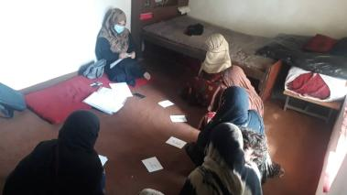
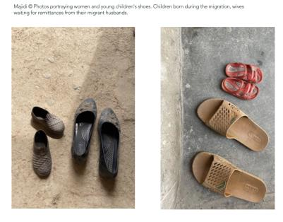
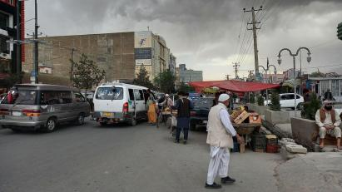
PHOTO EXAMPLES
Notes:
This type of slide should be avoided where possible and especially if the slides are going to be presented. Succinct, short sentences are always preferable. Please do not alter text size to fit more/less text on a page - use an additional slide instead.
Heading: Raleway Bold - size 28 - always capslock - #314247
Subheading: Raleway Bold - size 18 - always capslock - #536f88
Body text: Raleway Regular - size 16 - #314247

Slide 105
Any Questions?

Slide 106
Our research connects the voices of communities to change-makers for more inclusive societies.
Notes:
End slide for every presentation
Text = Raleway - size 24 - white

