Slide 1
ASSESSMENT
[Camp/Setting names]
Region, Country - Time frame
Enumerator assessment training
[PLACE, DATES]
[LOGO PARTNERS]

Slide 2

Introduction
  Opening session
  Welcome to the participants
  Introduction of participants
  Administrative/logistic information and guiding rules
  Presentation of teaching contents and teaching methods
  Training agenda
Assessment and Monitoring Resource Centre

Slide 3
Welcome to participants
  Speech to welcome the participants
  Show the gratitude for their participation on the training
  Explain why is important this assessment exercise for the humanitarian community and the importance of their role on the exercise
  Encourage them to give their best during the training and during the data collection exercise
  In case of a difficult/risky context, let them know which security measures have been considered and encourage them to inform their supervisors if, for some reason, they do not feel safe during the data collection exercise.
  Other key messages
Notes:
If possible the open session speech should be done by the UNHCR representative or any other hight manager to highlight the importance of the enumerator training and of the assessment.

Slide 4
Introduction of participants
  Invite the participants to present themselves proposing them to answer some questions, for example:
  Name?
  Where are they from?
  Job? Studies?
  Spoken languages?
  Experience in data collection?
Notes:
To do more interactive instead of that each participant present him/herself you can divide them by couples and give them 5 minutos to meet each other for later present his/her team partner to the audience.

Slide 5
Administrative/logistic information and guiding rules
  Provide information about the administrative/ logistic relevant topics and the guiding rules during the training. Example
  Are all of them already register? What to do if not?
  At what time the session start and end?
  Where is the coffee-break?
  Rules about the use of computers, phones... during the training
Notes:
On the rules about the use of computesr and phones during the traning discuss with them what are the best option always considering that during the next days the priority is the training.

Slide 6


How can we actively participate and contribute to an effective training?
Notes:
Be prepared to ask questions and share your thoughts.
Arrive on time and stay engaged throughout the training.
Be respectful of others and their opinions.
Follow the instructions of the trainer.

Slide 7
Learning and Teaching Methods
  Indicate which learning and teaching methods will be used during the training, for example:
  Power point presentations
  Group and individual exercises
  Demonstrations
  Practical exercises
  Field test
  Others

Slide 8
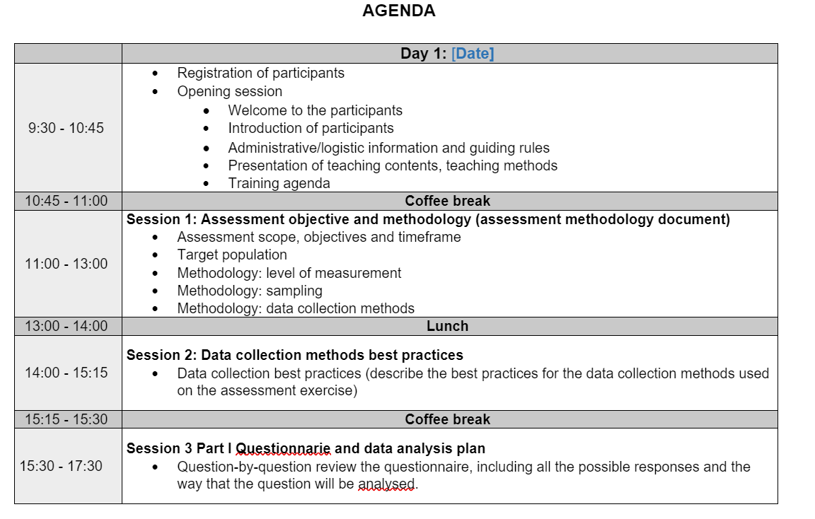
Present the training agenda
Notes:
Share the agenda with the participants and explain them the different sessions

Slide 9
Session 1: Assessment objectives and methodology
Based on the assessment methodology document explain the next topics:
  Assessment scope, objectives and timeframe
  Target population
  Methodology: level of measurement (community, HH, individual)
  Methodology: sampling (representative or not representative)
  Methodology: data collection methods (HH and or individual survey, key informant interviews, observations, focus group discussion)
Notes:
Although the enumerator will be only involve on the data collection phase it is important that they understand the whole exercise,
so ensure to dedicate enough time to this session and answer the questions from the participants.

Slide 10
Session 2: Data collection best practices
  This session include the best practices for the assessment data collection method such as:
  Key informant interviews
    What type of interview is planned to be done ? Structured, semi-structured, unstructured interviews - how to do it?
  Household or individual interviews
    What type of interview is planned to be done ? Structured, semi-structured...
Notes:
This session will depend of the data collection methods selected to implement the exercise. Ensure to explain the best practices of all the data collection methods that the enumerators will need to use during the data collection exercise. Information can be found:
UNHCR: Need assessment handbook
ACAPS: Direct Observation and Key Informant Interview Techniques for primary data collection during rapid assessments
UNHCR Focus Group discussion
JIPS Focus Group discussions

Slide 11
Session 2: Data collection best practices
  Observations: When to do it? By who?
  Focus group discussion
    With men
    With women
    With children
Notes:
This session will depend of the data collection methods selected to implement the exercise. Ensure to explain the best practices of all the data collection methods that the enumerators will need to use during the data collection exercise. Information can be found:
UNHCR: Need assessment handbook
ACAPS: Direct Observation and Key Informant Interview Techniques for primary data collection during rapid assessments
UNHCR Focus Group discussion
JIPS Focus Group discussions

Slide 12
Session 3 Part I, II and III: Questionnarie and data analysis plan
On this session review the questionnaire question-by-question, including all possible responses and the way that each question will be analysed.
For each question highlight:
  Purpose
  Disaggregation
  Terminology
  Possible answers
  How this data will be analysed and why
  Ask if training participants have any questions
Notes:
This session will depend of the data collection methods selected for the data collection exercise. Ensure to include a session part for each of the methods and do not forget to explain how the information collected in each of the methods will be analyse based on the data analysis plan.
At the begining of this session share with the participants:
Assessment questionnarie
Assessment data analysis plan. If the original data analysis plan is very complexe consider to develop a simplify version for the training
The but of this session is not to modify the questions of the questionnaire but if the enumerators have any specific comment on the questionnarie or on the asnwer take note of them and remember to have a look to these questions and its answer after the pilot to see if some modificaiton need to be done.

Slide 13
Session 4 Part I and II: Data collection tools
This session includes the steps to follow to use the data collection tool
Explain which tool will be used and how it should be used
  Test the tool with a practical exercise (for this session each enumerator will need access to a data collection tool such as a tablet)
    Ensure that the current assessment questionnaire is already on the tool
    Configure the tablets before the session
    If some participants already know how to use the tool, work with them to support colleagues who have never used the tool before
  Discuss issues faced during the exercise and answer the participant questions
Notes:
The tool used in UNHCR to collect data is Kobo. The key information that enumerators will need about Kobo is
How to open the questionnaire
How to complete the questionare
How to saved the questionare
How to send the questionnare to the server (offine versus online)
Kobo Tutorials can be found here
Kobo PP presentation can be found here

Slide 14
Session 5: Roles and responsabilites
This session includes team composition, roles and responsibilities, reporting and communication lines.
Team composition: Explain the assessment team organizational chart ( example on the next slide)
Roles and responsibilities: Explain the assessment data collection team TORs
Reporting and communication lines: Explain "who" report to "who" and "how" and "when" to do it. Explain how to do it regular reporting (through for example regular meetings between the team leaders and the enumerators) and how to report an urgent or important issue
Notes:
During this session share with the enumerators:
The assessment team organization chart
The assessement data collection team TORs: team leader assessment enumerators and enumerators

Slide 15
Assessment coordinator or assessment field coordinator
Supervisor 3
Supervisor 2
Data quality supervisor
Team leader 1
Team leader 2
4 Enumerators
4 Enumerators
Team leader 3
Team leader 4
4 Enumerators
4 Enumerators
Notes:
Example to be adapted to context and type of assessment.

Slide 16
Session 6: Assessment data collection pilot
This session should include:
What is an assessment pilot?
A pilot assessment is a strategy used to test the questionnaire using a smaller sample compared to the planned sample size.
  Why conduct an assessment pilot?.
  To improve the assessment tools and approach based on the pilot results: modify, add or remove some questions from the questionnaire, fix any issues identified with the data collection tool and/or improve the data analysis plan.
Notes:
After providing the explanation of what is an assessment pilot and why to conduct it organise the assessment data collection pilot:
Divide the enumerator into assessment field teams.
Each field team leader explains the logistic, data collection plan and other consideration to implement the assessment data collection pilot.
Additional information about key considerations for testing and piloting assessment can be found here. (add the link)

Slide 17
Session 7: Assessment protocols
Based on the assessment protocol document, this session includes instructions about how the assessment will be implemented. Topics to consider are:
Respondant selection: who is the target respondant for the interview and how will they be selected
Number of revisits: how many times a sampling unit will be revisited before being dropped.
Tracking: If a primary sampling unit has moved from the original or anticipated location, identify whether survey teams should track them down
Notes:
The training should ensure that all members of the data colletion team have a clear understanding of the assessment. The assessment team must pilot all prototols well in advance, as part of preparting for data collection.
For futher information on assessment protocols check the Enumerator manual template

Slide 18
Session 7: Assessment protocols
Drops: It is essential that field teams report which sampling units were dropped and why.
Replacecement: If a primary sampling unit is dropped, identify whether or not it will be replaced.
Use the data collection tool such a tablet: who is responsable of the tool, what to do if does not working during a data colleciton session and when sent the questionnarie to the sever.
Focus group discussion
  Outline processes to select the member of the focus group discussion

Slide 19
Session 8: Additional considerations to implement the assessment data step
This session includes additional areas to consider on the implementation of the data collection phase. Some exampleas are:
The consent form
The code of conduct
Security and emergency measures and procedures
Notes:
On this session share the consent form, the code of conduct and a list of security and emergency procedures including emergency telephone numbers.

Slide 20

Questions and discussion

Slide 21
Thank you
[LOGO PARTNERS]

