Slide 1


JOINT TARGETING GUIDANCE TRAINING PROGRAMME
Assessment and Analysis for Better Targeting

Slide 2
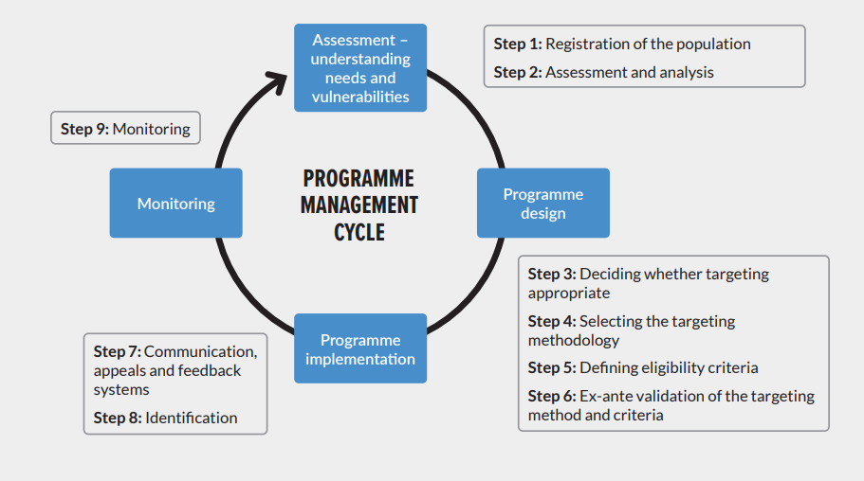
The targeting steps as part of the programme cycle
PROGRAMME MANAGEMENT CYCLE

Slide 3
Learning objectives
After this session, you will be able to:
  Explain the importance of understanding vulnerability and needs to inform targeting
  Describe the role of assessment and analysis to assess vulnerability and needs of refugees
  Elaborate data and information requirements and considerations
  Outline success factors for designing and implementing a joint assessment for targeting

Slide 4
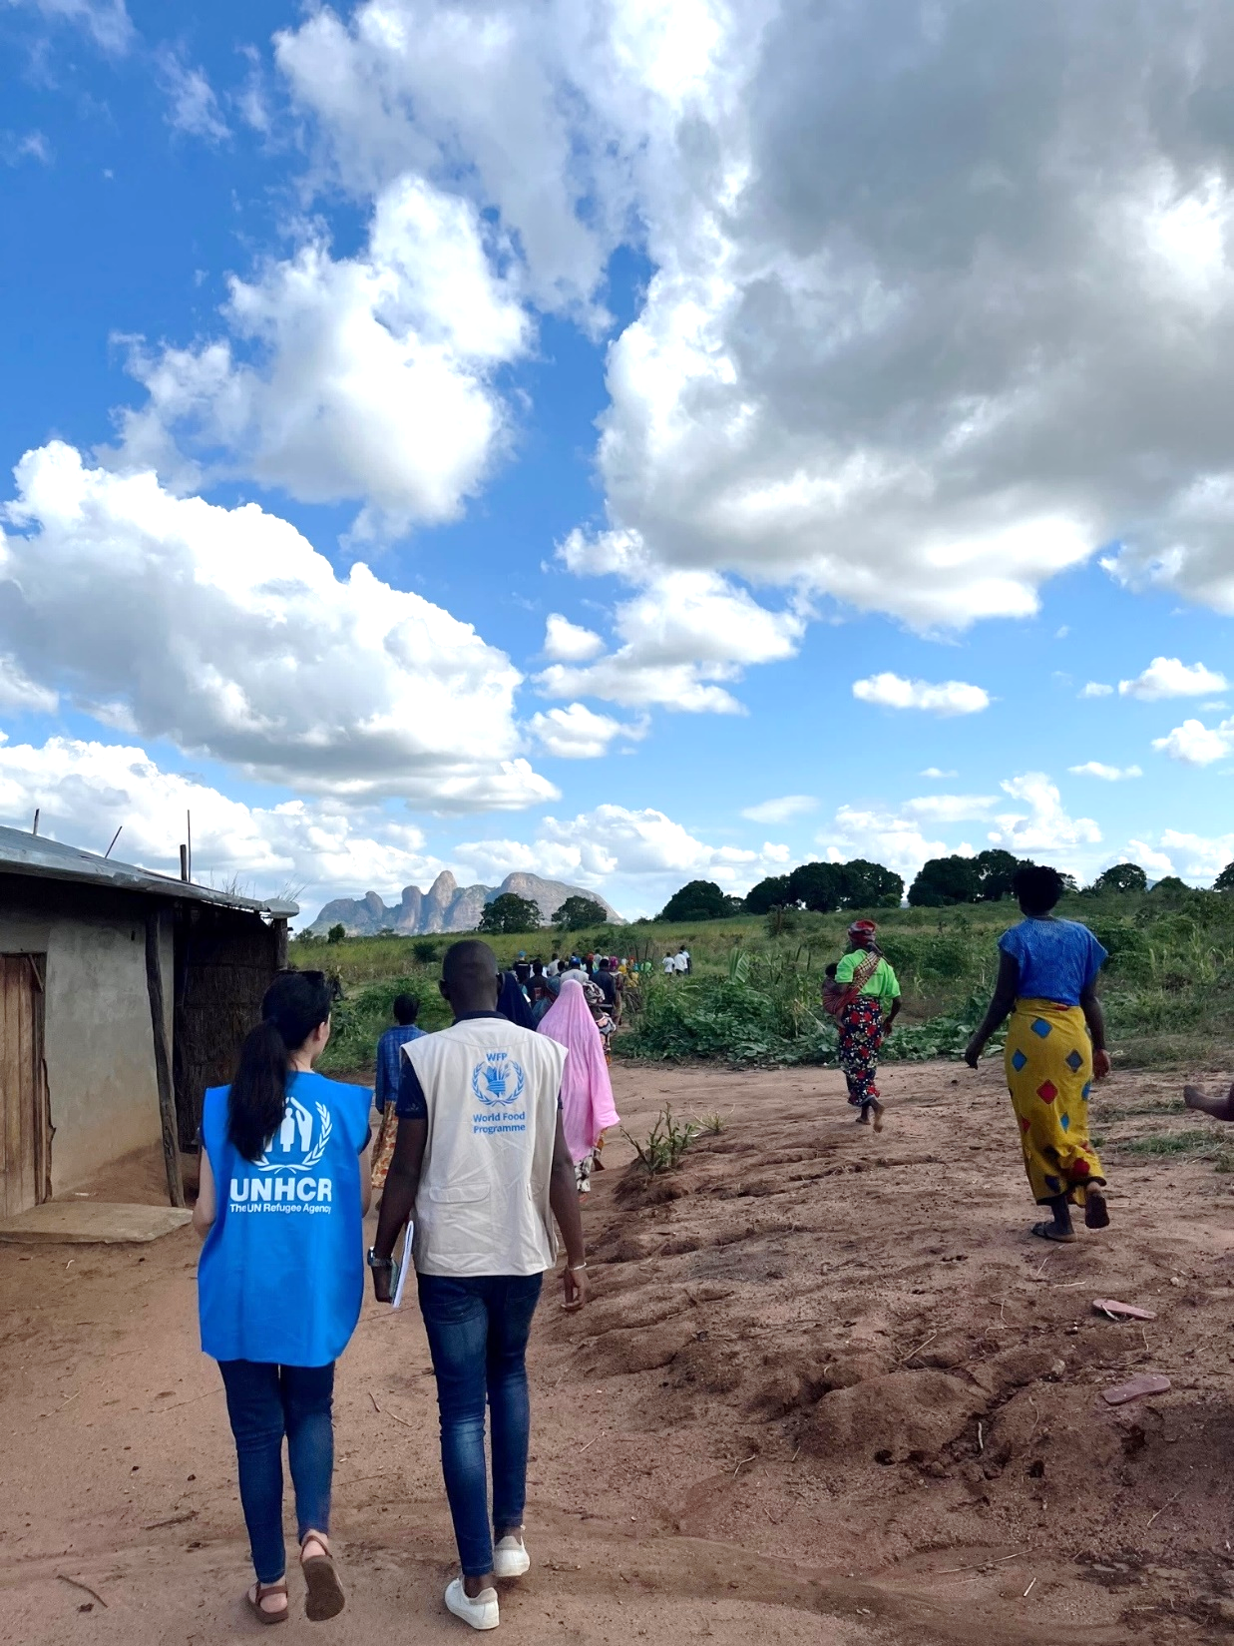



Topics
WHY assessment and analysis?
WHAT a typical joint assessment & analysis involve?
HOW to successfully design and implement a joint assessment?
Notes:
1. WHY assessment?
The process of a needs-based targeting
The role of needs assessment and analysis
The relevance of needs and vulnerability and how we measure vulnerability for refugees
Mapping essential information needs, data sources and gap
2. WHAT a typical joint assessment & analysis includes?
2.1 Key steps of a joint assessment
2.2 Key concepts when conceptualizing an assessment
3. HOW to successfully design and implement a joint assessment?
3.1 Success factors

Slide 5






Why assessment and analysis?

Slide 6

We’ve already done so many assessments!
Why do we need another one for targeting?

Slide 7
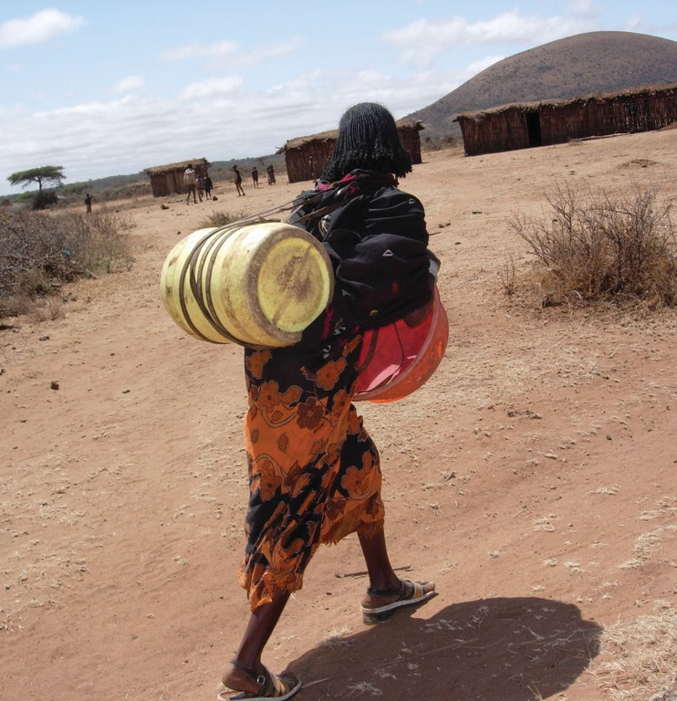
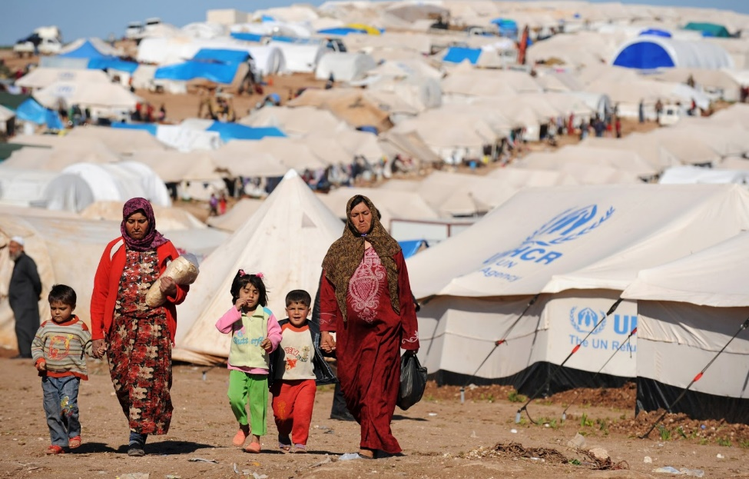
Assessment and analysis helps to:
Identify the level of needs and vulnerability relevant for programming
Establish common characteristics of vulnerable households
Inform if targeting is appropriate based on vulnerability analysis
This Photo by Unknown author is licensed under CC BY-SA.
This Photo by Unknown author is licensed under CC BY.
Notes:
This is for targeting and to inform programming:
Identify the level of needs of a population
Establish common characteristics of vulnerable households - used to define eligibility criteria for assistance.
Needs to be representative.

Slide 8
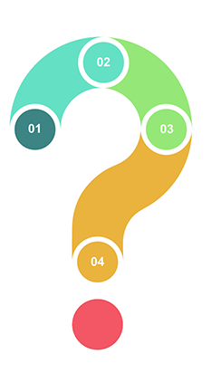
Understanding needs and vulnerability
How many of the refugees are the most vulnerable and in need of assistance?
03
Why are they vulnerable?
01
04
What are the protection needs and priorities?
02
Who are they and where do they live?
02
05
What assistance do they need?
05
Notes:
Why assessment? To help answer key questions such as:

Slide 9

How do we measure vulnerability?
Notes:
Intro to themes and indicators

Slide 10




Comprehensively measuring household vulnerability
Food security: Food Consumption Score
Protection: Livelihood coping strategies
Economic capacity: Capacity to meet essential needs
Level of vulnerabilities
Notes:
No single indicator to represent the household level needs and vulnerability , A composite indicator combining food access, protection & livelihood resilience, economic vulnerability
How we CAN measure it
Key message: cannot be measured by 1 single indicator
Multiple dimensions, what it measures
In refugee situations food and cash assistance often plays a major role, so the assessment methodology has to be slightly adjusted in order to measure the actual needs for assistance. In addition WFP carries out multisectoral Essential Needs Assessments with partners to ascertain what constitute the basic needs of a population of interest and which needs (such as food, shelter, education, or water) are met or unmet, how people meet them (or why people are unable to), in addition to identifying who and how many people are unable to meet these needs.

Slide 11
Comprehensively measuring household vulnerability
Household expenditure below 75% of Minimum Expenditure Basket (excluding cash assistance value)
Highly vulnerable
High risk coping (influence household expenditure or protection risk)
Poor
OR
OR
Between 75% and 100% of Minimum Expenditure Basket
Low risk coping
Borderline
Moderately vulnerable
Acceptable
AND
AND
Above Minimum Expenditure Basket
Borderline
Acceptable
Least vulnerable
Economic vulnerability
Livelihood coping
Food consumption
Classification
Notes:
Combined framework – composite indicators
Household status determined by comprehensive considerations of three dimensions
Joint analytical framework – next week workshop

Slide 12


How to design an assessment ?
Notes:
Intro to themes and indicators

Slide 13




Principles of assessment to inform targeting
Evidence-based
Protection-focused
Relevant
Inclusive
Notes:
Why assessment – Principles
EVIDENCE-BASED: The food-insecure, economically vulnerable and individuals/groups with specific protection risks shall be identified and targeted for assistance to meet their food and other basic needs based on objective information and practical eligibility criteria.
RELEVANT: in-depth and contextual analyses of risk, food security and vulnerability are the bedrock for defining needs and subsequent relevant assistance for PoC and should inform targeting decisions. The agreed targeting approach should be designed and actioned jointly for the specific context in question (not just to fill all their data gaps)
PROTECTION-FOCUSED: Make sure protection considerations are covered: Safety, specific needs, accountability – make sure this is addressed – help us to have a better contextual picture
INCLUSIVE: Inclusive Targeting must not be discriminatory and should take into account specific needs and risks related to age, gender, disability and diversity.

Slide 14
Define what is important to know
Notes:
What information is it important to know?

Slide 15
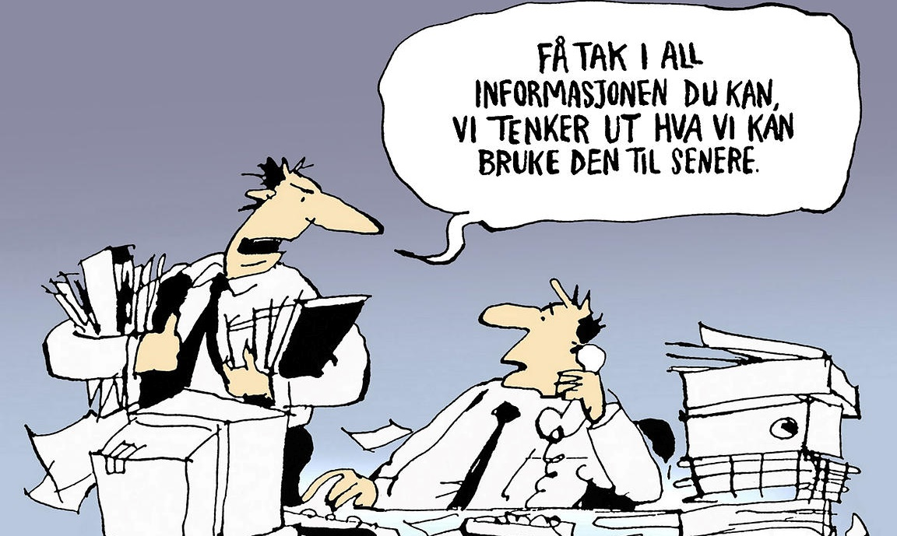
Get all the information you can, we’ll think of a use for it later.

Slide 16









Objectives
Thematic areas
Demographic
Protection
Food security & nutrition
Livelihood
Economic capacity
Access to services
Assistance & needs gap
Indicators per thematic area

Slide 17



Good assessment objectives
Define the scope of the assessment and ensure the relevance of the results to targeting and programmatic discussions
    Who are the population of interest?
    What targeting programme/ intervention is the country team considering?
    What remains the information gap to make an informed programmatic decision?

Slide 18


Good assessment objectives – Mozambique example
The overall objective of the JAM is to
collect up-to-date information on the refugee food security, nutrition and livelihoods situation and related indicators,
also considering a comparison with the host communities
to provide strategic directions for both agencies’ programming.
The findings of the JAM will highlight the refugees’ capacities to meet their basic needs, their livelihoods and self-reliance opportunities and challenges as well as any related protection concerns faced in the settlement.
This will support the country team to evaluate if the current assistance meets the contextual needs and respond to unaddressed needs.
To realize this, the JAM findings will feed into the development of a Joint Plan of Action (JPA) by UNHCR and WFP to ensure that effective programming is developed based on the recommendations and key findings.

Slide 19




Secondary data review

Slide 20





Secondary data sources
Registration data
Survey data and reports
Programme monitoring
Participatory assessments & community feedback
Notes:
Key secondary data resources to inform needs assessments:
• Registration data
• Participatory assessments, consultation reports and analysis of complaints and feedback mechanisms (CFMs)
• Food security/socio economic/livelihood assessments
• Nutrition surveys
• JAM reports
• Markets assessments
• Post distribution monitoring of existing assistance programmes
• Programme reports/evaluations
• Food security monitoring systems
• National social safety net programme information
• The private sector may have knowledge of the population and supporting data e.g., systems in place for receiving remittances and population groups accessing financial services

Slide 21
If assessment is needed ...
Notes:
Do you do this in your operations?
How do you do this?

Slide 22






Deciding the methodology
Quantitative
Qualitative
  Key Informant Interview
Sampled household survey
  Focal Group Discussion
Notes:
ProGres has demographic information but....

Slide 23
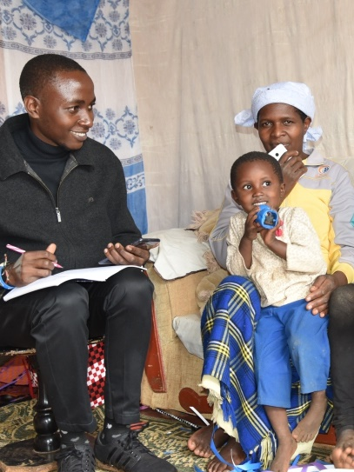





Sampling strategy for household survey
Adequate sample methodology and right sample size
Ensures estimates can be inferred to represent the total population
Probability sampling - Each element (household) has a known, equal mathematical chance to be selected
Notes:
A sampling strategy is the way to choose participants for a study. It outlines how to approach possible participants to best serve the objectives of the research.
Permits scientifically-grounded estimates to be made from the survey

Slide 24
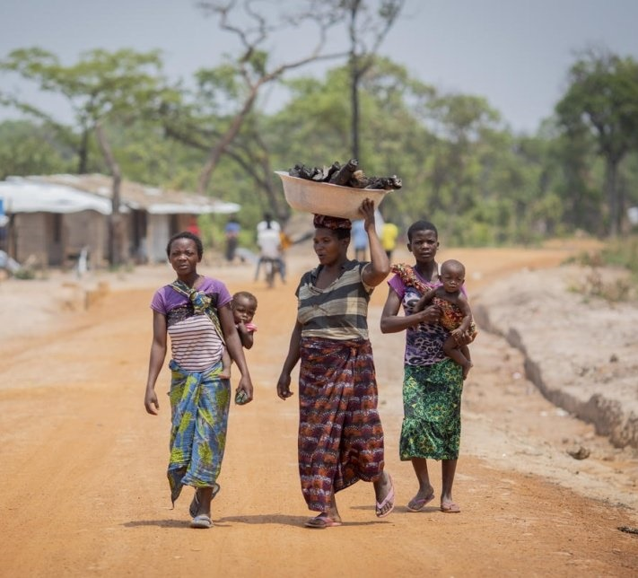
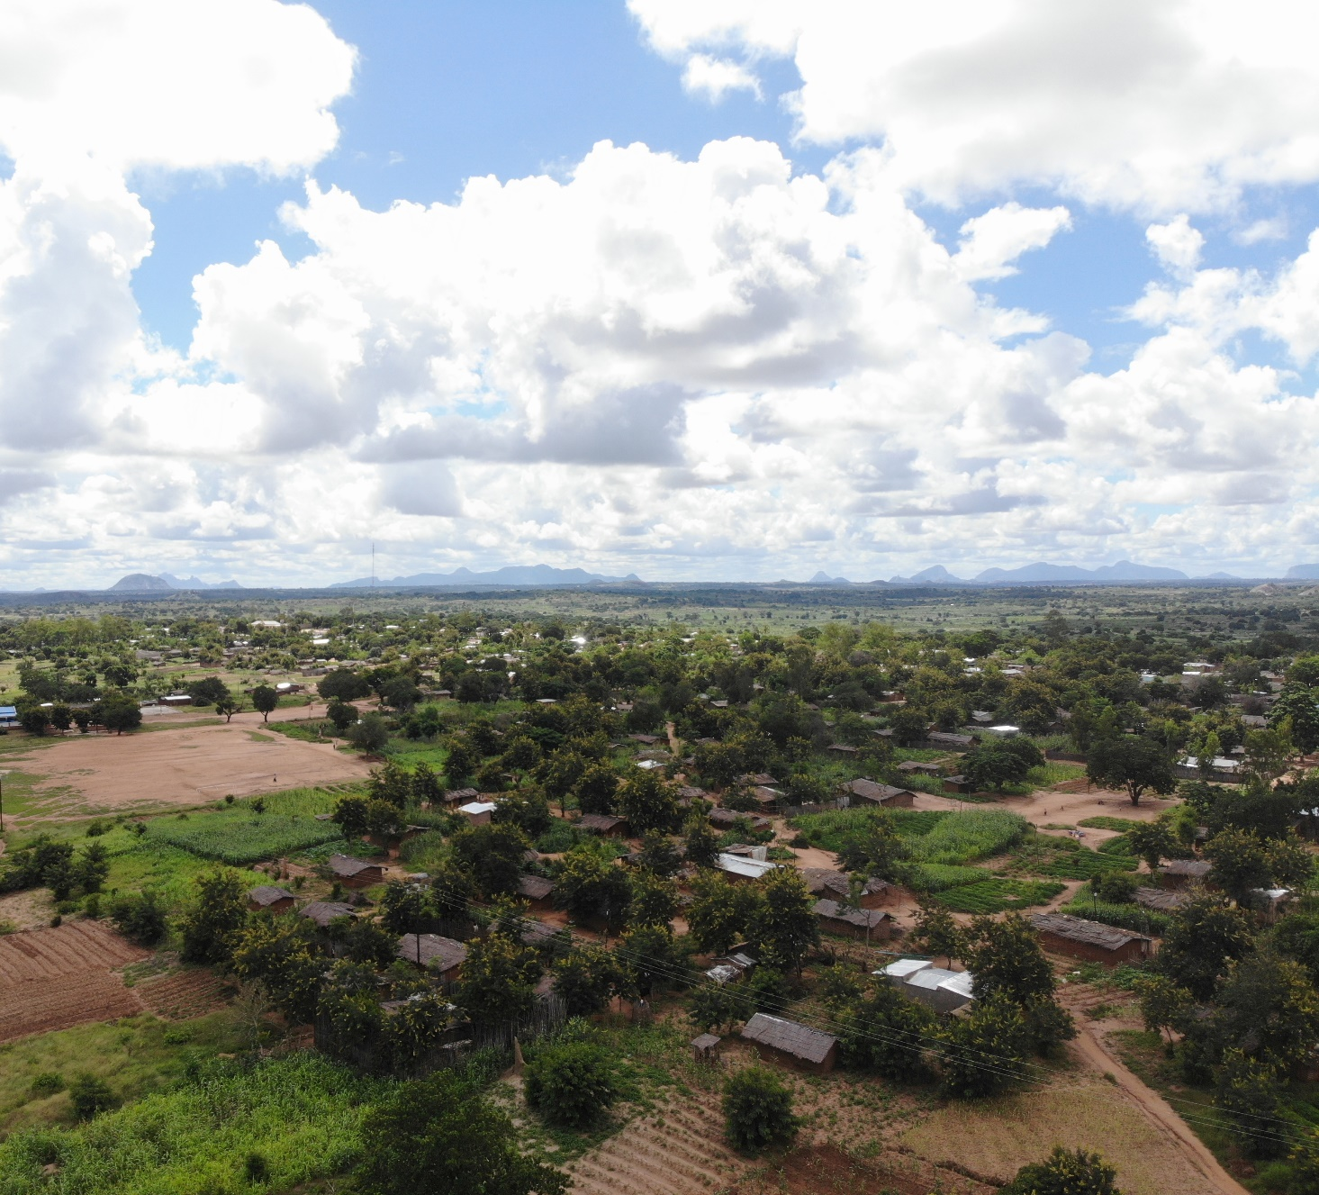
Design the sampling strategy for household survey
Zambia
Mozambique
Notes:
Examples

Slide 25
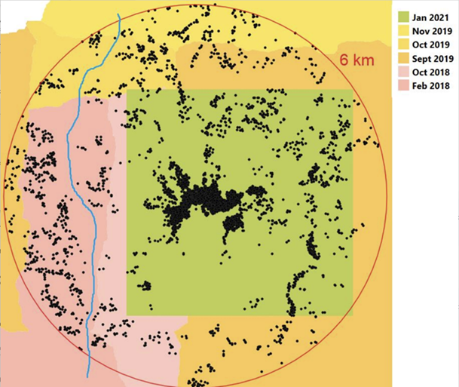
Zambia
Mozambique
Block | # of sampled HHs
1 | 29
2 | 50
3 | 38
4 | 41
5 | 39
6 | 40
7 | 35
8 | 19
9 | 33
10 | 40
11 | 33
12 | 36
13 | 29
14 | 46
Notes:
Sample size determined using statistical parameters
•Geographical coverage : within ~6km-radius distance from the camp & on the eastern side of river
•
•Satellite images of the selected households within 6 kms uploaded in the Tablets using Map package App.
•
•The selected households and replacement households were marked with different colours.
•ArcGIS worked offline and it guided the direction to the selected household as well as the distance from the user location to the sampled household.

Slide 26

Some considerations when choosing indicators

Slide 27
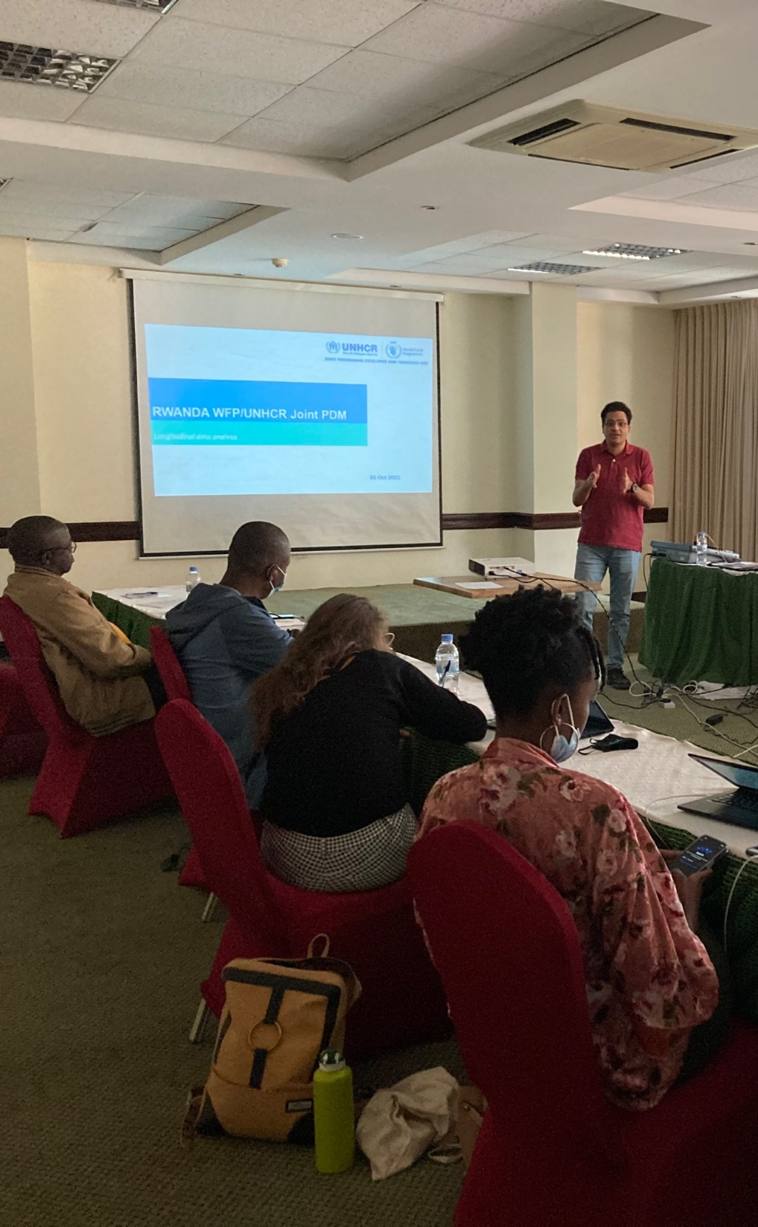


Determining indicators
Corporate outcome indicators
Programme information needs

Slide 28






Considerations for indicators
Important events, such as
Relocation
Assistance introduction or cuts
Fluctuation in prices
Sudden onset disasters or crisis
Protection sensitive, including gender sensitive

Slide 29


Topic | Sub-topic | Indicators and Analysis (*disaggregated by camp/host community)
Weight
Objective 1: Analyze the household demographic characteristics
Registration info. & number of households update | Registration group | ProGres Group ID in which the head is registered
 | Groups vs. households dynamics; | % HHs by number of registration groups within the household visited
 |  | % HH by if all members are registered in ProGres
 |  | Number of officially registered individuals in the group, in which the head is registered
Household composition | Location | % HHs by residence location (camp/host community)
 | Relationship of respondent to household head | % HHs by relationship of respondent to the household head
 | Assistance modality | % HHs by assistance modality and agency
 | Demographic characteristics | % Sex of the HH head
 |  | % Marital status of HH head
 |  | % Education level of HH head
 |  | % HHs by ethnicity group of majority of HH members
 |  | Average size of HH (number of people living together)
 |  | % HHs with young children(<5 yrs.)
 |  | % HHs with children(<18 yrs.)
 |  | % HHs with 2 or more children (<18 yrs.)
 |  | % HHs with children attending university
 |  | % HHs with elderly members (60+ yrs.) ;
 |  | % HHs with low Dependency Ratio (DR) (<2) and high DR (>=2)
 |  | % HHs with pregnant and lactating women
 | Physical disability and chronic illness | % HHs with members who are physically disabled
 |  | % HHs with members who are chronically ill
 |  | % HHs with members who are physically disabled or chronically ill
 |  | % HHs whose head is chronically sick or disabled
 | Movement | % HHs who have changed sites/village at least once since arriving in Cameroun
 |  | % HHs by reasons why they changed site/village
 |  | % HHs by length of time the household has moved/lived in current site/village
 |  | % HHs with member(s) who left current site/village in the past 3 months
 |  | % HHs by reasons why member left current site/village in the past 3 months
 |  | % HHs whose household head has not lived in the household in the past 6 months
 |  | % HHs whose household living outside in the past 6 months sends money back
Objective 2: Analyze the household's access to health and education
Health | Children's health and treatment | % HHs with children under 5 yrs. who were sick in the past 30 days
 |  | Average number of children under 5yrs who were sick in the past 30 days
 |  | Average number of children under 5yrs who were sick and sought treatment
 |  | % Diseases sick children under 5 yrs. contracted in the past 30 days
 |  | % Health institutions people visited to treat the sick children under 5 yrs.
 |  | % Reasons why treatment for the sick children was not sought
 | Pregnant women | % HHs with pregnant women
 |  | Average number of pregnant women in the household
 |  | Age distribution of the pregnant women
 |  | % HHs whose pregnant women all received antenatal consultation
 |  | % Reasons why antenatal consultation was not sought
 | Lactating women | % HHs with lactating women
 |  | Average number of lactating women in the household
 |  | Age distribution of the lactating women
Education | School attendance | % HHs whose children (6-12 yrs.) all go to school regularly in 2021
 |  | % HHs whose children (13-18 yrs.) all go to school regularly in 2021
Objective 3: Analyze the household livelihood capacity
Income sources, debt and savings | Income | Average number of household member who earn income in the last 30 days
 |  | % HH members who earn in income in the last 30 days by age group and gender
 |  | % HHs by primary, secondary, and tertiary income sources
 | Debt | % HHs who have incurred any debts in the past 3 months
 |  | % HHs who currently have a debt and level of debt (mean)
 |  | % Main reasons why debt is incurred in the past 3 months
 |  | % Main sources of debt/credit HHs used in the past 3 months
 |  | % HHs by number of months needed to repay the debts they currently hold
 | Covid-impact | % HHs by level of covid impact on livelihood
 | Saving | % HHs with savings and level of savings (mean)
HH expenditure | Food items and NFI expenditure | Average Food Expenditure Share(FES)
 |  | % HHs with more than 75% FES
 |  | Minimum Expenditure Basket (MEB); Food Minimum Expenditure basket %HHs that below MEB & Food Minimum Expenditure basket
 |  | % HH who spent cash, credit, in-kind, self-produced values on food & non food items
 |  | Debts average and share [see section on debt level]
Livelihood-based coping | Livelihood coping strategies | % stress, crisis, emergency livelihood copings
 |  | Frequency of coping strategies undertaken by HHs
Asset ownership | Household assets | Average number of assets owned by the household
 |  | Average number of productive assets owned by the household
 |  | % HHs owning productive assets
 |  | Frequency of assets owned by the households
Shock | Shocks | Frequency of HHs experiencing shocks in the past 6 months that affected their ability to meet basic food needs
 |  | Frequency of shocks HHs experienced in the past 6 months that affected their ability to meet basic food needs
 |  | Frequency of HHs who have been unable to recover from the impact of shocks experienced
Topic | Sub-topic | Sub-topic | Indicators and Analysis (*disaggregated by camp/host community) | Indicators and Analysis (*disaggregated by camp/host community)
Objective 4: Analyze the household's access to basic services
WASH | Drinking water | Drinking water | % HHs by main source of drinking water | % HHs by main source of drinking water
 |  |  | % HHs by length of time needed to reach the drinking water point | % HHs by length of time needed to reach the drinking water point
 |  |  | Average liter of water the household has access to on daily basis | Average liter of water the household has access to on daily basis
 | Sanitation | Sanitation | % HHs by type of toilets the household uses | % HHs by type of toilets the household uses
 |  |  | % HHs who share toilet with others | % HHs who share toilet with others
Energy | Energy for cooking | Energy for cooking | % HHs by main source of domestic energy for cooking | % HHs by main source of domestic energy for cooking
 | Energy for lighting | Energy for lighting | % HHs by type of energy sources for lighting | % HHs by type of energy sources for lighting
Shelter | Type of shelter | Type of shelter | % HHs by type of shelter people reside in | % HHs by type of shelter people reside in
 | Wall | Wall | % HHs by main materials of the wall | % HHs by main materials of the wall
 | Floor | Floor | % HHs by main materials of the floor | % HHs by main materials of the floor
 | Roof | Roof | % HHs by main materials of roof | % HHs by main materials of roof
 | Number of rooms | Number of rooms | Average number of rooms HHs own (excluding kitchen and bathroom) | Average number of rooms HHs own (excluding kitchen and bathroom)
 |  |  | % HHs by number of rooms HHs own (excluding kitchen and bathroom) | % HHs by number of rooms HHs own (excluding kitchen and bathroom)
 |  |  | % HHs by house ownership situation | % HHs by house ownership situation
Objective 5: Analyze the refugee households' food access and nutrition
Food access | Food sources | Food sources | % HHs' food sources by food group | % HHs' food sources by food group
 | Intra-household distribution | Intra-household distribution | Average number of meals consumed by adults had the day proceeding to the survey | Average number of meals consumed by adults had the day proceeding to the survey
 |  |  | Average number of meals consumed by children (5-18 yrs.) had the day proceeding to the survey | Average number of meals consumed by children (5-18 yrs.) had the day proceeding to the survey
 | Food consumption in the past 7 days | Food consumption in the past 7 days | % HHs by Food Consumption Score-Nutrition (FCS-N) Group | % HHs by Food Consumption Score-Nutrition (FCS-N) Group
 |  |  | Average number of days that key food items are consumed (vitamin-A rich, iron-rich, hem-iron rich) | Average number of days that key food items are consumed (vitamin-A rich, iron-rich, hem-iron rich)
 | Dietary diversity in the past 7 days | Dietary diversity in the past 7 days | Dietary Diversity Score (DDS) | Dietary Diversity Score (DDS)
 | reduced Coping Strategy Index (rCSI) | reduced Coping Strategy Index (rCSI) | rCSI classification | rCSI classification
 |  |  | % reduced Coping Strategies adopted by households | % reduced Coping Strategies adopted by households
Child nutrition | Breastfeeding | Breastfeeding | % young children who have never been breastfed since birth | % young children who have never been breastfed since birth
 |  |  | % young children by length of time after the children's birth to start breastfeeding | % young children by length of time after the children's birth to start breastfeeding
 |  |  | % young children by when the introduction of supplementary food started | % young children by when the introduction of supplementary food started
 | Edema | Edema | % HHs with children with presence of edema | % HHs with children with presence of edema
 | MUAC measurement | MUAC measurement | Prevalence of moderate acute malnutrition | Prevalence of moderate acute malnutrition
 |  |  | Prevalence of acute malnutrition | Prevalence of acute malnutrition
 | Food consumption in the past day | Food consumption in the past day | % children who consumed milk, yoghurt, porridge in the day proceeding to the survey | % children who consumed milk, yoghurt, porridge in the day proceeding to the survey
 |  |  | Average times that children consumed milk, yoghurt, porridge | Average times that children consumed milk, yoghurt, porridge
Objective 6: Analyze the agriculture & livestock ownership among refugee households
Agriculture participation | Agriculture practice | Agriculture practice | % HHs that practice agriculture in the 2021/2022 agricultural season | % HHs that practice agriculture in the 2021/2022 agricultural season
 |  |  | % Reasons why HHs did not practice agriculture in the 2021/2022 agricultural season | % Reasons why HHs did not practice agriculture in the 2021/2022 agricultural season
 |  |  | % Types of crops planted by the HHs | % Types of crops planted by the HHs
 |  |  | Average area sown by crop | Average area sown by crop
 |  |  | Average % of harvest sold by crop | Average % of harvest sold by crop
 |  |  | % Reasons why HHs sell their agricultural products | % Reasons why HHs sell their agricultural products
 | Livestock | Livestock | % HHs that own livestock | % HHs that own livestock
 |  |  | Average number of livestock (cows, goats, sheep, poultry, donkeys, horses) owned by HHs | Average number of livestock (cows, goats, sheep, poultry, donkeys, horses) owned by HHs
 |  |  | % Difficulties experienced by HHs during livestock breeding | % Difficulties experienced by HHs during livestock breeding
Objective 7: Analyze the access to assistance and any related challenges
Assistance | Overall -received assistance | Overall -received assistance | % HHs receiving assistance in the last 6 months | % HHs receiving assistance in the last 6 months
 |  |  | % HHs by assistance received and source | % HHs by assistance received and source
Cash assistance WFP | If the household is a WFP beneficiary | If the household is a WFP beneficiary | % HHs receiving WFP cash assistance in the last 6 months | % HHs receiving WFP cash assistance in the last 6 months
 | Last time received | Last time received | % HHs by last time they received the WFP cash assistance | % HHs by last time they received the WFP cash assistance
 | Amount | Amount | Average amount of cash received from WFP in the last 6 months | Average amount of cash received from WFP in the last 6 months
 | Knowledge | Knowledge | % HHs not receiving enough information about WFP's assistance and suggested channels | % HHs not receiving enough information about WFP's assistance and suggested channels
Cash assistance -other sources | If the household is a beneficiary | If the household is a beneficiary | % HHs receiving cash assistance from non-WFP sources in the last 6 months | % HHs receiving cash assistance from non-WFP sources in the last 6 months
 | Amount | Amount | Amount of cash received from non-WFP sources | Amount of cash received from non-WFP sources
 | Expectation | Expectation | Average amount of cash received from non-WFP sources in the last 6 months | Average amount of cash received from non-WFP sources in the last 6 months
UNHCR assistance | Knowledge | Knowledge | % HHs not receiving enough information about UNHCR's assistance and suggested channels | % HHs not receiving enough information about UNHCR's assistance and suggested channels
Objective 8: Analyze the beneficiary safety, complaints and feedback channel
Community safety | Safety problems | Safety problems | % HHs reporting feeling safe living in the current community | % HHs reporting feeling safe living in the current community
 |  |  | % Reasons of main safety and security concerns | % Reasons of main safety and security concerns
Complaints and feedback | Complaint and feedback mechanisms | Complaint and feedback mechanisms | % HHs that don't know how to complain if there is a problem regarding assistance | % HHs that don't know how to complain if there is a problem regarding assistance
 |  |  | % HHs by reporting channels they use when there is a problem regarding assistance | % HHs by reporting channels they use when there is a problem regarding assistance
 |  |  | % HHs who have used the channels to complain | % HHs who have used the channels to complain
 |  |  | % HHs who received an answer after complaining and if they are satisfactory | % HHs who received an answer after complaining and if they are satisfactory
 |  |  | Average number of days for HHs to receive an answer after they complain | Average number of days for HHs to receive an answer after they complain
 |  |  | % HHs finding feedback mechanisms equally accessible to every one | % HHs finding feedback mechanisms equally accessible to every one
 |  |  | % Reasons why feedback mechanisms are not equally accessible to every one | % Reasons why feedback mechanisms are not equally accessible to every one
 |  |  | % other channels of complaints suggested by HHs | % other channels of complaints suggested by HHs
Objective 9: Analyze the social cohesion situation
Social cohesion | Conflict/tension | Conflict/tension | % HHs experiencing a tension/conflict with Cameroonian households in the last 12 months | % HHs experiencing a tension/conflict with Cameroonian households in the last 12 months
 |  |  | % Reasons of tensions/conflicts between refugees and local households | % Reasons of tensions/conflicts between refugees and local households
 |  |  | % Consequences of tensions/conflicts between refugees and local households | % Consequences of tensions/conflicts between refugees and local households
 |  |  | % HHs by level of agreement to the statement that WFP assistance contributes to tension | % HHs by level of agreement to the statement that WFP assistance contributes to tension
 |  |  | Mostly stated reasons why WFP assistance contributes to tension | Mostly stated reasons why WFP assistance contributes to tension
 |  |  | % HHs by level of agreement to the statement that UNHCR assistance contributes to tension | % HHs by level of agreement to the statement that UNHCR assistance contributes to tension
 |  |  | Mostly stated reasons why UNHCR assistance contributes to tension | Mostly stated reasons why UNHCR assistance contributes to tension
 |  |  | % HHs by self-evaluation of relationship with the host community (Q16.1-Q16.10) | % HHs by self-evaluation of relationship with the host community (Q16.1-Q16.10)
Objective 10: Analyze the intra-household gender equality
Gender equality | Decision-making | Decision-making | % HHs by gender of decision-maker on food usages for different purposes (sell, exchange, share) | % HHs by gender of decision-maker on food usages for different purposes (sell, exchange, share)
 |  |  | % HHs by gender of decision-maker on the usage of income earned by men | % HHs by gender of decision-maker on the usage of income earned by men
 |  |  | % HHs by gender of decision-maker on the usage of income earned by women | % HHs by gender of decision-maker on the usage of income earned by women
 |  |  | % of different HH members who also takes care of the children in addition to the mother | % of different HH members who also takes care of the children in addition to the mother
 |  |  | % HHs knowing of any other households would marry girls <15yrs for lack of food | % HHs knowing of any other households would marry girls <15yrs for lack of food
 |  |  | % HHs by their attitudes towards WFP's targeting on women as beneficiaries | % HHs by their attitudes towards WFP's targeting on women as beneficiaries
 |  |  | % HHs by the reported impact of targeting women on the gender relations | % HHs by the reported impact of targeting women on the gender relations
Objective 11: Identify the vulnerability classification of the households
Vulnerability classification |  | ECMEN (based on MEB), FCS, Livelihood coping |  | % HHs by vulnerability classification
Notes:
The full analysis plan (just to show scale) – might seem a lot, but it’s important we get the complete picture

Slide 30
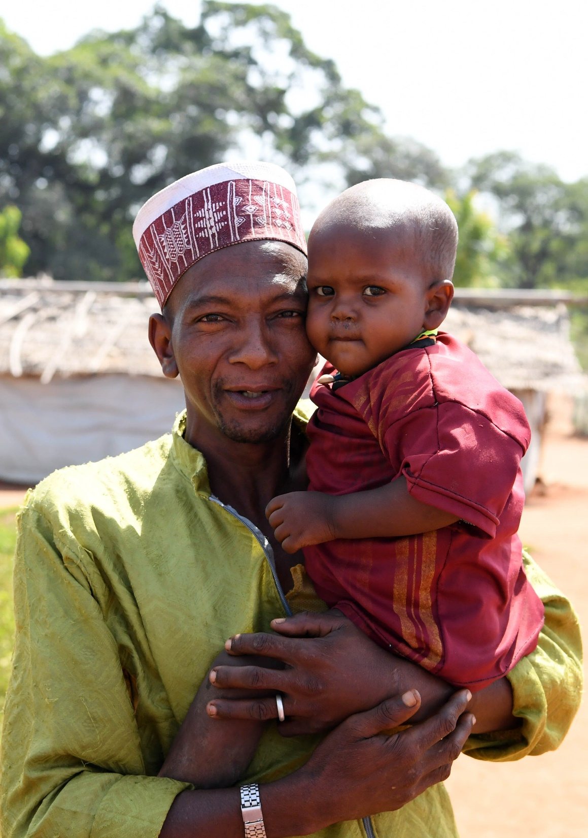
Objective 1: Analyze the household demographic characteristics
Demographic characteristics
% Sex of the household head
% Marital status of household head
% Education level of household head
% Households with young children(<5 yrs.)
% Households with children(<18 yrs.)
% Households with elderly members (60+ yrs.) ;
% Households with low Dependency Ratio (DR) (<2) and high DR (>=2)
% Households with pregnant and lactating women
Notes:
The dependency ratio: measure of the number of dependents aged zero to 14 and over the age of 65, compared with the total population aged 15 to 64. Basically, working age vs non-working age.

Slide 31


Objective 3: Analyze household livelihood capacity
Household expenditure
% Households with more than 75% Food Expenditure Share
% Households below Minimum Expenditure Basket & Food Minimum Expenditure Basket
Livelihood coping
% stress, crisis, emergency livelihood copings
Frequency of coping strategies undertaken by households
Notes:
To note: These are only a few examples
FES: How much of their spending is on food as a percentage?

Slide 32
Objectives
Thematic areas
Demographic
Protection
Food security & nutrition
Livelihood
Economic capacity
Access to services
Assistance & needs gap
Indicators per thematic area

Slide 33
How to prepare assessment and analysis?
Notes:
Intro to themes and indicators

Slide 34
Steps in a typical assessment
Notes:
What are some of the steps in the planning and preparation phase?

Slide 35








Steps of an assessment
Preparation
Data collection
Analysis & reporting
Planning
Notes:
The scope of an assessment:
● the spectrum of needs and risks ● geographical distribution of needs and severity ● temporal duration of needs (how long each need is expected to continue) ● estimated severity of conditions ● existing capacities and resources ● information available disaggregated by gender, age, minority group, vulnerability ● production of baseline data to measure future progress and inform future assessments.
This should be something discussed cross-units, at the beginning to gain consensus with a wide range of relevant teams. The assessment focal point(s) should consult widely.

Slide 36
Roles & Responsibilities
Provide narrative &
qualitative analysis
Technical Data Expert
Lack of buy-in
Subject Matter Expert
Get, clean and
visualize quantitative data
Data Informed Decision
Risk of misinterpretation
Lack of evidence
Decision Maker
Endorse summary
findings

Slide 37
Step 1: Planning
Define objectives of the assessment
Define the timeframe and assessment plan
Identify key questions and gaps
Conduct secondary data analysis
Plan resource/budget
Decide analytical methods, sampling methodology and sample size
Define analysis plan based on thematic areas and indicators
Notes:
First three- together, then last 2, then the rest (conduct secondary analysis and budget)

Slide 38




Step 1: Planning
Additional considerations in refugee context:
  Community sentiment, response fatigue
  Refugees' perception and expectation
  Mobility of refugees during the enumeration hours and survey period
  In-house capacity and support needed from different parties
  Security situation

Slide 39





Step 2: Preparation
Technical preparation
Logistics preparation
Consultation
Methodology (sampling, survey methods)
Community sensitization
Questionnaire toolkit development & coding
Data quality check plan
Training material preparation
Budget development & resource management
Enumerator recruitment
Tablet procurement
Vehicle procurement
Training venue provision
COVID-19 sanitation kits (if necessary) provision
Government
Community
Partners
Notes:
Train more people than needed and select enumerators after the training

Slide 40
Asking the right question
Example | Diagnosis | Another try
How satisfied are you with the current livelihood project?
Leading question
1. Are you satisfied with the current livelihood project? (Y/N) 2. If no, why?
What challenges do refugees face because of the food ration cut?
Loaded question
1. Do you observe or feel any challenges in ____ (security, livelihood, food security) since the food ration cut started? (Y/N) 2. If yes, what are they?
Notes:
https://www.surveymonkey.com/mp/5-common-survey-mistakes-ruin-your-data/
A loaded question is a form of complex question that contains a controversial assumption (e.g., a presumption of guilt). Such questions may be used as a rhetorical tool: the question attempts to limit direct replies to be those that serve the questioner's agenda.
Leading questions are survey questions that encourage or guide the respondent towards a desired answer. They are often framed in a particular way to elicit responses that confirm preconceived notions, and are favorable to the surveyor
While a leading question prompts someone toward an answer, a loaded question is a trick question. No matter how a respondent answers, they're saying something that they may not agree with.

Slide 41
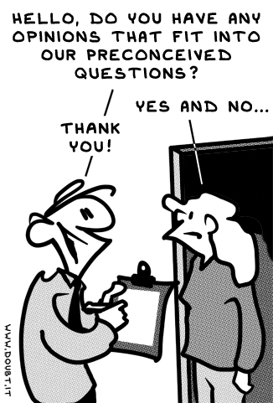

Slide 42
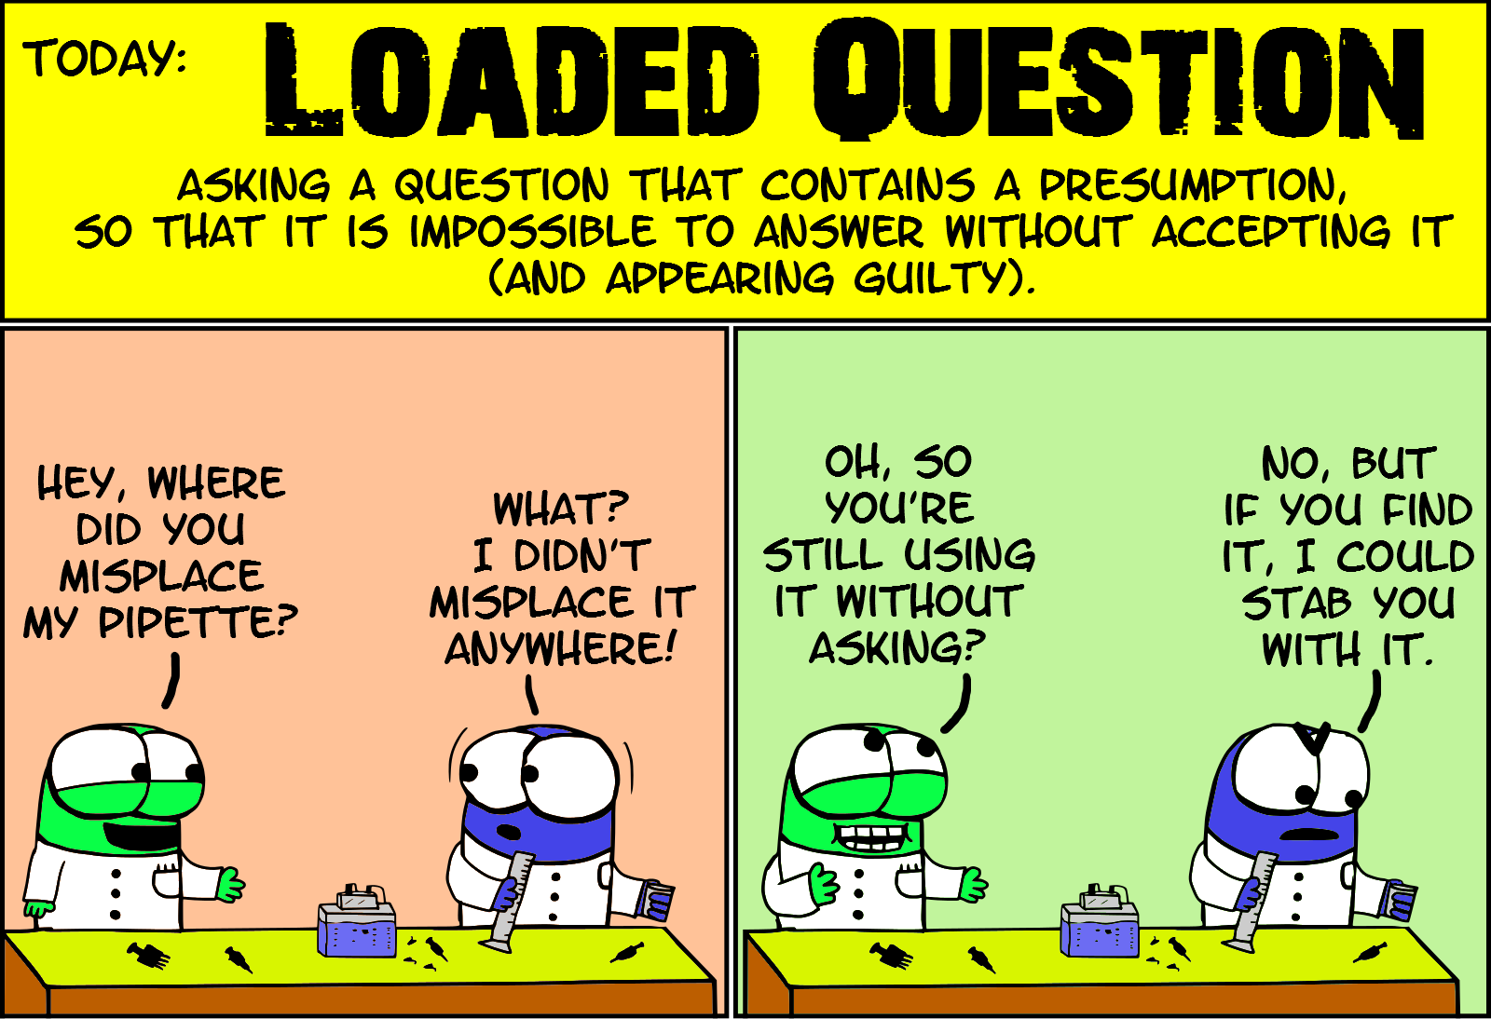

Slide 43
Asking the right question
Example | Diagnosis | Another try
How much cash assistance did you receive for energy and other NFI items last month?
Double-barreled question
Did you receive any cash assistance last month? If yes, how much for energy? If yes, how much for other NFI items?
Is there adequate access to health facilities in the past 6 months?
Complicated wording
Are there enough health care workers at the health facilities you usually visit in the past 6 months?
Notes:
https://www.surveymonkey.com/mp/5-common-survey-mistakes-ruin-your-data/
A loaded question is a form of complex question that contains a controversial assumption (e.g., a presumption of guilt). Such questions may be used as a rhetorical tool: the question attempts to limit direct replies to be those that serve the questioner's agenda.
Leading questions are survey questions that encourage or guide the respondent towards a desired answer. They are often framed in a particular way to elicit responses that confirm preconceived notions, and are favorable to the surveyor
While a leading question prompts someone toward an answer, a loaded question is a trick question. No matter how a respondent answers, they're saying something that they may not agree with.

Slide 44
Step 3: Data collection
Conduct pilot surveys (1-2 days)
1
Familiarize the team with the tool
Conduct household interviews
2
Find the sampled households in refugee context
To answer the "why" questions and supplement quantitative findings
Test and finalize the tool
Identify any other challenges (sampling)
Conduct key informant interviews and focal group discussions
3
Notes:
Test the translation

Slide 45
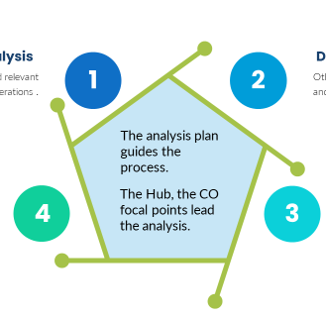
Step 4: Analysis
Corporate indicator analysis
Descriptive analysis
The analysis plan guides the process.
Vulnerability analysis
Profiling and Targeting analysis

Slide 46
Overall timeline of assessment: An example
conceptualization, scope of the assessment, TOR development
literature review, knowledge gap identification
questionnaire drafting and review; sampling
analysis plan development
questionnaire coding
logistics preparation (tablets, vehicle, COVID-19 kits, etc.)
enumerator recruitment
community sensitization
enumerator training, pilot survey & tool finalization
data collection
data cleaning and analysis
preliminary finding presentation
report/dashboard drafting, review and finalization
4- 6 weeks
4- 6 weeks
2- 4 weeks
4- 6 weeks
4- 6 weeks

Slide 47


What are some success factors for joint assessments for targeting?

Slide 48
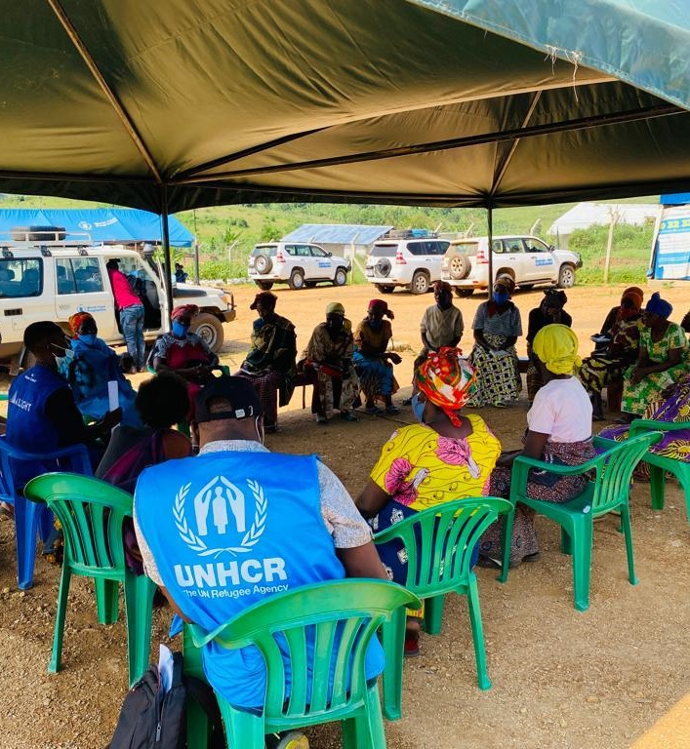
Success factors
A participatory, consultative and inclusive process:
Involve different functions for technical inputs through the planning phases
Plan and start community sensitization early and thoroughly
Inform the government and other partners throughout the process
Notes:
If needed, several times of sensitization over a period may be implemented
(animate three bullet points)

Slide 49
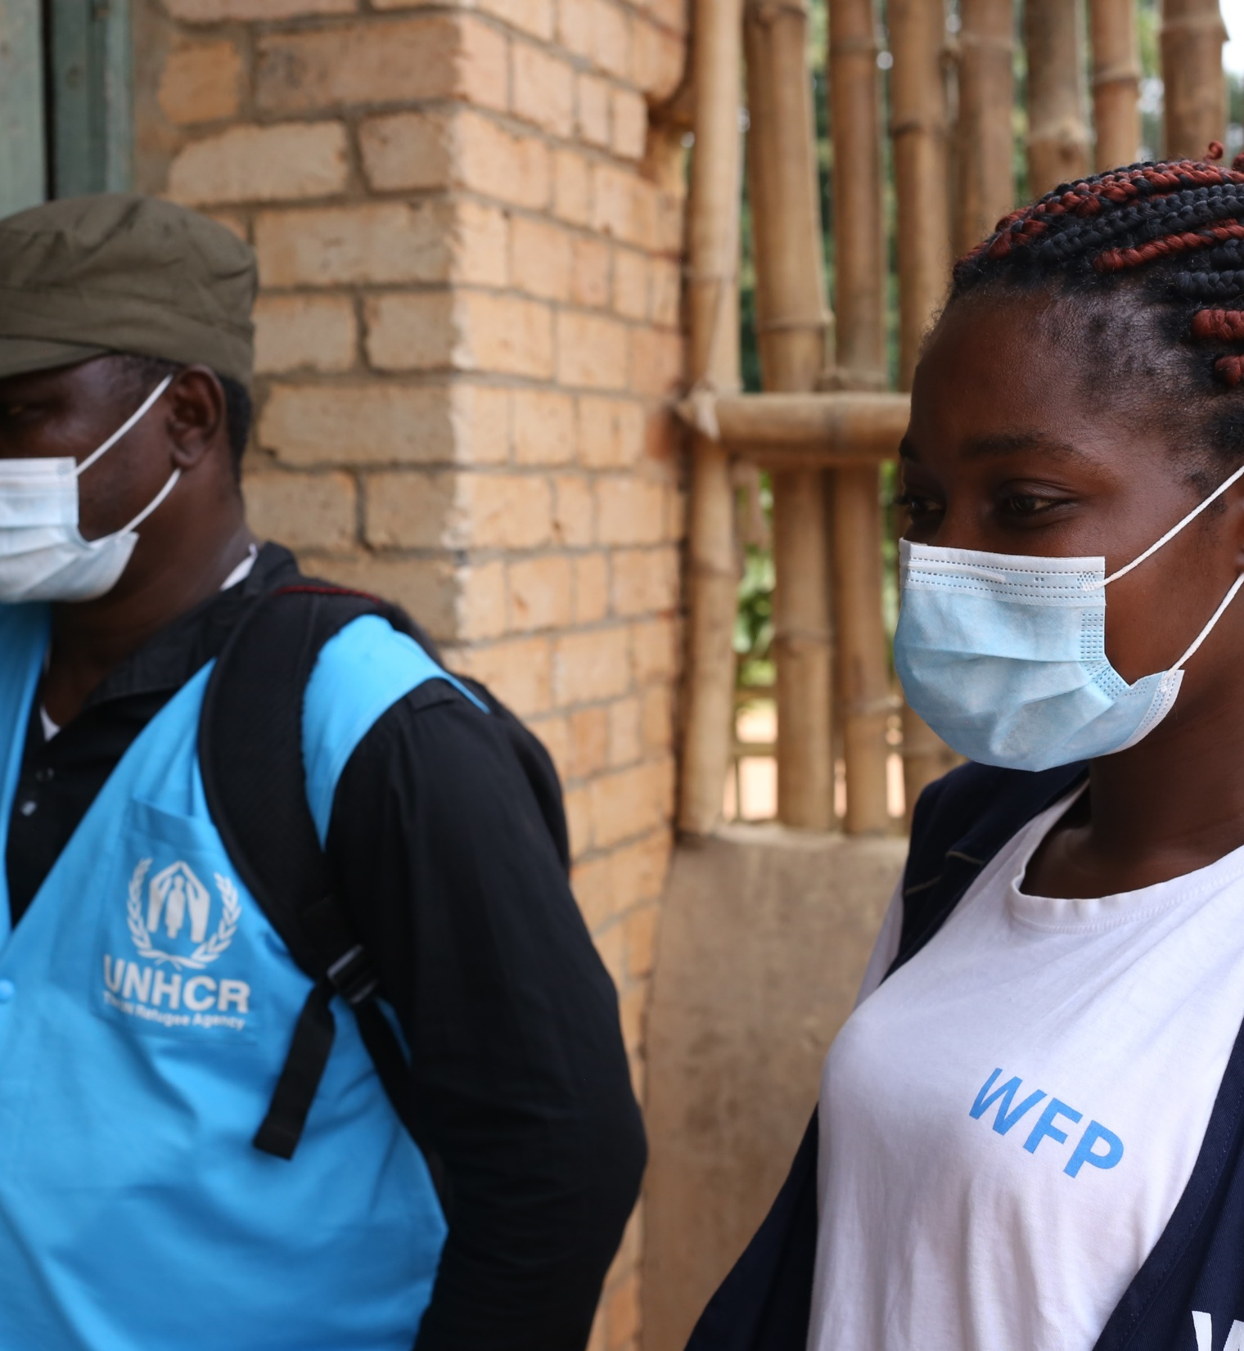
Success factors
Clearly defined roles and responsibilities:
Identify capacity gaps that require support
Set realistic timelines and expectations
Ensure colleagues dedication and consistent participation
Notes:
Capacity support from regional, headquarters to address at the earliest possibility

Slide 50
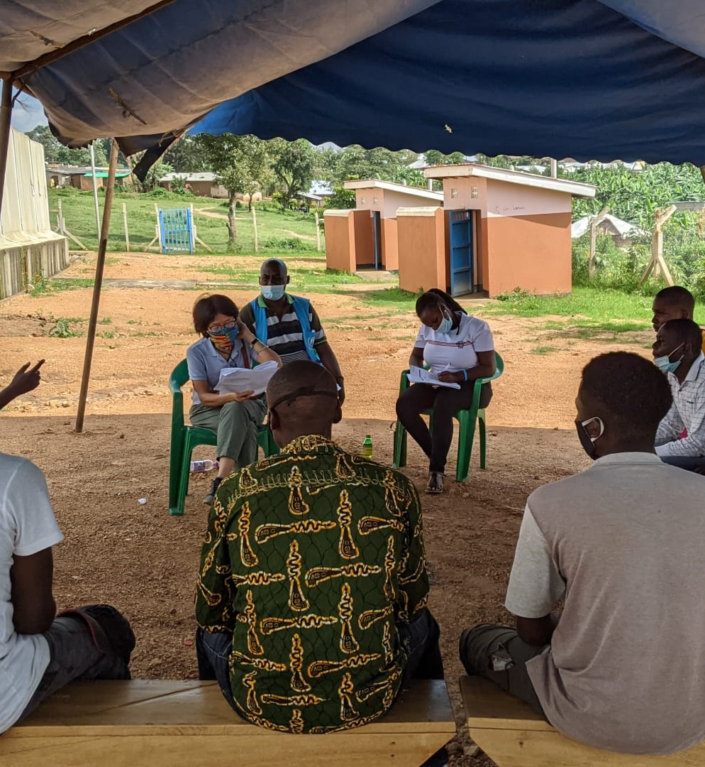
Success factors
Technical preparedness and flexibility
Have a Plan B: For sampling, data collection methods, training...
Have a communication strategy to address refugee households' questions, doubts and objections

Slide 51

Success factors
Close monitoring of collected data and regular data quality checks
Ensure pilot survey is implemented properly and informs the finalization of toolkits and questionnaire administration
Correct data entry mistakes, identify any misunderstanding of the questions and update the tools timely

Slide 52

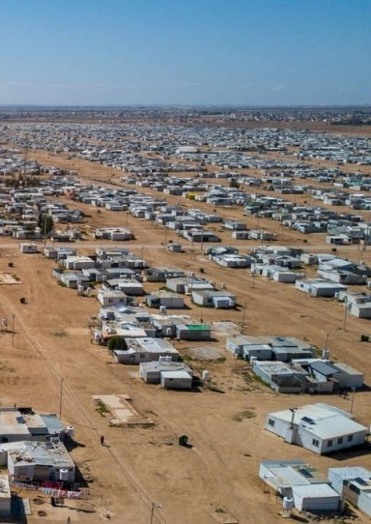



Example from Jordan
Data quality officers (Hub & WFP)
Enumerator supervisor/team leader (Mindset)
Questionnaire programmer (Mindset)

Slide 53


Topics
Why assessment for targeting
What an assessment involves
Success factors of a joint assessment
Notes:
Recap of content covered.

Slide 54



Next
Deciding whether targeting is appropriate

