Slide 1
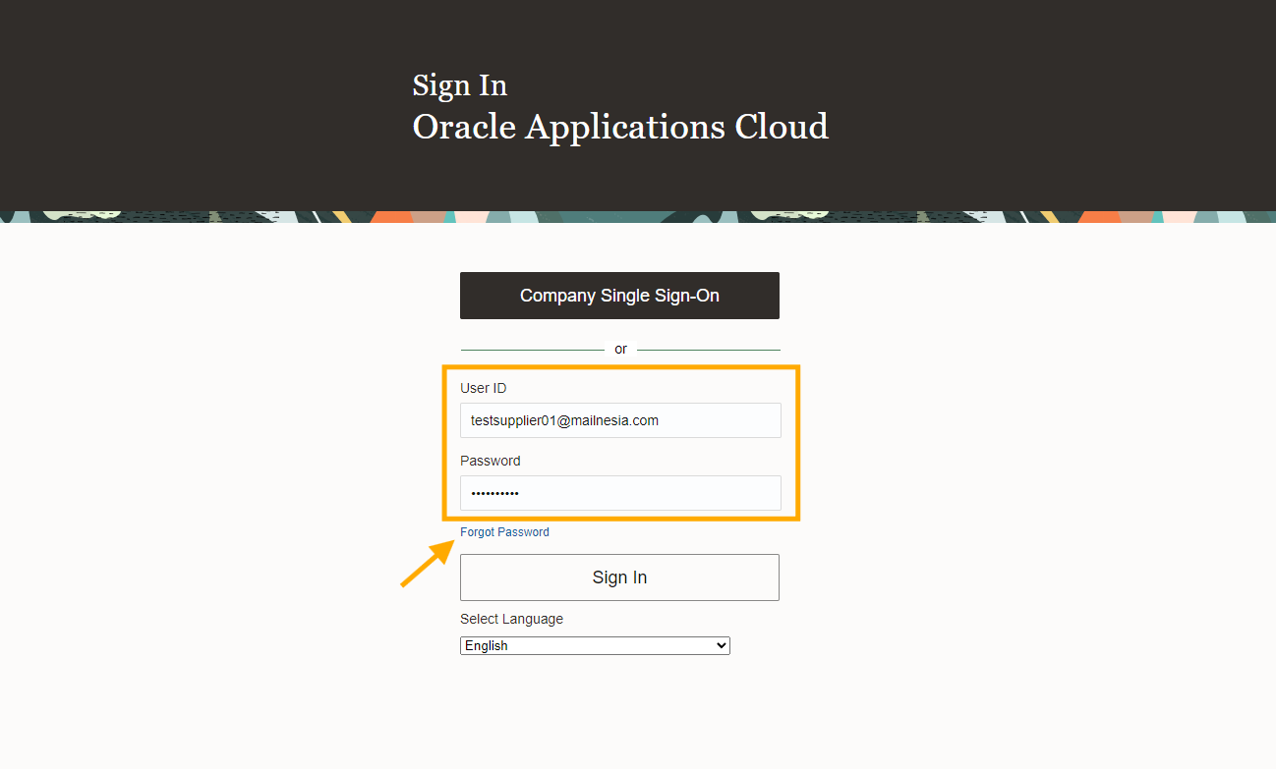
How to participate event and submit proposal
Log in to system:
Supplier put User ID and Password in CERP, click “Sign in”
If supplier forgets a password, click forgot password and follow an instruction.

Slide 2
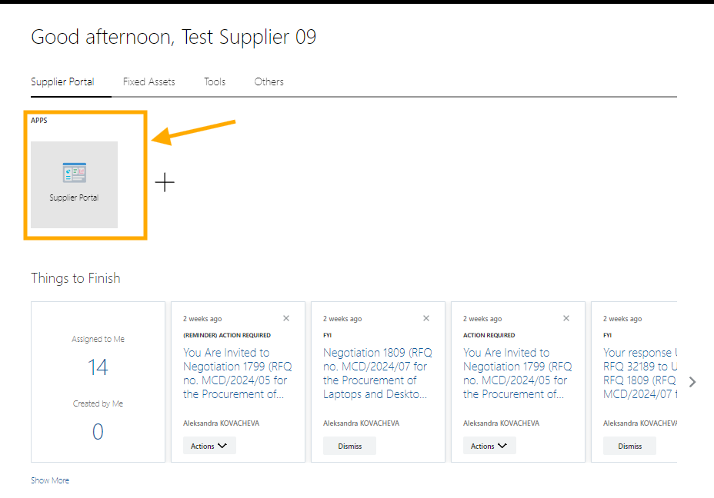
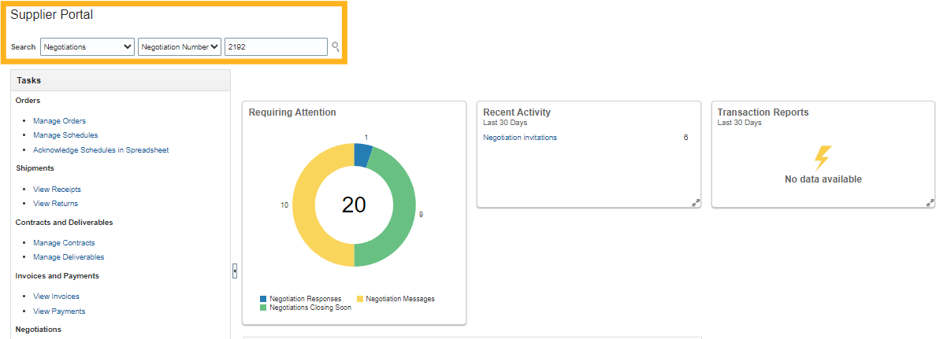
How to participate event and submit proposal
Go to Cloud ERP: Cloud ERP Sign in
Click “Supplier Portal”
At Supplier Portal, fill negotiation event number in “Search” field

Slide 3
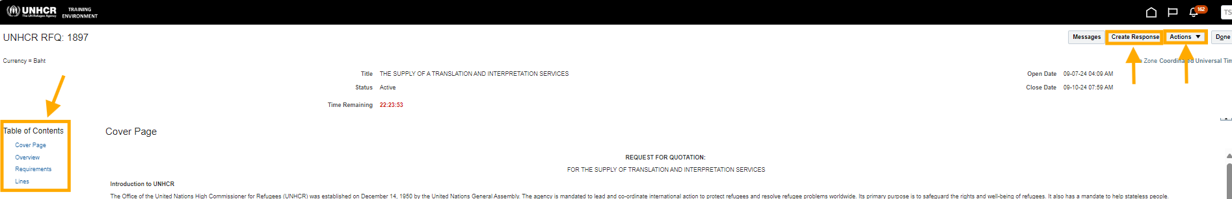
How to participate event and submit proposal
Click “Action” → Acknowledge Participation.
At “Table of Contents” to review the RFQ detail.

Slide 4
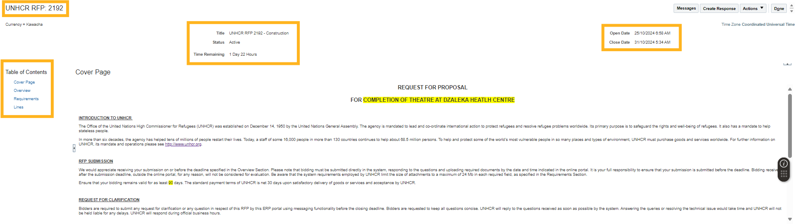
How to participate event and submit proposal
You will see the first page of negotiation event as below and can check information.
Title: the name of the tender event.
Time remaining- to show the time left prior the submission deadline.
Open date and close date- the duration of the event.
Table of Content- provide all related information and documents of the tenders.
* It’s recommended to read all information in the table of contents.

Slide 5
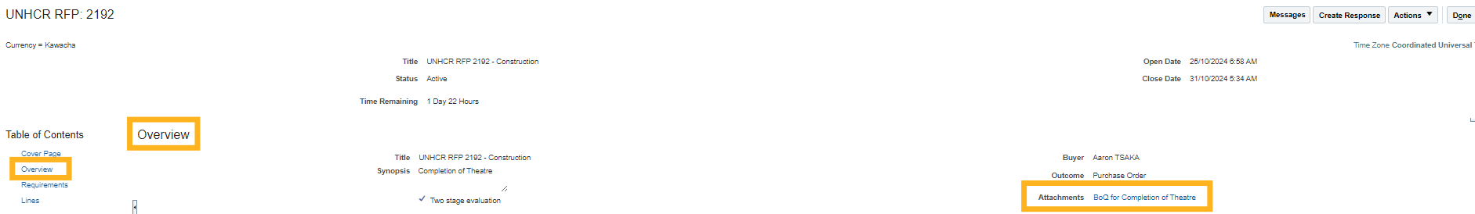
How to download RFP Documents from Cloud ERP
To download tender documents, click “Overview” at “Table of Contents” and then click “Attachments”.

Slide 6
Supplier’s Bid Submission
Click “Action” → Acknowledge Participation.
At “Table of Contents” to review the RFQ detail.
Click “Create Response” to response to the RFQ.

Slide 7
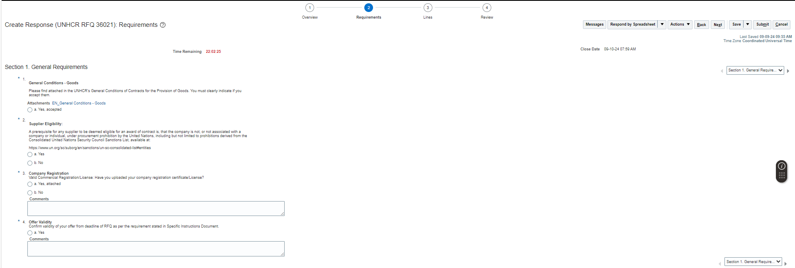
Supplier’s Bid Submission
Supplier(s) response to “requirements” and “Lines” section.
The “Review” section is to review the submission prior submit the offers.

Slide 8
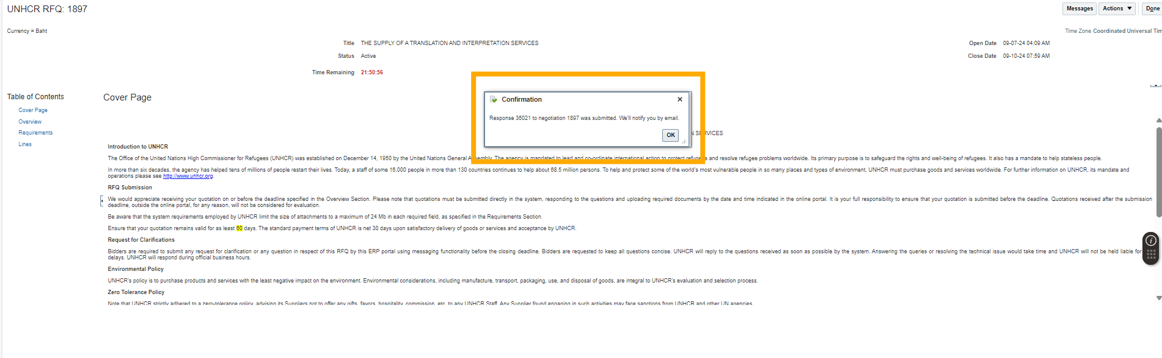
Supplier’s Bid Submission
Please ensure that you provide a response to all required section.
When the offer submitted, the confirmation will pop up.

Slide 9
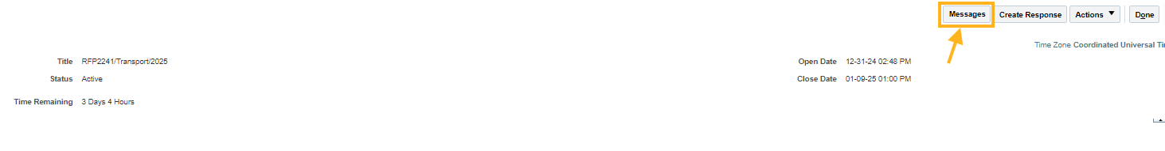
How to send a message through system
Cloud ERP system allows supplier to submit their query or to response the query from UNHCR.
To submit the message,
Click “messages” button at the top right of the page.

Slide 10
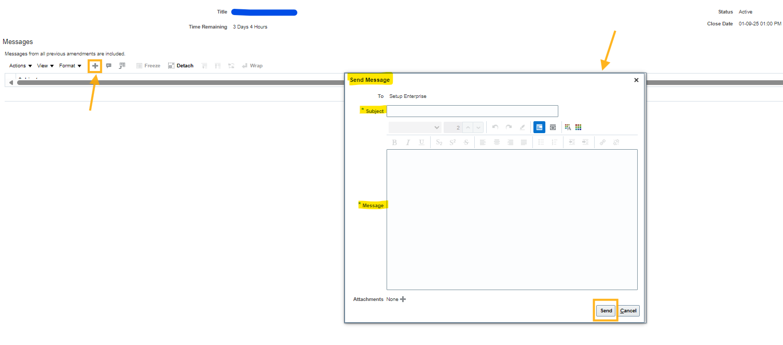
How to send a message through system
Then, click “+” symbol and add subject and message in the send message box and click “Send” or “Cancel”.

