Slide 1
SENS Surveys
[Camp/Setting names]
Region, Country - Time frame
Survey Training
[PLACE, DATES]
[LOGO PARTNERS]

Slide 2
Session 1: Anthropometry
  Weight
  Height/Length
  MUAC
  Bilateral Edema

Slide 3

What is anthropometry?

Slide 4
What is anthropometry?
Answer
  Anthropometry is the study and technique of human body measurement
  It is used to measure and monitor the nutritional status of an individual or population group

Slide 5
Target Groups

Slide 6
Who are the most targeted population group in anthropometric surveys?

Slide 7
Target groups - Anthropometry
Children 6-59 months
  Considered to be most vulnerable to nutritional stress
  Nutrition status indicates severity of situation in whole population
  In growth period
  Particularly vulnerable to disease and food shortage
  Easier to measure (equipment less bulky, possible to undress them when taking measurements)
  Generally at home
  Stakeholders are used to this type of data and appropriate response
  Lots of expertise in surveys for this age group
  Anthropometric indicators and measures are internationally recognized
Women 15-49 years
  For social and biological reasons, also considered to be most vulnerable of the population

Slide 8
WEIGHT

Slide 9
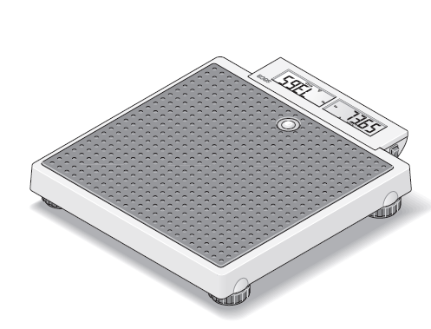
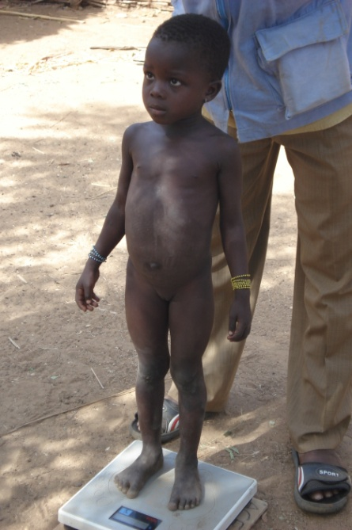
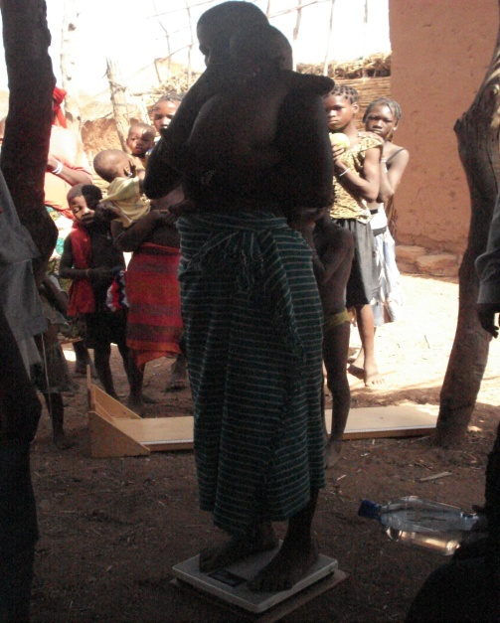
Measuring Weight: Digital Scale
Two methods of measuring a child using an electronic scale:
Direct: Measure the child by themselves
  Children able to stand up can be weighted by standing on the scale
Indirect: Measuring the child in the arms of a caretaker (“double weighing”)
  Babies/Young children unable to stand on their own
  Children who are too weak to stand on their own
  Children who are disabled
  Children who are restless and can’t stand still

Slide 10
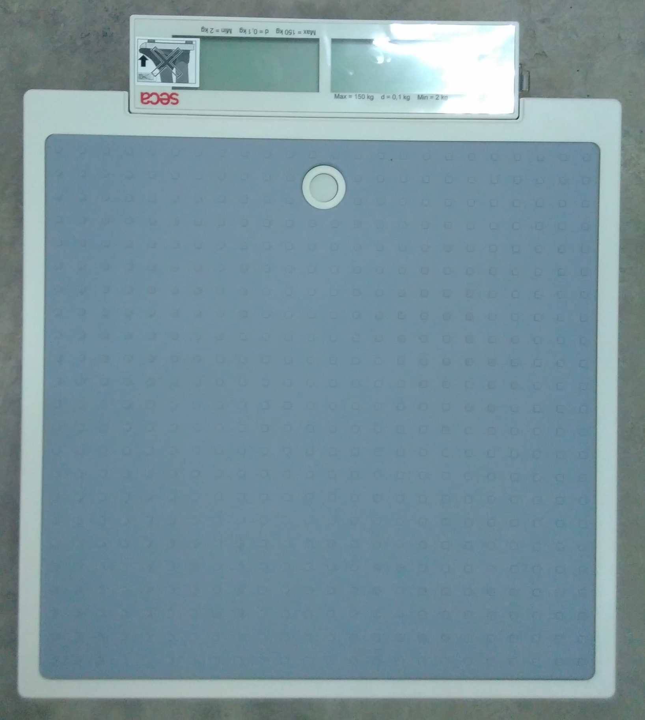
How to weigh properly?
  Place the scale on a hard and flat surface and in the shade or indoors
  Push the switch, located on the right side of the screen, in position “1”
  The scale has also a “Start” button on the front to switch on the scale
  “SECA”, “8.8.8.8.8” and appear consecutively in the display → The scale is ready to use

Slide 11
Direct Weighing
Always explain the procedure to the child’s mother or caretaker.
Place the scale on a flat surface. Turn on the scale.
If there is more than 1 eligible child in a household, always weigh the “less fussy” one first.
Take off the child’s clothes.
Ask mother to face the scale and bend down so they will be eye level with their child.
Ask the child to step on the scale, to keep still, and to look straight ahead at their mother.
After the weight appears (stop flashing), record weight.
Measurer reads the weight out loud. The Team leader repeats the weight out loud to confirm and records the weight in the questionnaire.

Slide 12
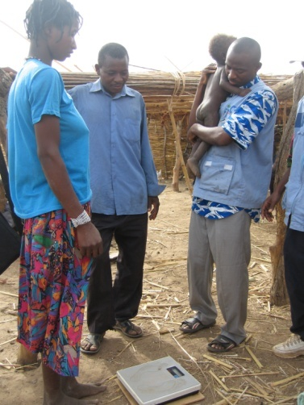
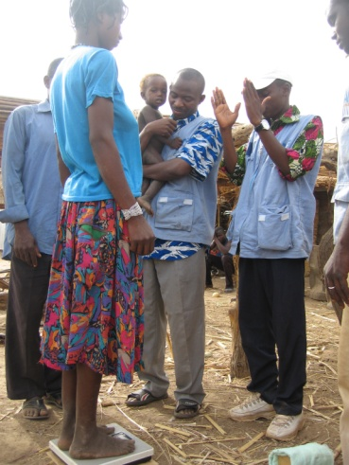
Indirect (Double) Weighing (1/2)
Always explain the procedure to the child’s mother or caretaker.
Place the scale on a flat surface. Turn on the scale.
If there is more than 1 eligible child in a household, always weigh the “less fussy” one first.
Take off the child’s clothes.
Ask the caretaker (mother) or the assistant to stand on the scale.
After the weight appears, the caretaker stays on the scale.

Slide 13
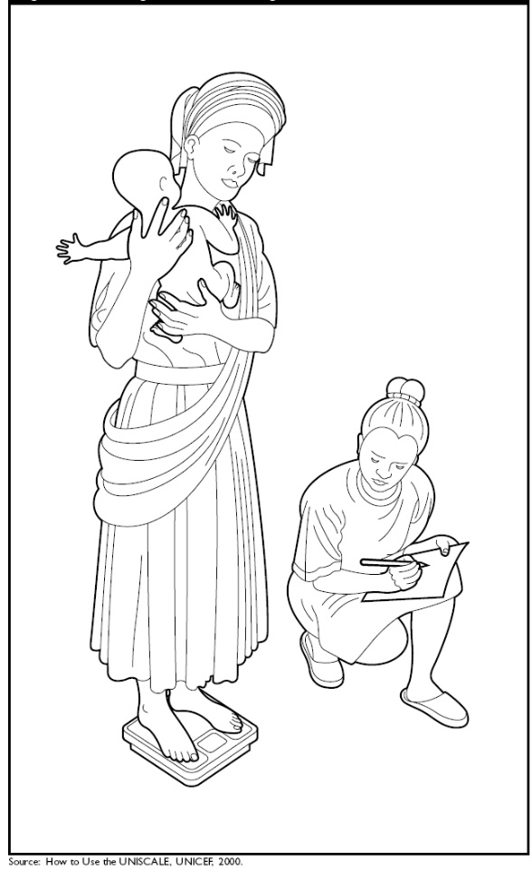
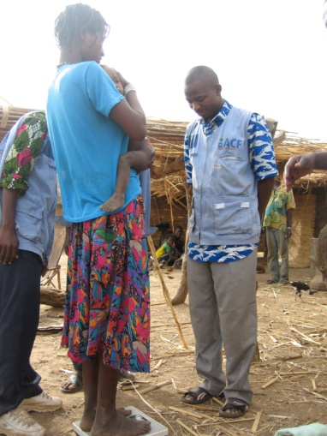
Indirect (Double) Weighing (2/2)
Measurer presses the “2-in-1” button (to “zero’’ the scale) → Wait until the appears.
Hand the child to the caretaker. The child must be held facing the caretaker and should keep still.
The weight display will be the child’s weight.
Measurer reads the weight out loud. Team leader repeats the weight out loud to confirm and records the weight in the questionnaire.

Slide 14
Roles
Measurer
  Take the reading
Assistant
  Kneel in front of the child
  Ensure that the child’s feet are entirely on the scale and that they are looking straight ahead (not down)
  If double weighing, assistant ensures that the child is held tight and facing the caregiver
Team leader
  Record the reading

Slide 15
Say the measurements out loud
Measurer: READ
Assistant: LISTEN
Team leader: REPEAT AND RECORD

Slide 16
Common Mistakes
Children not measured completely naked
The scale does not read “0.00” (the scale is not flat) before child steps on the scale
This can also occur during double weighing when a mother steps on a scale and the scale has not been set back to “0.00” before she is handed a child
The child does not stay still while they are being weighed
The mother steps off the scale after being measured before they are handled the child

Slide 17
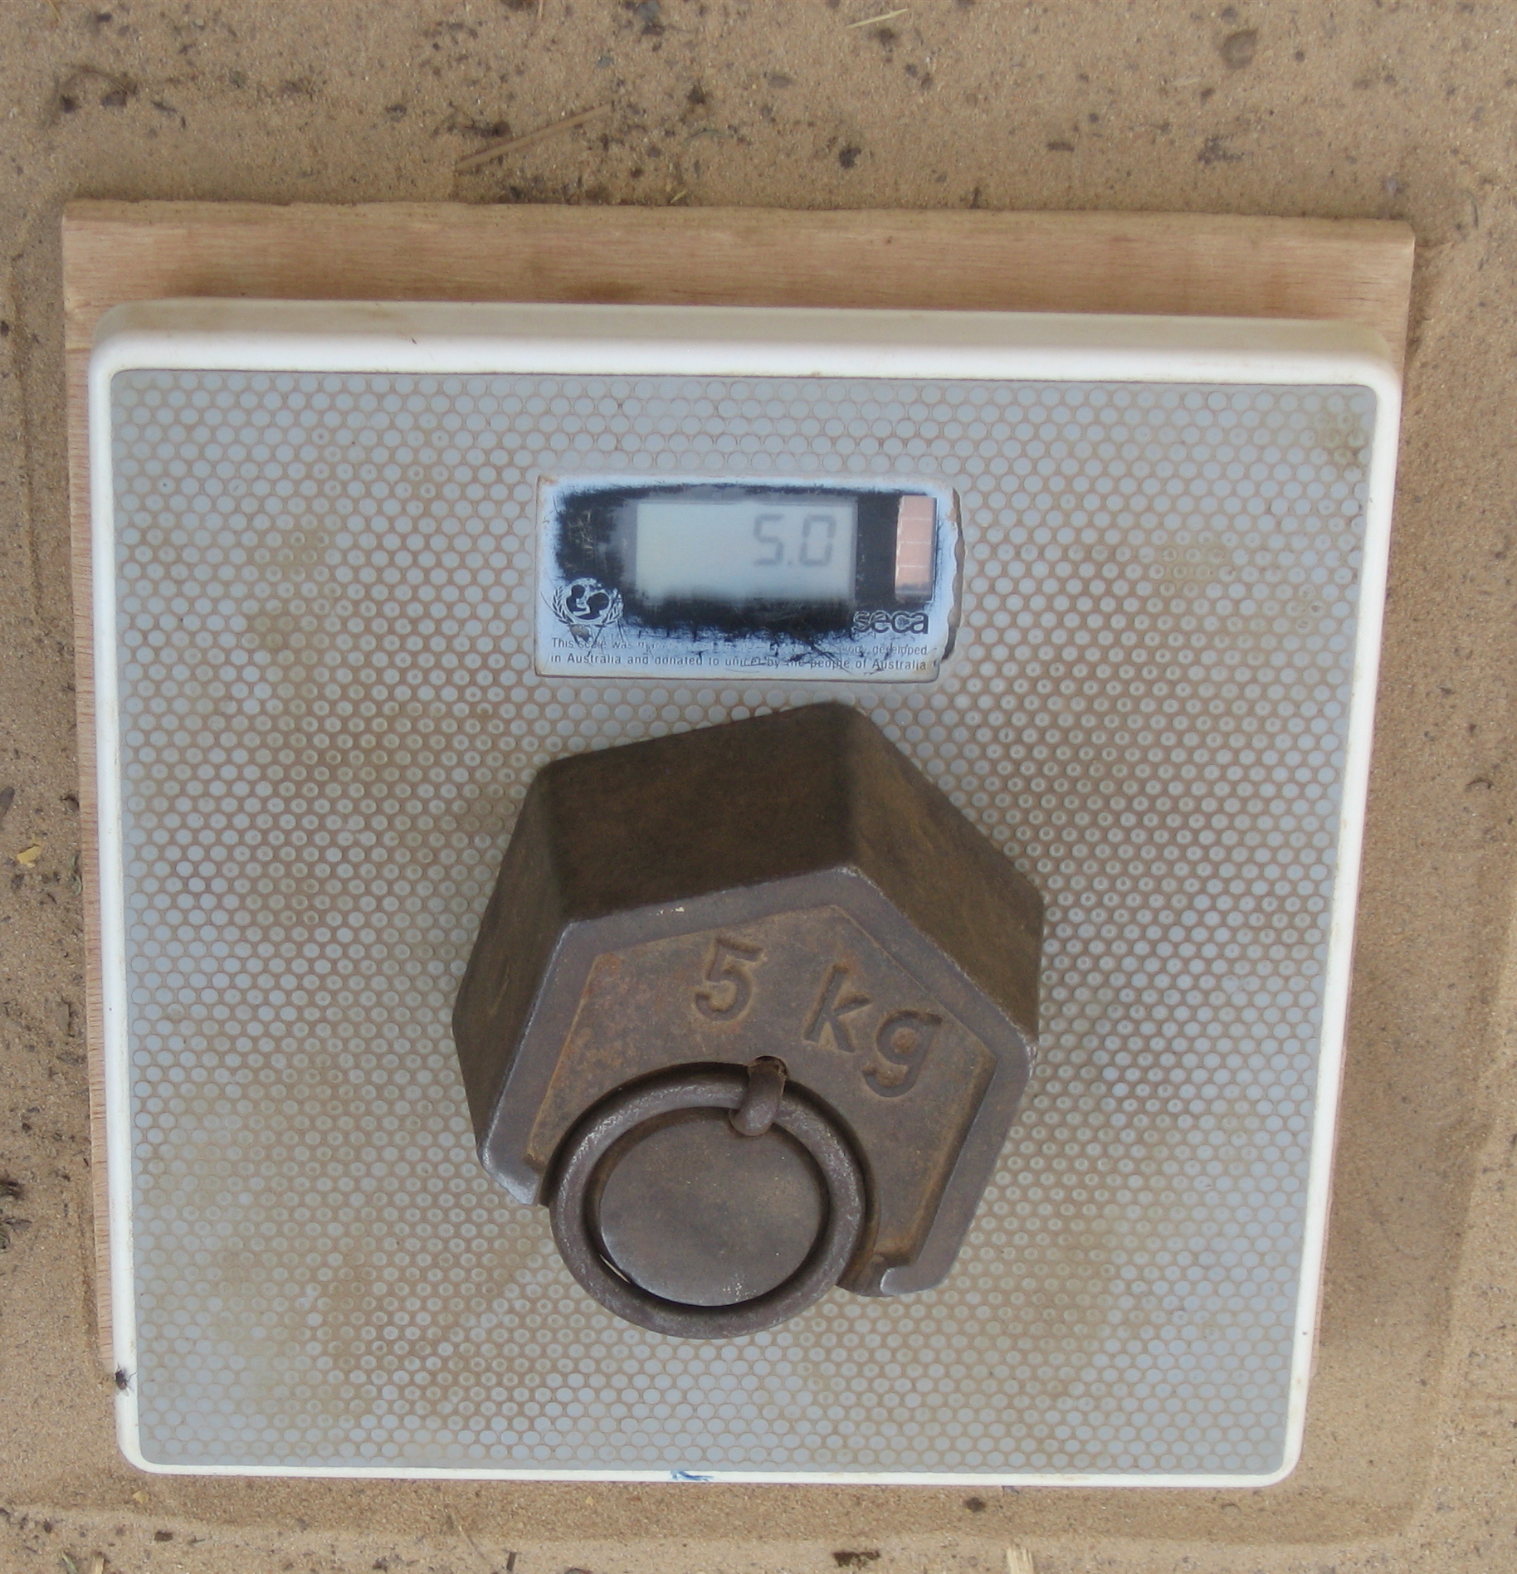
Measuring Weight
  Each day calibrate the scale with the standard weight
  Always explain the weighing procedure to the mother
  The child should be weighed completely naked → Ask for the mother’s authorization to undress the child
  Record the weight in kilograms to one digit to the right of the decimal point

Slide 18
Clothes
All children will be weighed without clothes
It is very important that all teams consistently weigh children the same way
If and only if the mother/caregiver categorically refuses to undress the child, the weight can be taken with light clothes
The team leader will put “Yes” to the next question about the clothes in the child questionnaire (“Was the child dressed during weight measurement?”)
Notes:
Variable « CLOTHES » is an optional SENS variable. Refer to Module 2 Anthropometry and Health for more details.

Slide 19
HEIGHT / LENGTH

Slide 20
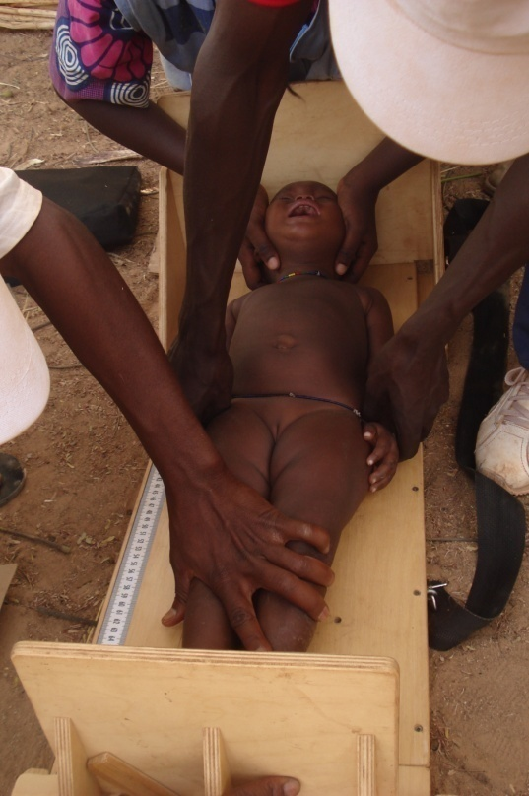
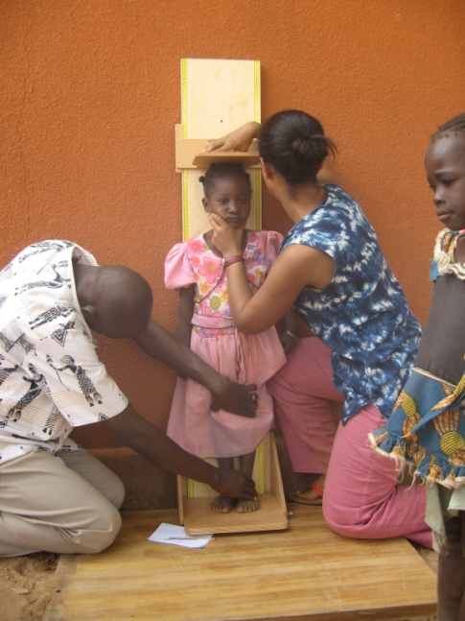
Height Cut-offs
  Children who will be less than 87.0 cm, standing height will be measured lying down
  Children who will measure 87.0 cm or more, will be measure standing

Slide 21
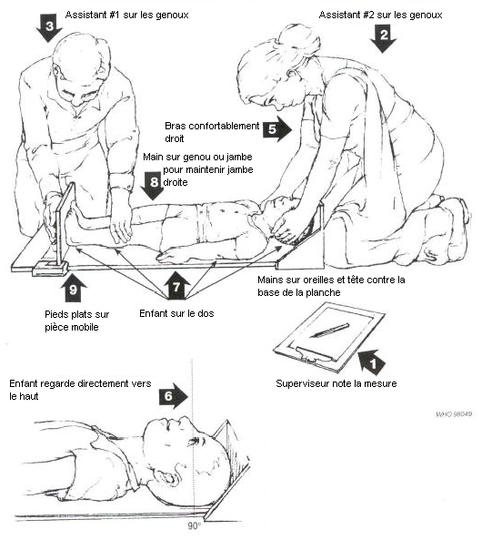
Mesuring Length (<87.0 cm) (1/3)

Slide 22
Mesuring Length (<87.0 cm) (2/3)
Place the board horizontally on a flat and solid surface.
Assistant kneels with both legs behind the base of the board.
With the mother’s help, lay the child on the board with his/her feet on the sides of the cursor.
Ask mother to kneel close to the other side of the board, facing the Measurer, so that the child remains calm.
Assistant puts his/her hands over the child’s ears. Place the child’s head against the base of the board so that the child looks upwards.
The child’s line of vision should be perpendicular to the ground. Assistant’s head should be straight, above the child’s head. Assistant looks straight in the child’s eyes.

Slide 23
Mesuring Length (<87.0 cm) (3/3)
Ensure that the child is laid down and that he/she is in the centre of the board.
Measurer places his/her left hand on the child’s knees and firmly pushes him/her against the board. With his/her left hand, he /she hold the cursor firmly against the child’s heels.
Measurer and Assistant verify the child’s position → Repeat any necessary step.
Once the child’s position is correct, Measurer will read the measure out loud to the nearest 0.1 cm (1 mm).
Team leader repeats the measurement out loud, and records it in the questionnaire.

Slide 24
Roles
Measurer
  Kneel beside child’s feet on the child’s right
  Place left hand on child knees to ensure legs remain straight
  Ensure that feet are FLAT against the cursor
  Take the reading
Assistant
  Kneel at top of child’s head
  Gently but firmly holds both sides of child’s head and ensures child is looking straight up towards the sky
Team leader
  Record the reading

Slide 25
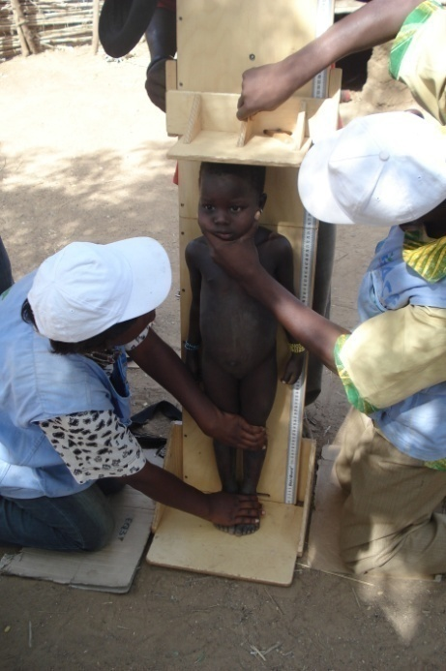
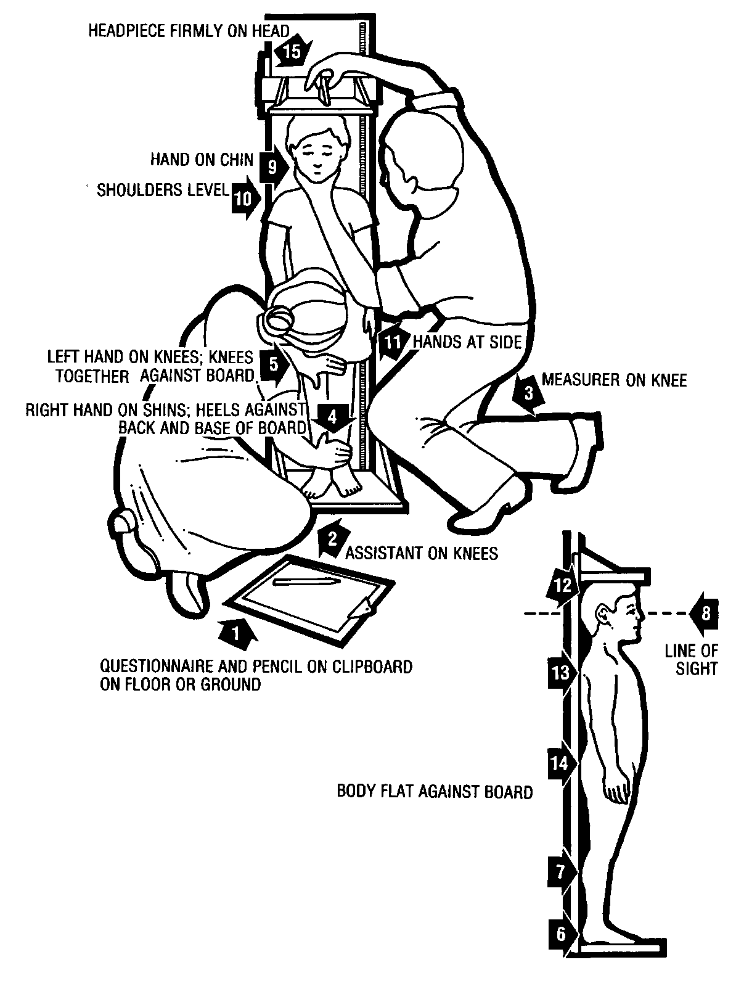
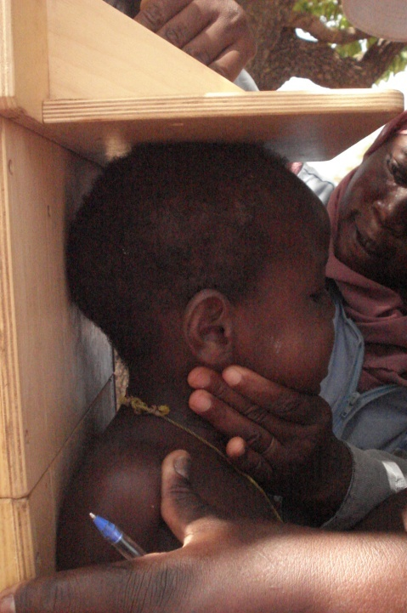
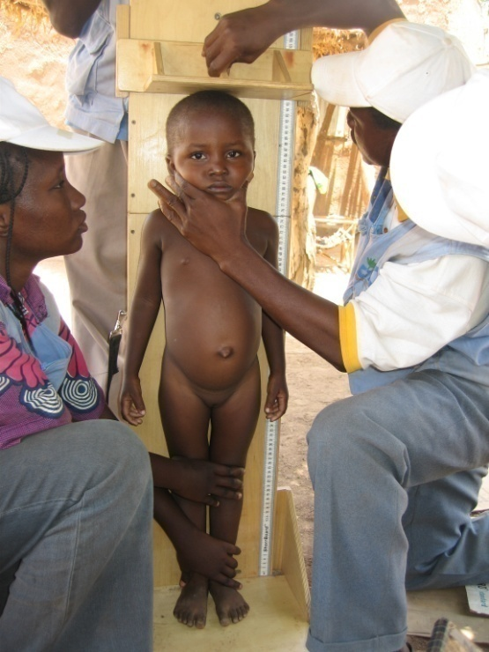
Measuring Height (≥87.0 cm) (1/3)

Slide 26
Measuring Height (≥87.0 cm) (2/3)
Place the board on a plane and solid surface against a wall, a table or a tree → Ensure that the board does not move.
Ask the mother to take the child’s shoes off and to undo the node or hair style that could interfere with the height measurement. Ask her to bring the child to the board and to kneel in front of the child.
Assistant kneels with both legs beside the child.
Assistant puts the child’s feet flat and joined at the centre and against the back and base of the board.
Assistant puts his/her right hand just over the child’s ankles on the tibias and his/her left hand on the child’s knees and push against the board → Child’s legs are straight, heels and calves are against the board.
Assistant informs the Measurer when he/she has finished positioning the feet and legs.

Slide 27
Measuring Height (≥87.0 cm) (3/3)
Measurer tells the child to look straight ahead towards his/her mother → Ensure that the child’s line of vision is parallel to the ground.
Measurer puts his/her left hand on the child’s chin (not cover the child mouth or ears).
Measurer ensures that the child’s shoulder are at the same level, hands on the side, and the head, the shoulder blades and the buttocks are against the board.
With his/her right hand, Measurer lower the cursor on the child’s head.
Measurer and Assistant verify the child’s position → Repeat any necessary step
Once the child’s position is correct, Measurer will read the measure out loud to the nearest 0.1 cm (1 mm).
Team leader repeats the measurement out loud and records it in the questionnaire.

Slide 28
Roles
Measurer
  Kneels beside child’s head on the child’s right
  Left hand gently but firmly holds the child neck/jaw straight and ensures that the child is looking straight ahead
  Check to see that heels, calves, buttocks, shoulders, and head are touching the height board
  Right hand on cursor and slowly lowers it so that is touching the child’s head
  Takes the reading

Slide 29
Roles
Assistant
  Kneels beside child’s feet on the child’s left
  Place right hand on ankles and left hand on knees to ensure that the two legs are touching each other as well as the back of the height board
Team leader
  Record the reading

Slide 30
Say the measurements out loud
Measurer: READ
Assistant: LISTEN
Team leader: REPEAT AND RECORD

Slide 31
Common Mistakes
Measuring children standing up is much easier. Length is much more difficult to measure than height
Common mistakes measuring Length
  Toes pointed
  Knees bent
  Head lifted off the board
Common mistakes measuring Height
  Child leaning to one side
  Heels not touching the board
  Hands not at side

Slide 32
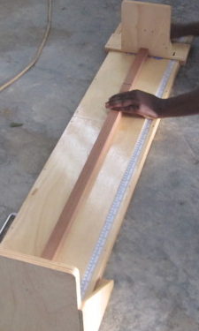
Measuring Height
Each day calibrate the height board with the wooden dowel (110.0 cm)
Always explain the height measurement procedure to the mother
Ask the mother to take the child’s shoes off and to undo the node or hair style that could interfere with the height measurement
Verify the child’s position → Repeat certain step if necessary
Record the height in centimeters to one digit to the right of the decimal point

Slide 33
Mid upper arm circumference (muac)

Slide 34
Measuring MUAC
Always look for bends or kinks in the MUAC tape everyday
→ New MUAC tape every 2-3 days
Always explain the procedure for the measurement of MUAC to the mother
Measures amount of soft tissue in the arm, reflects muscular density
Measurements taken on the left arm
Record the MUAC in millimeters

Slide 35
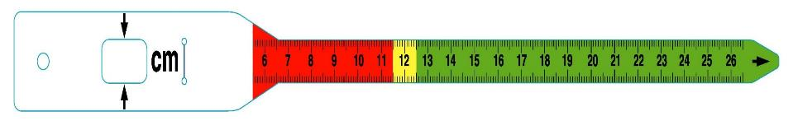
MUAC Tape
Align end of shoulder here
Pull MUAC through here
Feed the tape through the small hole. Read the measurement in the big hole (window)
Read MUAC here

Slide 36
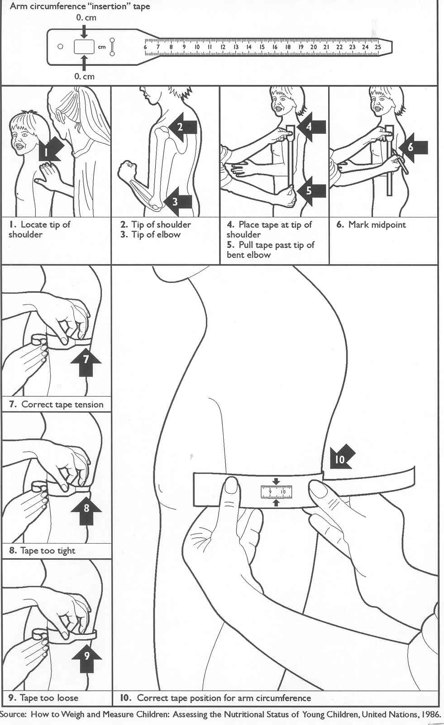
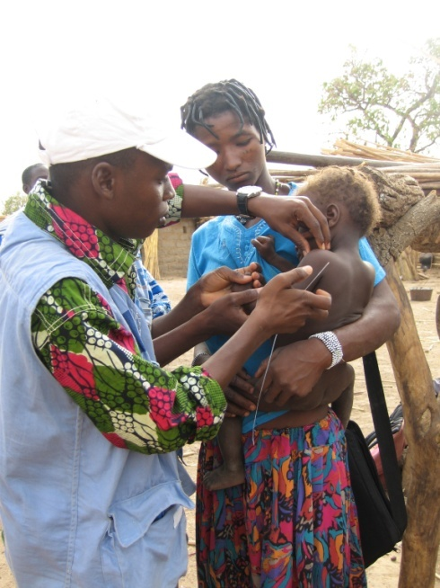
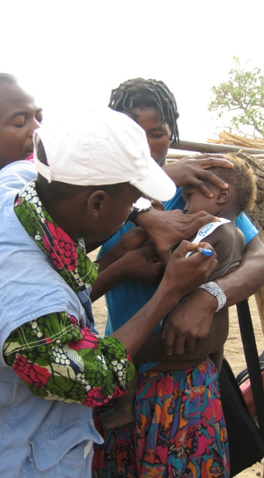
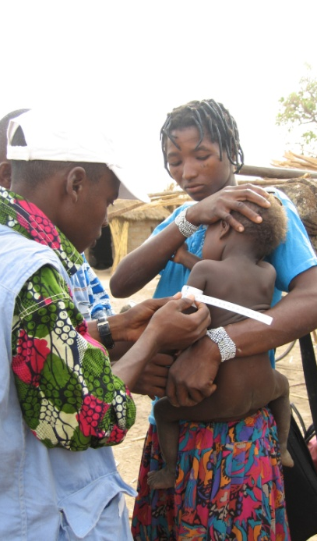
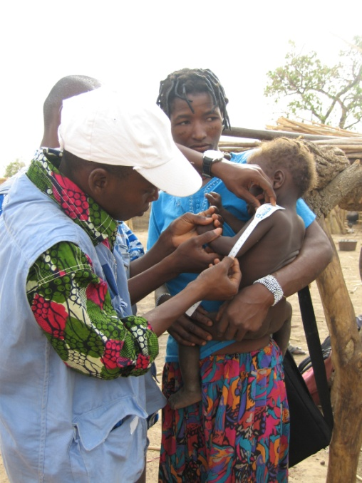
Measuring MUAC (1/3)

Slide 37
Measuring MUAC (2/3)
Describe to the mother the procedure for the measurement of MUAC.
If possible, the child should stand erect and sideways to the Measurer.
Bend the child’s left arm at 90 degrees to the body.
Place the measuring tape along the upper arm and find mid-point of the upper arm → Between the tip of the shoulder and the elbow.
Mark the mid-upper arm point with a pen.
Let the left arm relaxed at the side of the body.
Place the MUAC tape window (0 cm) on the mid-point.

Slide 38
Measuring MUAC (3/3)
While keeping the left hand planted, wrap the MUAC tape around the outside of the arm with the right hand.
Plant the right hand and feed the MUAC tape through the hole in the tape while keeping the right hand planted on the arm.
Pull the tape until it fits securely around the arm while keeping the right hand planted.
Measurer reads the measurement at the window of the tape to the nearest millimeter (mm).
Team leader repeats the measurement out loud and records it in cm in the questionnaire.

Slide 39
Say the measurements out loud
Measurer: READ
Assistant: LISTEN
Team leader: REPEAT AND RECORD

Slide 40
Common Mistakes
Measuring MUAC on the right arm
Estimating (rather than measuring) the mid-point of the upper arm
Bending the MUAC tape when measuring the mid-point
Not measuring the mid-point from the tip of the shoulder to the elbow bend
Pulling the MUAC tape too tight
Not pulling the MUAC tape tight enough (too slack)
Not reading the tape accurately (to nearest mm)

Slide 41
Bilateral edema

Slide 42
Bilateral Edema (1/3)
Edema results from an accumulation or an excess of extra-cellular fluid in the body due to severe nutritional deficiencies
Edema must be present in both feet → Bilateral Edema
If the child’s body appears swollen, ask the mother if the swelling begin in the feet. If the swelling did not begin in the feet, it is not bilateral edema

Slide 43
Bilateral Edema (2/3)
Describe to the mother the procedure for the assessment of edema and ask the child to sit on a chair or on their caretakers lap.
Hold child’s feet with both hands at the same time.
Apply pressure (hard pressure is not necessary) with the thumbs on the top part of both feet.
Hold the feet for 3 seconds (Count slowly 1001, 1002, 1003).
Release both feet and assess if the imprint of the thumbs remains for a few seconds on the top of the both feet.

Slide 44
Diagnosing Bilateral Edema: Thumb Pressure Test

Slide 45
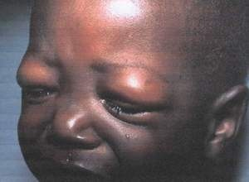
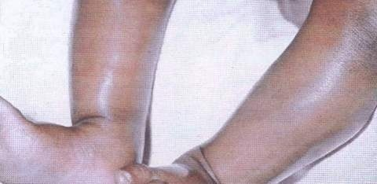
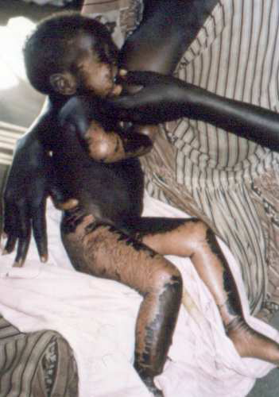
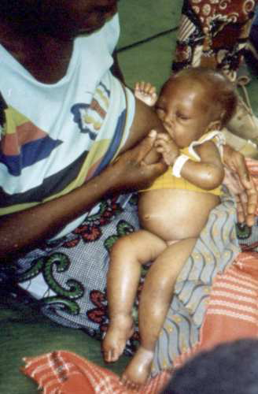
Bilateral Edema (3/3)
Edema is a VERY RARE event
Most common source of errors → Be careful of misclassifying edematous child
Supervisors should confirm edema (picture)
Edema is a form of severe acute malnutrition (referral form filled out)

Slide 46
Common Mistakes
Testing for edema on only one foot
Pressing thumbs to hard which can cause unnecessary pain to the child
Not pressing the thumbs in the correct place on the top of the foot

Slide 47
Tips for measuring children
If there is more than one eligible child in the household, measure the less ‘difficult’ child first
Explain the procedure to the mother and ask the mother’s authorisation to undress the child
To avoid the scales wobbling when placed on uneven ground, they should be stood on a flat wooden board

Slide 48
Exercise: find the errors

Slide 49
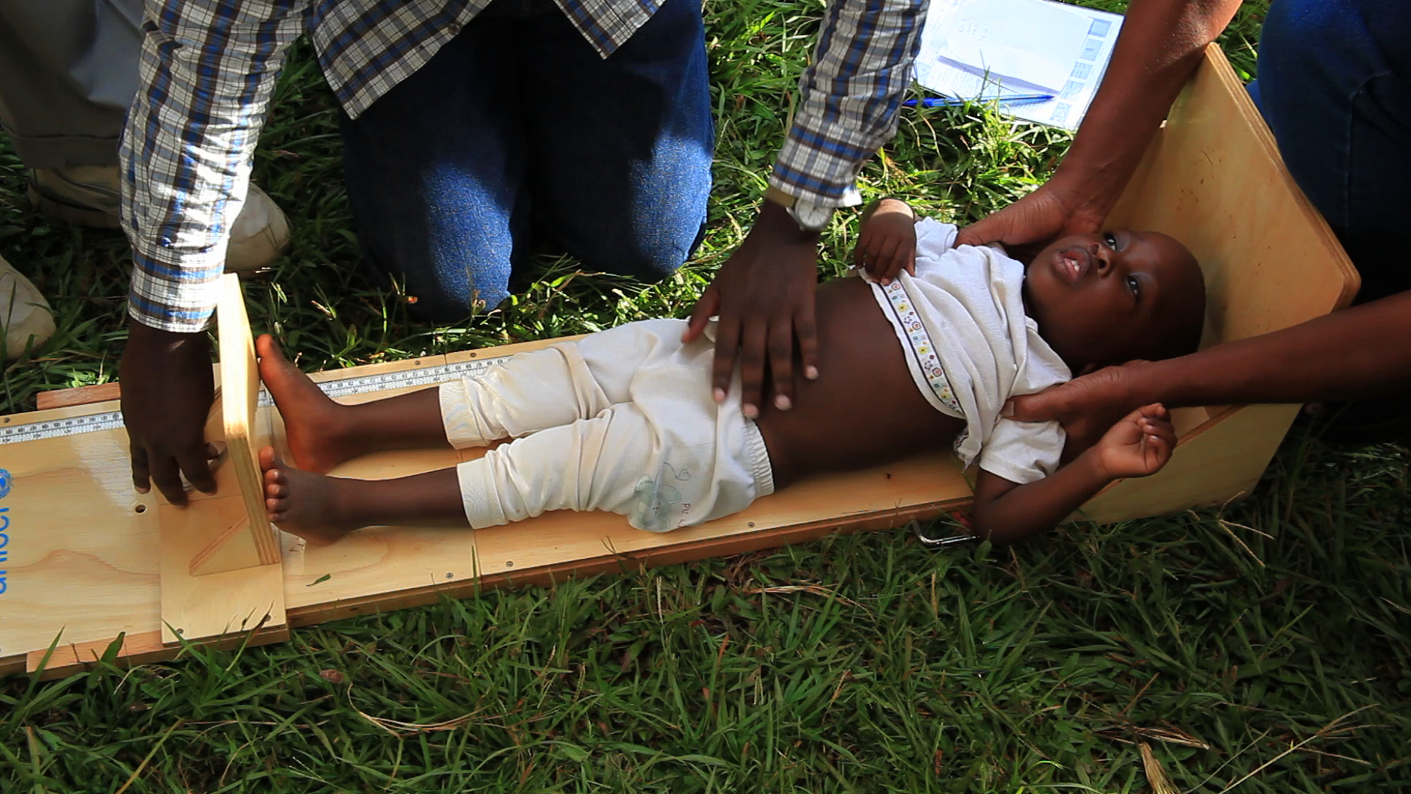
Notes:
Notes for trainers:
The position of the assistant’s hands are inappropriate. The hands should be cupped over ears and the head of the child should be against the base of the board.
The measurer’s hand is supposed to be on the child’s knees.
The measurer is supposed to push the foot piece against the child’s feet.
The measurer is supposed to be placed in parallel to the foot piece.
49

Slide 50
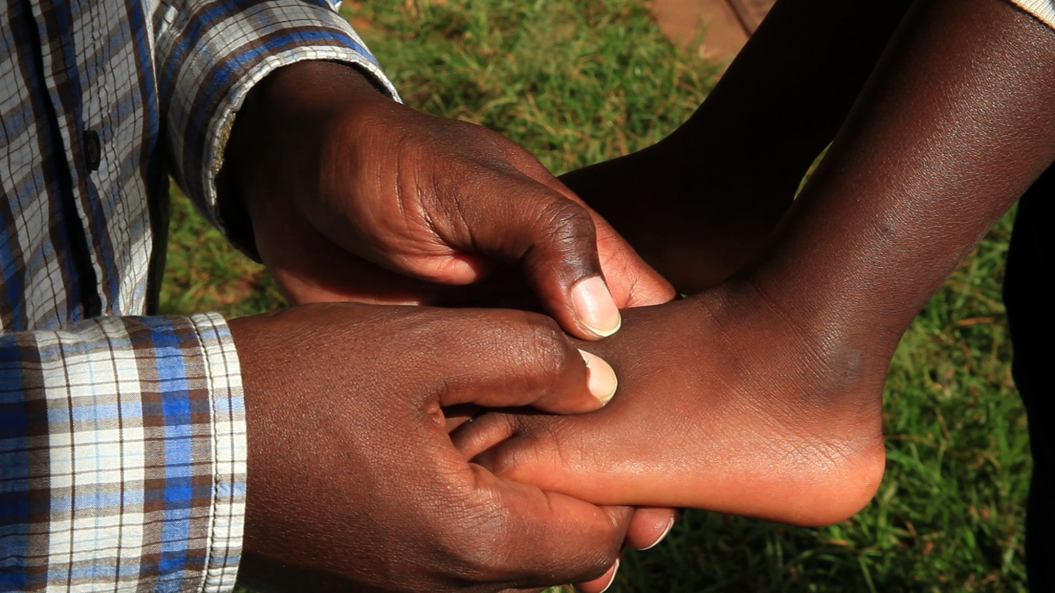
Notes:
Notes for trainers:
The surveyor is only checking one foot for edema.
50

Slide 51
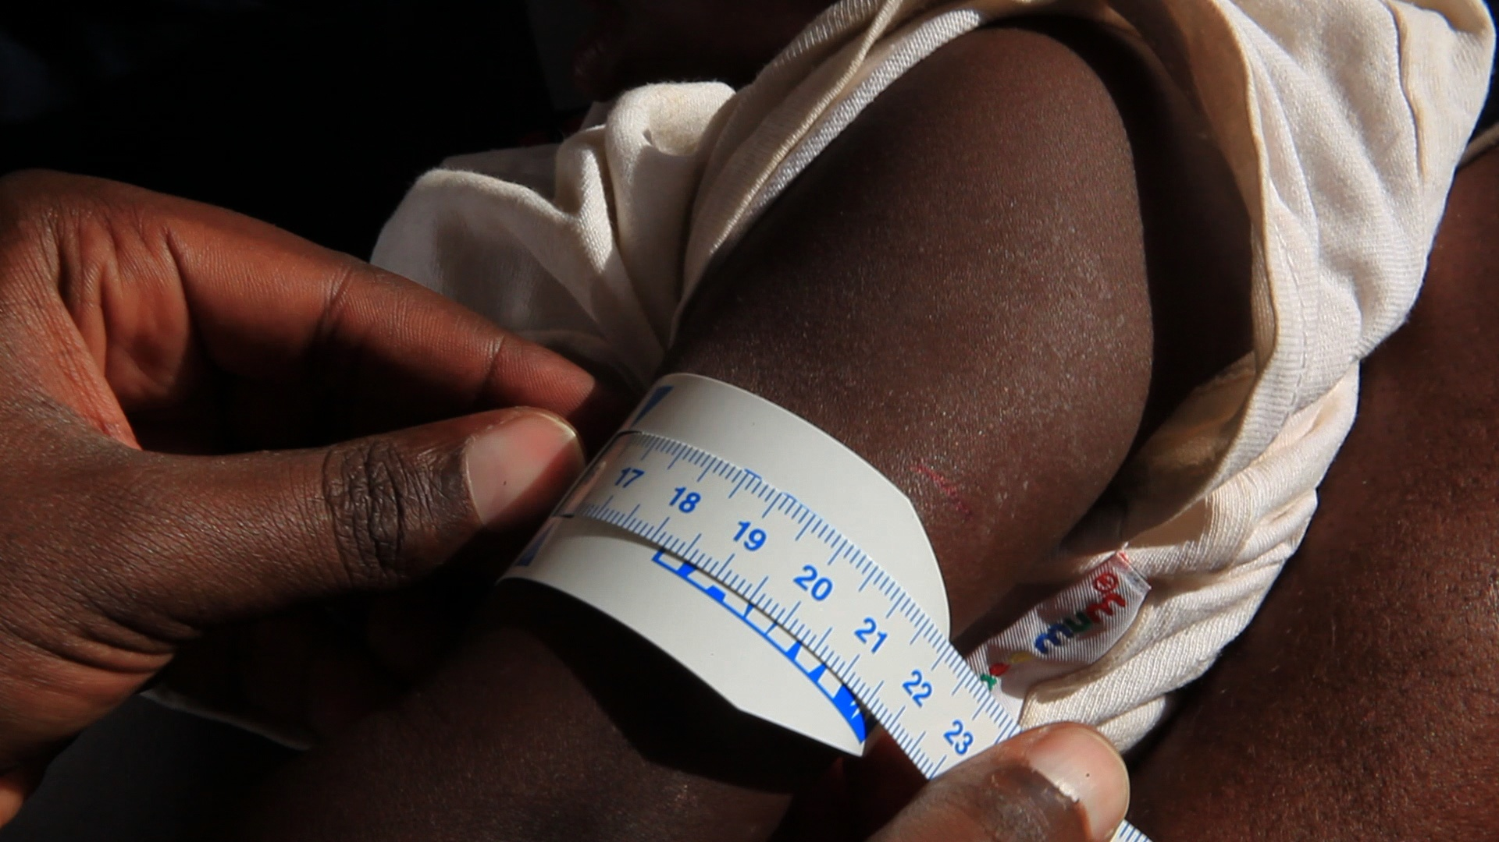
Notes:
Notes for trainers:
The MUAC tape is too loose.
51

Slide 52
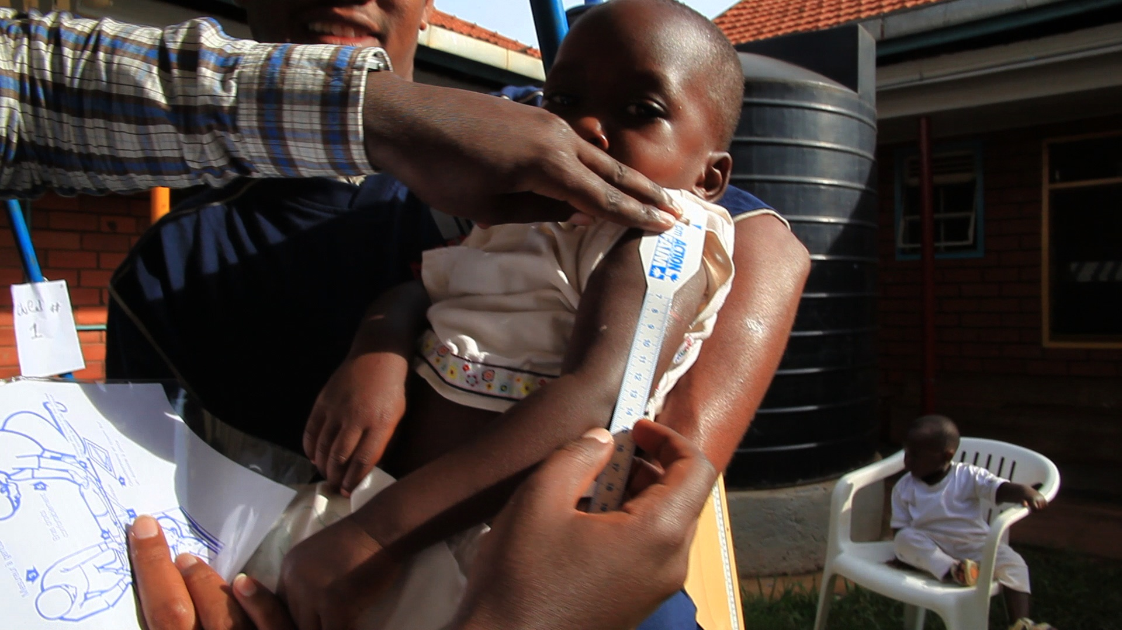
52
Notes:
Notes for trainers:
The measurer is trying to find the mid point on the upper arm of the child without having the child’s arm bent at 90 degrees.
52

Slide 53
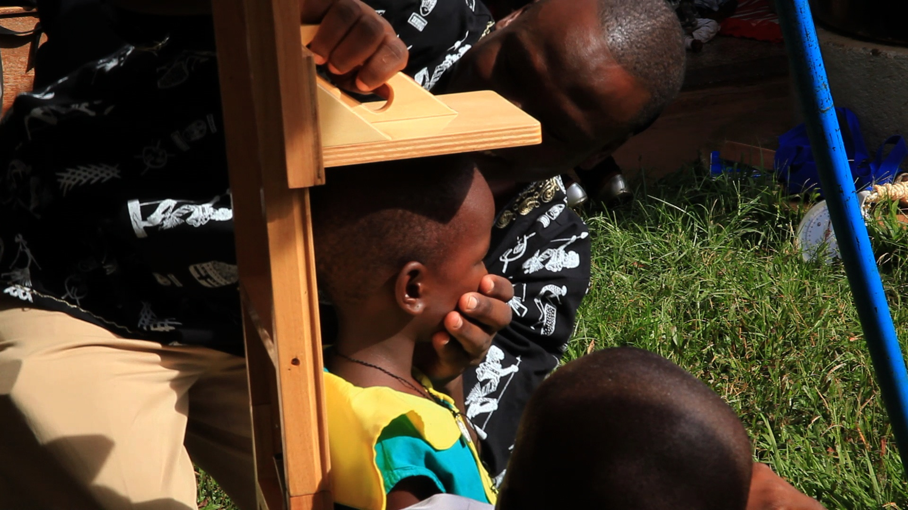
Notes:
Notes for trainers:
The surveyor’s hand is placed on the child’s mouth.
53

Slide 54
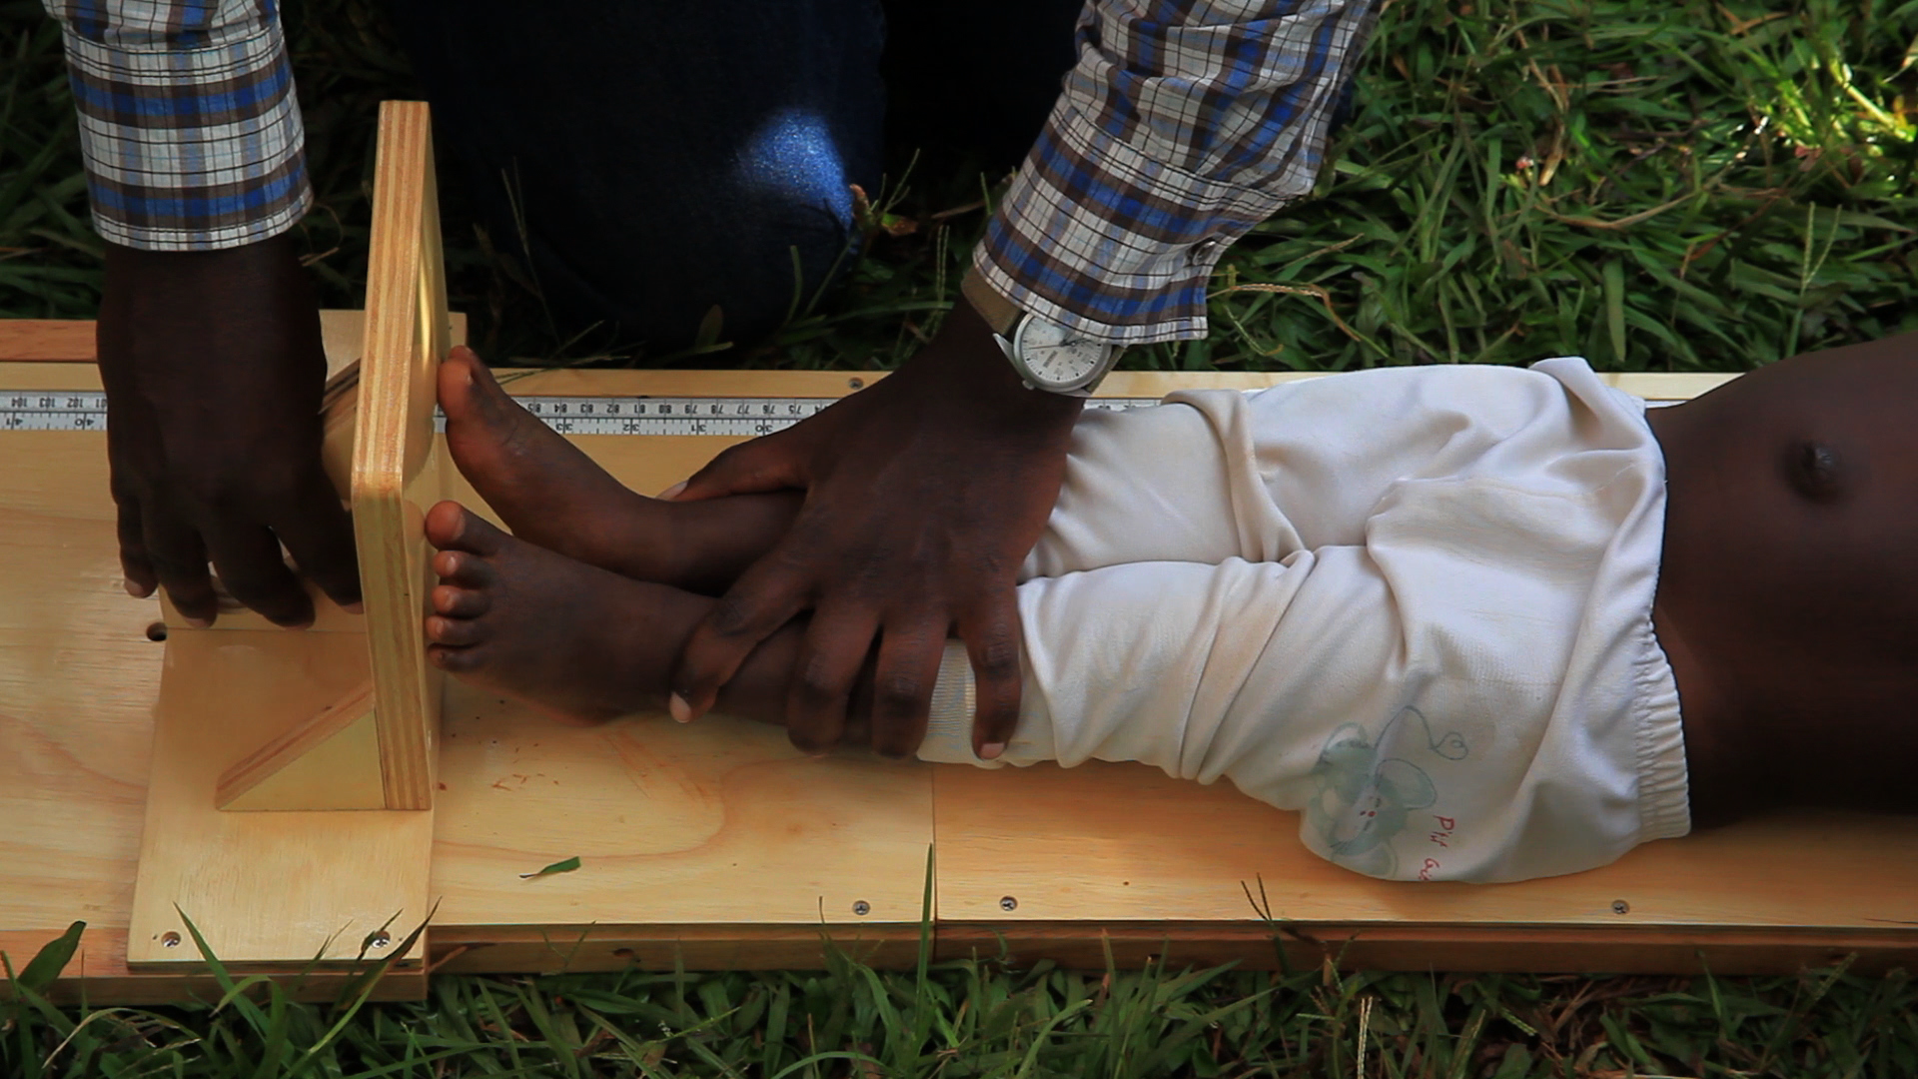
54
Notes:
Notes for trainers:
The position of the feet is inappropriate. The soles of the feet are supposed to be flat against the footpiece. Also, the hands of the measurer should be placed on the child’s knees.
54

Slide 55
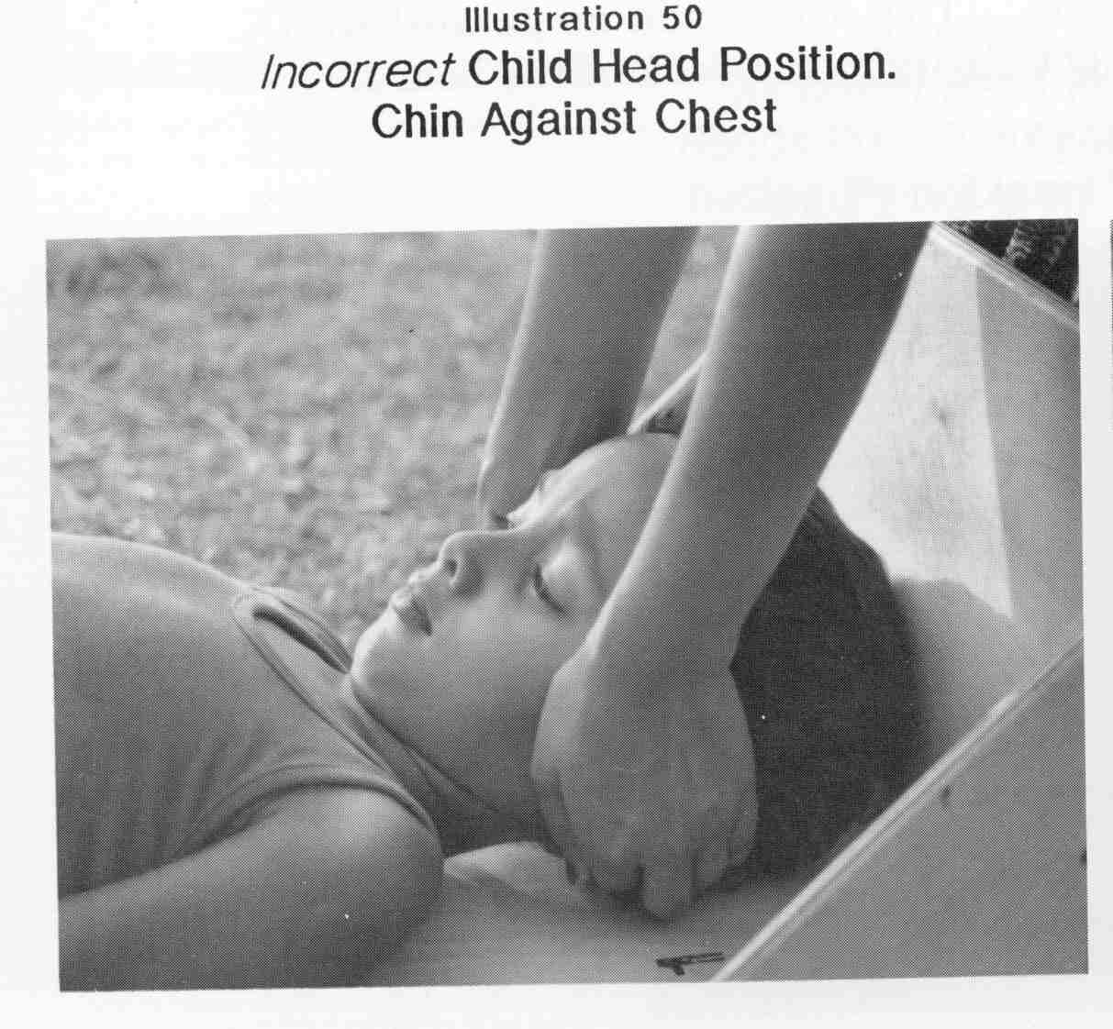
Notes:
55

Slide 56
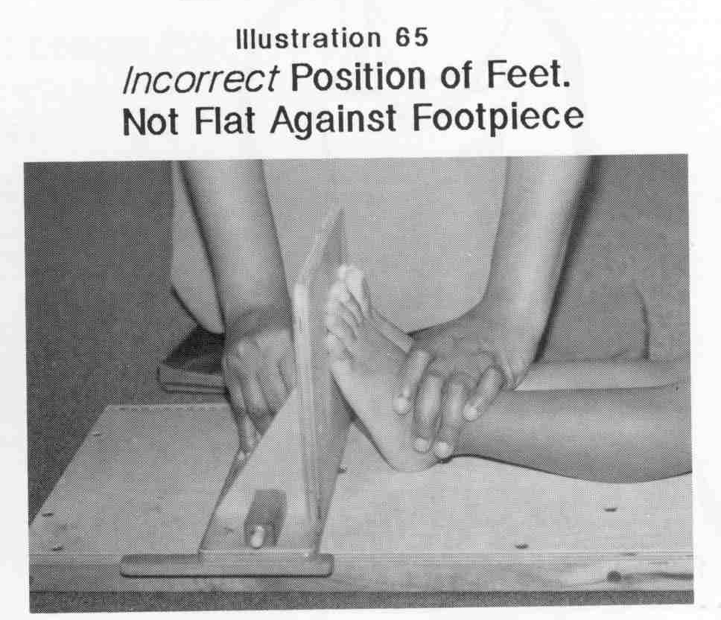
Notes:
56

Slide 57
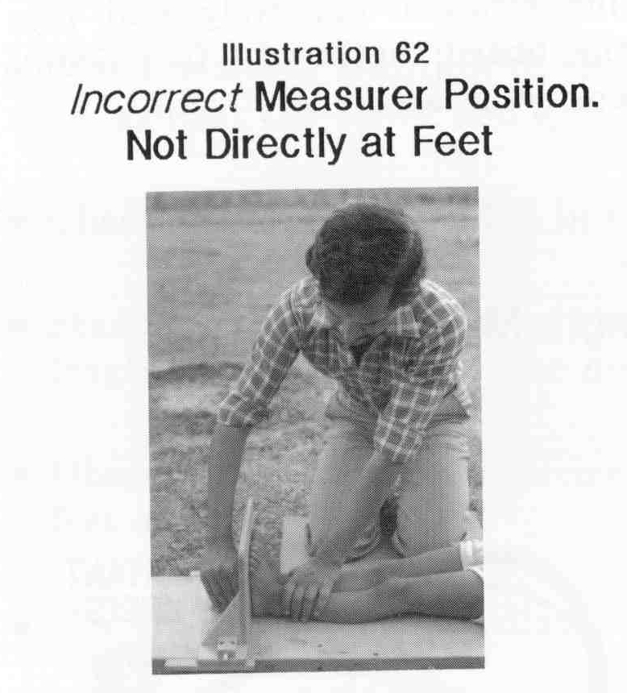
Notes:
57

Slide 58
ANY Question?
Discussion

Slide 59
THANK YOU
FOR LISTENING!
[LOGO PARTNERS]

