Slide 1
SENS Surveys
[Camp/Setting names]
Region, Country - Time frame
Survey Training
[PLACE, DATES]
[LOGO PARTNERS]

Slide 2
Session 4
  Standardization of anthropometric equipment
  Organization of the standardization test

Slide 3
To ensure high data quality…
Standardization of the anthropometric equipment
  Everyday during the survey before to start anthropometric measurements and data collection
Standardization of the enumerators

Slide 4
Standardization of anthropometric equipment

Slide 5
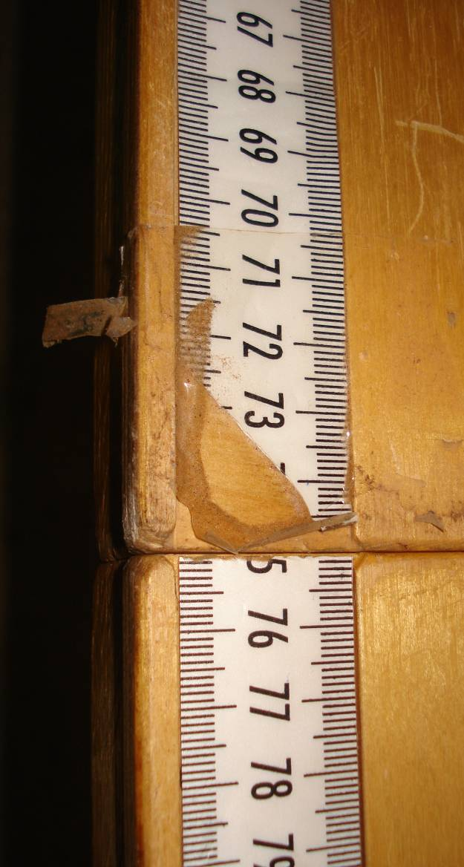
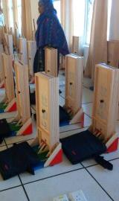
Standardization of equipment (1/3)
Ensure all anthropometry equipment is functioning and not broken
Before the standardization test → Label each piece of equipment with a distinct number
  Scales #1, #2,…
  Height boards #1, #2,…
  MUAC tapes

Slide 6
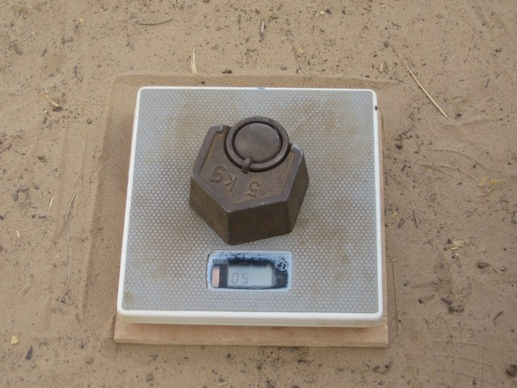
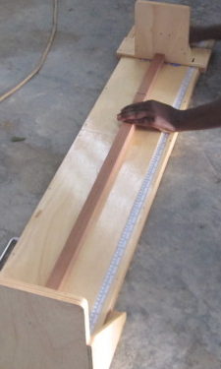
Standardization of equipment (2/3)
Everyday before data collection, test the precision of all equipment in use
Measure each height board with a wooden stick of 110.0 cm
Measure each scale twice with a standard weight
New MUAC tapes every 2-3 days

Slide 7
Standardization of equipment (3/3)
Record everyday each measure of standard weight or length from each numbered piece of equipment on the Anthropometry quality assurance control sheet
If a tool is broken, damaged or unusable, note the details in the "Remarks" column and replace the tool immediately
Each team will always carry spare equipment in case of problems
If any equipment is found to be not functioning, call the supervisor and request to exchange
Notes:
For a template of the Anthropometry quality assurance control sheet to use and adapt to the refugee setting, see SENS Anthropometry and Health Tool #4

Slide 8
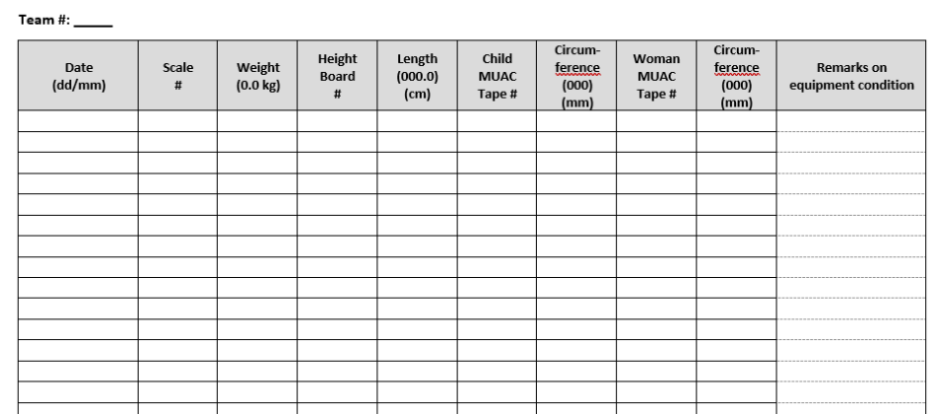
Anthropometry quality assurance control sheet
Notes:
For a template of the Anthropometry quality assurance control sheet to use and adapt to the refugee setting, see SENS Anthropometry and Health Tool #4

Slide 9
OrganiZation of the Standardization test

Slide 10
Standardization Test - Objectives
Assess the PRECISION and the ACCURACY of the measurements taken by each enumerator
To better understand the challenges in taking measurements
Practice makes perfect!

Slide 11
Precision vs. Accuracy (1/2)
Precision = Consistency
Accuracy = Validity
  Obtaining similar results with repeated measures (may or may not be accurate)
  Obtaining results close to true value with repeated measures

Slide 12
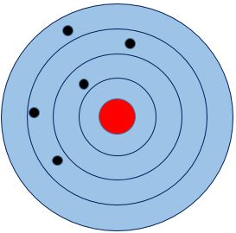
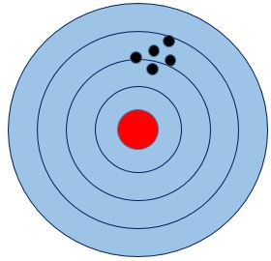
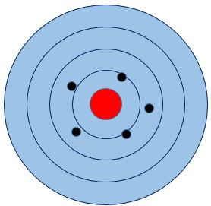
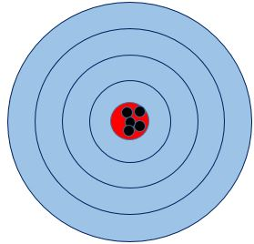
Precision vs. Accuracy (2/2)
Low Accuracy
Low Precision
Low Accuracy
High Precision
High Accuracy
Low Precision
High Accuracy
High Precision

Slide 13
Standardization Test - Principles
Each enumerator takes measurements of 10 children 18-59 months, TWICE, with an interval of time between the 1st and the 2nd measurements
Supervisors will observe how measurements are being taken
Enumerators measurements will be compared to the reference values
Results will be analyzed in the ENA for SMART software

Slide 14
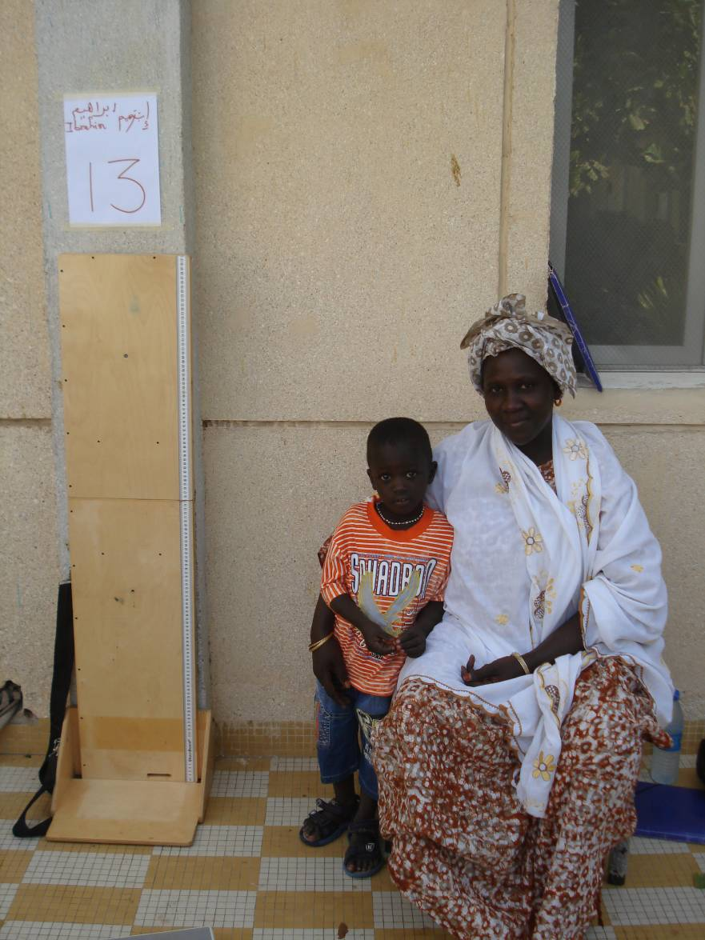
Organization of the test
Each station: 1 couple child/mother, 1 scale, 1 height board & 1 MUAC
Spacious and shady area
10 healthy children between 18-59 months
Each measurements station contains: height board, scale and MUAC tape
Each child must remain with their mother in a fixed station with an ID number
Enumerators are groups into pairs, but each trainee must carry out the measurements in turn. Each enumerator is given an ID
There should only be one pair of enumerators per child at the same time
It is prohibited for pairs of enumerators to speak with other teams during the test

Slide 15
Carrying out the Test (1/2)
Reference person: The reference person carefully weighs and measure each child without allowing the teams to see the values
1st Session: Each team starts with a different child/station. The 1st measurer in the team measures the child and records the results for the 1st measurement. Then, the 1st measurer should move on to the next child
After the 10 children have been measured once by the 1st measurer, the 2nd measurer in the team measures the same 10 children
Break: After the 10 children have been measured once by the all measurers/teams, the teams and the children then take a break
2nd Session: The whole process is repeated after the break

Slide 16
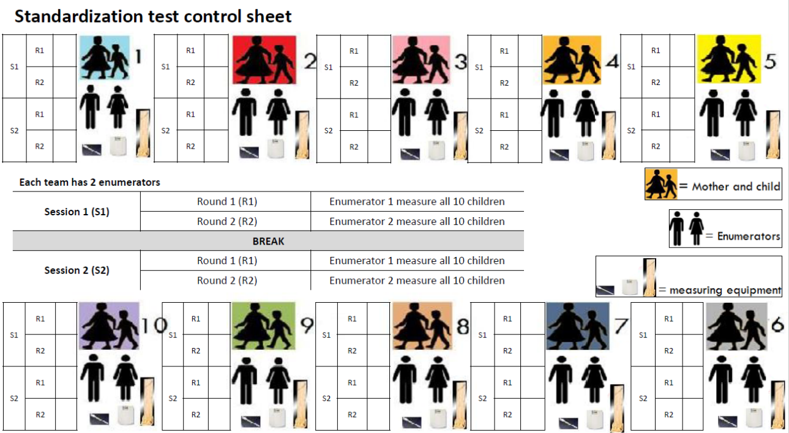
Carrying out the Test (2/2)

Slide 17
ANY Question?
Discussion

Slide 18
THANK YOU
FOR LISTENING!
[LOGO PARTNERS]

