Slide 1
Third Quarterly Informal Briefing on the Global Compact on Refugees
18 October 2023

Slide 2
INFORMATION FOR PARTICIPANTS
Interpretation is available in English and French.
  Select your preferred language using the Interpretation button in Zoom.
  Click ‘ View Options’ at the top of your screen, then in the drop down menu click your chosen language for viewing, either "ENGLISH (UNHCR)" or "FRANCAIS (UNHCR)"
Please indicate your request to speak in the chat box of Zoom:
  Please indicate the name of your Government or Organization as well as your title.
  If you requested in advance to speak, please indicate your presence in the chat box.
Questions for panellists may be posed through the chat box.
Written statements to be posted online can be sent to hqgcr@unhcr.org.
The presentation and summary of the briefing will be made available online at https://www.unhcr.org/events/briefings-and-meetings-2023.
For any technical issues during the meeting, please contact hqgcr@unhcr.org.

Slide 3
AGENDA
Opening remarks and update on Global Refugee Forum preparations
Ms. Perveen Ali, Senior Policy Advisor & Head of GCR Coordination Team, UNHCR
Demonstration of Pledge Submission Form
Mr. Radu Barza, Associate Information Management Officer, UNHCR
Interventions from the floor and Q&A on multi-stakeholder pledges
Closing remarks
Ms. Perveen Ali, Senior Policy Advisor & Head of GCR Coordination Team, UNHCR
Moderator​
Mr. Ziad Ayad, Senior Policy Officer, Global Compact on Refugees Coordination Team, UNHCR

Slide 4
Opening remarks and update on GRF preparations
Ms. Perveen Ali, Senior Policy Advisor & Head of the GCR Coordination Team, UNHCR

Slide 5
Proposed Key Outcomes

Slide 6
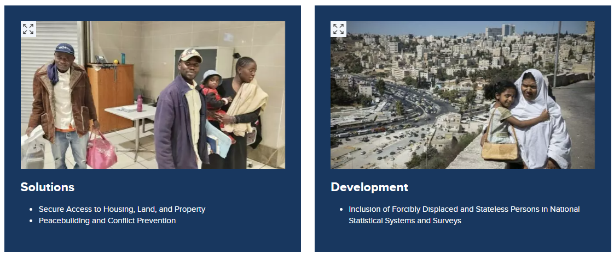
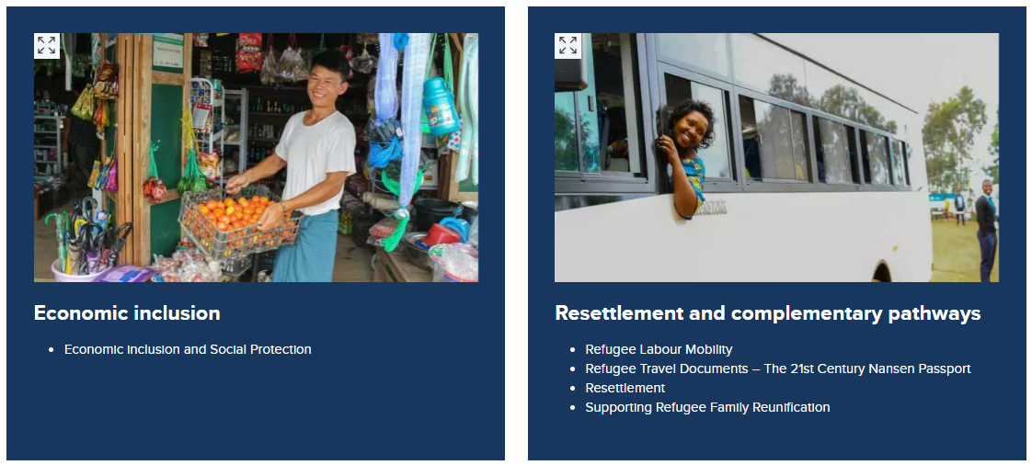


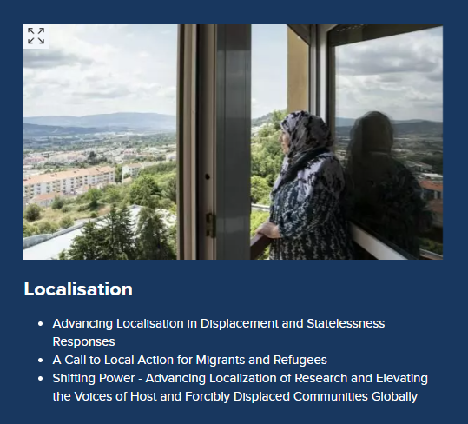
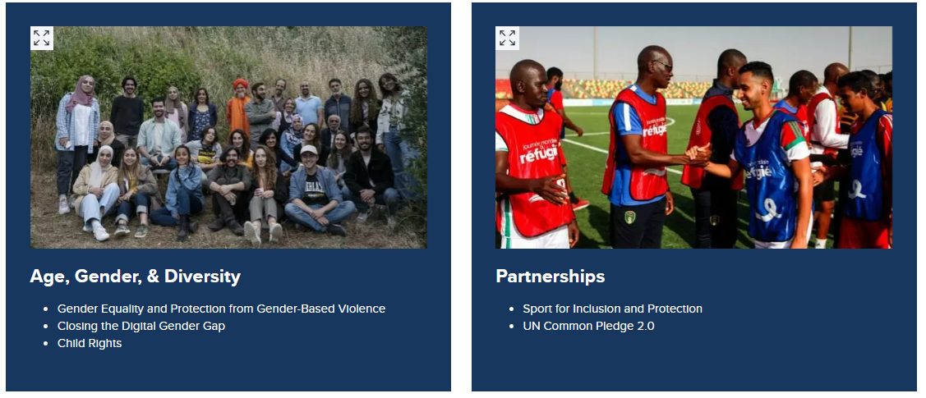
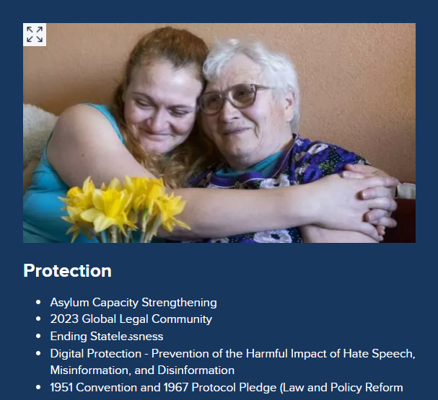
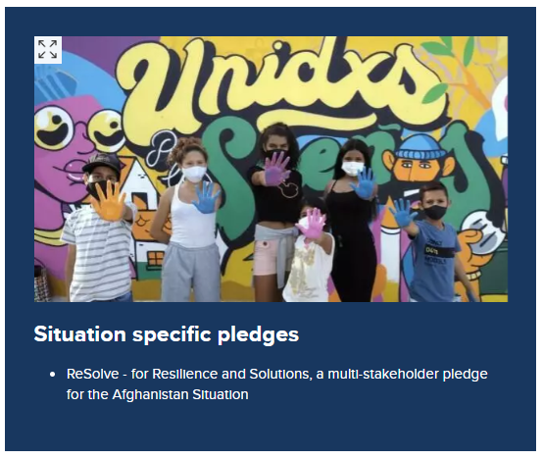
Multi-stakeholder pledges in support of key outcomes
https://globalcompactrefugees.org/pledges-contributions/multistakeholder-pledges-global-refugee-forum-2023

Slide 7
Update on the GRF programme see: https://www.unhcr.org/about-unhcr/overview/global-compact-refugees/global-refugee-forum-2023/programme-overview

Slide 8
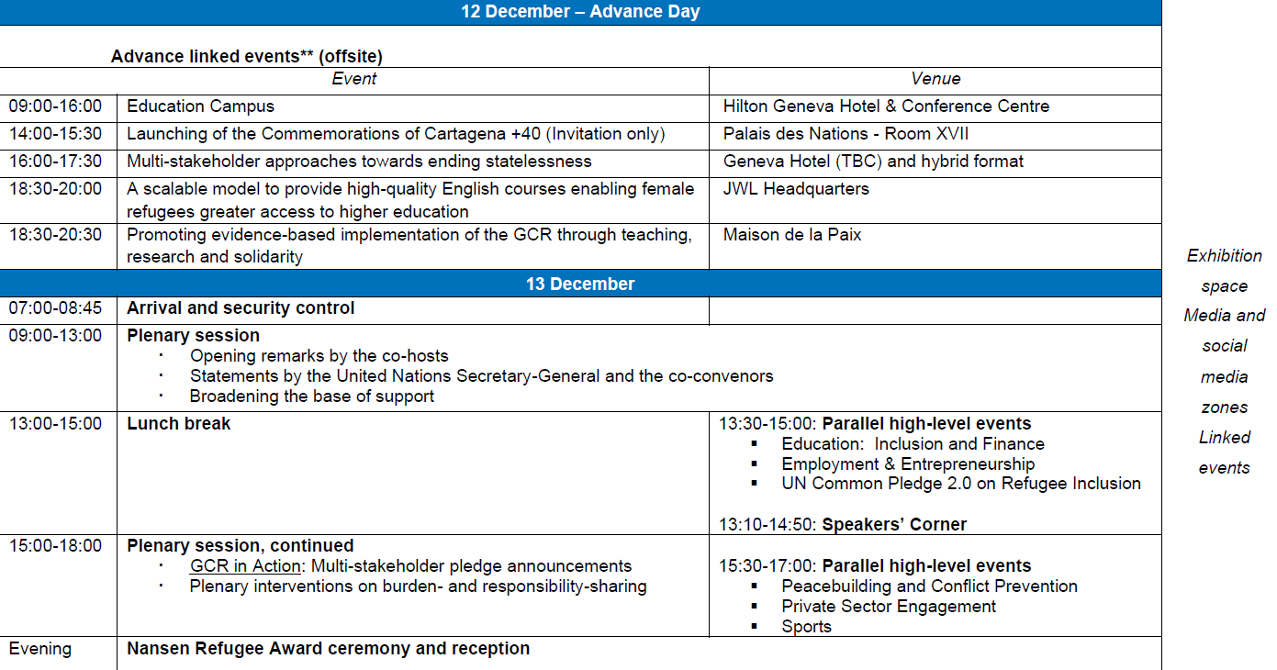

Slide 9
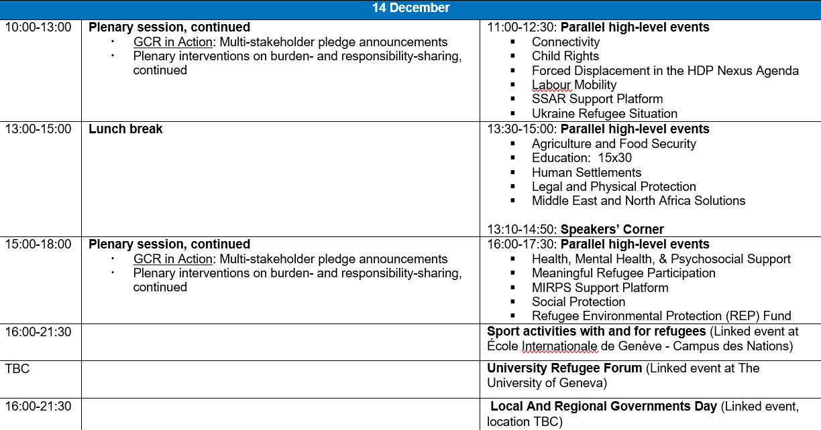

Slide 10
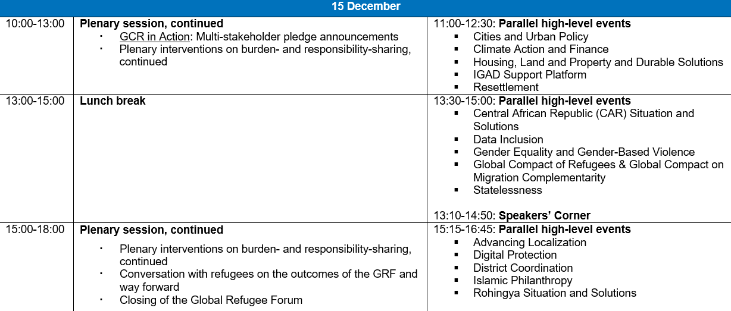

Slide 11

Protocol and Logistics
Information note and details on registration will be posted on https://www.unhcr.org/global-refugee-forum-2023
We advise that delegations plan for no more than 3-5 members to be in the Palexpo at any given time due to the space constraints

Slide 12
Demonstration of Pledge Submission Form
Mr. Radu Barza, Associate Information Management Officer, UNHCR

Slide 13


Slide 15
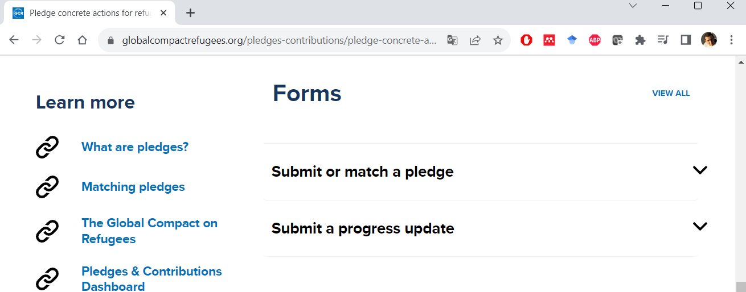

Slide 16
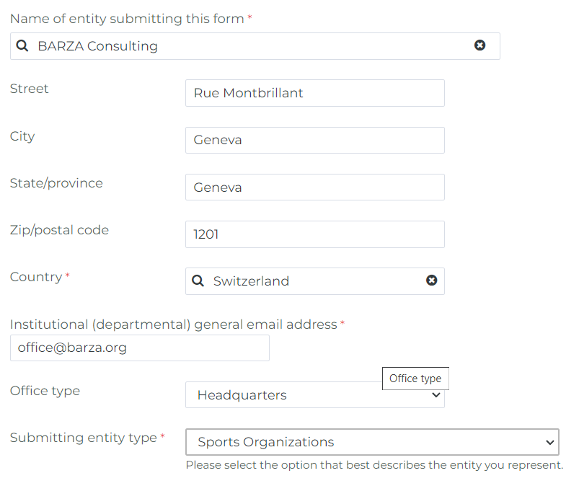
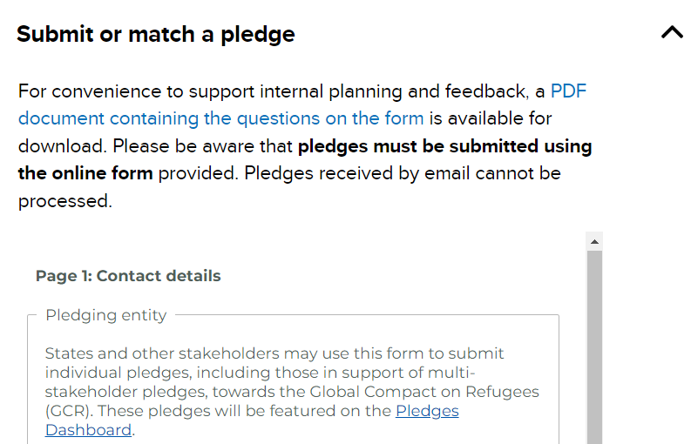

Slide 17
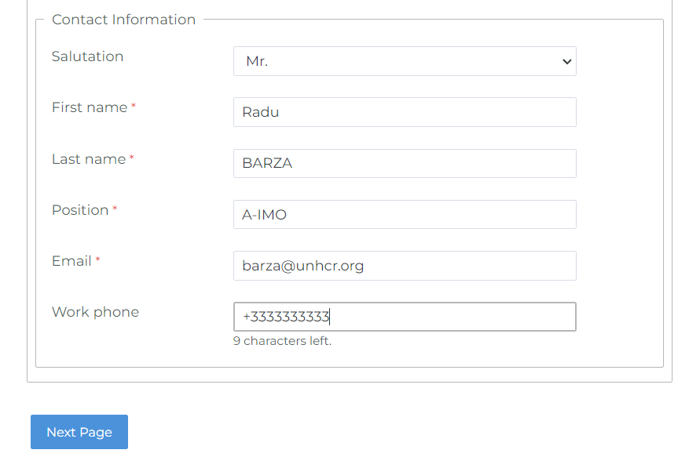

Slide 18
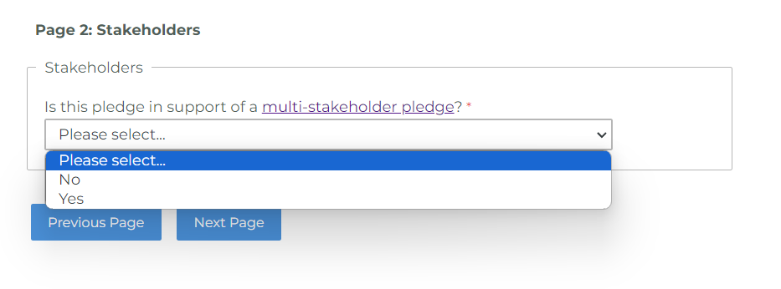
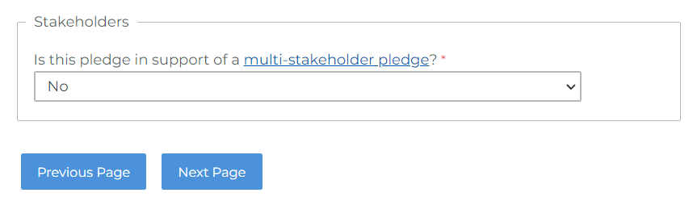

Slide 19
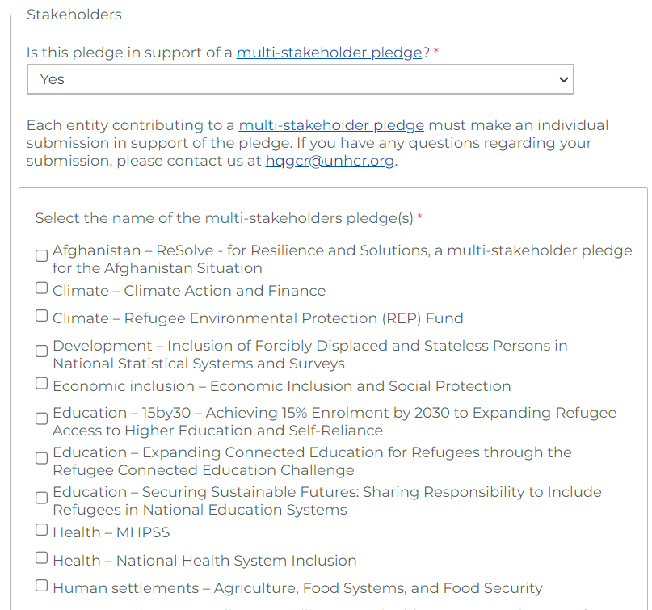
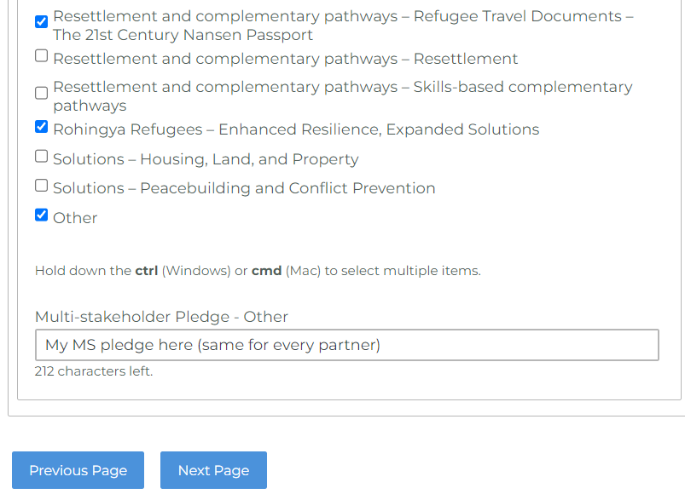

Slide 20
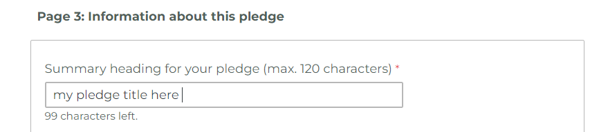
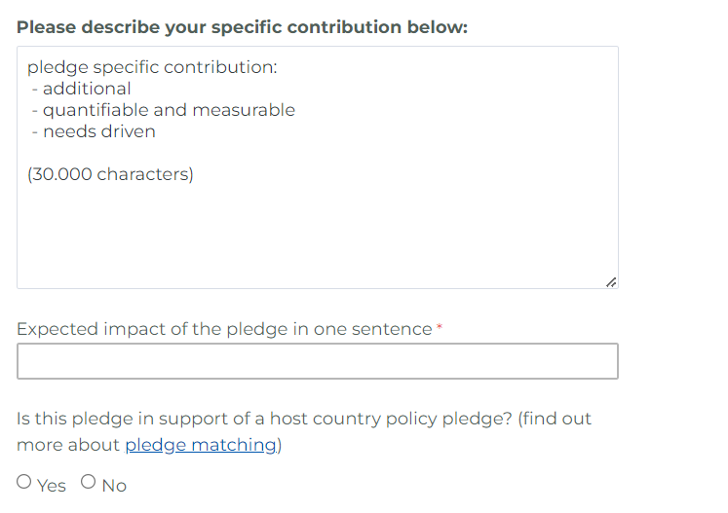
Title: 120 characters

Slide 21
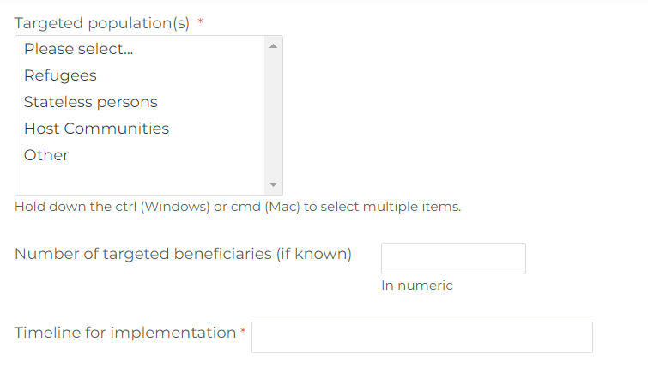

Slide 22
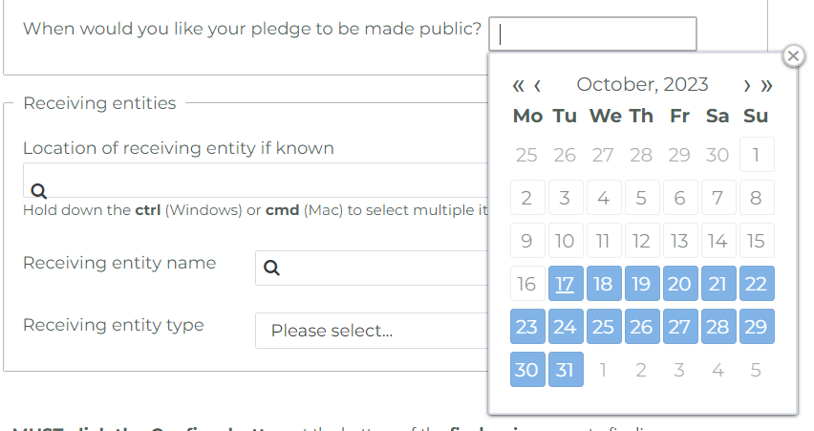

Slide 23
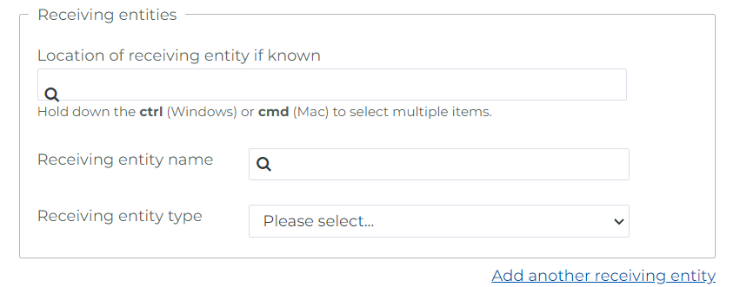

Slide 24
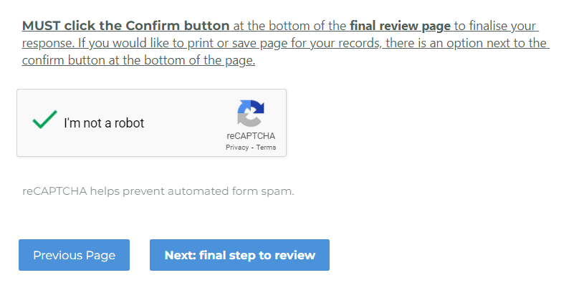

Slide 25
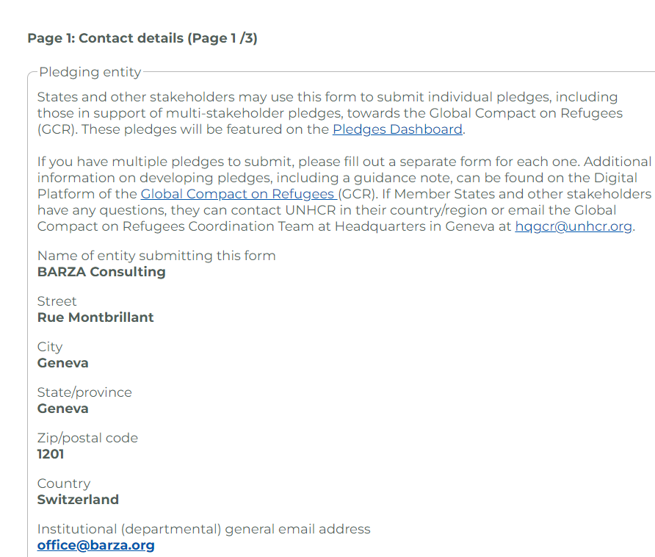
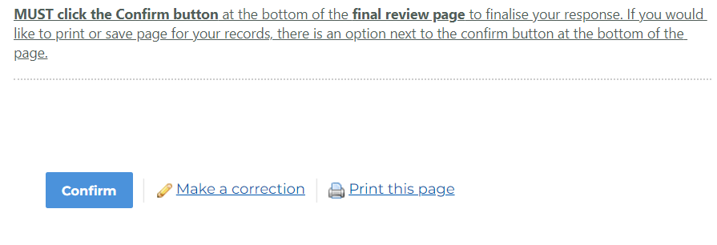

Slide 26
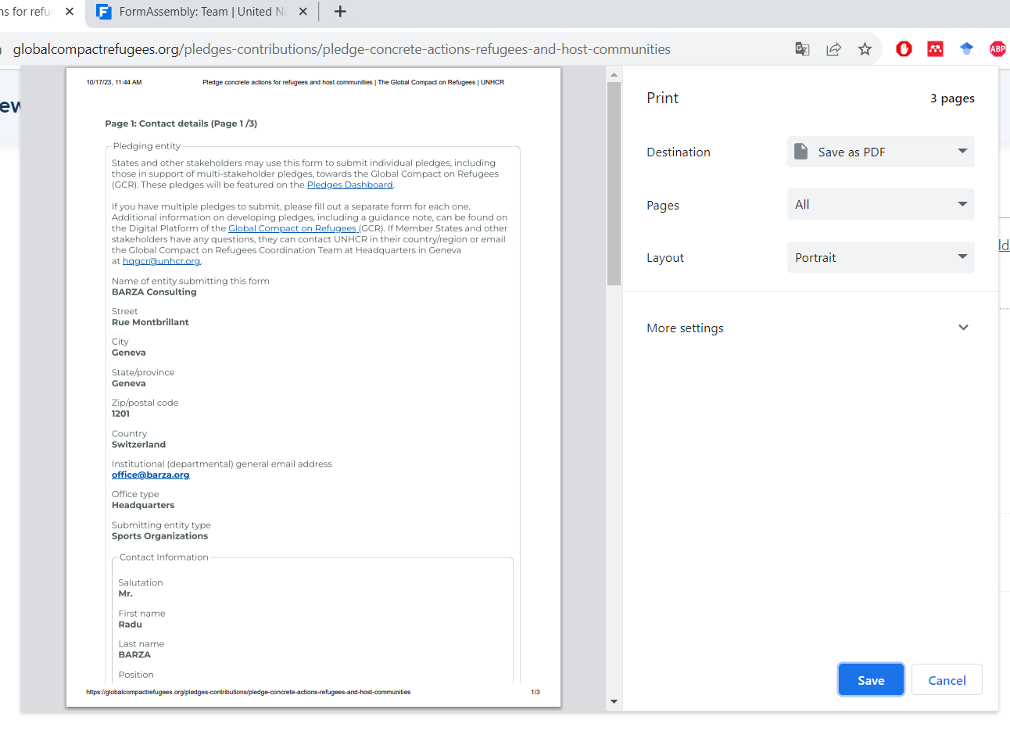

Slide 27
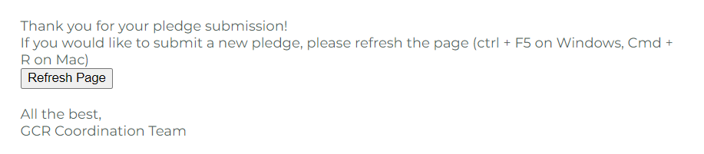

Slide 28
Interventions from the floor and Q&A on multi-stakeholder pledges
Mr. Ziad Ayad, Senior Policy Officer
Global Compact on Refugees Coordination Team, UNHCR

Slide 29
Closing Remarks
Ms. Perveen Ali, Senior Policy Advisor & Head of GCR Coordination Team, UNHCR

