Slide 1
THIS PRESENTATION HAS NOTES
The text the Facilitator speaks during this training session is contained in the notes section of the presentation slides. The slide notes also contain critical facilitation information, including timings and references to the corresponding page numbers in the Facilitation Guide. It is important to review the slide notes in full before facilitating this training package, and to print them as a reference tool for your session.
The notes should appear in the dock below the image of the slide when View is set to Normal. If you do not see the notes, hold your cursor on the thin gray bar at the bottom of the window and drag the bar upwards. The notes section will appear. To view the slides with the notes in large text below them, move your cursor to the top of the window and click View, then Notes Page. To print the slide notes with images of the slides (handy for facilitating for the first time, especially for lengthy teaching segments), click Print, then under Print Layout, choose Notes Pages.
IMPORTANT!
TIP ON HIDING SLIDES
If you decide to remove slides from this presentation – for instance, because you are not doing a particular exercise – it is better practice to hide the slide rather than deleting it. This ensures that the Timing Chart in the Facilitation Guide will still reflect the correct slide numbers. To hide a slide, click on the slide. Then, under the tab Slide Show, click on the icon “Hide Slide.” This means the slide will not be shown on the screen during your slide show.
Notes:
Important!
This Presentation Has Notes
The text the Facilitator speaks during this training session is contained in the notes section of the presentation slides. The slide notes also contain critical facilitation information, including timings and references to the corresponding page numbers in the Facilitation Guide. It is important to review the slide notes in full before facilitating this training package, and to print them as a reference tool for your session.
The notes should appear in the dock below the image of the slide when View is set to Normal. If you do not see the notes, hold your cursor on the thin gray bar at the bottom of the window and drag the bar upwards. The notes section will appear.
To view the slides with the notes in large text below them, move your cursor to the top of the window and click View, then Notes Page. To print the slide notes with images of the slides (handy for facilitating for the first time, especially for lengthy teaching segments), click Print, then under Print Layout, choose Notes Pages.
Tip on Hiding Slides If you decide to remove slides from this presentation – for instance, because you are not doing a particular exercise – it is better practice to hide the slide rather than deleting it. This ensures that the Timing Chart in the Facilitation Guide will still reflect the correct slide numbers. To hide a slide, click on the slide. Then, under the tab Slide Show, click on the icon “Hide Slide.” This means the slide will not be shown on the screen during your slide show.

Slide 2
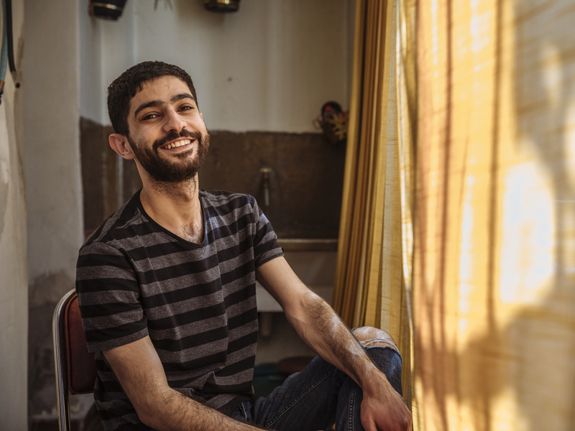



Sexual Orientation, Gender Identity, Gender Expression and Sex Characteristics (SOGIESC) in Forced Displacement and Migration
DATE / TIME / OTHER NOTES
Notes:
Opening Slide
[Image description: a person sitting in a chair smiling at the camera; a yellow curtain to the right filters in sunlight.]

Slide 3
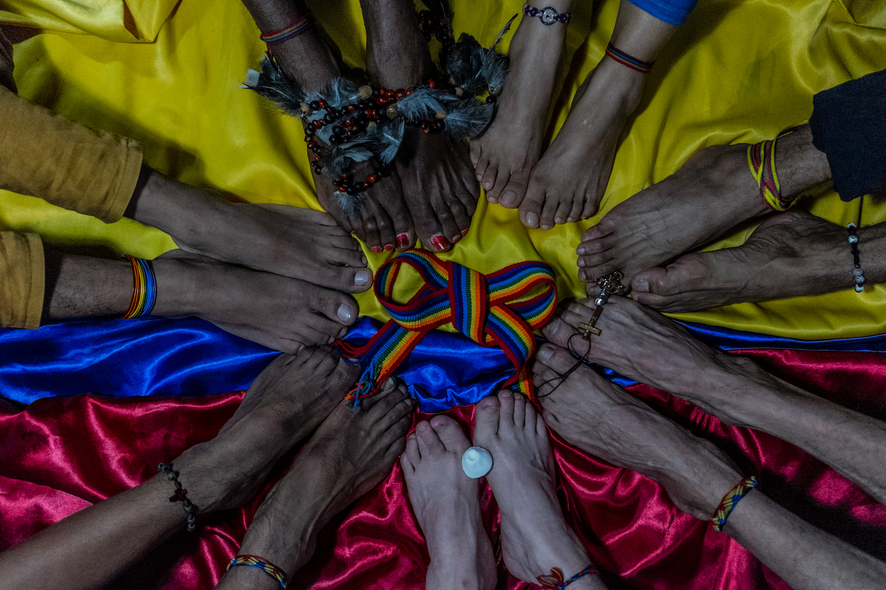
Modules 10-12
3
Notes:
Modules 10-12: Protection
Welcome to Modules 10-12 of Sexual Orientation, Gender Identity, Gender Expression and Sex Characteristics in Forced Displacement and Migration.
In Module 10, we'll talk in-depth about a number of key challenge areas and risk points for people with diverse SOGIESC, the barriers that keep them from receiving inclusive protection assistance, and the potential solutions and enablers that can address those issues.
In Module 11, we’ll look at different tools that can be utilized to assess protection needs.
In Module 12, we’ll look at three potential solutions: local integration, assisted voluntary return and resettlement.
[Image description: A close-up of seven people’s feet touching, creating a circle with a rainbow ribbon tied into a bow in the middle.]

Slide 4

10
PROTECTION
4
Notes:
Module 10 Overview
Protection is at the core of our mandate. Regardless of the work we are doing within the organization, we have a responsibility to protect every person who walks through our door, including people with diverse SOGIESC.
Moreover, we have a responsibility to ensure that SOGIESC issues are proactively identified and discussed within our work – including in our guidance, our standard operating procedures, our training sessions and our staff meetings – and to not limit protection topics to age, nationality, disability and binary gender. We also have a responsibility to identify risks and barriers for people with diverse SOGIESC and to put in place solutions and enablers that address those risks and barriers.
As we’ve learned, individuals with diverse SOGIESC work in our offices around the world and are within every population we assist. When their needs and challenges are not a consideration in our planning or actions, we further marginalize some of the most vulnerable populations in the world and may even cause them harm.
In this module, you’ll learn how the protection needs of people with diverse SOGIESC are impacted by migration and forced displacement and learn some of the specific issues that affect different populations.
----
Time: 2 minutes.
Total Module Time: 6 hours 30 minutes.

Slide 5
MODULE 10
OBJECTIVES
01
02
03
core protection challenges
risks points and barriers
How Enablers address barriers
Describe the core protection challenges people with diverse SOGIESC face during migration and in forced displacement
Detail the unique risks points and barriers faced by individuals within the SOGIESC spectrum
Explain how enablers can help address the barriers in protection spaces
1
1
5
Notes:
Objectives
Let’s review our objectives for Module 10. By the end of this module, you should be able to:
Describe the core protection challenges people with diverse SOGIESC face during migration and in forced displacement.
Detail the unique risks points and barriers faced by individuals within the SOGIESC spectrum.
Explain how inclusive programming and enablers can help address the risk points and barriers in protection spaces.
We’ll achieve these objectives by first reviewing the general subject of people with diverse SOGIESC in protection spaces and introducing the ten key challenge areas. We’ll then work on identifying the risk points and barriers. And finally, we’ll identify potential ways to address these risk points and barriers.
----
Time: 2 minutes.

Slide 6
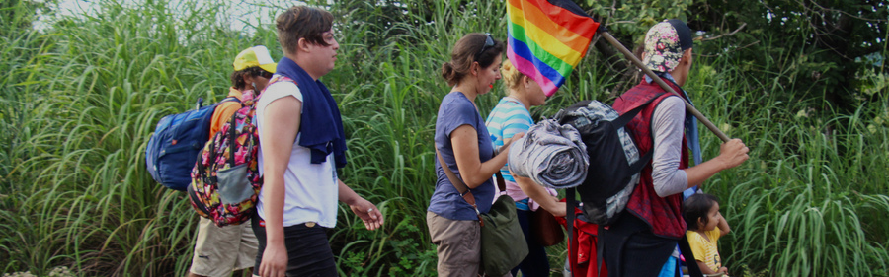
What challenges do people with diverse SOGIESC experience?
OBJECTIVES
During migration or forced displacement, people with diverse SOGIESC may experience:
COMPOUNDED MARGINALIZATION
EVOLVING NEEDS
HIGH RISK SITUATIONS
1
1
6
Notes:
What Challenges Do People with Diverse SOGIESC Experience?
Let’s start by looking at three issues individuals with diverse SOGIESC experience during migration and forced displacement.
The first issue is compounded marginalization. Who can tell us what compounded marginalization is?
Pause to allow learners to answer.
----
Time: 7 minutes for “What Challenges Do People with Diverse SOGIESC Experience?” slides.
[Image description: Central American migrant caravan passing by Chiapas, Mexico on their way to the United States. One migrant holds a rainbow flag; others have backpacks and a child in a stroller.]

Slide 7
What challenges do people with diverse SOGIESC experience?
OBJECTIVES
During migration or forced displacement, people with diverse SOGIESC may experience:
COMPOUNDED MARGINALIZATION
EVOLVING NEEDS
HIGH RISK SITUATIONS
They may encounter marginalization as both migrants and people of diverse SOGIESC.
1
1
7
Notes:
What Challenges Do People with Diverse SOGIESC Experience? continued
Compounded marginalization means that individuals with diverse SOGIESC may be marginalized both because of their sexual orientation, gender identity, gender expression or sex characteristics AND because they are migrants or have been forcibly displaced. Other intersectional factors can further compound their marginalization, such as age, gender, disability and employment status.
Why do you think compounded marginalization might be important to understand in relation to our work?
Pause to allow learners to answer. If the below has already been said by learners, skip to the next facilitated text; if it has not, go through it before moving on.
Compounded marginalization is important to understand in our work because it can affect an individual’s visibility to us, their vulnerability and their ability to access dignified employment, healthcare and other services (TJ: and can impact the solutions that are considered for them) . Often the most vulnerable populations are the most invisible to us. Understanding compound marginalization helps us understand the importance of outreach and why individuals with diverse SOGIESC require special assistance that does not align with the assistance we give to other populations, such as women and girls.
Let’s now look at evolving needs. Who can tell us what we mean by evolving needs?
Pause to allow learners to answer.
----
Time: 7 minutes for “What Challenges Do People with Diverse SOGIESC Experience?” slides.
[Image description: Central American migrant caravan passing by Chiapas, Mexico on their way to the United States. One migrant holds a rainbow flag; others have backpacks and a child in a stroller.]

Slide 8
What challenges do people with diverse SOGIESC experience?
OBJECTIVES
During migration or forced displacement, people with diverse SOGIESC may experience:
COMPOUNDED MARGINALIZATION
EVOLVING NEEDS
HIGH RISK SITUATIONS
They may encounter marginalization as both migrants and people of diverse SOGIESC.
As migration or forced displacement can last months, years or decades, people with diverse SOGIESC may have evolving needs throughout their migration journey.
1
1
8
Notes:
What Challenges Do People with Diverse SOGIESC Experience? continued
Migration journeys and forced displacement can last months, years or decades. This means people with diverse SOGIESC will have different needs at different points as their sexual orientation, gender identity, gender expression or sex characteristics intersect with their age, educational experience, health needs, marital and family status, employment status, disabilities and other factors.
Why do you think evolving needs might be important to understand in relation to our work?
Pause to allow learners to answer. If the below has already been said by learners, skip to the next facilitated text; if it has not, go through it before moving on.
Evolving needs are important to understand because we must be ready to offer a variety of different services at different points during our interactions with individuals of diverse SOGIESC, especially if the individual is transgender and undergoing transition. It is also important to understand that individuals with diverse SOGIESC who are displaced or migrate may experience new risks and challenges and may end up in a worse situation than the one they fled or migrated from.
Finally, let’s look at high-risk situations. Who can tell us what we mean by high-risk situations?
Pause to allow learners to answer.
----
Time: 7 minutes for “What Challenges Do People with Diverse SOGIESC Experience?” slides.
[Image description: Central American migrant caravan passing by Chiapas, Mexico on their way to the United States. One migrant holds a rainbow flag; others have backpacks and a child in a stroller.]

Slide 9
What challenges do people with diverse SOGIESC experience?
OBJECTIVES
During migration or forced displacement, people with diverse SOGIESC may experience:
COMPOUNDED MARGINALIZATION
EVOLVING NEEDS
HIGH RISK SITUATIONS
They may encounter marginalization as both migrants and people of diverse SOGIESC.
As migration or forced displacement can last months, years or decades, people with diverse SOGIESC may have evolving needs throughout their migration journey.
Movement, especially across borders, can place people with diverse SOGIESC in high-risk situations.
1
1
9
Notes:
What Challenges Do People with Diverse SOGIESC Experience? continued
Movement – and especially movement that takes place across borders – can be a high-risk situation for people with diverse SOGIESC. This is especially true for same-gender partners and people with diverse gender identity and expression, including people who are transgender, non-binary and gender non-conforming.
----
Time: 7 minutes for “What Challenges Do People with Diverse SOGIESC Experience?” slides.
[Image description: Central American migrant caravan passing by Chiapas, Mexico on their way to the United States. One migrant holds a rainbow flag; others have backpacks and a child in a stroller.]

Slide 10

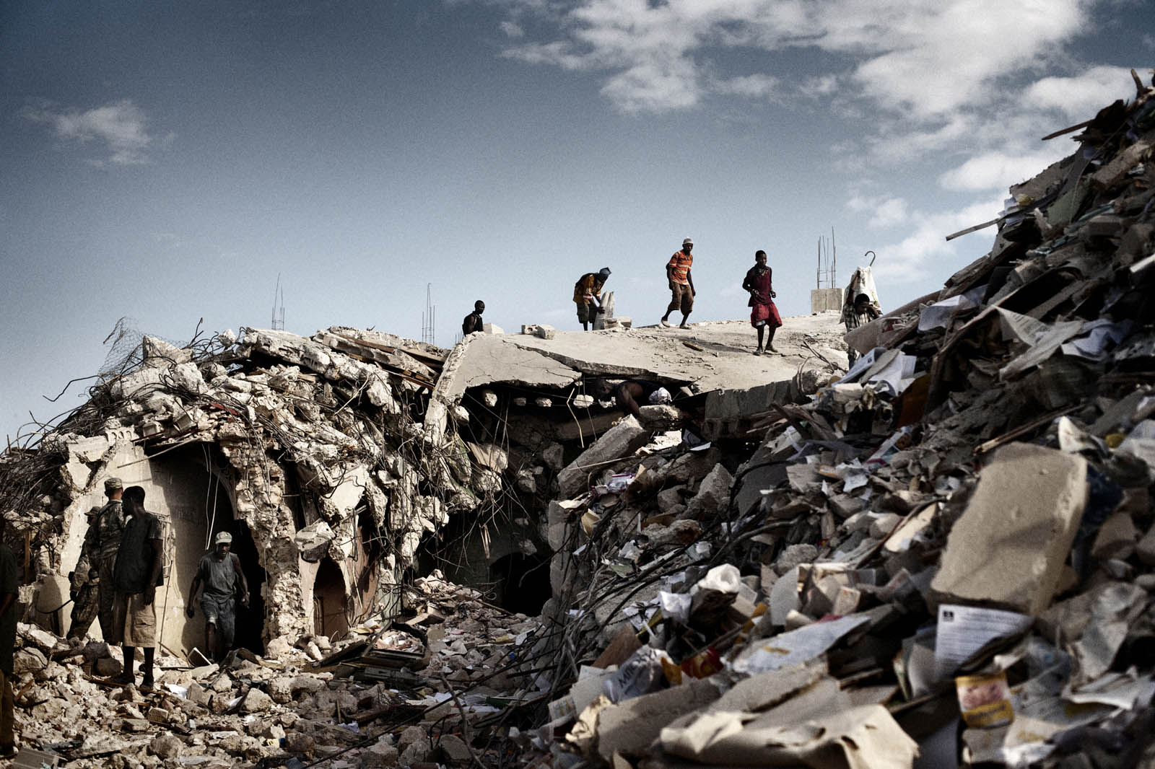
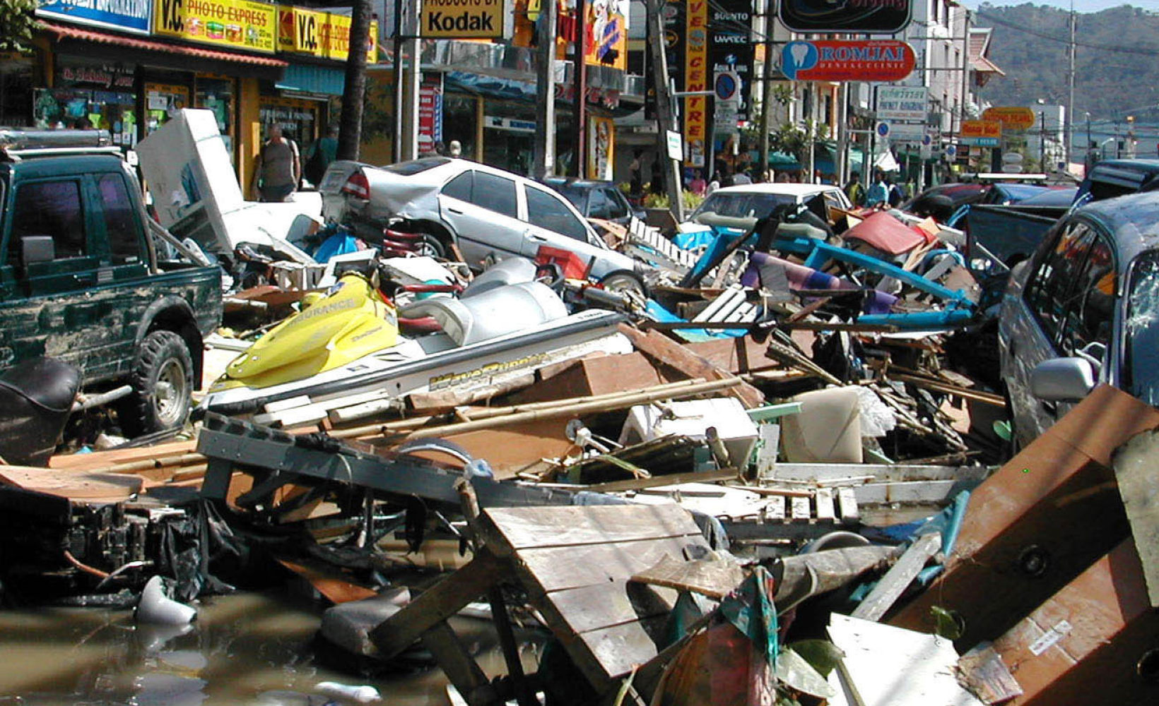
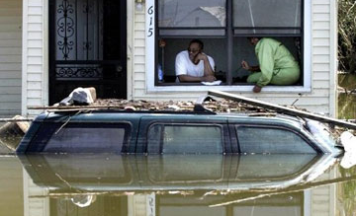
How Do Migration, Forced Displacement and Crisis Create Challenges?
01
02
03
DISCONNECTION
CATEGORIZATION
INSUFFICIENT RESPONSE
Disconnection of Normal Coping Mechanisms
Categorization of Identities
Insufficient Response to Unique LGBTIQ+ Needs
10
Notes:
How Do Migration and Forced Displacement Create Challenges?
Now let’s examine how migration, forced displacement and crisis situations create challenges for individuals with diverse SOGIESC:
The first is in the collapse of normal coping mechanisms.
The second is in the categorization of identities.
And the third is due to insufficient response to the unique needs of people with diverse SOGIESC.
----
Time: 20 minutes for “How Do Migration, Forced Displacement and Crisis Create Challenges?” slides.
[Image description: three images of crisis situations. Migrants walking over rubble, streets filled with debris; and a car almost completely under water after a flood.]

Slide 11
How Do Migration, Forced Displacement and Crisis Create Challenges?
Disconnection from Normal Coping Mechanisms
01
What are normal coping mechanisms?
A
“Normal coping mechanisms” are spaces such as social networks, sensitive health centers and community centers.
B
“Normal coping mechanisms” describes our mental capacity to handle high levels of stress.
C
“Normal coping mechanisms” are substances such as alcohol, drugs and sugar.
11
Notes:
How Do Migration and Forced Displacement Create Challenges? continued
The first area we will look at is disconnection from normal coping mechanisms. Coping mechanisms are typically used by individuals who live in locations in which diverse SOGIESC is not accepted or is not mainstreamed within the society.
Which do you think are examples of “normal coping mechanisms”?
There are three answer options on the screen:
“Normal coping mechanisms” are spaces such as social networks, sensitive health centers and community centers.
“Normal coping mechanisms” describes our mental capacity to handle high levels of stress.
“Normal coping mechanisms” are substances such as alcohol, drugs and sugar.
Pause to allow learners to answer.
The answer is a. Normal coping mechanisms can include spaces in which people of diverse SOGIESC are treated with dignity and respect, can network with other people like them, and can access what they need in a safe and confidential way.
----
Time: 20 minutes for “How Do Migration, Forced Displacement and Crisis Create Challenges?” slides.

Slide 12
How Do Migration, Forced Displacement and Crisis Create Challenges?
Disconnection from Normal Coping Mechanisms
01
DISCONNECTION
RESOURCES
BLAME
During migration, individuals may become disconnected from normal coping mechanisms, including social networks, sensitive health centers and community centers.
Facilities and services offered to migrants may not meet the needs of migrants with diverse SOGIESC.
Migrants with diverse SOGIESC can be targeted by a host society or blamed for a crisis, making the loss of coping mechanisms more problematic.
12
Notes:
How Do Migration and Forced Displacement Create Challenges? continued
When an individual migrates or becomes forcibly displaced, they become disconnected from their usual coping mechanisms. This is also the case in crises where coping mechanisms may be incapacitated or destroyed.
It can be difficult to connect with new resources during migration or in forced displacement, often because of cultural and linguistic barriers, and the facilities and services offered to migrants, persons who are forcibly displaced or crisis-affected populations may not meet the needs of people with diverse SOGIESC.
Finally, people with diverse SOGIESC can be targeted by a society or blamed for a crisis, making the loss of coping mechanisms even more problematic.
----
Time: 20 minutes for “How Do Migration, Forced Displacement and Crisis Create Challenges?” slides.

Slide 13
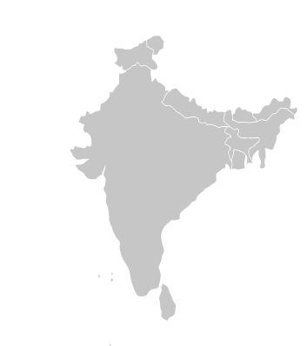
How Do Migration, Forced Displacement and Crisis Create Challenges?
Disconnection from Normal Coping Mechanisms
01
EXAMPLE 1
NEPAL
Some forced relocation schemes in Nepal’s Tarai region after the 2008 flooding did not take into account the need for access to many of the vital services that support metis’ (people who were assigned the sex of male at birth but identify as women) lives, including HIV services and community-based organization social services.
13
Notes:
How Do Migration and Forced Displacement Create Challenges? continued
A real-world example of disconnection from coping mechanisms is from Nepal, where many thousands of people were displaced and crisis-affected by an earthquake in 2015. During the earthquake, the Kathmandu offices of the national LGBT organization were damaged and many of the staff were affected, so individuals who usually relied on their services were unable to do so. Because displaced persons camps were not safe spaces for LGBTIQ+ Nepalis, they formed their own camps and were greatly in need of supplies such as food and clean water. Despite the visibility of their plight, their needs were largely overlooked by the organizations engaged in emergency response.
----
Time: 20 minutes for “How Do Migration, Forced Displacement and Crisis Create Challenges?” slides.

Slide 14
How Do Migration, Forced Displacement and Crisis Create Challenges?
Disconnection from Normal Coping Mechanisms
01
EXAMPLE 2
NEPAL
During the 2015 earthquake, the Kathmandu offices of the national LGBT organization were damaged and many of the staff were crisis-affected, so individuals who usually relied on their services were unable to do so. Because displaced persons camps were not safe spaces for LGBT Nepalis, they formed their own camps and were greatly in need of supplies such as food and clean water. Despite the visibility of their plight, their needs were largely overlooked by the organizations engaged in emergency response.
14
Notes:
How Do Migration and Forced Displacement Create Challenges? continued
Another example from Nepal is related to the Tarai region after the 2008 floods. Some forced relocation schemes meant to move individuals to safer areas did not take into account the need for access to many of the vital services that buoy metis’ lives – metis being people who were assigned the sex of male at birth but identify as women – including HIV services and community-based organization social services serving LGBTIQ+ people.
----
Time: 20 minutes for “How Do Migration, Forced Displacement and Crisis Create Challenges?” slides.

Slide 15

How Do Migration, Forced Displacement and Crisis Create Challenges?
Disconnection from Normal Coping Mechanisms
01
EXAMPLE
3
HAITI
The 2010 earthquake destroyed protective infrastructure, “from walls that ensured privacy at home to alleyways that made travel to clinics and gathering spaces safe. In the wake of the damage, people who had relied on specialized and often discreet services, such as HIV/AIDS clinics, were forced to turn to the common consumption of relief aid.”
15
Notes:
How Do Migration and Forced Displacement Create Challenges? continued
Another example is from Haiti. In 2010, a massive earthquake struck the country. It destroyed protective infrastructure, “from walls that ensured privacy at home to alleyways that made travel to clinics and gathering spaces safe. In the wake of the damage, people who had relied on specialized and often discreet services, such as HIV/AIDS clinics, were forced to turn to the common consumption of relief aid.”
----
Time: 20 minutes for “How Do Migration, Forced Displacement and Crisis Create Challenges?” slides.

Slide 16
How Do Migration, Forced Displacement and Crisis Create Challenges?
The Categorization of Identities
02
What is the categorization of identities?
A
Providing assistance to individuals of one identity category and refusing assistance to individuals of another.
B
Forcing individuals to report whether they have a diverse sexual orientation, gender identity, gender expression or sex characteristics.
C
Categorizing individuals by sex, gender, marital status, family composition and other factors
16
Notes:
How Do Migration and Forced Displacement Create Challenges? continued
The second area we will look at is the categorization of identities.
To understand more about what “categorization of identities” means, I’ll ask another question. “What is the categorization of identities?”
There are three answer options on the screen:
Providing assistance to individuals of one identity category and refusing assistance to individuals of another.
Forcing individuals to report whether they have a diverse sexual orientation, gender identity, gender expression or sex characteristics.
Categorizing individuals by sex, gender, marital status, family composition and other factors.
Pause to allow learners to answer.
The answer is c. This means categorizing individuals by sex, gender, marital status, family composition and other factors. Categorization is done to register, track and assist people.
----
Time: 20 minutes for “How Do Migration, Forced Displacement and Crisis Create Challenges?” slides.

Slide 17
How Do Migration, Forced Displacement and Crisis Create Challenges?
The Categorization of Identities
02
Categorization
SEX AND GENDER
EXPECTATIONS
Categorization for the purposes of registering, tracking and assisting people may not be varied enough.
Categories such as sex and gender may be conflated and may thus, for example, not be able to capture an individual’s gender identity in addition to the sex marker on their official ID.
Individuals who do not align with expectations of what men and women act and look like may be excluded altogether due to insufficient categories.
17
Notes:
How Do Migration and Forced Displacement Create Challenges? continued
There are several issues with the categorization of identities:
Categorization for the purposes of registering, tracking and assisting people may not be varied enough. For instance, when referencing gender, we may refer to “women,” but not to non-binary individuals or men, and categories related to sex characteristics, sexual orientation and gender identity may be absent on forms or in official data registers.
Categories such as sex and gender may be conflated and may thus not be able to capture an individual’s gender identity in addition to the sex marker on their official ID.
Individuals who do not align with expectations of what men and women act and look like may be excluded altogether due to insufficient categories.
----
Time: 20 minutes for “How Do Migration, Forced Displacement and Crisis Create Challenges?” slides.

Slide 18
How Do Migration, Forced Displacement and Crisis Create Challenges?
The Categorization of Identities
02
invisibility
family
programs
Official scrutiny of bodies, documents, families and behaviors can be problematic. Those who previously used invisibility as a coping mechanism may be especially at risk.
The definition of “family” may exclude same-gender couples and chosen families, leading to limited access to aid or separation, especially if parents with diverse SOGIESC with children are outed.
Programs or infrastructure may be designed without the needs of people with diverse SOGIESC or their family structures in mind because the categories simply don’t exist.
18
Notes:
How Do Migration and Forced Displacement Create Challenges? continued
Official scrutiny of bodies, documents, families and behaviors can be problematic for people of diverse SOGIESC. Those who previously used invisibility as a coping mechanism may be especially at risk.
The definition of “family” may exclude same-gender couples and chosen families, leading to limited access to aid or separation, especially if parents with diverse SOGIESC with children are outed.
Programs or infrastructure may be designed and constructed without the needs of people of diverse SOGIESC in mind because the categories simply don’t exist. For instance, the definition of “family” may exclude same-gender couples and chosen families, leading to their limited access to programs.
----
Time: 20 minutes for “How Do Migration, Forced Displacement and Crisis Create Challenges?” slides.

Slide 19

How Do Migration, Forced Displacement and Crisis Create Challenges?
The Categorization of Identities
02
EXAMPLE
1
PERU
In 2020 during the COVID-19 pandemic, government officials in several Latin American countries, including Peru, enacted a scheme during quarantine that allowed residents to leave their homes at specific times to shop for basic supplies based on the sex marker on their official ID card. This system impacted transgender people – including nationals, migrants, refugees and asylum-seekers – as it increased their visibility to others and put them in the way of potential harm.
19
Notes:
How Do Migration and Forced Displacement Create Challenges? continued
In 2020 during the COVID-19 pandemic, government officials in several Latin American countries, including Peru, enacted a scheme during quarantine that allowed residents to leave their homes at specific times to shop for basic supplies based on the sex marker on their official ID card. This system impacted transgender people – including nationals, migrants, refugees and asylum-seekers – as it increased their visibility to others and put them in the way of potential harm.
----
Time: 20 minutes for “How Do Migration, Forced Displacement and Crisis Create Challenges?” slides.

Slide 20
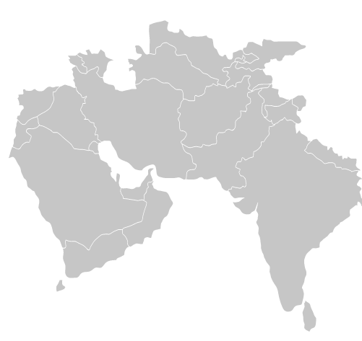
How Do Migration, Forced Displacement and Crisis Create Challenges?
The Categorization of Identities
02
EXAMPLE
2
PAKISTAN
In 2010 flood relief efforts in Pakistan, reports emerged that transgender women were left out of the aid efforts organized by UN agencies and NGOs and denied access to IDP camps because of general prejudice, their non-conforming appearance, and their lack of proper identification documents.
20
Notes:
How Do Migration and Forced Displacement Create Challenges? continued
Another example of this is from 2010 flood relief efforts in Pakistan. Reports emerged that transgender women were left out of the aid efforts and denied access to internally displaced persons camps because of general prejudice, their non-conforming appearance – they did not fit strict binary gender categories of male or female – and their lack of proper identification documents.
----
Time: 20 minutes for “How Do Migration, Forced Displacement and Crisis Create Challenges?” slides.

Slide 21
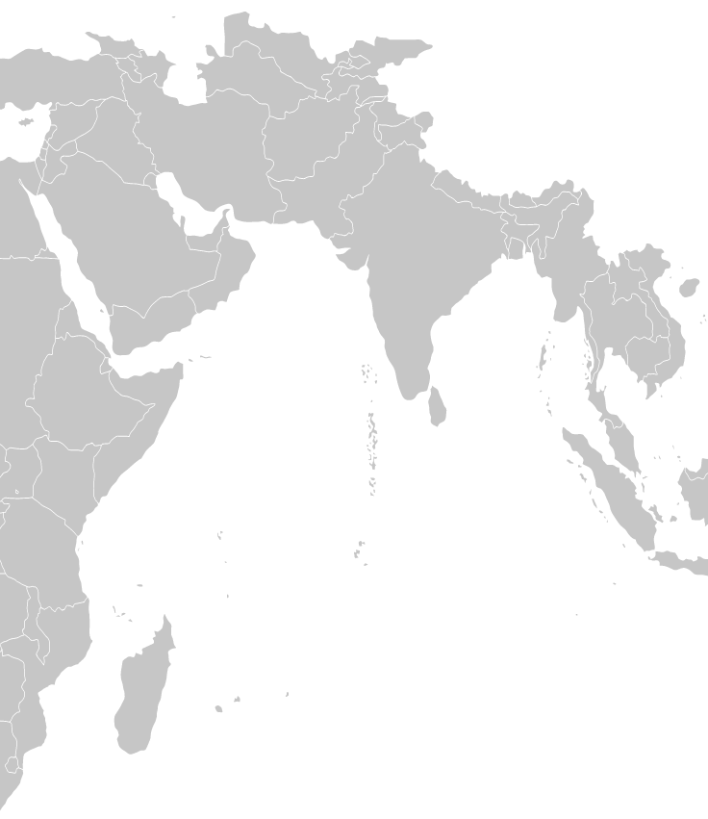
How Do Migration, Forced Displacement and Crisis Create Challenges?
The Categorization of Identities
02
EXAMPLE
3
INDIA
In the immediate relief programs in India following the 2004 Indian Ocean tsunamis, aravanis (people assigned the sex of male at birth who identify as female) were excluded from temporary shelters and denied rations cards because their appearance and identity did not fit in the administrative definitions of man or woman. Left off the official list of affected people eligible for post-disaster assistance, aravanis did not receive any compensation for property losses from the government.
21
Notes:
How Do Migration and Forced Displacement Create Challenges? continued
A third example is from the immediate relief programs in India following the 2004 Indian Ocean tsunamis. Aravanis, who are people that were assigned the sex of male at birth but identify as female, were excluded from temporary shelters and denied rations cards because their appearance and identity did not fit in the administrative definitions of man or woman. Because they were left off the official list of affected people eligible for post-disaster assistance, aravanis did not receive any compensation for property losses from the government.
----
Time: 20 minutes for “How Do Migration, Forced Displacement and Crisis Create Challenges?” slides.

Slide 22
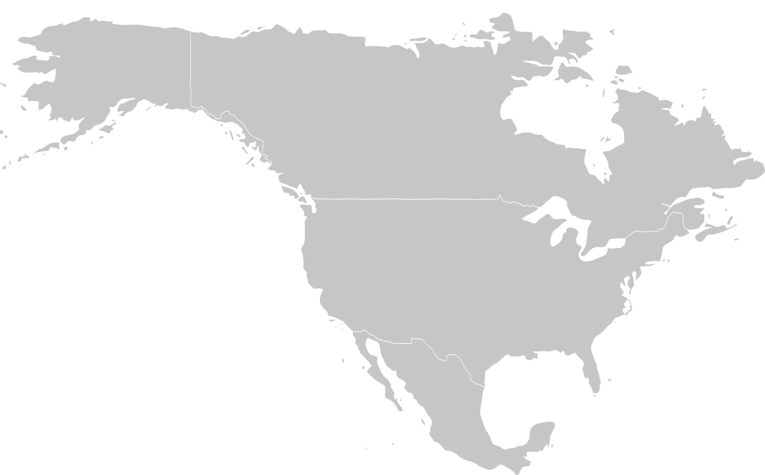
How Do Migration, Forced Displacement and Crisis Create Challenges?
INSUFFICIENT RESPONSE TO LGBTIQ+ PEOPLE
03
EXAMPLE
3
USA
Several relief programs initiated in response to Hurricane Katrina in the USA employed administrative systems that made assumptions and arrangements based on different-gender marriage and family structure. This resulted in discrimination against people with diverse SOGIESC, same-gender couples and families. In some cases, it prevented them from receiving federal aid and accessing health care.
22
Notes:
How Do Migration and Forced Displacement Create Challenges? continued
The fourth example is from the United States. Several relief programs initiated in response to Hurricane Katrina employed administrative systems that made assumptions and arrangements based on different-sex marriage and family structure. This resulted in discrimination against people with diverse SOGIESC, same-gender couples and families. In some cases, it prevented them from receiving federal aid and accessing health care.
----
Time: 20 minutes for “How Do Migration, Forced Displacement and Crisis Create Challenges?” slides.

Slide 23
How Do Migration, Forced Displacement and Crisis Create Challenges?
INSUFFICIENT RESPONSE TO PEOPLE WITH DIVERSE SOGIESC
03
What does insufficient response mean?
A
Organizations designing programs for heterosexual, cisgender, endosex individuals and different-gender couples.
B
Organizations omitting references to people of diverse SOGIESC from guidance documents and protection trainings.
C
Organizations stating they assist “men, boys, women and girls” without reference to trans or non-binary populations.
D
All of the above.
23
Notes:
How Do Migration and Forced Displacement Create Challenges? continued
The third area we will look at is insufficient response.
What does insufficient response mean?
There are three answer options on the screen:
Organizations designing programs for heterosexual, cisgender, endosex individuals and different-gender couples.
Organizations omitting references to people of diverse SOGIESC from guidance documents and protection trainings.
Organizations stating they assist “men, boys, women and girls” without reference to trans or non-binary populations.
All of the above.
Pause to allow learners to answer.
The answer is d: all of the above. There are many ways in which organizations, including ours, exhibit insufficient responses to the populations we serve.
----
Time: 20 minutes for “How Do Migration, Forced Displacement and Crisis Create Challenges?” slides.

Slide 24
How Do Migration, Forced Displacement and Crisis Create Challenges?
INSUFFICIENT RESPONSE TO PEOPLE WITH DIVERSE SOGIESC
03
marginalization
invisibility
exclusion
Social exclusion of people of diverse SOGIESC can put them at risk due to stigma and marginalization in a wide variety of spaces, including labour markets, migrant and displaced persons communities, refugee camps and during aid efforts.
Invisibility can be a deliberate strategy for people of diverse SOGIESC, who often employ creative strategies to achieve and maintain their safety amid dangerous conditions.
This can lead to their exclusion from programs for migrants that do not include outreach efforts targeted at people who are less visible, or specialized services.
24
Notes:
How Do Migration and Forced Displacement Create Challenges? continued
First, organizations are often unprepared. They design programs without the needs of people of diverse SOGIESC in mind and may wrongly assume that people with diverse SOGIESC will benefit from, for instance, binary gender programs. They do not mention people of diverse SOGIESC in their guidance documents or trainings for staff. They say that they assist “men, boys, women and girls” without reference to trans or non-binary populations, and may not mention that the men, boys, women and girls they serve include people of diverse SOGIESC.
Social exclusion of people of diverse SOGIESC can put them at risk due to stigma and marginalization in a wide variety of spaces, including labour markets, communities, refugee camps and during aid efforts; and invisibility can be a deliberate strategy for people of diverse SOGIESC, who often employ creative tactics to achieve and maintain their safety amidst dangerous conditions. Both of these factors can lead to exclusion from programs that do not include outreach efforts targeted at people who are less visible or specialized services.
----
Time: 20 minutes for “How Do Migration, Forced Displacement and Crisis Create Challenges?” slides.

Slide 25
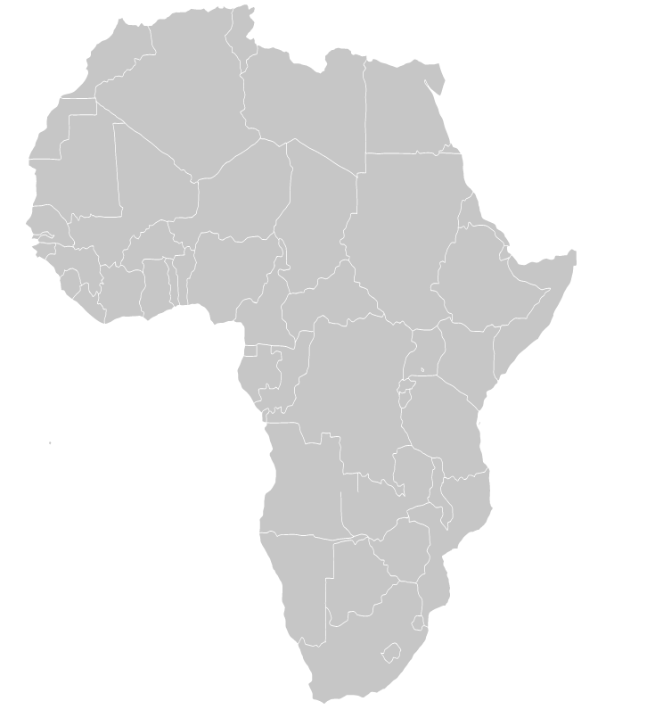
How Do Migration, Forced Displacement and Crisis Create Challenges?
INSUFFICIENT RESPONSE TO PEOPLE WITH DIVERSE SOGIESC
03
EXAMPLE
1
LYBIA
As tens of thousands of labour migrants sought IOM’s help to leave Libya and return to their home countries, a migrant approached IOM staff. He explained he was gay and faced persecution in his home country. IOM was the only organization in the area and was only undertaking assisted voluntary return activities. Thus, he was told there were no other services available, and he must return home if we wanted help leaving Libya. He was repatriated to a country with the death penalty for homosexuality.
25
Notes:
How Do Migration and Forced Displacement Create Challenges? continued
A real-world example of insufficient response is from the migration crisis sparked by the 2011 conflict in Libya. As tens of thousands of labour migrants sought IOM’s help to leave Libya and return to their home countries, a migrant approached an IOM staff member to explain that he was gay and faced persecution in his home country. IOM was the only organization in the area and was only undertaking assisted voluntary return activities. Thus, he was told there were no other services available, and he must return home if we wanted help leaving Libya. He was repatriated to a country with the death penalty for homosexuality.
----
Time: 20 minutes for “How Do Migration, Forced Displacement and Crisis Create Challenges?” slides.

Slide 26
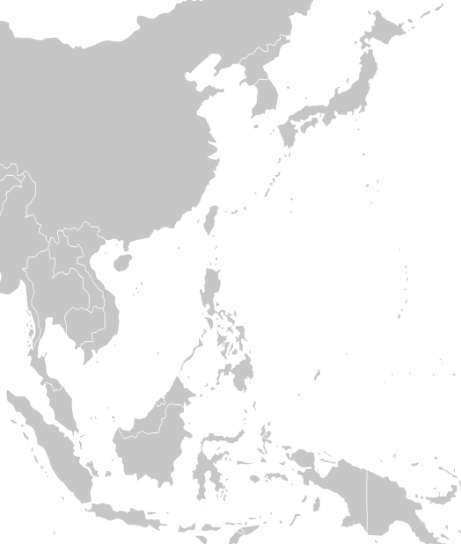
How Do Migration, Forced Displacement and Crisis Create Challenges?
INSUFFICIENT RESPONSE TO PEOPLE WITH DIVERSE SOGIESC
03
EXAMPLE
2
PHILIPPINES
For some people assigned the sex of male at birth who identify as female in the Philippines, accessing gender-segregated toilets and shower facilities in temporary shelters after natural disasters has been an embarrassing or humiliating experience. Many report they would feel more comfortable in female facilities, but the social norm associated with their masculine body compels them to use male bathrooms where they suffer from mockery from cisgender males.
26
Notes:
How Do Migration and Forced Displacement Create Challenges? continued
The second example is from the Philippines. For some people assigned the sex of male at birth who identify as female, accessing gender-segregated toilets and shower facilities in temporary shelters after natural disasters has been an embarrassing or humiliating experience. Many report they would feel more comfortable in female facilities, but the social norm associated with their masculine body compels them to use male bathrooms where they suffer from mockery from cisgender males.
----
Time: 20 minutes for “How Do Migration, Forced Displacement and Crisis Create Challenges? slides.

Slide 27
How Do Migration, Forced Displacement and Crisis Create Challenges?
INSUFFICIENT RESPONSE TO PEOPLE WITH DIVERSE SOGIESC
03
EXAMPLE
3
UGANDA
Human Rights First reported in 2012 that a bisexual refugee and her child living in Uganda were beaten by other refugees in the camp who disapproved of her sexual orientation, as well as removed from the queue for food along with other LGBTIQ+ refugees. They were told that if they formed their own queue, the food providers would not assist them. Thus, they were often denied access to food.
27
Notes:
How Do Migration and Forced Displacement Create Challenges? continued
The third example is from Uganda. Human Rights First reported in 2012 that a bisexual refugee and her child living in Uganda were beaten by other refugees in the camp who disapproved of her sexual orientation, as well as removed from the queue for food along with other LGBTIQ+ refugees. They were told that if they formed their own queue, the food providers would not assist them. Thus, they were often denied access to food.
----
Time: 20 minutes for “How Do Migration, Forced Displacement and Crisis Create Challenges?” slides.

Slide 28
How Do Migration, Forced Displacement and Crisis Create Challenges?
INSUFFICIENT RESPONSE TO PEOPLE WITH DIVERSE SOGIESC
03
EXAMPLE
4
UGANDA & KENYA
A gay male refugee in Uganda was locked inside his house by a group of refugees who tried to burn him alive.
A Sudanese lesbian in Uganda had her house burned down by the local refugee community.
Two Ethiopian refugees in Kenya were beaten and robbed repeatedly as well as lost their jobs due to their sexual orientation.
In Kenya, the house of a lesbian Ugandan refugee was demolished by local residents after refugees told the local council about her sexual orientation.
28
Notes:
How Do Migration and Forced Displacement Create Challenges? continued
Fourth, here are several other examples as reported by Human Rights First:
A gay male refugee in Uganda was locked inside his house by a group of refugees who tried to burn him alive.
A Sudanese lesbian in Uganda had her house burned down by the local refugee community.
Two Ethiopians refugees in Kenya were beaten and robbed repeatedly as well as lost their jobs due to their sexual orientation.
In Kenya, the house of a lesbian Ugandan woman was demolished by local residents after refugees told the local council about her sexual orientation.
----
Time: 20 minutes for “How Do Migration, Forced Displacement and Crisis Create Challenges?” slides.

Slide 29

When Do People with Diverse SOGIESC Face Challenges?
Challenges for people with diverse SOGIESC occur throughout the migration journey, in the emergency and post-emergency phases and throughout the entire cycle of displacement.
Risks may occur at all stages in the provision of assistance and protection, including during registration, assistance, with community-based services and durable solutions.
In crisis situations, people with diverse SOGIESC may face the same – or even greater – challenges after the initial emergency phase is over and can be at risk of harm throughout the post-emergency phase.
29
Notes:
When Do People with Diverse SOGIESC Face Challenges?
Challenges for people with diverse SOGIESC occur throughout the migration journey, in the emergency and post-emergency phases and throughout the entire cycle of displacement.
Challenges may occur at all stages in the provision of assistance and protection, including during registration, assistance, with community-based services and durable solutions.
In crisis situations, people with diverse SOGIESC may face the same – or even greater – challenges after the initial emergency phase is over and can be at risk of harm throughout the post-emergency phase. This makes the situation of people with diverse SOGIESC in crisis situations unique and is due to their disconnection from normal coping mechanisms. These challenges can last throughout the post-emergency phase which, especially in the case of displacement, can last years or even decades.
----
Time: 2 minutes.

Slide 30
Where Do Risk Points Occur for People with Diverse SOGIESC?
A risk point is any point at which someone may face harassment, abuse or violence because their diverse SOGIESC is visible in some way.
What is a RISK POINT?
30
Notes:
Where Do Risk Points Occur for People with Diverse SOGIESC?
We’ll now take some time to talk about risk points.
Recognizing risk points for individuals in migration, forced displacement and crisis situations, and determining how we might mitigate them, is one of the keys to improving the protection of migrants.
What is a risk point?
Pause to allow learners to answer, then move slide forward through animation.
A risk point is any point at which someone may face harassment, abuse or violence because their diverse SOGIESC is visible in some way.
----
Time: 5 minutes total for “Where Do Risks Occur for People with Diverse SOGIESC?” slides.

Slide 31
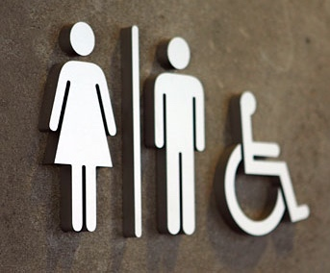

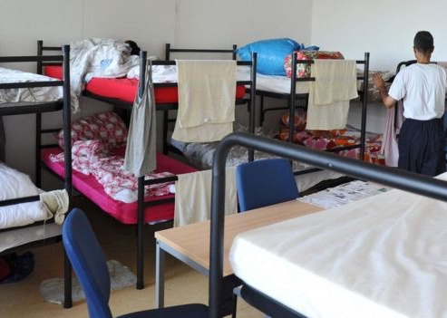
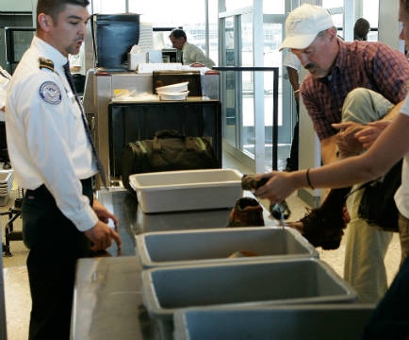
Where Do Risk Points Occur for People with Diverse SOGIESC?
31
Notes:
Where Do Risk Points Occur for People with Diverse SOGIESC? continued
There are many for people with diverse SOGIESC in migration, forced displacement and crisis situations, both inside and outside our spaces. What are some of them? They can be physical locations or more general spaces.
Pause to allow learners to answer.
----
Time: 5 minutes total for “Where Do Risks Occur for People with Diverse SOGIESC?” slides.
[Image description: collection of images representing risk points, including a security officer, stacks of bunk beds in a shelter, an airport checkpoint with an officer, a long hallway with lockers, and a medical room with a medical table and equipment,]

Slide 32
Where Do Risk Points Occur for People with Diverse SOGIESC?
IMMIGRATION POINTS AND GOVERNMENT OFFICES
EMPLOYMENT SECTORS
COMMUNITIES, AND FAMILIES
HEALTH CENTERS
Any location where there is interface with immigration or government officials.
Both formal and informal employment sectors.
Unwelcoming or persecutory communities and families.
Health and counselling centers, including those run by our organizations and public facilities.
INFORMATION AND REGISTRATION POINTS
SANITATION, SHELTER AND DETENTION
CRISIS AID DISTRIBUTION AREAS
OUR OFFICES AND PROGRAMMES
Particularly if they exclude people of diverse SOGIESC and if staff are untrained.
Information and registration points for migrants, displaced persons and crisis-affected populations.
Sanitation facilities, regular housing, group shelters, temporary shelters in urban areas, transit facilities, camps, and detention centers.
Centralized aid distribution areas and aid queues.
32
Notes:
Where Do Risk Points Occur for People with Diverse SOGIESC? continued
Risk points include, but are not limited to:
Immigration points and government offices – any location where there is interface with immigration or government officials who may scrutinize an individual’s ID, body or family
Employment sectors – both informal and formal, where there is interface with employers who may review documentation or other aspects of an individual
Communities and families – that are unwelcoming or persecutory based on an individual’s adherence with gender norms or lack thereof
Health centers and counselling centers – where documentation, bodies or families may be scrutinized, or an individual may need to seek care related to their diverse SOGIESC
Our offices and programs – particularly if they exclude people with diverse SOGIESC and if staff are untrained
Information and registration points – Information and registration points for migrants, displaced persons and crisis-affected populations
Sanitation, Shelter and Detention – including regular housing, group shelters, temporary shelter in urban areas, transit facilities, camps, sanitation facilities, and detention centers where IDs, bodies, families and behaviours are under close scrutiny by others
Crisis and distribution areas – including centralized aid distribution areas and aid queues where ID cards, family composition and adherence o gender norms may be scrutinized
As you can see, the common thread here is situations in which someone’s ID card, body, family, or adherence to gender norms might be scrutinized by others, such as officials, staff of organizations or community members.
Are there any else you can think of that aren’t represented here and that we didn’t state before?
----
Time: 5 minutes for “Where Do Risks Occur for People with Diverse SOGIESC?” slides.

Slide 33
Where Do Risk Points Occur for People with Diverse SOGIESC?
See UNHCR detention-related guidance links in the Workbook.
PHYSICAL, MENTAL AND SEXUAL ABUSE
LACK OF SUPPORT
Physical, mental and sexual abuse, discrimination, separation from partners, denial of conjugal visits and quarters inappropriate for self-identified gender.
Lack of access to legal and social support, justice systems, appropriate counselling and sufficiently trained staff.
CRITICAL MEDICAL CARE
ISOLATION OR CONFINEMENT
Denial of critical medical care, including HIV treatment, hormonal therapy or care related to sexual violence or reproductive health.
Isolation or solitary confinement used as a means of protection, rather than release or referral alternatives.
Notes:
Where Do Risk Points Occur for People with Diverse SOGIESC? continued
Let’s take a moment to highlight the risks for people in detention. They include:
Physical, mental and sexual abuse, discrimination, separation from partners, denial of conjugal visits and quarters inappropriate for self-identified gender. For instance, a woman who was assigned the sex of male at birth may be housed with men rather than women based on the sex marker on their ID, leading to harassment, abuse and possibly violence.
Denial of critical medical care, including HIV treatment, hormonal therapy or care related to sexual violence or reproductive health.
Lack of access to legal and social support, justice systems, appropriate counselling and sufficiently trained staff.
Isolation or solitary confinement used as a means of protection, rather than release or referral alternatives.
See UNHCR detention-related guidance links in the Workbook for more information on detention.
----
Time: 5 minutes for “Where Do Risks Occur for People with Diverse SOGIESC?” slides.

Slide 34

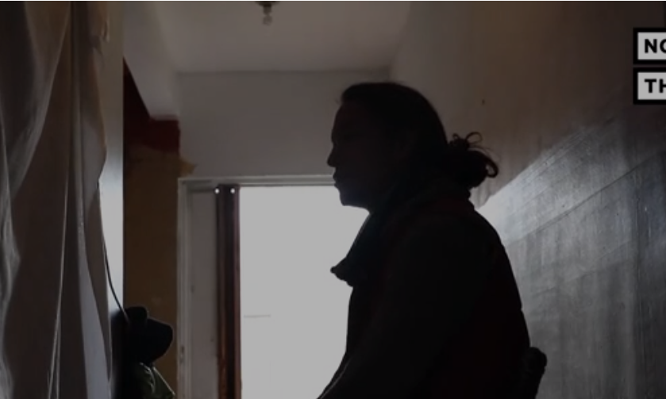
Video
These Sustainable Homes in Mexico Receive & Protect LGBTQ Migrants
Daily Motion NOW THIS (5:00)
34
Notes:
Video
Before we look at the barriers faced by different individuals with diverse SOGIESC, we’ll watch a video about how one organization is providing safe shelter to LGBTIQ+ migrants in Mexico while they wait to apply for asylum in the United States.
----
Video Link: https://www.bing.com/videos/search?q=video+about+protection+of+lgbti+migrants&docid=608048214058863396&mid=088CDAB288AE69492C01088CDAB288AE69492C01&view=detail&FORM=VIRE OR https://www.dailymotion.com/video/x7dccj9.
Time: 5 minutes.

Slide 35
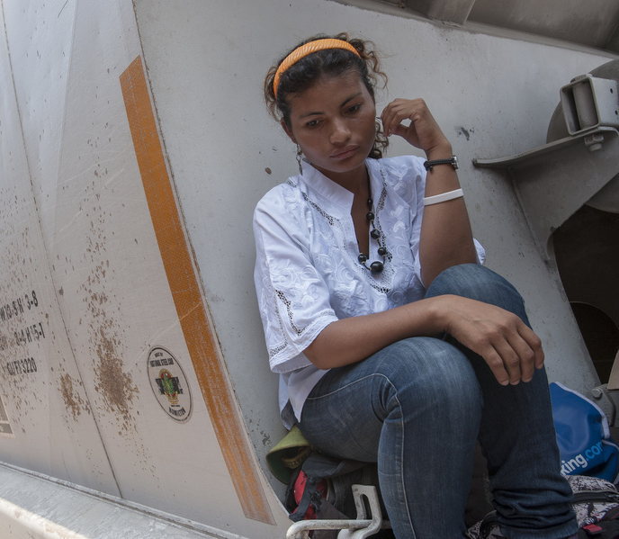
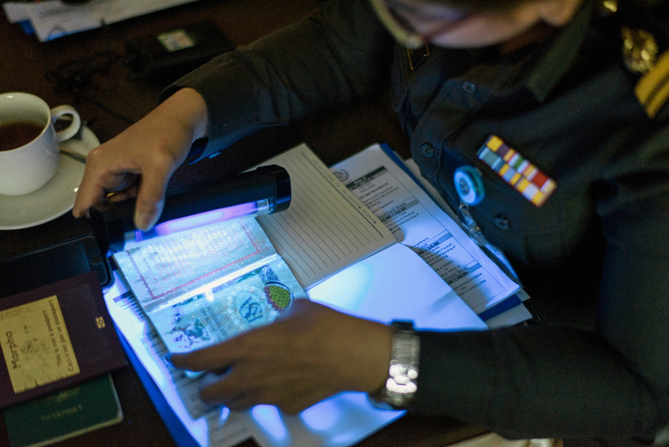

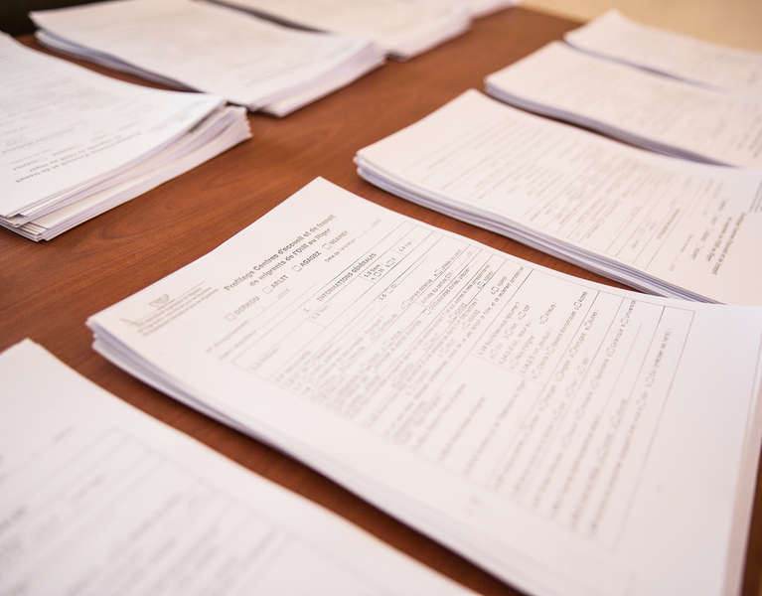
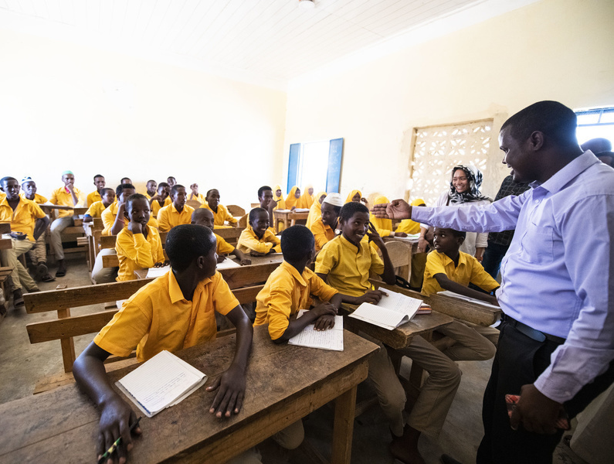
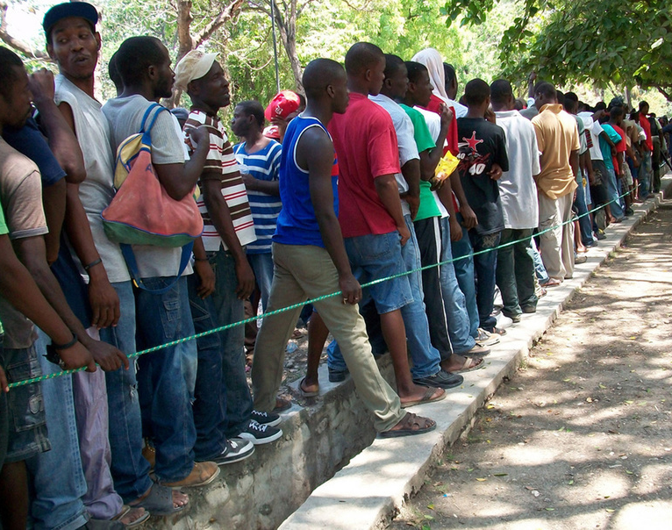
What are the Barriers for Specific People?
ATTITUDINAL
INSTITUTIONAL
ENVIRONMENTAL
35
Notes:
What are the Barriers to Protection for Specific People?
Now, let’s think about the barriers to protection for specific individuals in the context of migration, forced displacement and crisis situations. As we did in the Safe Spaces module, we’ll draw on the disability inclusion model to apply the concept of barriers here. What is a barrier?
Pause to allow learners to answer.
In the disability inclusion context, a barrier is anything that prevents a person with a disability from fully participating in all aspects of society because of their disability. Applying this to people with diverse SOGIESC, we can say that a barrier is anything that prevents a person with diverse SOGIESC from fully accessing assistance, or participating in programmes and services, because of their diverse SOGIESC.
Barriers can be attitudinal, institutional or environmental. What are examples of attitudinal barriers?
Pause to allow learners to answer. Examples: Community members believing that people with diverse SOGIESC are evil, against the predominant religion, sick or cursed; employers believing that people with diverse SOGIESC are not fit to work at their business; teachers having homophobic, transphobic, biphobic or intersexphobic attitudes against their students.
What are examples of institutional barriers?
Pause to allow learners to answer. Examples: Policies excluding people with diverse SOGIESC; laws that criminalize same-gender relationships or people with diverse gender expressions; laws that prevent same-gender couples from marrying or adopting children; documentation rules that disallow changes in sex or gender markers; health insurance plans that do not cover transition care.
What are examples of environmental barriers?
Pause to allow learners to answer. Examples: Gender-binary toilets and showers; gender-binary housing facilities; gender-segregated security checks; gender-segregated schools.
---------
Time: 2 minutes.
[Image description: a collection of images representing barriers, including a classroom that is designated for boys only, a bathroom with three toilet stalls and a shadowy figure in distress, an officer looking at paperwork and passports, a long line of men, and a distressed person with their head down sitting on their travel pack.]

Slide 36


What are the Barriers for Specific People?
PEOPLE WITH DIVERSE GIESC
disproportionately affected by discrimination, violence, insecurity in shelter and sanitation, documentation issues and access to services
PEOPLE WITH DIVERSE SO insecurity in employment, access to services, violence, family unity
INTERSECTIONS diverse SOGIESC intersects with factors such as age, gender, ethnicity, class and dis/ability
36
Notes:
What are the Barriers to Protection for Specific People? continued
People with diverse SOGIESC as a group are affected in migration, forced displacement and crisis situations in many of the same ways. However, different populations face different barriers to receiving assistance and accessing our programmes and services.
For instance, people with diverse sexual orientation may face barriers in gaining dignified employment and shelter, accessing respectful healthcare, and maintaining family unity.
People with diverse gender identity and/or expression face many attitudinal, institutional and environmental barriers accessing justice systems, education, employment, housing and health care, may be more susceptible to poverty and may have difficulty accessing documents.
People with diverse sex characteristics face attitudinal barriers from health providers, families and communities and have difficulty accessing dignified and appropriate healthcare due to both attitudinal and institutional factors.
Intersectionality plays a critical role in which barriers an individual may face. There are intersections between diverse sexual orientation, gender identity, gender expression, sex characteristics and many other factors, including age, gender, ethnicity, class and disability.
----
Time: 10 minutes for “What are the Barriers for Specific People?”

Slide 37
What are the Barriers for Specific People?
BINARY GENDER
MEN
WOMEN
AGE
DISABILITY
CHILDREN
OLDER PEOPE
INTERSECTIONAL FACTORS
COMPOUNDED BARRIERS
37
Notes:
What are the Barriers to Protection for Specific People? continued
Let’s now look at the intersectional factors of gender, age and disability and think about how those factors create barriers for individuals with diverse SOGIESC.
Binary Gender:
Men: face many attitudinal and institutional barriers, including difficulty in reporting sexual violence, laws criminalizing homosexuality, and stereotypes by international organizations and NGOs about how they should look or act in order to be believed to be gay, bisexual or transgender.
Women: are often less mobile and less economically independent, which can affect their ability to migrate or to leave a difficult situation at home. They may also face societal pressure to get married and have a family by a particular age, which can further inhibit their mobility and independence. Like men, women may be stereotyped by organizations for not looking or acting “gay” or “lesbian,” which can lead to assistance providers believing they are lying in order to receive special treatment.
Age:
Children: face the attitudinal barrier that they are not old enough to have a clear understanding of their SOGIESC, and thus their persecution on the basis of their SOGIESC may be overlooked; they also face institutional barriers in seeking support outside their families. In the United States, studies have shown that children with diverse SOGIESC are over-represented in the juvenile justice systems, and that the majority of those youth are from marginalized ethnic backgrounds.
Older people: with diverse SOGIESC may be less visible to assistance providers and may be more likely to have to conceal their SOGIESC – even if they previously did not conceal – due to their dependence on individuals, institutions and systems that are discriminatory or unsafe.
Disability:
Prevalence: It’s important that we think about disability as an intersectional factor because so many people with diverse SOGIESC have disabilities. For instance, a study in the US found that two out of every five transgender people (40%) had a disability; in Washington State, 40% of bisexual men, 36% of lesbian women, 36% of bisexual women and 26% of gay men reported having a disability compared with 27.2% of the general population.
People with disabilities: face compounded sets of barriers based on their gender, age and SOGIESC. Depending on their disability, they may have more reliance on individuals, institutions, organizations and systems that are discriminatory against diverse SOGIESC, which can lead either to concealment or heightened possibility of abuse.
----
Time: 10 minutes for “What are the Barriers for Specific People?”
Facilitation Note: One report from the United States noted that, “over 40% of incarcerated women and nearly 60% of girls in juvenile justice facilities are sexual minorities, with as many as 85% of LGBTQ youth being youth of color. And recent estimates show that 32% of people in prison and 40% of those in jails have at least one disability.” The same report is the source of the above statistics on SOGIESC and disability: Movement Advancement Project | LGBT PEOPLE WITH DISABILITIES (lgbtmap.org).

Slide 38
Key Challenge Areas
01
Participation and Outreach
02
03
Sexual and Gender- Based Violence
Individual Documentation
04
Other Issues of Safety and Security
05
Access to Justice
06
Material Assistance
07
Shelter and Sanitation
08
09
10
Education
Livelihoods
Health
38
Notes:
Ten Key Challenge Areas
Let’s now look at the ten key challenge areas for people with diverse SOGIESC in migration, forced displacement and crisis situations. These are the key challenge areas we’ll be focusing on for the rest of the module. They are:
1. Participation and Outreach
This area relates to the inclusion of migrants with diverse SOGIESC in our programs and our ability to reach them to provide appropriate assistance and services. This is also related to the reality that often we’re already assisting individuals with diverse SOGIESC but they don’t feel comfortable sharing their identity with us, so we are unable to provide them tailored assistance.
2. Individual Documentation
This area relates to documents such as national ID cards, passports, birth certificates, travel documents, registration certificates and refugee and IDP ID cards. Particularly for migrants with diverse gender identity and expression, including transgender, non-binary and gender non-conforming migrants, not having identification that matches their physical appearance can be a significant risk point during their migration or displacement and if they attempt to return to their home country.
3. Gender-Based Violence
This area relates to private or public harmful acts specifically perpetrated on the basis of an individual’s gender, including physical, mental or sexual harm, threats of such acts, coercion and other deprivations of liberty. We know that people with diverse SOGIESC face disproportionately high rates of GBV.
4. Other Issues of Safety and Security
This area relates to any act that threatens or violates a person’s physical, emotional or mental safety or security, including acts of discrimination, harassment, abuse or violence.
5. Access to Justice
This area relates to an individual’s ability to access dignified and respectful legal assistance and judicial systems, as well as to receive assistance from government representatives, such as police officers, when experiencing issues related to GBV or safety and security.
6. Material Assistance
This area relates to the receipt of aid, including water, food and non-food items, such as fuel, soap, shelter material or cash for subsistence goods.
7. Shelter and Sanitation This area relates to housing, including temporary settlements, urban housing and sanitation facilities, including toilets and showers.
8. Education
This area relates to schooling, primarily for children.
9. Livelihoods
This area relates to employment and business assistance programs, including skills training programs.
10. Health
This area relates to any services supporting mental or physical health care, including private doctors or hospitals and private, government and NGO-operated health clinics. Health can be one of the most significant issues people of diverse SOGIESC face because there are so few health providers globally who are skilled in providing appropriate and dignified care to people with diverse SOGIESC. This includes international organizations such as IOM and UNHCR.
Which of these areas do you feel are most important to your work?
----
Time: 4 minutes.

Slide 39

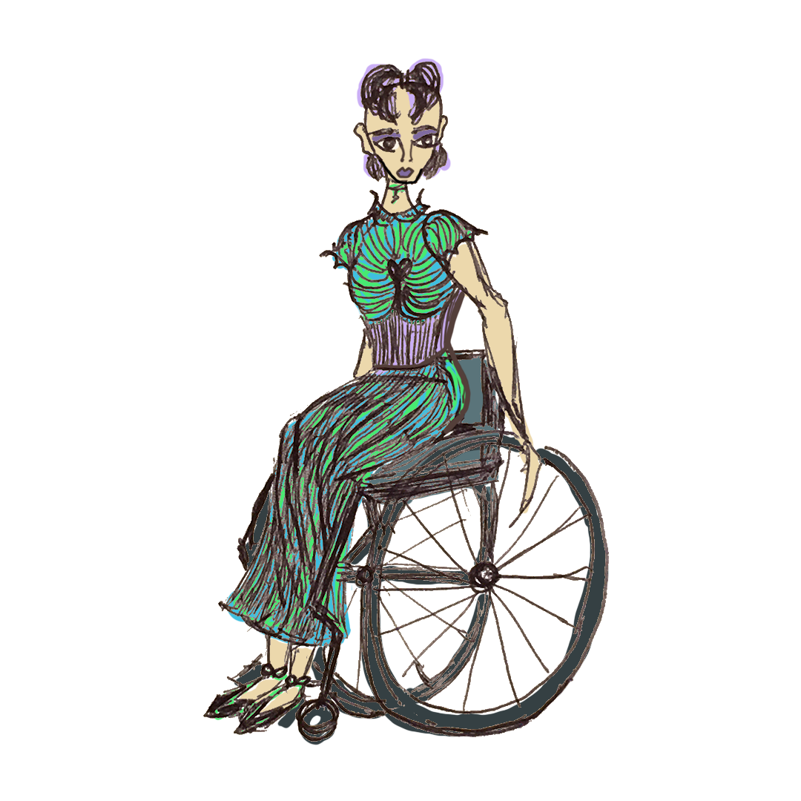
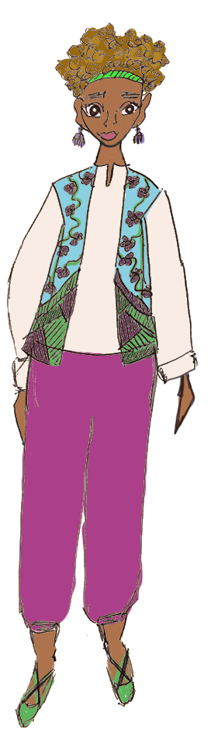
Risk POINTS AND BARRIERS Assessment
Exercise
WORKBOOK - PAGE 7
Bonus Exercise - PAGE 11
Guidance - PAGE 12
39
Notes:
Exercise: Risk Points and Barriers Assessment
We’ll now do the Risk Points and Barriers Assessment exercise. Please turn to the page in your Workbook that is on the screen.
For this exercise, you’ll split into six teams. Please count off by six. I’ve placed the numbers one through six on the tables. Please go to your number.
In your Workbook are the Risk Point and Barrier Assessment Profiles and Risk Point and Barrier Assessment Worksheet. Read the profile that corresponds to your team number, then turn to the worksheet.
Fill in the most important risk point and the most important t barrier you believe the individual faces in each key challenge area. Keep in mind we are thinking about the risk points and barriers these individuals face in all aspects of their daily lives.
When you determine the top risk point and top barrier for each key challenge area, ensure you take into account the full information in the profile and other factors like location and age.
You should consider the risk points and barriers the individual faces not only today but also in the future – three months from now, six months from now, a year from now and beyond. If you need ideas, please turn to the guidance section after your worksheet.
After you have read your profile and filled in the worksheet, we’ll hold a group discussion. I’ll ask you to briefly describe your profile and go through the top risk points and barriers, explaining why you chose them.
You have forty minutes to complete your worksheets. If you complete your sheet early, you can turn to the bonus chart on the next page where you will consider how visibility changes the situation for your individual.
After 40 minutes have passed-
Now that you have completed your assessment, let’s discuss them. Listen closely while each group discusses their profile. If you believe the individual profiled may face risks the team has not considered, please raise this so we can discuss as a group. Please nominate a team spokesperson.
----
Facilitation Note: While the teams are presenting, the Facilitator should display the relevant profile slides. The Facilitator should then use the blank slide following the profile to list the risk points and barriers identified by the team. After the team presents, the Facilitator should ask the group for initial ideas on how these risk points and barriers can be addressed and type them on the screen next to the identified risk points. See the Facilitation Guide page 176 for more information about this exercise and alternative facilitation ideas.
Time: 1 hour 40 minutes. 40 minutes for team activity; 60 minutes for discussion.

Slide 40


Exercise: Risk Points and Barriers Assessment
Ava is 62 years old. When she was 18, she got married. She and her husband were married for more than fifteen years, but Ava was unable to bear children, and he granted her a divorce. Due to her age and the economic needs of her family, they did not pressure her to marry again. Ava found a job working at a health clinic. It was there she met Laila more than 25 years ago. At that time, Laila was in her early 20s and married with three children. Ava and Laila were careful to conceal their relationship since they knew they could be gravely harmed. Despite their precautions, Ava’s brother discovered her and Laila together. He threatened to report her to the police. He also told Laila’s husband about the relationship. Ava and Laila fled, leaving Laila’s children behind.
Profile #1:
Ava
40
Notes:
Exercise: Risk Points and Barriers Assessment, continued
We’ll start with the first profile, Ava. Please start by reading your profile.
----
Facilitation Note: Display during the team’s presentation on this profile.
Time: 1 hour 40 minutes. 40 minutes for team activity; 60 minutes for discussion.
[Image description: a close-up of a person with feminine gender expression leaning her head on her hand, with small reading glasses at the tip of her nose.]

Slide 41
Exercise: Risk Points and Barriers Assessment
A sympathetic colleague put them in touch with a women’s group in a large city in another province. Ava obtained a job at a local clinic, and they were able to establish a household together there. A number of years later, there was an earthquake that devastated the city. The women’s organization Laila and Ava had relied on for support was destroyed. Feeling too vulnerable as single women to remain in the city, and unable to return to their village, Ava and Laila crossed the border into the country of asylum and sought assistance there.
Profile #1:
Ava
41
Notes:
Exercise: Risk Points and Barriers Assessment, continued
We’ll start with the first profile, Ava. Please start by reading your profile.
----
Facilitation Note: Display during the team’s presentation on this profile.
Time: 1 hour 40 minutes. 40 minutes for team activity; 60 minutes for discussion.
[Image description: a close-up of a person with feminine gender expression leaning her head on her hand, with small reading glasses at the tip of her nose.]

Slide 42
Exercise: Risk Points and Barriers Assessment
Since arriving, Ava and Laila have had difficulty finding work, and Laila has engaged in survival sex work. It is a rural area with many individuals from their country of origin who were displaced either by the earthquake or a tribal conflict in the region. They have told everyone they are aunt and niece, but fear being exposed.
Profile #1:
Ava
42
Notes:
Exercise: Risk Points and Barriers Assessment, continued
We’ll start with the first profile, Ava. Please start by reading your profile.
----
Facilitation Note: Display during the team’s presentation on this profile.
Time: 1 hour 40 minutes. 40 minutes for team activity; 60 minutes for discussion.
[Image description: a close-up of a person with feminine gender expression leaning her head on her hand, with small reading glasses at the tip of her nose.]

Slide 43
Exercise: Risk Points and Barriers Assessment
Profile #1: Ava
Ava is 62 years old. When she was 18, she got married. She and her husband were married for more than fifteen years, but Ava was unable to bear children, and he granted her a divorce. Due to her age and the economic needs of her family, they did not pressure her to marry again. Ava found a job working at a health clinic. It was there she met Laila more than 25 years ago. At that time, Laila was in her early 20s and married with three children. Ava and Laila were careful to conceal their relationship since they knew they could be gravely harmed. Despite their precautions, Ava’s brother discovered her and Laila together. He threatened to report her to the police. He also told Laila’s husband about the relationship. Ava and Laila fled, leaving Laila’s children behind.
A sympathetic colleague put them in touch with a women’s group in a large city in another province. Ava obtained a job at a local clinic, and they were able to establish a household together there. A number of years later, there was an earthquake that devastated the city. The women’s organization Laila and Ava had relied on for support was destroyed. Feeling too vulnerable as single women to remain in the city, and unable to return to their village, Ava and Laila crossed the border into the country of asylum and sought assistance there.
Since arriving, Ava and Laila have had difficulty finding work, and Laila has engaged in survival sex work. It is a rural area with many individuals from their country of origin who were displaced either by the earthquake or a tribal conflict in the region. They have told everyone they are aunt and niece, but fear being exposed.
Potential Responses
Top Risk Points and Barriers
List / discuss risk point or barrier
43
Notes:
Exercise: Risk Points and Barriers Assessment, continued
Now please share the top risk point and barrier in each key challenge area.
Once all risk points and barriers are shared and noted on the screen-
What are some of the ways you think we could address these risk points and barriers?
----
Facilitation Note: Use this slide to enter the risk points the profile faces, as articulated by the team presenting on the profile, as well as potential responses.
Time: 1 hour 40 minutes. 40 minutes for team activity; 60 minutes for discussion.

Slide 44
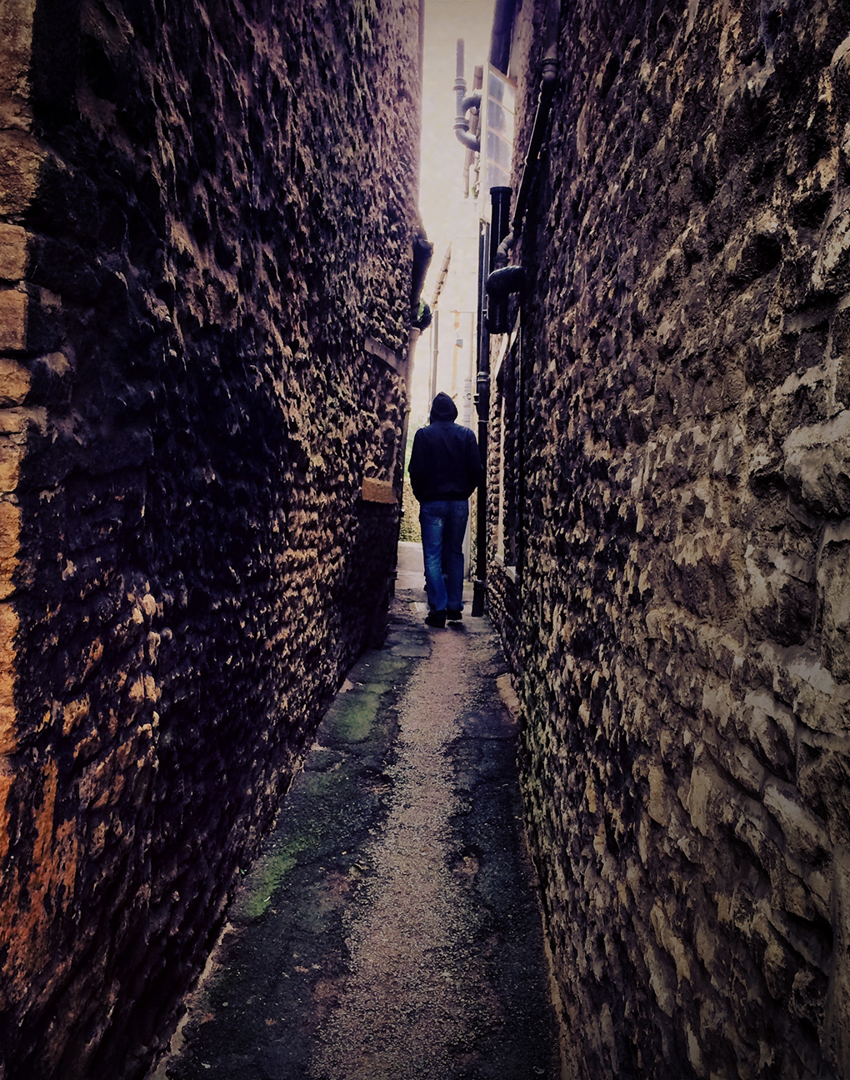
Exercise: Risk Points and Barriers Assessment
Anwar does not have friends or family members in the county of asylum.
He has recently approached assistance organizations because his savings are running out, and he does not have a legal work permit. Anwar fled his country of origin after being detained and severely abused by the police. The incident occurred because Anwar confessed to his wife that he had been in a long-term relationship with a man.
Profile #2:
Anwar
44
Notes:
Exercise: Risk Points and Barriers Assessment, continued
Now let’s look at the second profile. Please start by reading your profile.
----
Facilitation Note: Display during the team’s presentation on this profile.
Time: 1 hour 40 minutes. 40 minutes for team activity; 60 minutes for discussion.
[Image description: a long thin space in between two buildings made of stone with a shadowy figure with a hoodie on walking away.]

Slide 45
Exercise: Risk Points and Barriers Assessment
She suspected he was having an affair for some time, and after reading text messages on his phone confronted him. He hoped she might be sympathetic so confided in her. Instead, she reported him and his partner to the local police station. After she reported him, the police arrested Anwar and his partner and detained them for several weeks.
Anwar’s wife told her family he was arrested because he had been abusing her.
Profile #2:
Anwar
45
Notes:
Exercise: Risk Points and Barriers Assessment, continued
Now let’s look at the second profile. Please start by reading your profile.
----
Facilitation Note: Display during the team’s presentation on this profile.
Time: 1 hour 40 minutes. 40 minutes for team activity; 60 minutes for discussion.
[Image description: a long thin space in between two buildings made of stone with a shadowy figure with a hoodie on walking away.]

Slide 46
Exercise: Risk Points and Barriers Assessment
During his detention, Anwar suffered both physical and sexual violence. Eventually, friends paid his bail and, after his release, Anwar emptied his bank account and fled the country. As he was leaving, he received threatening text messages from his wife’s family. Since his arrival, he’s had no contact with them or his partner.
Profile #2:
Anwar
46
Notes:
Exercise: Risk Points and Barriers Assessment, continued
Now let’s look at the second profile. Please start by reading your profile.
----
Facilitation Note: Display during the team’s presentation on this profile.
Time: 1 hour 40 minutes. 40 minutes for team activity; 60 minutes for discussion.
[Image description: a long thin space in between two buildings made of stone with a shadowy figure with a hoodie on walking away.]

Slide 47
Exercise: Risk Points and Barriers Assessment
Profile #2: Anwar
Anwar lives in an urban area and has isolated himself from other persons of concern, including those from his country of origin, due to the fear they will persecute him. He maintains a low profile. He avoids going out during the day, if possible, and avoids crowded public areas where people may see him. He prefers to go out in the evenings and do his shopping when markets are less crowded and he can maintain his anonymity. Anwar does not have friends or family members in the county of asylum. He has recently approached assistance organizations because his savings are running out, and he does not have a legal work permit. Anwar fled his country of origin after being detained and severely abused by the police. The incident occurred because Anwar confessed to his wife that he had been in a long-term relationship with a man.
She suspected he was having an affair for some time, and after reading text messages on his phone confronted him. He hoped she might be sympathetic so confided in her. Instead, she reported him and his partner to the local police station. After she reported him, the police arrested Anwar and his partner and detained them for several weeks. Anwar’s wife told her family he was arrested because he had been abusing her.
During his detention, Anwar suffered both physical and sexual violence. Eventually, friends paid his bail and, after his release, Anwar emptied his bank account and fled the country. As he was leaving, he received threatening text messages from his wife’s family. Since his arrival, he’s had no contact with them or his partner.
Potential Responses
Top Risk Points and Barriers
List / discuss risk point or barrier
47
Notes:
Exercise: Risk Points and Barriers Assessment, continued
Now please share the top risk point and barrier in each key challenge area.
Once all risk points and barriers are shared and noted on the screen-
What are some of the ways you think we could address these risk points and barriers?
----
Facilitation Note: Use this slide to enter the risk points the profile faces, as articulated by the team presenting on the profile, as well as potential responses.
Time: 1 hour 40 minutes. 40 minutes for team activity; 60 minutes for discussion.

Slide 48
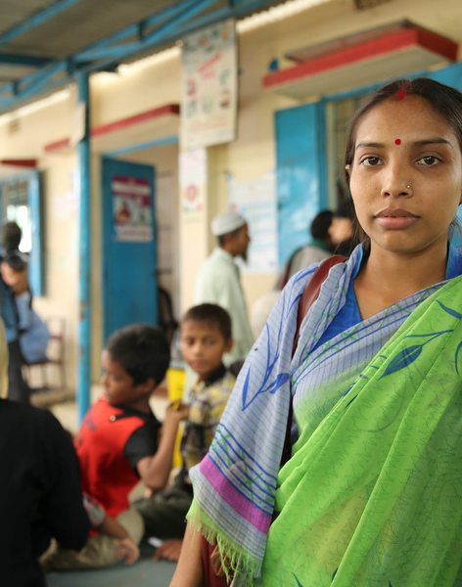

Exercise: Risk Points and Barriers Assessment
Mia is a 24-year-old bisexual woman who was displaced eight months ago. Mia’s mother died when she was born and her father remains in the country of origin. She has no other relatives or close friends in the country of asylum. Mia lives with three young single women in an urban area that is primarily populated by migrants and asylum-seekers from the region. She was placed in the housing with the young women through a service provider and does not know them well.
Profile #3:
Mia
48
Notes:
Exercise: Risk Points and Barriers Assessment, continued
Now let’s look at the third profile. Please start by reading your profile.
----
Facilitation Note: Display during the team’s presentation on this profile.
Time: 1 hour 40 minutes. 40 minutes for team activity; 60 minutes for discussion.
[Image description: a young woman stands facing the camera indoors, with others in the background behind her facing other directions.]

Slide 49
Exercise: Risk Points and Barriers Assessment
Prior to her flight, Mia was severely injured in an attack against her and her female partner by members of the community. Her partner was killed. Friends later helped Mia flee the country. As a result of her injuries, Mia now has severe mobility issues and requires assistance walking.
She subsists on assistance from an organization for asylum-seekers with disabilities, but the assistance is limited, and Mia often must rely on sympathetic neighbors and friends in order to support herself throughout the month.
Profile #3:
Mia
49
Notes:
Exercise: Risk Points and Barriers Assessment, continued
Now let’s look at the third profile. Please start by reading your profile.
----
Facilitation Note: Display during the team’s presentation on this profile.
Time: 1 hour 40 minutes. 40 minutes for team activity; 60 minutes for discussion.
[Image description: a young woman stands facing the camera indoors, with others in the background behind her facing other directions.]

Slide 50
Exercise: Risk Points and Barriers Assessment
Mia has avoided discussing her relationships with women or her partner due to her fear of discrimination or violence from service providers, housemates, neighbors and community members. She also fears that if she discloses the reason she fled her country of origin, she will stop receiving assistance. Prior to the attack, Mia had experienced a number of other issues in her country of origin related to her perceived and real sexual orientation, including harassment and violence. She is currently seeking asylum.
Profile #3:
Mia
50
Notes:
Exercise: Risk Points and Barriers Assessment, continued
Now let’s look at the third profile. Please start by reading your profile.
----
Facilitation Note: Display during the team’s presentation on this profile.
Time: 1 hour 40 minutes. 40 minutes for team activity; 60 minutes for discussion.
[Image description: a young woman stands facing the camera indoors, with others in the background behind her facing other directions.]

Slide 51
Exercise: Risk Points and Barriers Assessment
Profile #3: MIA
Mia is a 24-year-old bisexual woman who was displaced eight months ago. Mia’s mother died when she was born and her father remains in the country of origin. She has no other relatives or close friends in the country of asylum. Mia lives with three young single women in an urban area that is primarily populated by migrants and asylum-seekers from the region. She was placed in the housing with the young women through a service provider and does not know them well.
Prior to her flight, Mia was severely injured in an attack against her and her female partner by members of the community. Her partner was killed. Friends later helped Mia flee the country. As a result of her injuries, Mia now has severe mobility issues and requires assistance walking.
She subsists on assistance from an organization for asylum-seekers with disabilities, but the assistance is limited, and Mia often must rely on sympathetic neighbors and friends in order to support herself throughout the month.
Mia has avoided discussing her relationships with women or her partner due to her fear of discrimination or violence from service providers, housemates, neighbors and community members. She also fears that if she discloses the reason she fled her country of origin, she will stop receiving assistance. Prior to the attack, Mia had experienced a number of other issues in her country of origin related to her perceived and real sexual orientation, including harassment and violence. She is currently seeking asylum.
Potential Responses
Top Risk Points and Barriers
List / discuss risk point or barrier
51
Notes:
Exercise: Risk Points and Barriers Assessment, continued
Now please share the top risk point and barrier in each key challenge area.
Once all risk points and barriers are shared and noted on the screen-
What are some of the ways you think we could address these risk points and barriers?
----
Facilitation Note: Use this slide to enter the risk points the profile faces, as articulated by the team presenting on the profile, as well as potential responses.
Time: 1 hour 40 minutes. 40 minutes for team activity; 60 minutes for discussion.

Slide 52

Exercise: Risk Points and Barriers Assessment
Jack is a 28-year-old transgender man. He moved to the country of asylum as a labor migrant in his early 20s. At that time, Jack had the gender expression of female and used the name that was assigned to him at birth, Shreeni. His official documents, including a national ID card, visa and passport, list this name.
Jack experienced a wide range of issues related to his gender identity while growing up, including violence at home and in school. Due to bullying from students and extended periods of drug use, Jack dropped out of school at age 14. His parents later asked him to leave the house. He subsequently moved to the capital city in order to look for work. Later, he decided to move abroad to work as a domestic helper.
Profile #4:
Jack
52
Notes:
Exercise: Risk Points and Barriers Assessment, continued
Now let’s look at the fourth profile. Please start by reading your profile.
----
Facilitation Note: Display during the team’s presentation on this profile.
Time: 1 hour 40 minutes. 40 minutes for team activity; 60 minutes for discussion.
[Image description: a close-up of half of the face of a shadowed person who is looking down at the ground.]

Slide 53
Exercise: Risk Points and Barriers Assessment
After several years in the country of asylum, Jack decided to quit his domestic job and transition to male. He accessed hormones through the black market, transitioned his gender expression to male and moved to temporary housing in a city with other transgender migrants. In order to support himself, Jack began working in the informal economy, mostly doing construction. After transitioning, Jack determined he was unable to return to his country of origin and applied for asylum. Soon after, he was detained at a police checkpoint for lacking proper identification, since his past employer had kept his passport. Jack is currently in detention for working illegally in the country and is facing deportation. He is being denied access to hormones and the sanitary supplies that are furnished to female detainees.
Profile #4:
Jack
53
Notes:
Exercise: Risk Points and Barriers Assessment, continued
Now let’s look at the fourth profile. Please start by reading your profile.
----
Facilitation Note: Display during the team’s presentation on this profile.
Time: 1 hour 40 minutes. 40 minutes for team activity; 60 minutes for discussion.
[Image description: a close-up of half of the face of a shadowed person who is looking down at the ground.]

Slide 54
Exercise: Risk Points and Barriers Assessment
Profile #4: Jack
Jack is a 28-year-old transgender man. He moved to the country of asylum as a labor migrant in his early 20s. At that time, Jack had the gender expression of female and used the name that was assigned to him at birth, Shreeni. His official documents, including a national ID card, visa and passport, list this name.
Jack experienced a wide range of issues related to his gender identity while growing up, including violence at home and in school. Due to bullying from students and extended periods of drug use, Jack dropped out of school at age 14. His parents later asked him to leave the house. He subsequently moved to the capital city in order to look for work. Later, he decided to move abroad to work as a domestic helper.
After several years in the country of asylum, Jack decided to quit his domestic job and transition to male. He accessed hormones through the black market, transitioned his gender expression to male and moved to temporary housing in a city with other transgender migrants. In order to support himself, Jack began working in the informal economy, mostly doing construction. After transitioning, Jack determined he was unable to return to his country of origin and applied for asylum. Soon after, he was detained at a police checkpoint for lacking proper identification, since his past employer had kept his passport. Jack is currently in detention for working illegally in the country and is facing deportation. He is being denied access to hormones and the sanitary supplies that are furnished to female detainees.
Potential Responses
Top Risk Points and Barriers
List / discuss risk point or barrier
54
Notes:
Exercise: Risk Points and Barriers Assessment, continued
Now please share the top risk point and barrier in each key challenge area.
Once all risk points and barriers are shared and noted on the screen-
What are some of the ways you think we could address these risk points and barriers?
----
Facilitation Note: Use this slide to enter the risk points the profile faces, as articulated by the team presenting on the profile, as well as potential responses.
Time: 1 hour 40 minutes. 40 minutes for team activity; 60 minutes for discussion.

Slide 55
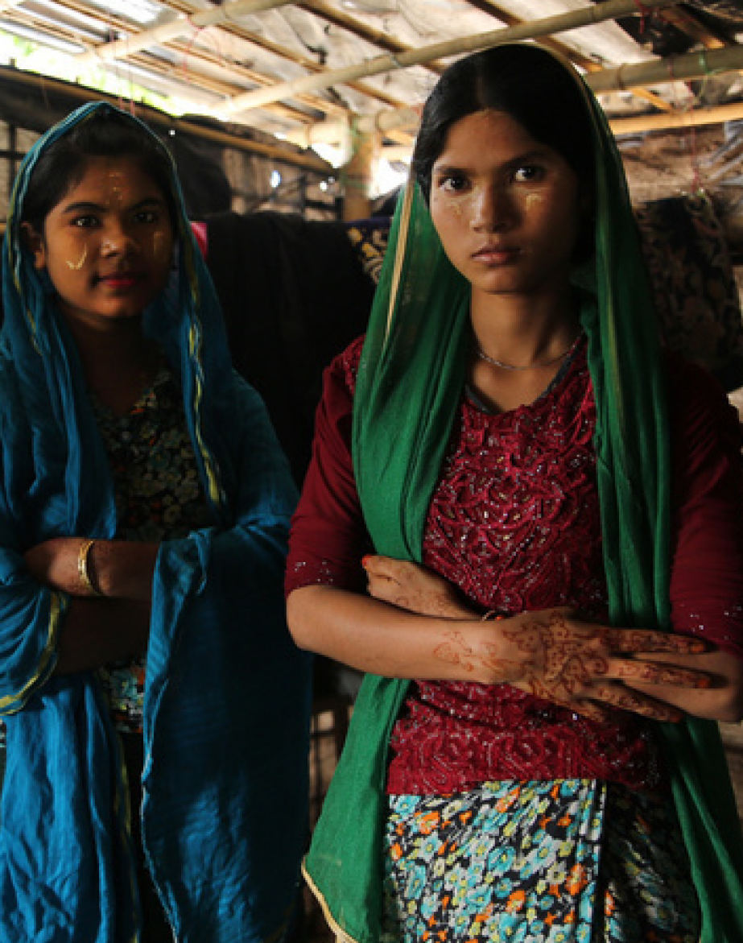
Exercise: Risk Points and Barriers Assessment
Sarah is a 22-year-old transgender woman. When she was 21, she left her community due to ongoing political conflict. She was already living apart from her family at the time she left and has not been in touch with them since. She fled with the two friends with whom she had been sharing an apartment, and together they moved into a temporary camp established by other displaced transgender women. Sarah lost her documents when they fled their apartment and has not been able to return to retrieve them. They list her sex assigned at birth as male.
Profile #5:
Sarah
55
Notes:
Exercise: Risk Points and Barriers Assessment, continued
Now let’s look at the fifth profile. Please start by reading your profile.
----
Facilitation Note: Display during the team’s presentation on this profile.
Time: 1 hour 40 minutes. 40 minutes for team activity; 60 minutes for discussion.
[Image description: a young woman with her arms folded across her stomach stands in a shelter with a friend in Cox’s Bazar, Bangalessh. They both look at the viewer.]

Slide 56
Exercise: Risk Points and Barriers Assessment
Prior to leaving her community and moving to the temporary camp, Sarah was taking hormones. She was easily able to obtain them from a pharmacy prior to fleeing, but now that she is living in a camp has more difficulty obtaining them. The nearest pharmacy does not have the hormones she needs, and the cost of travelling to the city to obtain them is prohibitive given her meager savings. She instead relies on the black market and many days has to skip doses.
Profile #5:
Sarah
56
Notes:
Exercise: Risk Points and Barriers Assessment, continued
Now let’s look at the fifth profile. Please start by reading your profile.
----
Facilitation Note: Display during the team’s presentation on this profile.
Time: 1 hour 40 minutes. 40 minutes for team activity; 60 minutes for discussion.
[Image description: a young woman with her arms folded across her stomach stands in a shelter with a friend in Cox’s Bazar, Bangalessh. They both look at the viewer.]

Slide 57
Exercise: Risk Points and Barriers Assessment
Sarah and the other women living in the camp experience regular food insecurity and do not have access to clean water or sanitation facilities. Because they largely do not have ID cards matching their gender expression, they have been unable to register for aid from government providers. They have been ignored by the international organizations who are assisting residents of other camps, and the little aid they receive is coming from sympathetic community members and one local women’s organization. They have tried to elevate their situation to a nearby UN office by leaving messages with the security guards at the gate but have received no response. Based on the reactions they receive from the guards, they suspect their messages are not reaching the reception desk or relevant staff members. Some have suggested that they may need to camp outside the office gates of the UN office in order to have their voices heard.
Profile #5:
Sarah
57
Notes:
Exercise: Risk Points and Barriers Assessment, continued
Now let’s look at the fifth profile. Please start by reading your profile.
----
Facilitation Note: Display during the team’s presentation on this profile.
Time: 1 hour 40 minutes. 40 minutes for team activity; 60 minutes for discussion.
[Image description: a young woman with her arms folded across her stomach stands in a shelter with a friend in Cox’s Bazar, Bangalessh. They both look at the viewer.]

Slide 58
Exercise: Risk Points and Barriers Assessment
Profile #5: Sarah
Sarah is a 22-year-old transgender woman. When she was 21, she left her community due to ongoing political conflict. She was already living apart from her family at the time she left and has not been in touch with them since. She fled with the two friends with whom she had been sharing an apartment, and together they moved into a temporary camp established by other displaced transgender women. Sarah lost her documents when they fled their apartment and has not been able to return to retrieve them. They list her sex assigned at birth as male.
Prior to leaving her community and moving to the temporary camp, Sarah was taking hormones. She was easily able to obtain them from a pharmacy prior to fleeing, but now that she is living in a camp has more difficulty obtaining them. The nearest pharmacy does not have the hormones she needs, and the cost of travelling to the city to obtain them is prohibitive given her meager savings. She instead relies on the black market and many days has to skip doses.
Sarah and the other women living in the camp experience regular food insecurity and do not have access to clean water or sanitation facilities. Because they largely do not have ID cards matching their gender expression, they have been unable to register for aid from government providers. They have been ignored by the international organizations who are assisting residents of other camps, and the little aid they receive is coming from sympathetic community members and one local women’s organization. They have tried to elevate their situation to a nearby UN office by leaving messages with the security guards at the gate but have received no response. Based on the reactions they receive from the guards, they suspect their messages are not reaching the reception desk or relevant staff members. Some have suggested that they may need to camp outside the office gates of the UN office in order to have their voices heard.
Potential Responses
Top Risk Points and Barriers
List / discuss risk point or barrier
58
Notes:
Exercise: Risk Points and Barriers Assessment, continued
Now please share the top risk point and barrier in each key challenge area.
Once all risk points and barriers are shared and noted on the screen-
What are some of the ways you think we could address these risk points and barriers?
----
Facilitation Note: Use this slide to enter the risk points the profile faces, as articulated by the team presenting on the profile, as well as potential responses.
Time: 1 hour 40 minutes. 40 minutes for team activity; 60 minutes for discussion.

Slide 59
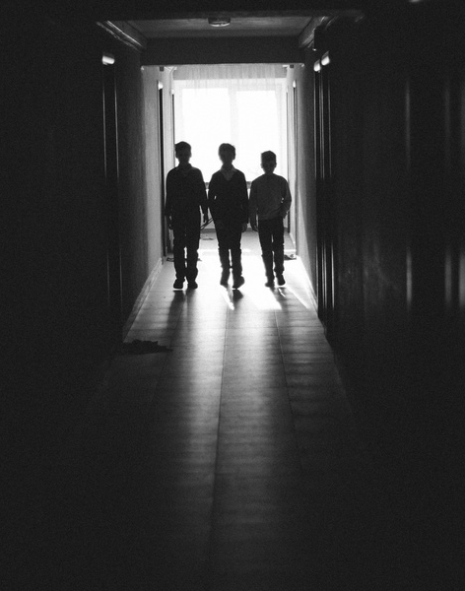
Exercise: Risk Points and Barriers Assessment
Aden and Awo are ages five and seven, respectively. They are siblings and live in a camp with their parents, grandparents and three other siblings. Both children are intersex. Aden’s birth certificate lists him as male and Awo’s birth certificate lists her as female. The children have been raised to conform to those gender roles.
For that reason, when Aden and Awo’s parents fled the country due to violence related to a revolution, they moved to a different area of the asylum country than most individuals from their community.
Profile #6:
Aden and Awo
59
Notes:
Exercise: Risk Points and Barriers Assessment, continued
Now let’s look at the sixth profile. Please start by reading your profile.
----
Facilitation Note: Display during the team’s presentation on this profile.
Time: 1 hour 40 minutes. 40 minutes for team activity; 60 minutes for discussion.
[Image description: three young children stand in a doorway walking toward the viewer. The image is back-lit and their faces are obscured.]

Slide 60
Exercise: Risk Points and Barriers Assessment
Aden and Awo’s parents fled their country of origin before Aden was born. In their country of origin, they experienced discrimination from neighbors and community members who were aware that Awo was intersex. In their culture, children born intersex are viewed as having a severe disability. Families may hide the fact that children are intersex and, in extreme cases, place them in foster care or orphanages.
Profile #6:
Aden and Awo
60
Notes:
Exercise: Risk Points and Barriers Assessment, continued
Now let’s look at the sixth profile. Please start by reading your profile.
----
Facilitation Note: Display during the team’s presentation on this profile.
Time: 1 hour 40 minutes. 40 minutes for team activity; 60 minutes for discussion.
[Image description: three young children stand in a doorway walking toward the viewer. The image is back-lit and their faces are obscured.]

Slide 61
Exercise: Risk Points and Barriers Assessment
After arriving in the country of asylum, Aden was born. The nurses at the clinic in the camp where he was delivered noted he was intersex and did not keep the information confidential. Therefore, it is widely known that the family has an intersex child, although neighbors do not know definitively which child. All members of the family face stigma and discrimination, both at home and in school. Aden and Awo’s parents are afraid that the idle threats neighbors have made against them might one day be actualized.
Profile #6:
Aden and Awo
61
Notes:
Exercise: Risk Points and Barriers Assessment, continued
Now let’s look at the sixth profile. Please start by reading your profile.
----
Facilitation Note: Display during the team’s presentation on this profile.
Time: 1 hour 40 minutes. 40 minutes for team activity; 60 minutes for discussion.
[Image description: three young children stand in a doorway walking toward the viewer. The image is back-lit and their faces are obscured.]

Slide 62
Exercise: Risk Points and Barriers Assessment
Profile #5: ADEN AND AWO
Aden and Awo are ages five and seven, respectively. They are siblings and live in a camp with their parents, grandparents and three other siblings. Both children are intersex. Aden’s birth certificate lists him as male and Awo’s birth certificate lists her as female. The children have been raised to conform to those gender roles.
Aden and Awo’s parents fled their country of origin before Aden was born. In their country of origin, they experienced discrimination from neighbors and community members who were aware that Awo was intersex. In their culture, children born intersex are viewed as having a severe disability. Families may hide the fact that children are intersex and, in extreme cases, place them in foster care or orphanages
For that reason, when Aden and Awo’s parents fled the country due to violence related to a revolution, they moved to a different area of the asylum country than most individuals from their community.
After arriving in the country of asylum, Aden was born. The nurses at the clinic in the camp where he was delivered noted he was intersex and did not keep the information confidential. Therefore, it is widely known that the family has an intersex child, although neighbors do not know definitively which child. All members of the family face stigma and discrimination, both at home and in school. Aden and Awo’s parents are afraid that the idle threats neighbors have made against them might one day be actualized
Potential Responses
Top Risk Points and Barriers
List / discuss risk point or barrier
62
Notes:
Exercise: Risk Points and Barriers Assessment, continued
Now please share the top risk point and barrier in each key challenge area.
Once all risk points and barriers are shared and noted on the screen-
What are some of the ways you think we could address these risk points and barriers?
----
Facilitation Note: Use this slide to enter the risk points the profile faces, as articulated by the team presenting on the profile, as well as potential responses.
Time: 1 hour 40 minutes. 40 minutes for team activity; 60 minutes for discussion.

Slide 63
PROTECTION responses
Exercise
WORKBOOK - PAGE 18
Guidance - PAGE 22
63
Notes:
Exercise: Protection Responses
We’ll now do the Protection Responses exercise.
In the previous exercise we analyzed risk points and barriers by looking at key challenge areas and various profiles people with diverse SOGIESC. In this exercise we’ll identify potential responses by looking at a specific scenario in which people with diverse SOGIESC are at risk.
For this exercise, we’ll form three new teams. Please count off by three. I’ve laid out team number table cards.
In your workbooks are a set of scenarios and a worksheet. Read the scenario that corresponds to your team number, then turn to the worksheet. Your goal is to come up with specific and actionable responses to each key challenge area within the scenario, keeping in mind the various needs of different people with diverse SOGIESC.
Once you have formulated responses, you should write them on the post-it notes I’ve distributed and place them on the wall under the corresponding key challenge area. Write one response per post-it note only. If you need inspiration, please see the guidance section in your workbook or look at the other team’s responses.
Keep in mind that your responses should be specific and reasonable. Use plenty of detail to explain how you will achieve your responses. If you finish early or need extra help, I will give you new information
You have 60 minutes to complete the exercise, then we will discuss.
After 60 minutes have passed-
Now we’ll look at all of the responses. Let’s all stand up and go to the first key challenge area. Each group will tell us in turn what your responses were in that area. We’ll go through each area one by one.
----
Facilitation Note: Hand Alert Cards to teams that finish early and Response Example Cards to teams that need assistance. See the Facilitation Guide page 187 for more information about this exercise and alternative facilitation ideas.
Time: 2 hours 10 minutes. 60 minutes for team activity; 70 minutes for group discussion.

Slide 64
Building Service Networks
Exercise
WORKBOOK - PAGE 25
64
Notes:
Exercise: Building Service Networks
We’ll now do an exercise on Building Service Networks.
For this exercise, we’ll form new teams. Please group together by mission, programme or organization. If you are the only individual from your organization, you may join individuals from another organization – ideally those who partner with you – or work on your own.
In your Workbook is a Building Service Networks worksheet. During the next 20 minutes, you should fill out this worksheet with the organizations you might be able to work with in each thematic area.
If you are unsure of any organizations that are LGBTIQ+ friendly, list organizations you may be able to work with and specify in the notes area what might be done to increase their readiness of LGBTIQ+ competency, such as training or information sessions. Once you are finished, we will share with one another.
After 20 minutes have passed-
Now that you have completed your worksheet, let’s hear about it. Tell us about your proposed list of organizations and share with us any challenges or action items you foresee. Where are the gaps in service?
----
Facilitation Note: See the Facilitation Guide page 208 for more information about this exercise and alternative facilitation ideas.
Time: 40 minutes. 20 minutes for team activity; 20 minutes for group discussion.

Slide 65
Action Plan
Exercise
WORKBOOK - PAGE 28
65
Notes:
Exercise: Action Plan
We’ll now do our final exercise, which is creating an action plan to take back to your office. Please turn to the Action Plan exercise worksheet.
For this exercise, we’ll form new teams. Please group together by mission, programme or organization. If you are the only individual from your organization, you may join individuals from another organization – ideally those who partner with you – or work on your own.
In your Workbook is an Action Plan worksheet. During the next 15 minutes, you should fill out this worksheet with actionable items you can implement in your office when you return after this training.
The items should be appropriate, achievable in a reasonable time frame and directly related to the risk points people with diverse SOGIESC face in your location or programmes. Set a timeline you think is reasonable to implement each item. Also note any barriers or obstacles you foresee and how you will overcome those challenges.
The goal is to create a list of actionable items you can realistically implement in the coming months and that you think will address the major risk points for people with diverse SOGIESC where you work. If you need inspiration, you can look at the guidance following the worksheet.
After 15 minutes have passed-
Now that you have completed your plan, let’s hear about it. Tell us about your proposed list of action items, including the timelines and the potential challenges.
----
Facilitation Note: See the Facilitation Guide page 212 for more information about this exercise and alternative facilitation ideas.
Time: 25 minutes. 15 minutes for team activity; 10 minutes for group discussion.

Slide 66
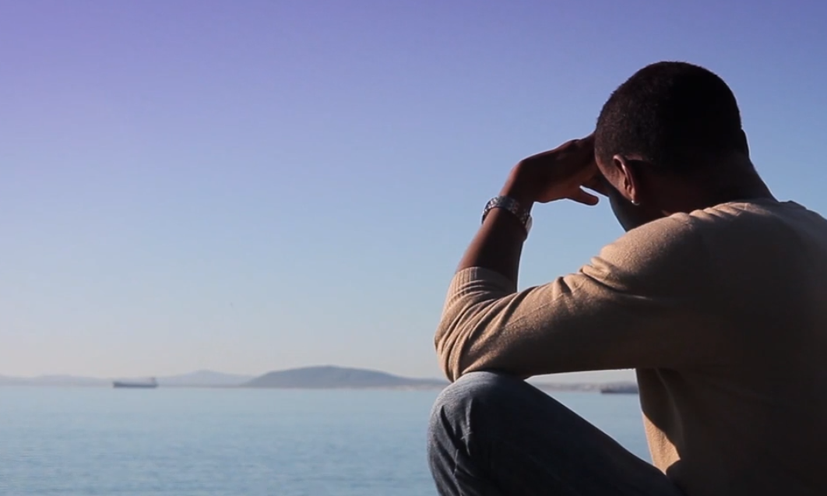
Video
As I Am: Understanding the Sexual Orientation and Gender Identity of Refugees
ORAM (2:55)
66
Notes:
Video
Before we wrap up this module, we’ll learn about the lived experiences of someone with diverse SOGIESC. This video is about a refugee from the Democratic Republic of Congo.
----
Video Link: Play from 4:35 – 7:40 (2:55): https://vimeo.com/58754985
Time: 3 minutes.

Slide 67
Special Considerations in IOM Programming
OBJECTIVES
EMERGENCIES AND ASSISTANCE TO VULNERABLE MIGRANTS
AVRR AND VICTIMS OF TRAFFICKING WHO HAVE RETURNED HOME
INTERNATIONAL BORDER MANAGEMENT AND SECURITY POINTS
The needs of people with diverse SOGIESC are unique and relevant to every sector of response and all IOM programming.
Returned migrations and victims of trafficking may need special support to re-establish themselves.
Security, immigration and border officials should be encouraged to treat all migrants with respect.
1
1
67
Notes:
Considerations for IOM Programming
We’ll wrap up this module by thinking about some of the protection considerations for various types of IOM programming. IOM has a wide range of programs, so these are just a few highlights relating to some of our work.
Emergencies and Assistance to Vulnerable Migrants: Emergency response teams and programs offering assistance to vulnerable migrants typically include gender specialists and/or protection specialists. Those personnel should be trained to understand the issues people with diverse SOGIESC face, and should understand how to make their work inclusive, participatory and confidential. The needs of people with diverse SOGIESC are unique and relevant to every sector of emergency response, from shelter and NFIs to WASH to health, as well as to all IOM programming for vulnerable migrants. Those needs are often different from, and in some cases contrary to, the needs of other vulnerable populations. For teams with little experience working with people with diverse SOGIESC, webinars can be arranged through the IOM LGBTIQ+ Focal Point. When designing settlements and facilities, teams should refer to the IOM Guidance on Inclusive Facilities. That guidance is available on the IOM intranet under “About Us” and “Diversity and Inclusion in IOM Programming”.
Assisted Voluntary Return and Reintegration (AVRR) and Victims of Trafficking Who Have Returned Home: Migrants accessing IOM’s assisted voluntary return and reintegration programs should be given clear information on the circumstances related to diverse SOGIESC in their country. Migrants who have returned home through AVRR programs, including those who are victims of trafficking, may have unique needs related to shelter and community support. It is important to keep in mind that they may have left their countries, in whole or in part, in order to escape SOGIESC-related discrimination and persecution, and they may not be able to return to their communities of origin in the same way other migrants would. During migration, they may have become disconnected with normal coping mechanisms in their home country and need support in reconnecting to organizations who can assist them.
International Border Management and Security Points: A key factor to keep in mind in relation to IOM’s work at borders, as well as IOM-managed security points, is that how migrants with diverse SOGIESC are treated by security, border and immigration officials matters in terms of their willingness to share information later. IOM is often tasked with training security, border and immigration officials. In our trainings, we should emphasize that it is critical all migrants are treated with dignity and respect, regardless of their appearance or incongruencies between their gender expression and official documentation. Even in countries where SOGIESC topics are sensitive, we can convey the message that everyone should be treated respectfully, no matter how they look or behave. This can help deter officials from laughing at, making fun of, exposing or turning away an individual with diverse SOGIESC.
----
Facilitation Note: This slide is optional depending on the audience. If using this slide for an IOM or partner audience, un-hide it by moving your arrow to the left navigation pane, right-clicking on this slide and choosing “Hide Slide.” The slide color in the navigation pane will shift from opaque to transparent and the slide will appear when the presentation is in Slide Show mode. If you later wish to hide it again, you can do so by moving your arrow to the left navigation pane, right-clicking on this slide and choosing “Hide Slide.” Do not delete this slide, as the slide numbers in the remainder of the presentation will then be incorrect in reference to the Facilitation Guide Timing Charts.
Time: 3 minutes.

Slide 68
Key Learning Points
Myriad and often severe needs
Intersectional factors
Some individuals are at particular risk
Normal protection tools
01
02
03
04
68
Notes:
Key Learning Points
The key learning points from this module are:
The protection needs of people with diverse SOGIESC are myriad and often severe, and may span the entire cycle of migration, displacement or a crisis.
An individual’s needs may be dependent on factors such as location, age, gender identity, sexual orientation and whether the individual has a partner or children.
Particular risks are faced by single women, transgender people, same-gender partners, people with disabilities and people in detention, although everyone is potentially vulnerable.
The benefits and risks of normal protection tools should be weighed carefully, as people with diverse SOGIESC may have different needs.
----
Time: 1 minute.

Slide 69
Key Learning Points
Time and creative solutions
Establish trust
Mainstream into services and programmes
Approach in a holistic manner
05
06
07
08
69
Notes:
Key Learning Points, continued
Remember that addressing risk points and barriers for people with diverse SOGIESC takes time and requires creative solutions tailored to the available resources and environment.
Establish trust with people with diverse SOGIESC and relevant organizations and listen to their ideas about how you can best address risk points and barriers.
Seek ways to mainstream protection of people with diverse SOGIESC into all services and programs in your office.
Approach safe spaces in a holistic manner: establish them in your own office while encouraging others to do the same.
----
Time: 1 minute.

Slide 70

11
ASSESSING
PROTECTION
NEEDS
70
Notes:
Module 11 Overview
In this module, you’ll learn how to use the UNHCR High Risk Identification Tool (HRIT) and apply it to different scenarios involving people with diverse SOGIESC.
----
Total Module Time: 2 hours 5 minutes.

Slide 71
MODULE 11
OBJECTIVES
01
02
common protection issues
Heightened Risk Identification Tool
Review common protection issues faced by people with diverse SOGIESC
Explore how to use the Heightened Risk Identification Tool, or HRIT, for people with diverse SOGIESC
1
1
71
Notes:
Objectives
The objectives of this module are to:
Review common protection issues faced by people with diverse SOGIESC.
Explore how to use the Heightened Risk Identification Tool, or HRIT, for people with diverse SOGIESC.
----
Time: 1 minute.

Slide 72
During The Asylum Process, LGBTIQ+ People Risk:
Threats
Attacks and harassment
to their physical safety
by local persons or other asylum-seekers and refugees
Violence and detention
Sexual violence, detention and refoulement
Lack of support
Penalties
from police or security entities
Criminal penalties
72
Notes:
Review: Common Protection Issues
Before we do the exercise for this module, let’s quickly review the common protection issues faced by people with diverse SOGIESC.
In displacement and during the asylum process, people with diverse SOGIESC face:
Threats to their physical safety
Attacks and harassment by local persons, asylum-seekers and refugees
Sexual violence, detention and refoulement
Criminal penalties
A lack of support from police or security entities
----
Time: 2 minutes.

Slide 73
Exacerbating Factors Include:
A lack of family and community support (sometimes called double marginalization).
Difficulty accessing housing, employment, education, health, psychological care and social services.
Eviction from housing and firing from employment – individuals may resort to sex work to survive.
Negative attitudes and prejudice from staff of service organizations.
Length of the asylum process.
Length of the resettlement process, if it is an option.
Poor resettlement placement, continuing cycle of marginalization and victimization, or a resettlement destination that does not provide adequate medical care.
prejudice
family
Lack of
housing
support
lengthy
access
community
EMPLOYMENT
difficult
marginalization
resettlement
lengthy
asylum
inadequate medical
placement
health care
care
73
Notes:
Review: Common Protection Issues, continued
Exacerbating factors include:
A lack of family and community support. This is sometimes called double marginalization, which means individuals are marginalized both because they are migrants, refugees or asylum-seekers and because they have diverse SOGIESC.
Difficulty accessing housing, employment, education, health, psychological care and social services.
Eviction from housing and firing from employment – individuals may resort to sex work to survive.
Negative attitudes and prejudice from staff of service organizations.
Exacerbating factors also include:
The length of the asylum process.
The length of the resettlement process, if it is an option.
Poor resettlement placement, continuing the cycle of marginalization and victimization, or a resettlement destination that does not provide adequate medical care.
----
Time: 3 minutes.

Slide 74
Case Study Assessment
Exercise
WORKBOOK - PAGE 33
74
Notes:
Exercise: Case Study Assessment
We'll now do an exercise that will help us learn about assessing protection needs. It will also provide you with the opportunity to use the Heightened Risk Identification Tool for a person with diverse SOGIESC.
I have distributed to you the HRIT and HRIT User Guide. You will first thoroughly read the HRIT and the HRIT User Guide. Take 30 minutes to do this.
After 30 minutes –
You should now turn to the exercise worksheet in your workbook. We’ll start with the case study of Amal. Read the case study and then fill out the worksheet. It will prompt you when you have to use the HRIT. You have 20 minutes to work on this case study.
After 20 minutes–
Let’s now discuss Amal. Let’s go through the worksheet question by question. What did you put for #1? (Discuss each question with the group in turn.) Overall, what do you think about Amal’s risk level?
After 20 minutes–
Let’s now turn to the case study for Nur. Read the case study and fill out the worksheet for Nur.
After 20 minutes–
Let’s now discuss Nur. Let’s go through the worksheet question by question. What did you put for #1? (Discuss each question with the group in turn.) Overall, what do you think about Nur’s risk level?
After you have discussed both Amal and Nur, ask the learners to compare the two cases.
----
Facilitation Note: See the Facilitation Guide page 216 for more information about this exercise and alternative facilitation ideas.
Time: 1 hour 50 minutes. 30 minutes to read HRIT and HRIT User Guide; 40 minutes for team activity (20 minutes for each case study); 40 minutes for group discussion (20 minutes for each case study).

Slide 75
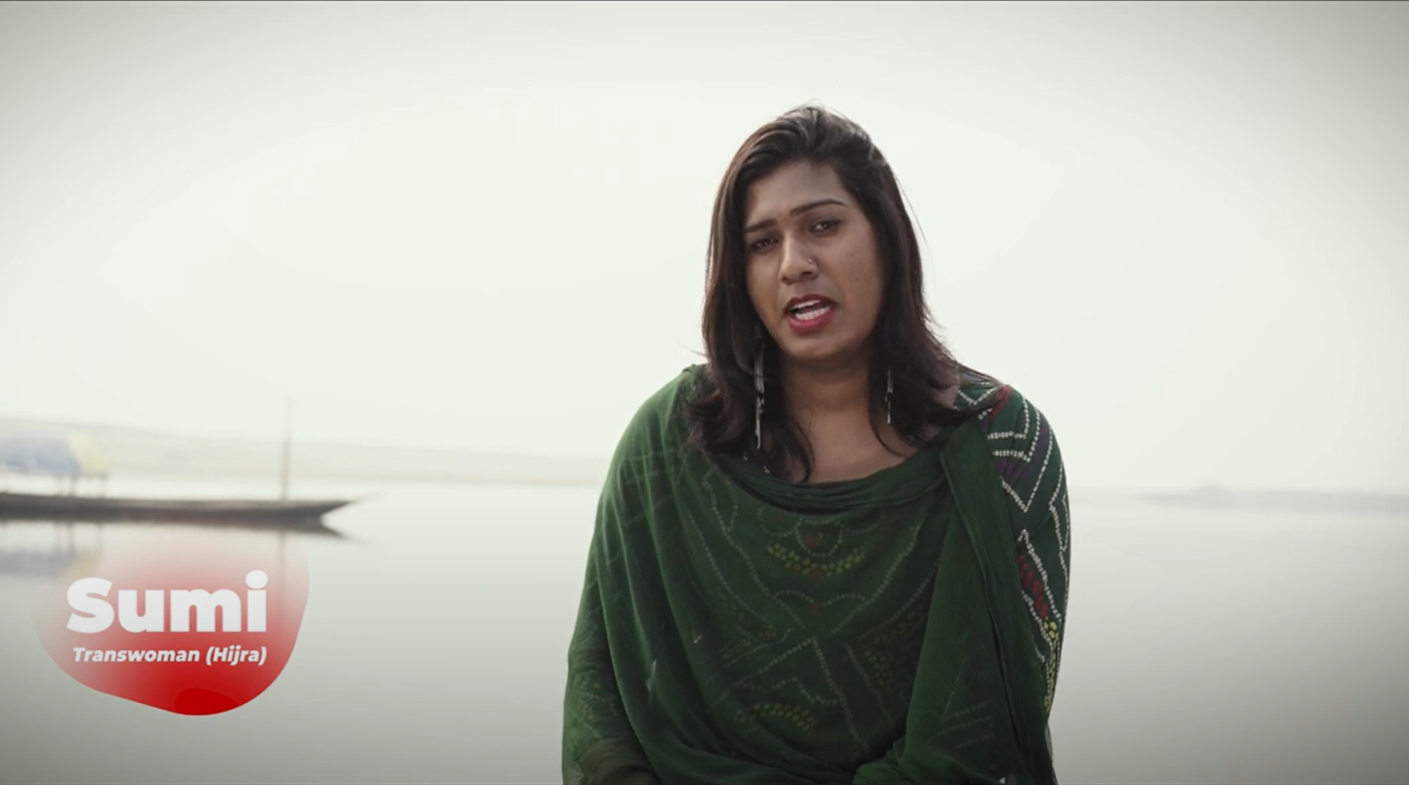
Video
Adamya: Stalwart (Documentary)
Bandhu Social Welfare Society (7:00)
75
Notes:
Video
Before we wrap up this module, we’ll learn about the lived experiences of people with diverse SOGIESC. This video is about transgender and gender diverse individuals in Bangladesh.
----
Video Link: https://drive.google.com/file/d/1x-BUcxndyEK3fzQNAqNLFFWFo2fe8TtX/view or https://iomint-my.sharepoint.com/:v:/g/personal/jrumbach_iom_int/EdxhNeergwpPlkrkgUWoX9oBD2m3-17eu5ozDuCKgXDrTg?e=5ytZ8v (7:00)
Time: 7 minutes.

Slide 76
Key Learning Points
HRIT
Unique risks and tailored response
Identify risks and solutions
01
02
03
76
Notes:
Key Learning Points
Here are the key learning points from this module:
The protection needs of people with diverse SOGIESC can be quickly identified by using the HRIT.
There is no one size fits all solution. Every individual is unique in the risks they experience, and responses should be tailored to those needs based on a sound understanding of risks.
Proper identification of individual risks is important to identify the most appropriate solutions.
----
Time: 2 minutes.

Slide 77

12
solutions
77
Notes:
Module 12: Solutions
Module 12 is Solutions.
Total Module Time: 2 hours 45 minutes.

Slide 78
MODULE 12
OBJECTIVES
01
02
traditional solutions
Resettlement needs for LGBTQ+
Review the traditional solutions options available to LGBTIQ+ persons of concern – voluntary repatriation, local integration and resettlement
Explore how resettlement needs and priorities are determined for LGBTIQ+ individuals
1
1
78
Notes:
Objectives
Let’s review our objectives for Module 12. By the end of this module, you should be able to:
Review the traditional solutions options available to LGBTIQ+ persons of concern – voluntary repatriation, local integration and resettlement; keeping in mind that an individual assessment should be done to analyze the protection risks the individual faces and identify the appropriate protection and solutions response in each case.
Explore how resettlement needs and priorities are determined for LGBTIQ+ individuals.
----
Time: 2 minutes.

Slide 79
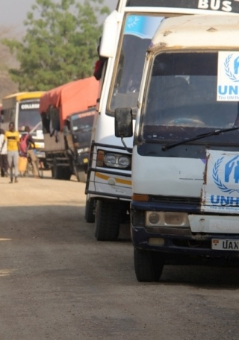
Voluntary repatriation must be based on a free and informed decision and wish and take place in conditions of safety and dignity.
The decision should be made on the basis of relevant and reliable COI; LGBTIQ+ persecution may continue when other reasons for flight cease.
A LGBTIQ+ person cannot be expected to return to their CoO if they would have to exercise discretion or conceal.
Local integration options may thus be limited or non-existent. This option should be carefully reviewed.
Voluntary Repatriation
Returnee monitoring should include supporting LGBTIQ+ returnees to ensure they enjoy basic human rights.
79
Notes:
Voluntary Repatriation
Let's first consider voluntary repatriation. Voluntary repatriation must be based on a free and informed decision and take place in conditions of safety and dignity. It should be a freely expressed wish – not implied or assumed – and an individual decision.
The decision should be made on the basis of relevant and reliable information about the situation in the country of origin (CoO). An LGBTIQ+ person cannot be expected to return to their CoO if they would have to exercise discretion or conceal.
Local integration options may thus be limited or non-existent. This option should be carefully reviewed.
Returnee monitoring should include supporting LGBTIQ+ returnees to ensure they enjoy basic human rights.
----
Time: 2 minutes.
[Image description: a long line of UNHCR trucks on the road.]

Slide 80
Considering Voluntary Repatriation
Exercise
WORKBOOK - PAGE 41
80
Notes:
Exercise: Considering Voluntary Repatriation
We'll now do an exercise that will highlight considerations associated with voluntary repatriation. Please turn to the worksheet in your workbook.
Using the case study of Jean-Pierre, fill out the worksheet. Please raise your hand if you have any questions. You have 20 minutes to complete the exercise.
Now, let’s go through the exercise worksheet together. What did you answer for question number one?
Go through the questions in turn, ensuring everyone in the group has the opportunity to share their opinion. After you have gone through all five questions –
Let’s consider some additional diversity factors in relation to question number five. How would your assessment change if Jean-Pierre was female? What if Jean-Pierre was older? Or had a disability?
----
Facilitation Note: See the Facilitation Guide page 226 for exercise instructions.
Time: 45 minutes. 5 minutes for activity description; 20 minutes for activity; 20 minutes for discussion.

Slide 81

CoAs may not be welcoming or may have discriminatory or persecutory laws or practices, including abuse and refoulement.
In many cases, LGBTIQ+ people struggle to access the same services in the CoA as other persons of concern, such as health care, education and self-reliance assistance due to discrimination.
They may also struggle to access and maintain employment and safe housing and may face greater security issues due to discrimination.
Local Integration
Local integration options may thus be limited or non-existent. This option should be carefully reviewed.
81
Notes:
Local Integration
Let's now consider the solution of local integration. Often, persons of concern flee from one country with discriminatory laws and practices to another country with discriminatory laws and practices.
Countries of asylum (CoAs) may not be welcoming or may have discriminatory or persecutory laws or practices, including abuse and refoulement.
In many cases, LGBTIQ+ people struggle to access the same services in the CoA as other persons of concern, such as health care, education and self-reliance assistance due to discrimination.
They may also struggle to access and maintain employment and safe housing and may face greater security issues due to discrimination.
Local integration options may thus be limited or non-existent. This option should be carefully reviewed.
----
Time: 30 minutes for slides 82-91.
[Image description: view of a city with houses, buildings, a place of worship and mountains in the background.]

Slide 82

While not all LGBTIQ+ persons of concern will be in need of and eligible for resettlement, it may be a viable solution and protection tool for those most at risk. In some instances, resettlement may be the only viable solution.
Mechanisms should be in place for partner organizations to make referrals following the principles of informed consent, confidentiality and “need-to-know” information sharing safeguards to protect information, and data protection.
Eligibility and priority level of LGBTIQ+ cases should be determined through a resettlement interview and assessment.
Resettlement
82
Notes:
Resettlement
Now let's consider the third solution, resettlement. According to the UNHCR Resettlement Handbook: “Resettlement involves the selection and transfer of refugees from a State in which they have sought protection to a third State that has agreed to admit them – as refugees – with permanent residence status.”
While not all LGBTIQ+ persons of concern will be in need of and eligible for resettlement, it may be a viable solution and protection tool for those most at risk. In some instances, resettlement may be the only viable solution.
Mechanisms should be in place for partner organizations to make referrals following the principles of informed consent, confidentiality and "need-to-know" information sharing safeguards to protect information, and data protection.
Eligibility and priority level of LGBTIQ+ cases should be verified and determined through a resettlement interview and assessment.
----
Time: 30 minutes for slides 82-91.
[Image description: close-up of the wing of an airplane flying over a foggy water way.]

Slide 83
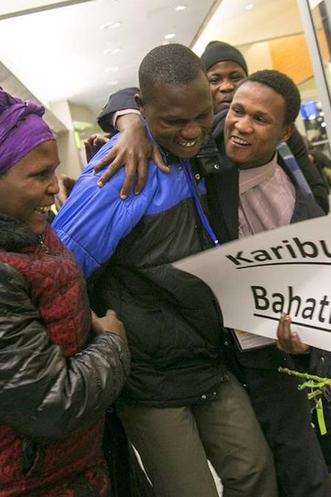
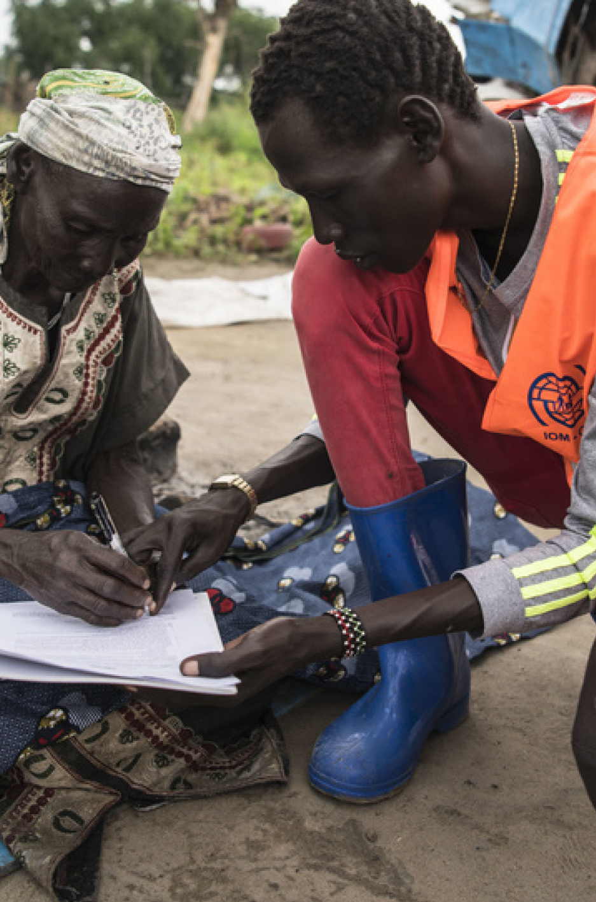
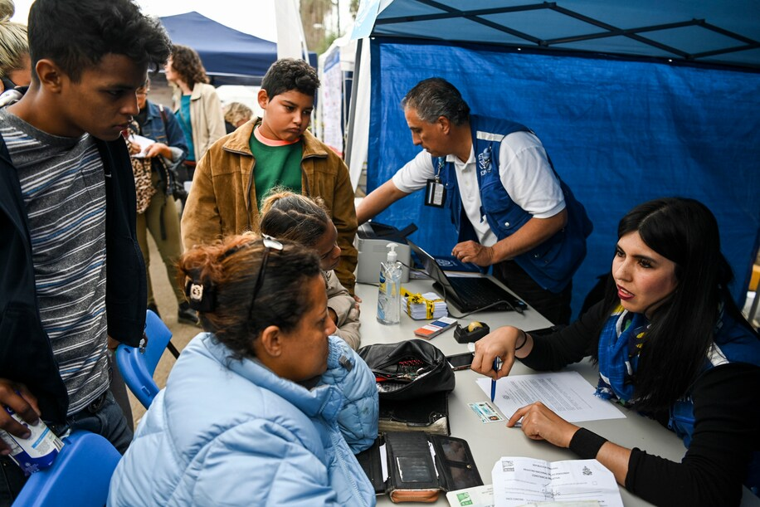
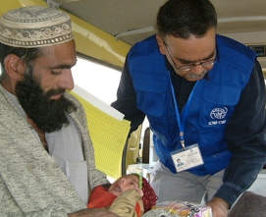
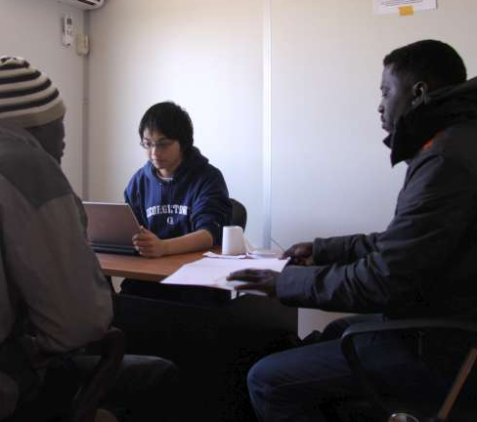
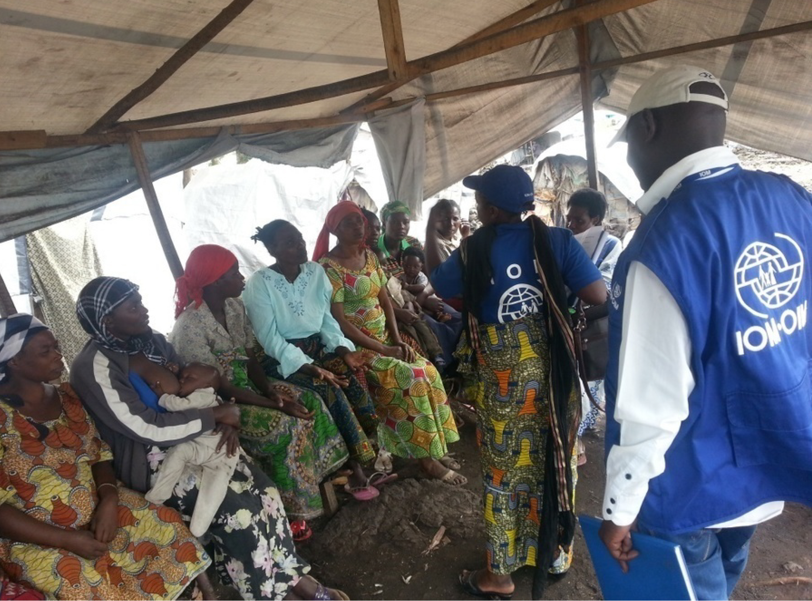
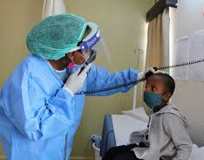
Resettlement Referrals
Specific vulnerabilities and protection needs of LGBTIQ+ persons of concern are mainstreamed and addressed through existing resettlement categories. Depending on the circumstances, LGBTIQ+ people may qualify under:
Legal and/or physical protection
Family reunification
Survivors of violence and/or torture
Medical needs category
Women and girls at risk
Children or adolescents at risk
83
Notes:
Resettlement Referrals
Specific vulnerabilities and protection needs of LGBTIQ+ persons of concern are mainstreamed and addressed through existing resettlement categories. In other words, there are no special categories related exclusively to sexual orientation, gender identity, gender expression and sex characteristics.
LGBTIQ+ cases in need of resettlement should fit one of the following more specific categories for submission for resettlement consideration. Depending on the circumstances, LGBTIQ+ people seeking international protection may qualify for third-country resettlement under the following categories:
Legal and/or physical protection needs;
Survivors of violence and/or torture;
Women and girls at risk;
Children or adolescents at risk;
Family reunification; and
Medical needs category.
----
Time: 30 minutes for slides 82-91.
[Image description: a series of small images of UNHCR and IOM staff members assisting migrants in a variety of settings, including performing a medical check and giving a briefing to a group of individuals who are seated.]

Slide 84

Although many LGBTIQ+ cases will warrant urgent or emergency referral, each case should be evaluated on its own merit. Use the HRIT to assess.
If eligibility and acceptance is confirmed, some individuals may require temporary protective measures, such as safe shelter, relocation to an urban center or evacuation to an ETF/C.
An individual’s SOGIESC may be material to their RSD or resettlement case or shared later in the process. Some individuals flee their countries for mixed reasons but have serious protection risks related to SOGIESC.
Assessing Resettlement Needs
Resettlement needs should be assessed without reference to discretion or what a person could “reasonably tolerate” if returned to the CoO. Both bars have been discredited as violating human rights.
84
Notes:
Resettlement Priorities
When we're assessing an LGBTIQ+ applicant’s resettlement priority, we should keep in mind that:
Although some LGBTIQ+ cases will warrant urgent or emergency referral, each case should be evaluated on its own merit. This is subject to the LGBTIQ+ individual’s specific circumstances and the context in the country of asylum. Staff can use the UNHCR Heightened Risk Identification Tool (HRIT) when they undertake priority processing for resettlement.
We should keep in mind that emergency resettlement may be necessary to ensure the security of persons who face serious threats to their physical safety or lives in the country of asylum, by either state or non-state actors. As noted in the UNHCR Resettlement Handbook, “emergency processing or evacuation may be required as lengthy processing can exacerbate the security risks.”
Please keep in mind that the HRIT is a tool for identifying refugees at risk. It is not determinative for assessing the RST needs and priority of cases of refugees who have already been identified as experiencing heightened risks. If eligibility for and acceptance by a resettlement State is confirmed, some individuals may require temporary protective measures, such as safe shelter or relocation to an urban center or evacuation to an ETF/C.
However, UNHCR RST guidance does not view this as part of the resettlement needs assessment. It is more relevant to the overall protection response in the Country of Asylum and to RST arrangements if the LGBTIQ+ person of concern was found eligible for resettlement and accepted by the resettlement country. Note there are often other people from the same country of origin at the transit and emergency transit facility or center.
We thus have to weigh whether sending an LGBTIQ+ person to a particular transit facility will put them at further risk. In many instances, it may be better to send them directly to the country of resettlement. An individual’s SOGIESC may be material to their RSD or resettlement case or shared later in the process. Some individuals flee their countries for mixed reasons but have serious protection risks related to their SOGIESC.
Resettlement needs should be assessed without reference to discretion or what a person could “reasonably tolerate” if returned to the CoO. Both bars have been discredited as violating basic and fundamental human rights.
----
Time: 30 minutes for slides 82-91.
[Image description: close-up of someone writing down information in a notebook.]

Slide 85
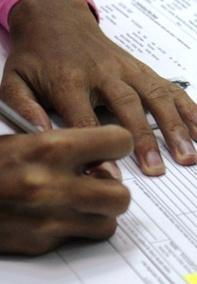
Protection and resettlement needs specific to the individual’s perceived or self-identified SOGIESC should be clearly reflected in the Resettlement Registration Form (RRF). This includes legal and protection-related information on the treatment of LGBTIQ+ people in the CoO and CoA.
Any other concerns that the individual has in common with other people from the CoO/CoA should also be reflected.
The concept of dependency is central to who is considered a member of the family. Same-gender couples are recognized as a family unit for the purposes of resettlement processing by UNHCR.
The RRF
85
Notes:
RRF
Let's now discuss the Resettlement Registration Form, or RRF.
Protection and resettlement needs that are specific to the individual's perceived or self-identified SOGIESC should be clearly reflected in the Resettlement Registration Form (RRF).
This includes legal and protection-related information on the treatment of LGBTIQ+ people in the CoO and CoA.
Any other concerns that the individual has in common with other people from the CoO/CoA should also be reflected.
The concept of dependency is central to who is considered a member of the family. Same-gender couples are recognized as a family unit for the purposes of resettlement processing. They should be submitted as one case, not linked cases.
Both individuals should be listed under Section 2. If they do not live together, it should be noted why in Section 7.
----
Time: 30 minutes for slides 82-91.
[Image description: close-up of someone writing down information on a form.]

Slide 86
Not all resettlement countries accept same-gender partners for the purposes of immigration based on family reunification. Some require proof of co-habitation or legal registration.
Transgender people should be asked if there is a name, gender, title and pronoun with which they identify.
Recall that self-defined gender identity is accepted without regard to legal documentation, hormone therapy or surgery.
The RRF
The correct name, gender and pronoun should be reflected in the RRF, registration and other documentation.
86
Notes:
RRF continued
Not all resettlement countries accept same-gender partners for the purposes of immigration based on family reunification. Some require proof of co-habitation or legal registration.
Transgender people should be asked if they have a name, gender, title and pronoun with which they identify.
Recall that self-defined gender identity is accepted without regard to legal documentation, hormone therapy or surgery.
The correct name, gender and pronoun should be reflected in the RRF, registration and other documentation.
----
Time: 30 minutes for slides 82-91.
[Image description: close-up of someone writing down information on a form.]

Slide 87
Where legal documents from the CoA or CoO reflect the correct name and gender, it should be recorded under bio-data in “first name” and “sex” and used throughout the RRF.
Where legal documents from the CoA or CoO reflect the birth (or incorrect) name and sex, this information should be recorded under bio-data in “first name” and “sex.”
The chosen name should be recorded under “Alias Names” and the chosen pronoun and gender should be used throughout the RRF.
If a case member who is not the head of household expresses diverse SOGIESC, you must keep the information confidential from the case members, if requested – even if the individual is a child.
The RRF – Documentation
87
Notes:
RRF continued
The following directive is on how to list name, pronoun, title and gender for transgender people is from the UNHCR Resettlement Assessment Tool:
Where legal documents from the CoA or CoO reflect the correct name and gender, it should be recorded under bio-data in “first name” and “sex” and used throughout the RRF.
Where legal documents from the CoA or CoO reflect the birth (or incorrect) name and sex, this information should be recorded under bio-data in “first name” and “sex.”
The current name should be recorded under “Alias Names” and the chosen pronoun and gender should be used throughout the rest of the RRF.
If a case member who is not the head of household expresses a diverse SOGIESC, you must keep the information confidential from the case members, if requested – even if the individual is a child.
----
Time: 30 minutes for slides 82-91.
[Image description: close-up of someone writing down information on a form.]

Slide 88
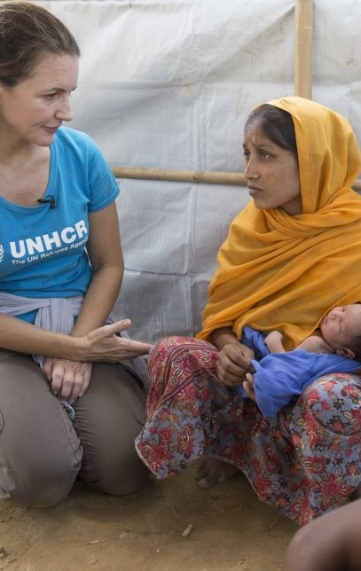
Some LGBTIQ+ refugees may have been or currently be involved in compulsory relationships with partners from a different gender, with whom they have children.
It is essential to counsel refugees to be entirely transparent about their family composition from the very beginning.
When their relationships with different-gender partners or with children through these partners is disclosed late in the process, it may hurt the credibility of their case.
Counseling for Refugees with Complex Family Situations
It may also make it harder to reunify their family if they have already been resettled.
88
Notes:
Counseling for Refugees with Complex Family Situations
The following guidance concerns counseling needed for LGBTIQ+ refugees who may be involved in relationships with partners of a different gender (such as through a forced marriage) and who have children:
Some LGBTIQ+ refugees may have been or currently be involved in forced or compulsory relationships with partners from a different gender, with whom they have children. This applies to any LGBTIQ+ refugee, regardless of their gender.
It is essential to counsel refugees to be entirely transparent about their family composition from the very beginning.
When their relationships with different-gender partners or with children through these partners is disclosed late in the process, it may hurt the credibility of their case.
It may also make it harder to reunify their family if they have already been resettled.
----
Time: 30 minutes for slides 82-91.
[Image description: a UNHCR staff member kneels down to speak to a person of concern who is holding a baby.]

Slide 89

LGBTIQ+ refugees should not be resettled where they may be isolated or re-victimized.
Clarify the assistance available in the resettlement country. States with a focus on LGBTIQ+ persons of concern may better meet their needs.
Consider whether same-gender family reunification rights are recognized.
The length of processing time for LGBTIQ+ cases should be weighed.
Resettlement Country Considerations
89
Notes:
Resettlement Country Considerations
There are several things to keep in mind when you are considering which resettlement country might best fit the needs of a person of diverse SOGIESC.
LGBTIQ+ people often undergo the integration process alone. They should not be resettled where they may be isolated or re-victimized.
Some individuals have specific mental health care, medical and financial assistance needs. Clarify the assistance available.
States with a positive focus on LGBTIQ+ persons of concern may better meet their needs.
Consider whether same-gender family reunification rights are recognized if the individual is separated from a spouse or partner.
Consider situations where the individual was previously involved in relationships with partners from a different gender (e.g., be in a forced heterosexual marriage) and has children.
The length of processing time should be weighed.
Also note past involvement in sex work can be an obstacle to resettlement. Such activity should be considered an indication of vulnerability.
----
Time: 30 minutes for slides 82-91.
[Image description: a close-up of a world map and a passport.]

Slide 90
When assessing potential resettlement countries for LGBTIQ+ applicants, please keep in mind that:
Core protection standards are expected to be met in all resettlement countries.
Let us now look at several elements to consider when submitting an LGBTIQ+ case to a potential resettlement country.
Here are questions we might ask when considering which resettlement country is the most appropriate.
Are SOGIESC related laws and policies non-discriminatory and friendly?
Is accessing police protection, employment, health care, education and other services non-discriminatory and friendly?
What are the predominant social attitudes towards LGBTIQ+ people?
Are there immigration provisions allowing for the reunification of partners/spouses?
Are post-arrival services for LGBTIQ+ refugees with specific needs available?
Have NGOs and other service providers been trained to assist LGBTIQ+ refugees?
Are there related LGBTIQ+ community organizations? Are they linked with refugee-serving organizations?
Resettlement Country Considerations
90
Notes:
Resettlement Country Considerations (Continued)
Here are questions we might ask when considering which resettlement country is the most appropriate:
Are SOGIESC related laws and policies non-discriminatory and friendly?
Is accessing police protection, employment, health care, education and other services non-discriminatory and friendly?
What are the predominant social attitudes towards LGBTIQ+ people?
Are there immigration provisions allowing for the reunification of partners/spouses?
Are post-arrival services for LGBTIQ+ refugees with specific needs available?
Have NGOs and other service providers been trained to assist LGBTIQ+ refugees?
Are there related LGBTIQ+ community organizations? Are they linked with refugee-serving organizations?
Is there an existing community from the same CoO? Would this be a source of support or further persecution?
If a country does not fulfill all of the above requirements, it may still offer protection and a solution, as well as adequate reception conditions for a LGBTIQ+ refugee. But the receiving country’s overall conditions and integration infrastructure for LGBTIQ+ resettled refugees need to be taken into consideration when recommending LGBTIQ+ refugees for resettlement in specific countries.
----
Time: 30 minutes for slides 82-91.
[Image description: a closed-up of a world map and a passport.]

Slide 91
CONSIDERING Resettlement
Exercise
WORKBOOK - PAGE 43
Country office facts
- PAGE 47
91
Notes:
Exercise: Considering Resettlement
We'll now do an exercise that will help you when considering resettlement as a solution for a LGBTIQ+ refugee and will help you become familiar with the Resettlement Assessment Tool.
I have distributed two Resettlement Assessment Tools to each of you. You can turn in your workbooks to the exercise worksheets and Country Office Facts sheet. Using the case studies of Amal and Nur, as well as the set of country office facts, fill out the Resettlement Assessment Tools and worksheets.
For Step 3 of the tool, you can fill in what you know from the facts and create the rest based on best practices and how you would complete the RRF if this were a case you were interviewing. You have 40 minutes to complete the exercise, or 20 minutes for each case study.
Now that you have completed your worksheets and Tools, let’s discuss them. Let’s start with Amal. What would be the focus or highlight of a resettlement interview with Amal?
What considerations should be made when identifying a resettlement country for Amal? What did you learn while filling out the Resettlement Assessment Tool for Amal?
Now let’s turn to Nur. What would be the focus or highlight of a resettlement interview with Nur? What considerations should be made when identifying a resettlement country for Nur? What did you learn while filling out the Resettlement Assessment Tool for Nur? How does the resettlement picture differ for Amal and Nur differ?
What questions or concerns would you have about using the Resettlement Assessment Tool in your offices? What limitations or gaps do you think the Resettlement Assessment Tool has?
----
Facilitation Note: See the Facilitation Guide page 229 for exercise instructions.
Time: 85 minutes. 5 minutes for activity description; 40 minutes for activity (20 minutes per case study); 40 minutes for group discussion (20 minutes per case study).

Slide 92
Key Learning Points
Resettlement as a solution on a case-by-case basis
Encouraging
transparency
Care and accuracy with gender identity
Urgency and protection
01
02
03
04
92
Notes:
Key Learning Points
The key learning points from this module are:
LGBTIQ+ people may have limited access to voluntary repatriation or local integration. Resettlement should be weighed as a solution on a case-by-case basis.
Individuals may not realize their same-gender partner can be resettled with them and that they need to be transparent if they also have children and different-gender partners. We should always ask them to be transparent, so that we can provide appropriate counseling.
Care should be taken to accurately record a person of diverse gender identity's correct name, gender, title and pronoun.
When choosing the resettlement country, consider the urgency of the case, protection safeguards, accommodations and other services available.
----
Time: 1 minute.

Slide 93

WRAP UP
93
Notes:
Wrap-Up
----
Facilitation Note: If you gathered questions at the beginning of the training session, this is a good time to review them and determine which questions have been answered by the module content, which questions may be answered in upcoming modules, and which questions may need further attention at this time. See the “Frequently Asked Questions” and “Answering Difficult or Unexpected Questions” sections of the Facilitation Guide for more guidance.

Slide 94

Bureau of Population, Refugees and Migration (PRM) of the United States Department of State
The development of this training package was made possible through the generous support of the American people through the Bureau of Population, Refugees and Migration (PRM) of the United States Department of State as part of the project, “Sensitization and Adjudication Training on Refugees Fleeing Persecution Based on Sexual Orientation and Gender Identity.” The content does not necessarily reflect the views of PRM or the United States.
Notes:
The development of this training package was made possible through the generous support of the American people through the Bureau of Population, Refugees and Migration (PRM) of the United States Department of State as part of the project, “Sensitization and Adjudication Training on Refugees Fleeing Persecution Based on Sexual Orientation and Gender Identity.” The content does not necessarily reflect the views of PRM or the United States.

Slide 95

CONTACT US
For more information about this training package, please contact: IOM: Global LGBTIQ+ / SOGIESC Focal Point LGBTIFocalPoint@iom.int UNHCR: Community-Based Protection, Division of International Protection hqts00@unhcr.org
Please also visit the Social Inclusion in IOM Programming website at https://www.iom.int/social-inclusion-iom-programming for the most updated resources and training materials.

