Slide 1
Guidelines for UNHCR Suppliers How to use the Supplier Portal

Slide 2



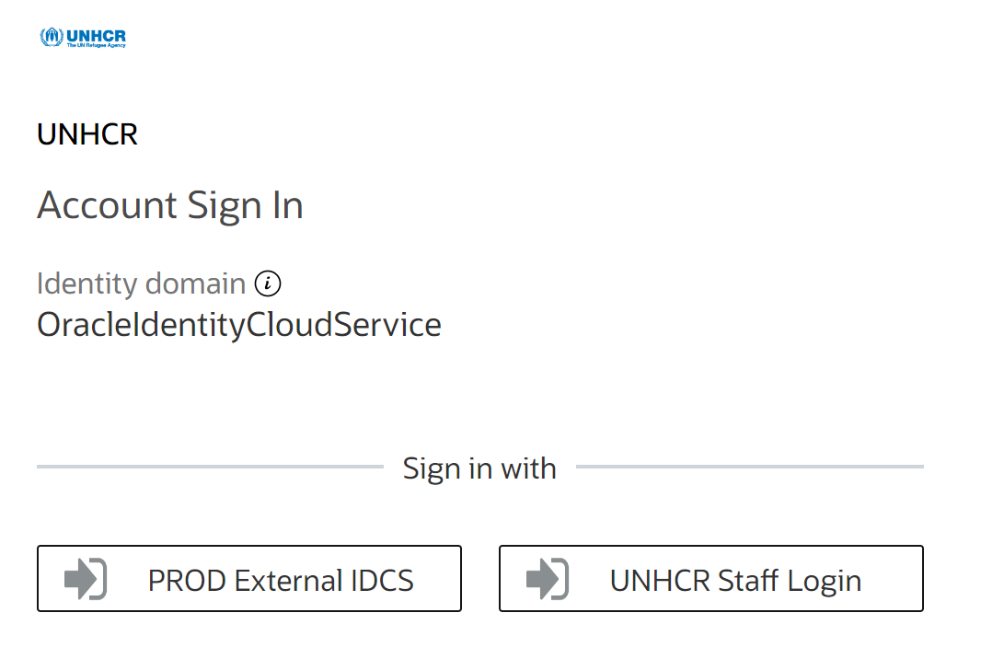
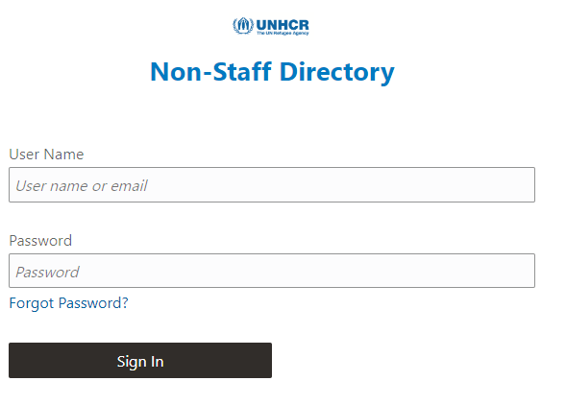
When logging in…
Double check access on Supplier Portal way before a tender is launched.
If you can’t log-in, check if you have the correct link:
https://supplier-portal.unhcr.org
If it fails, confirm with UNHCR if your user account (email id) has been activated.
If yes, click ‘Forgot password’ and follow the instructions. Check Spam/Junk folders.

Slide 3





When submitting an offer…
Log-in to the system & create a draft response as early as possible
(not during the deadline itself).
Email issues as early as you can (not just within 1 hour before the deadline).
Be specific and attach screenshots when raising issues.
Indicate your company name and the negotiation number.
Consider that resolving the issue will take some time (not just 1 hour).
UNHCR will not be held responsible for any delay.

Slide 4




When doing business with UNHCR…
Monitor your registered email actively.
Look out for notification emails from the system ending in oracle.com
Check spam/junk folders at all times.
Raise any issue as soon as possible.

Slide 5
Table of Contents
Introduction
2. Register and manage supplier profile
3. Submit and manage bid
4. Manage order
5. Helpdesk support
1.1 The Business Transformation Programme (BTP)
1.2 Quick references to the guide
1.3 How to use the guide
1.4 What is Supplier Portal?
1.5 Who can use the Supplier Portal?
2.1 Supplier Registration Overview
2.2 Enter Supplier profile
2.3 Confirm registration and create new password
2.4 Update Supplier profile
2.5 Manage user access
2.6 Setting profile preferences
2.7 Forgotten password
3.1 Search for negotiation
3.2 Subscribe to a negotiation
3.3 Prepare/submit negotiation
3.4 View a bid response
3.5 Revise/edit the bid response for an on-going negotiation
4.1 Manage order
4.2 Review receipts
4.3 View payment
5.1 Technical assistance
5.2 FAQs
5.3 Glossary

Slide 6
1.1 The business transformation programme (BTP)
1.2 Quick references to the guide
1.3 How to use the guide
1.4 What is Supplier Portal?
1.5 Who can use the Supplier Portal?
1. Introduction

Slide 7


1.1 The Business Transformation Programme (BTP)
The Business Transformation Programme (BTP) is part of UNHCR’s ambitious reform agenda launched by the High Commissioner to make UNHCR more agile, efficient, inclusive, and collaborative. It was introduced in 2020 as the main initiative driving efficiency, by modernizing and streamlining our systems, tools and processes.
The BTP comprises six projects, tasked with transforming our financial, human, resources, programme, procurement/ supply, partnerships, and external engagement management systems.
In the framework of this digital transformation, UNHCR is adopting different new systems to adjust its ways of working and significantly changing how the organization manages business relationships with commercial partners - with the ultimate goal of improving the life of refugees, stateless and other displaced persons.
Among the 6 digital solutions UNHCR is adopting, the most relevant to commercial partners is the new Oracle Cloud ERP integrated solution, which will replace the current Enterprise Resource Planning (ERP) system for finance-budget and supply management.
The new ERP will ensure better business relationship with UNHCR’s commercial partners as well as better integrated communication and business transactions through the use of a dedicated Supplier Portal for all commercial stakeholders wishing to maintain a business relationship with UNHCR.

Slide 8

1.2 Quick references to the Guide
The Supplier Portal guide is intended for individuals or companies who wish to participate in UNHCR’s negotiations managed through this portal or register as an authorized supplier to acknowledge and manage contract agreements via the portal. Login Link for Supplier Portal is https://supplier-portal.unhcr.org .
For quick reference, you can navigate directly to a specific topic by clicking on the relevant hyperlink:
To create a profile and register as a supplier in the portal, please refer to How to Register a Supplier Profile
If you already have an account and wish to participate in a negotiation, please refer to How to Submit a Bid
To search for Negotiations and download negotiation documents with a registered user account please click here.
If you already are a Spend Authorized supplier and wish to review Purchase Orders (PO), please click here.
If you have an account, but have forgotten your password, please click here.
If you are experiencing any technical difficulties with signing in, registration, or bid submission, please refer to the section on Helpdesk Support .
IMPORTANT:
In the Cloud ERP system, “Negotiation” stands for solicitation/tender.

Slide 9
1.3 How to use the Guide
This guide is organized in several sections that correspond to different functions of the Supplier Portal such as registration, submitting bids, maintaining profile, etc.
The Table of Contents (TOC) provides a detailed overview of all the topics covered in this User Guide. It contains hyperlinks to the exact page of the sections in the document so the reader can navigate directly to the relevant section.
Each section starts with a brief overview of the content of that section with hyperlinks.
Throughout the document, there are three types of hyperlinks:
Hyperlink buttons that will take reader to the main TOC ( ), found at the top right corner of each page.
Hyperlinks ( ) that take readers to the beginning of the current section, usually found at the bottom left corner like in this page.
Hyperlinked words that take reader directly to a location of the document related to the text. For example, by clicking on the hyperlinked TOC here, the reader can go directly to the TOC page of this document.

Slide 10
1.4 What is Supplier Portal?
The Supplier Portal module is designed to facilitate Supplier interactions during negotiation process and later for contract management. The system aims to enhance the integrity and transparency of the procurement process and enables the streamlining of the processes: Suppliers can use online portal to view negotiation documents, submit their bids, communicate with procurement office, etc.
The Supplier Portal system addresses UNHCR’s fundamental procurement values, such as fairness, integrity, transparency and accountability.
Some of the main benefits of the system are:
No late submissions are accepted: The system will automatically reject any bid after the deadline.
Electronic sealed bids: The system encrypts the bids submitted in the system and does not allow anyone to view any information provided before the bidding deadline.
Streamlines the bidding process: Suppliers can register in the system, retrieve all information and negotiation documents, submit their bid online, edit it directly in the system, and receive automatic notifications once the evaluation is finalized and the contract is awarded.
Electronic submissions of Invoices: The system enables suppliers to submit their own invoices and view payments, receipts and orders electronically.
Provides an audit trail: As the Supplier Portal system records all activity in the system, it keeps an audit trail for increased accountability and transparency.

Slide 11
1.5 Who can use the Supplier Portal?
Prospective Suppliers
Spend-Authorized Suppliers
Prospective Suppliers wishing to participate in a Negotiation can self-register in the Supplier Portal with a facilitated/light registration’s procedure
Prospective Suppliers awarded by UNHCR to become Spend-Authorized Suppliers will be contacted in order to provide the required information and documentation to be approved for business transactions with UNHCR.
Previous UNHCR’s Spend-Authorized suppliers will receive notification by email to access and setup their new credentials in the Supplier Portal
IMPORTANT:
If a prospective supplier won the negotiation, they will be awarded after the profile is spend authorized.

Slide 12
2.1 Supplier registration overview
2.2 Enter Supplier profile
2.3 Confirm registration and create new password
2.4 Update Supplier profile
2.5 Manage user access
2.6 Setting profile preferences
2.7 Forgotten password
2. Register and manage
supplier profile

Slide 13
2.1 Supplier Registration Overview
The first time a prospective supplier enters the UNHCR Cloud ERP Supplier Portal, a one-time registration process is required.
Suppliers only register once, and thereafter enter the Portal with their own User ID and password. Companies with their own
email domains need to make sure that unhcr.org and oracle.com are not blocked by their email firewalls.
Visit
Supplier Portal
Register mandatory information
Submit
Check e-mail
Click this LINK or enter from the UNHCR WEBSITE.
Prepare all information and documentation before starting the registration process.
Input mandatory information:
Company name as legally registered
Tax Organisation Type
Contact person details to maintain the account (email + telephone number)
Company address with valid Postal Code
Tax ID / Tax Registration Number
Registration will be auto-approved for prospective suppliers
Check email account to create password and log-in to the system

Slide 14
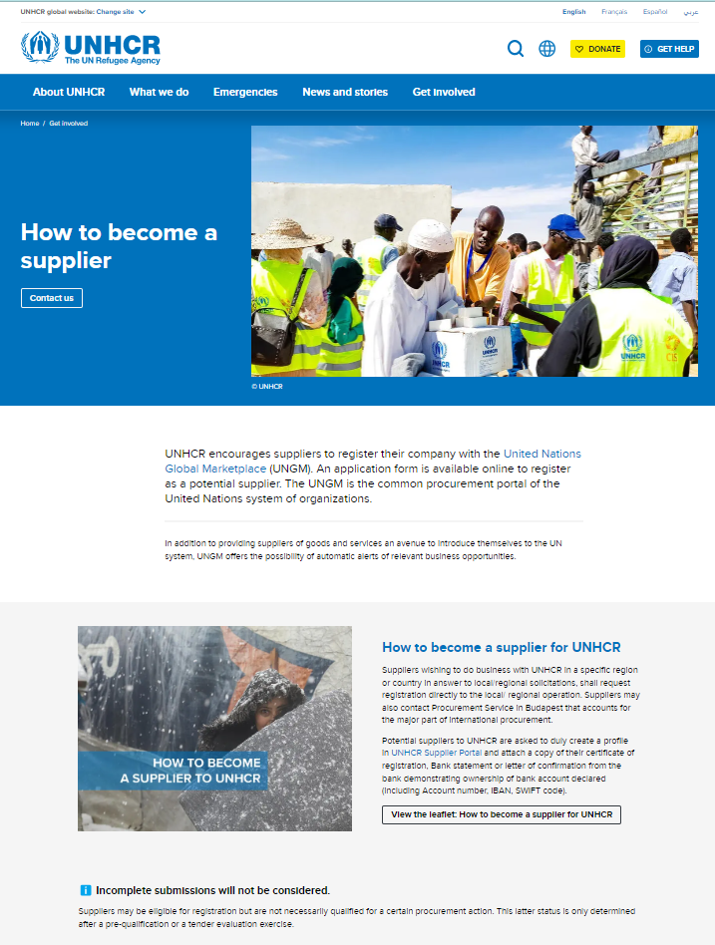
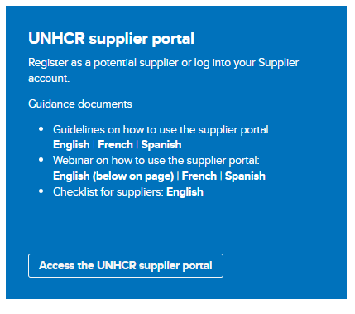
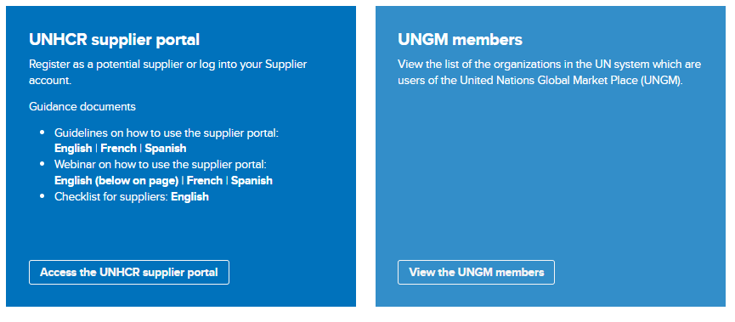
2.1 Supplier Registration: Visit Supplier Portal
Click this LINK or enter from the UNHCR WEBSITE
If you are already registered in the system but do not remember your password, please do not register again.
Please click here to login in the system with your User ID (e-mail address) and the password. If you have forgotten your password, you need to click on the “Forgotten Password” link and create a new password. Please see Instructions on how to generate a new password if you forget it.
Important:
The UNHCR Supplier Portal is not the same as the UNGM (United Nations Global Marketplace) or the e-tender box. If you want to conduct business with UNHCR, you must first register as a supplier in the UNHCR Supplier Portal.

Slide 15
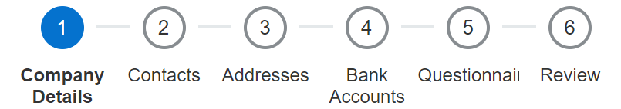
Register supplier (6 train stops)
Stop1. Enter the company details
Stop 2. Insert or edit the contact (user) details
Stop 3. Insert the company address
Stop 4. Enter bank details
Stop 5. Complete the questionnaire
Stop 6. Review and complete the registration
2.2 Enter supplier profile
IMPORTANT
Only applicable for Spend authorized suppliers

Slide 16

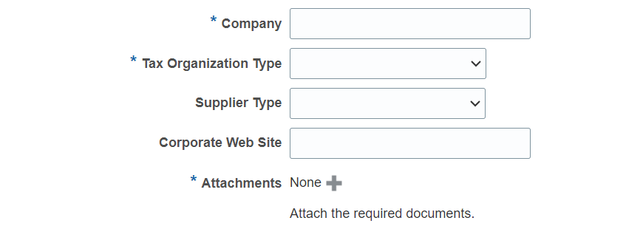
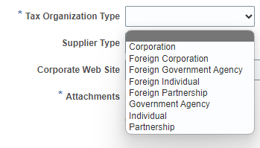

Train stop 1: Part 1
2.2 Enter supplier profile
Company (name)
- Must correspond to the name recognized and registered in relevant registration office
- Only Latin characters are allowed for the Company name
- Special characters are not permitted in Company names
Tax Organization Type
Select one of the options from the dropdown menu (select either Corporation or Individual)
Supplier type
- Select Commercial Supplier from the dropdown menu
Corporate Web Site
- Enter the link of Corporate Web Site (optional)
Attachments
- Users can attach required supporting documents to the registration describing company background, certifications, and so on. Attachments can be in the form of files, URLs, or text notes.
IMPORTANT
* means mandatory field to be filled

Slide 17
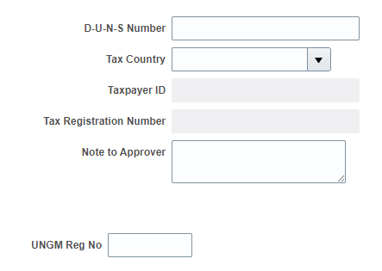
Part 2
Please select the Tax Country first and the other fields will open for completion.
Enter a value for at least one of these highlighted fields:
D-U-N-S Number (Dun & Bradstreet business credit profile to check the business credit scores and assess the company's financial health): Applicable for Suppliers who have this number only
It should contain 9 to 12 digits
Taxpayer ID
Tax Registration Number
- Once the Tax Country is selected, the Taxpayer ID and Tax Registration Number will be editable
2.2 Enter supplier profile
UNGM Reg No
If your company is registered on the United Nation’s Global Marketplace (UNGM) website, please insert the registration number.
IMPORTANT
If you want to include information about VAT exemption, please indicate in Note to Approver section.

Slide 18
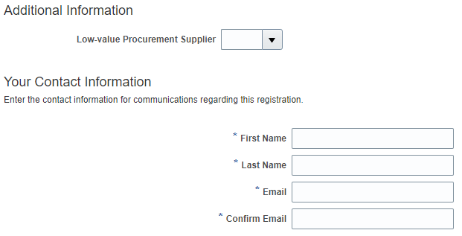
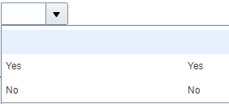
Part 3
IMPORTANT
In order to avoid problems and maintain control of your supplier profile in the event that the person working on the bid submission leaves the company, please use a generic email account that numerous individuals at your organization have access to.
2.2 Enter supplier profile
Additional Information
Low-value Procurement Supplier: Leave it as empty.
Your Contact Information
First/Last name
Name of the person authorized by your company to use the system and represent the company
Email address
- Must be a valid email address for your company. Please note that this e-mail will be used as User ID to login in the system and all further communications from the system will be sent to this address.

Slide 19


Going to next train stop
When you complete to fill “Company Details”, click on Next button to go for next train stop.
Use “Save for Later” button to save or continue the registration at a later time.
2.2 Enter supplier profile
TIP:
The system times out after a certain time of inactivity and any unsaved changes will be lost. To save the data entered at any moment prior to completing the registration and to be able to continue working on the registration later, please click the "Save for Later" button.

Slide 20
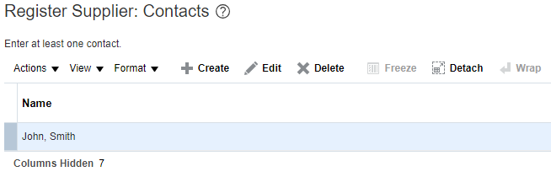

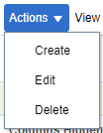
Train stop 2: Contacts page
2.2 Enter supplier profile
Create
Click on Action > Create button to add more contact information
Edit
Click on Action > Edit button to review and edit current contact information
Delete
Select existing contact information and delete the information

Slide 21
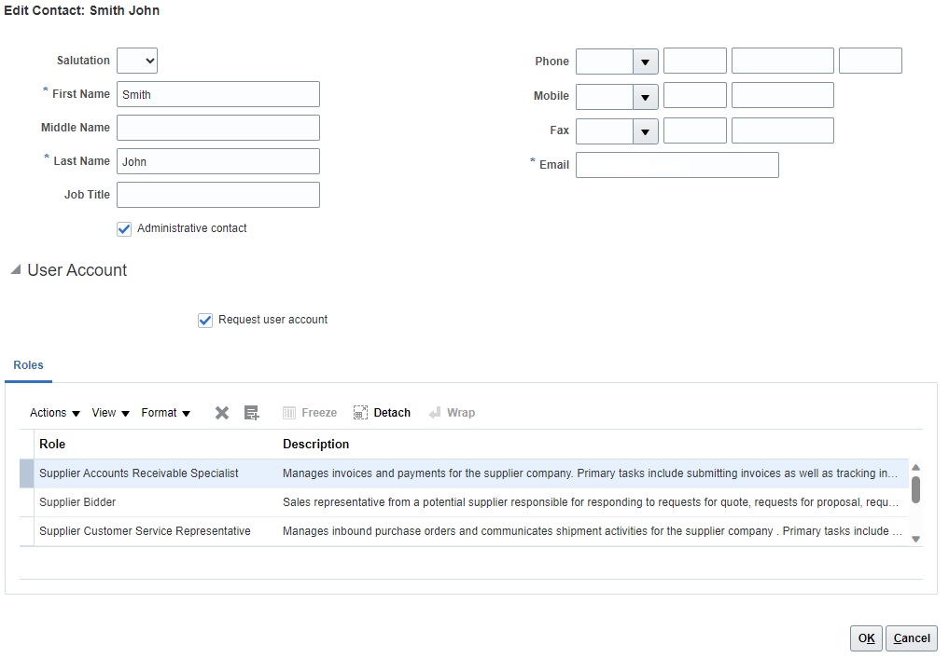
Edit Contact page
When you click on the edit button, the “Edit Contact” page will appear.
Edit contact:
Review and edit focal person information and contact details.
Tick “Administrative contact” if this must be considered an administrative contact
User Account:
Tick “Request user account” if a user account is required for this contact
There is no need to edit Role section.
Then click on OK button.
2.2 Enter supplier profile

Slide 22
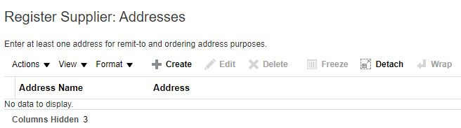

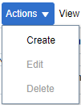
Train stop 3: Addresses page
2.2 Enter supplier profile
Create
Click on Action > Create button to enter address details
Edit
Click on Action > Edit button to review and edit already entered address details
Delete
Select existing address information and delete the information

Slide 23
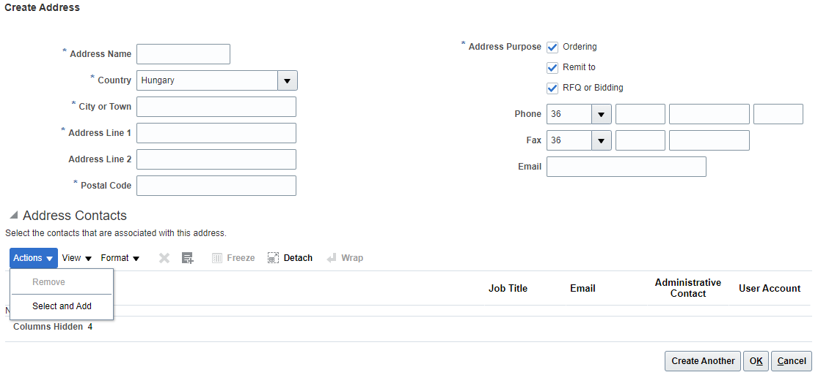
Create Address page
IMPORTANT: * means mandatory field to be filled.
When you click on the create button, “Create Address” page will be appeared.
2.2 Enter supplier profile
Address Name: Address name must be manually entered (see next slides to know more)
Country: Select the country of your company from dropdown menu or click on Search button.
Address Purpose: Select/tick applicable options (RFQ or Bidding is for negotiation participation; Ordering and Remit to are for Spend Authorized suppliers)
Actions: Use Remove/Select and Add buttons to edit the registered address
Click on Create Another/OK buttons to complete the action

Slide 24
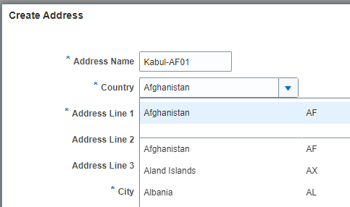
Create Address Name
Up to 100 different addresses within the City/State/Canton.
Every number represents a single location in each city.
2.2 Enter supplier profile
Complete City
Name
-
Country Code
(2 digits)
City Index Number
(2 digits)
Kabul
-
ISO Code 3166-1
From 01 to 99
Create your ADDRESS NAME using:
Complete Name of the City + "dash" symbol + Country Code (2 digits) + City index Number (If you have multiple addresses, you can put number by sequence)

Slide 25
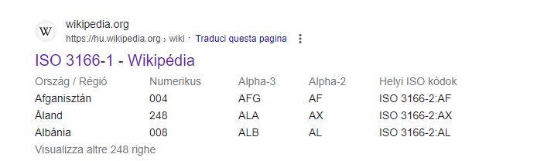
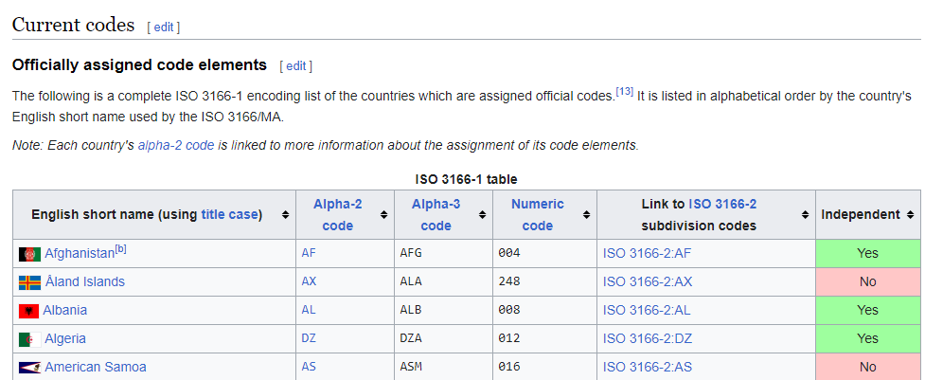
Address name reference
2.2 Enter supplier profile
ALTERNATIVELY,
check the appropriate
ISO 3166-1 coding
ISO 3166-1 - Wikipedia

Slide 26
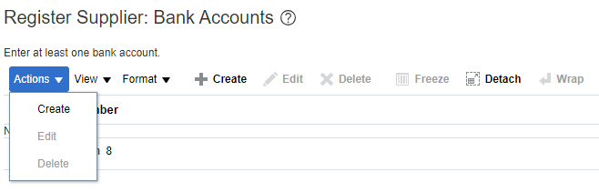

Train stop 4: Bank accounts page
2.2 Enter supplier profile
Create: Click on Actions > Create button to add a Bank accounts
Edit: If you want to edit the existing bank account, please click on Actions > Edit button to review and edit the bank accounts
Delete: Select the line and delete the invalid bank account if applicable
IMPORTANT:
If Bank accounts tab is not available, skip to the next page.
This step is applicable for the Spend Authorized Suppliers only.

Slide 27
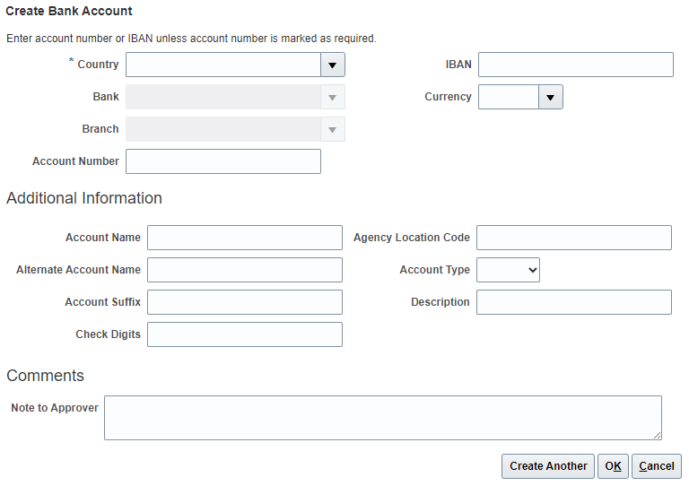
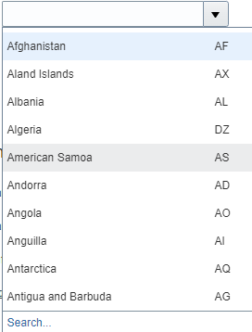
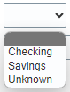
Create Bank Account page
IMPORTANT: * means mandatory field to be filled.
2.2 Enter supplier profile
IMPORTANT:
if bank and branch is not available, supplier should contact the buyer with Vendor Registration Form to get new bank and branch setup.
Enter the bank account details according to the requirements of the country.
Select Country, Bank, Branch, Currency and Account type from the dropdown menu.
Add Bank Account Name/Number/IBAN
Add the additional information if applicable

Slide 28
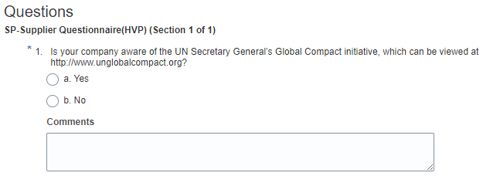


Train stop 5: Questionnaire page
Fill the questionnaire​
​
There are multiple sections with questions on the Questionnaire page. ​
​
Some of the questions require selecting one or multiple options from a list of answers. ​
​
Other questions require a textual answer. ​
2.2 Enter supplier profile
TIP:
Please provide as much possible a comprehensive answer to these questions. Most of them will be included in specific negotiations and when you will prepare your bid responses the answers provided at the registration will automatically appear (you will not need to answer them again). ​​

Slide 29
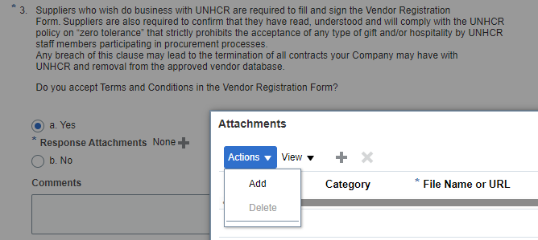
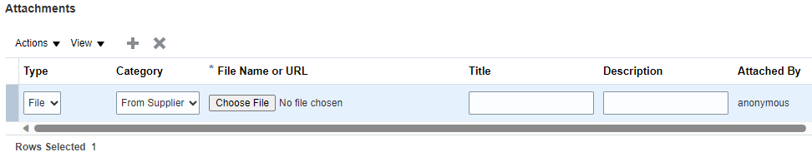
Attachments page
​Some of the question that you will answer with the option Yes will require to upload a scanned copy of the supporting document. ​​
Click on the + button below the response Yes to add the required attachment.
Click again on the + button and then click on Choose File. Select the file you wish to attach, enter the description in the Description field and click OK.
2.2 Enter supplier profile
IMPORTANT:
Some of the questions that you need to download mandatory forms and fill out for uploading. For example: The Vendor Registration Form

Slide 30
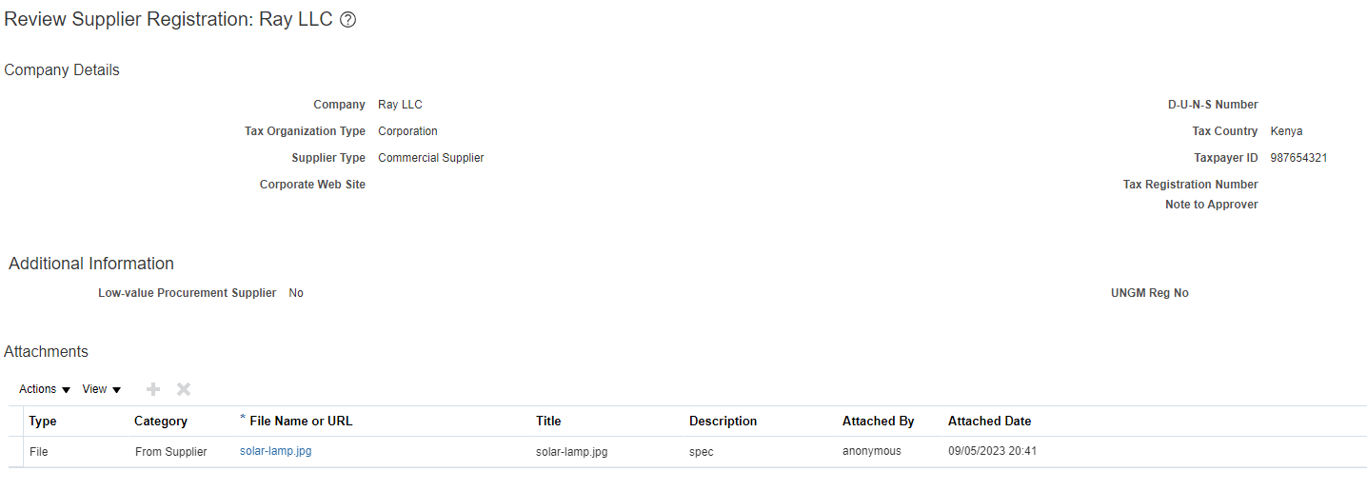


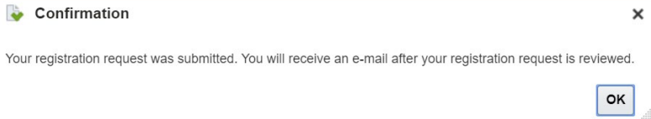
Train stop 6: Review Supplier Registration page
Company LLC
Company LLC
​Review all entered data and revise/correct if applicable.
2.2 Enter supplier profile
To finish the registration, click the Register button.
A confirmation message will pop-up on your screen confirming that the registration was submitted.

Slide 31
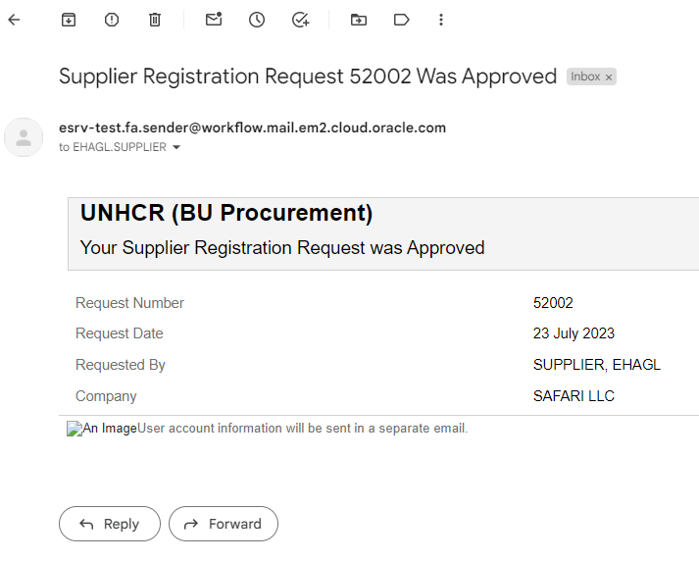
2.3 Confirm registration and create password
A first email will arrive to confirm the approved registration once the validation is done by UNHCR.
User account information will be sent in a separate email

Slide 32
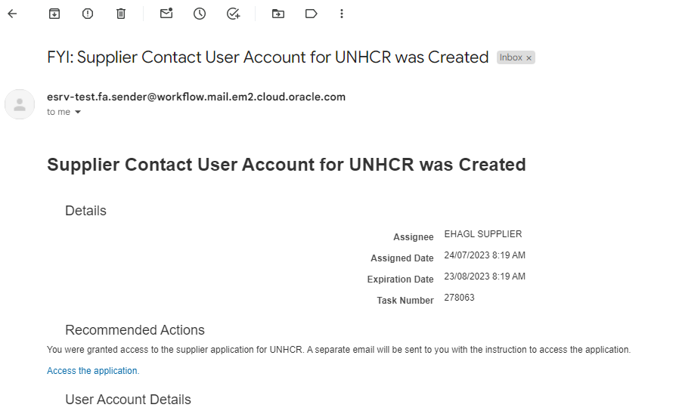
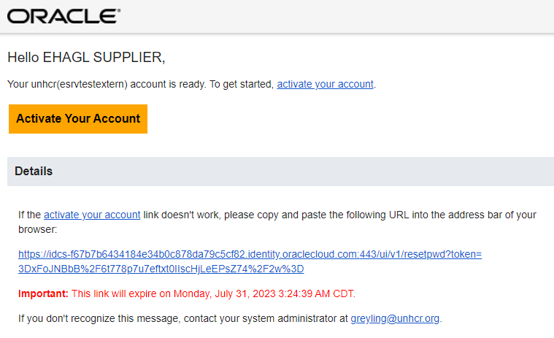
Notification on the account creation and activation
2.3 Confirm registration & create password
A third email will arrive and you need to activate your account by clicking on the link.
A second email will arrive to confirm the creation.

Slide 33
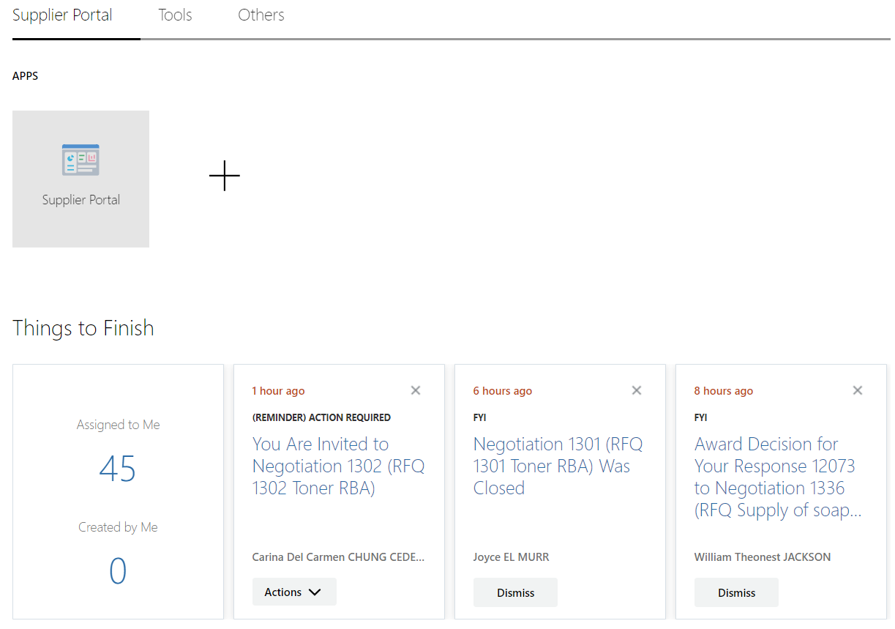

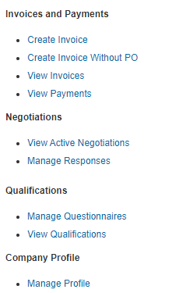
2.4 Update Supplier Profile
In order to update your company profile, log-in to the ERP system and click on Supplier Portal icon
To view or manage/edit the data of your supplier profile, click on the Manage Profile

Slide 34
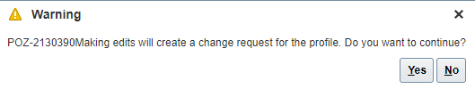
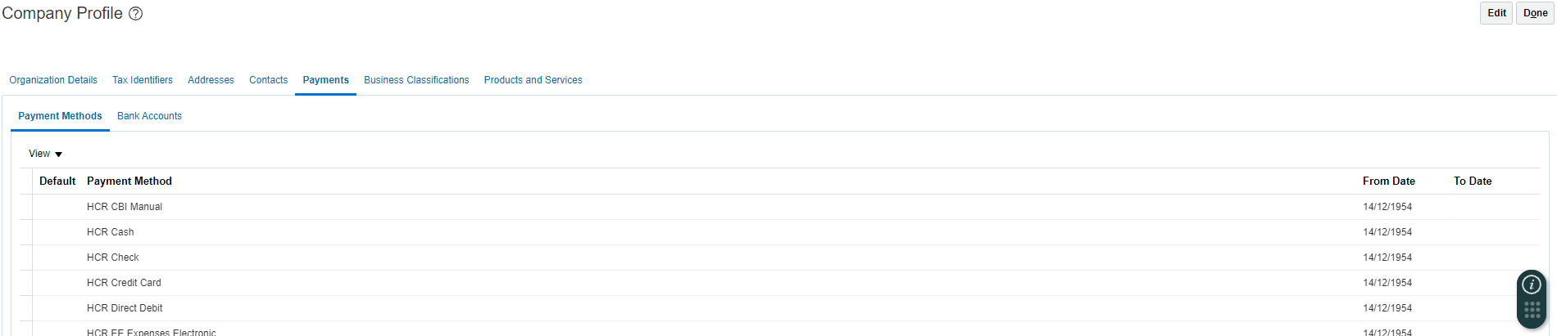
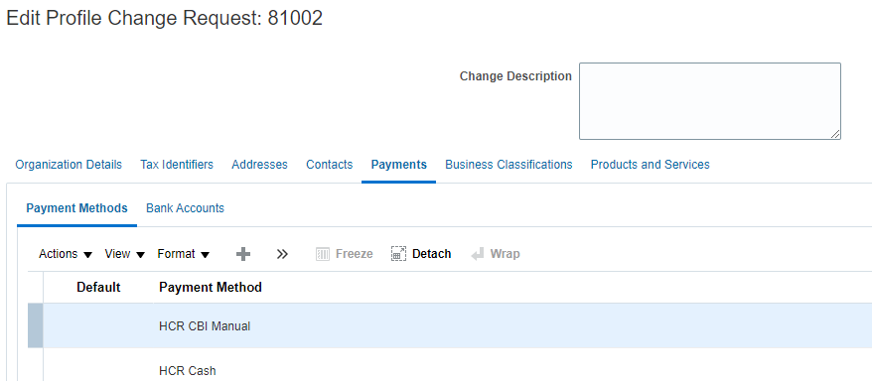
Company Profile page
​To open the profile for editing, click on Edit button and click Yes.
2.4 Update Supplier Profile
​- Review and click on each tab
Edit if necessary
Insert short description of implemented changes

Slide 35
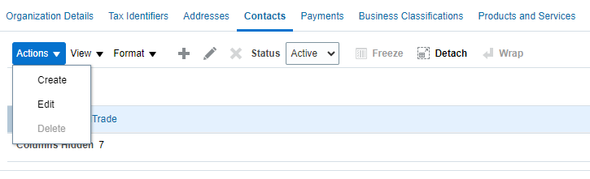
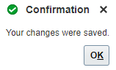
Manage Contacts
2.5 Manage User Access
​- Click on Contacts tab
Click on Actions > Create new contact or
Click on Actions > Edit button to revise existing contact details
​To save the changes, click on Save and Close button.
Confirmation box will be displayed once it's saved.

Slide 36
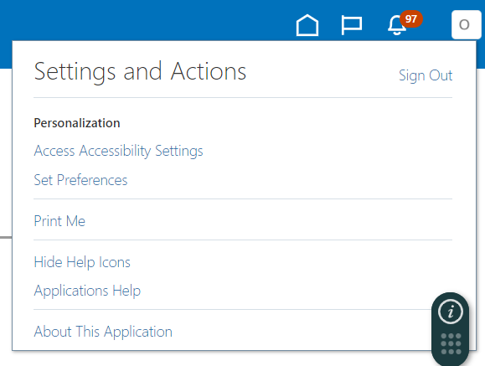
2.6 Setting profile preferences
The Portal gives the possibility each supplier to Set the preferences of their own supplier profile. This relates only to system interface and not negotiation documents.
Once you login to the system, click on Setting and Actions icon in the upper right corner of your screen and select the option Set Preferences.

Slide 37
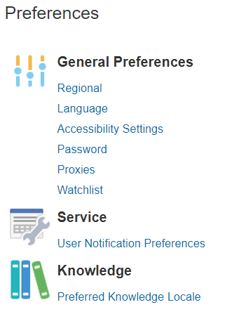
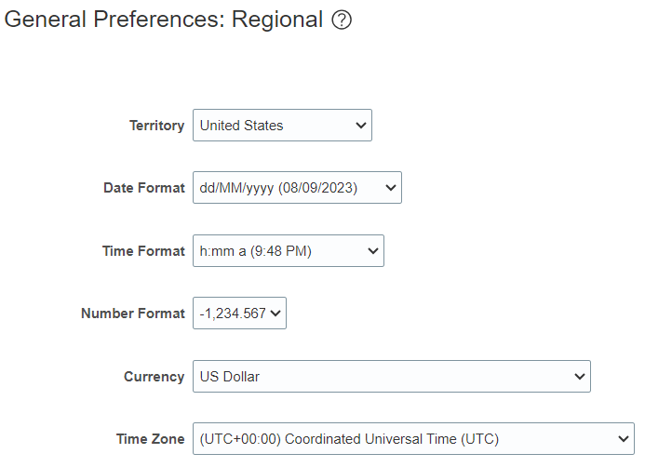
Regional Preferences
2.6 Setting Profile Preferences
​Territory: Select your country
Date and Time Format: Select the format in which you wish the date/time to be presented
Time Zone: Select the time zone in which you operate. This will convert the negotiation deadline to the exact time as per your chosen setting.

Slide 38
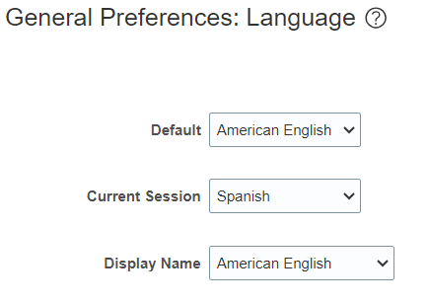
Language Preferences
Language page of the Set Preferences work area to set your language preferences.​ Default language of the system is English.
2.6 Setting Profile Preferences
​Default: Select the default system language for your profile
Current Session: Select the language to be used in the current session until you either log off or change your language preference.
Display Name: Select the language to be used for your display name in the global header. If the equivalent of a name doesn't exist in the preferred display language, or if the display language isn't set, then the user names are displayed in the preferred default language.

Slide 39
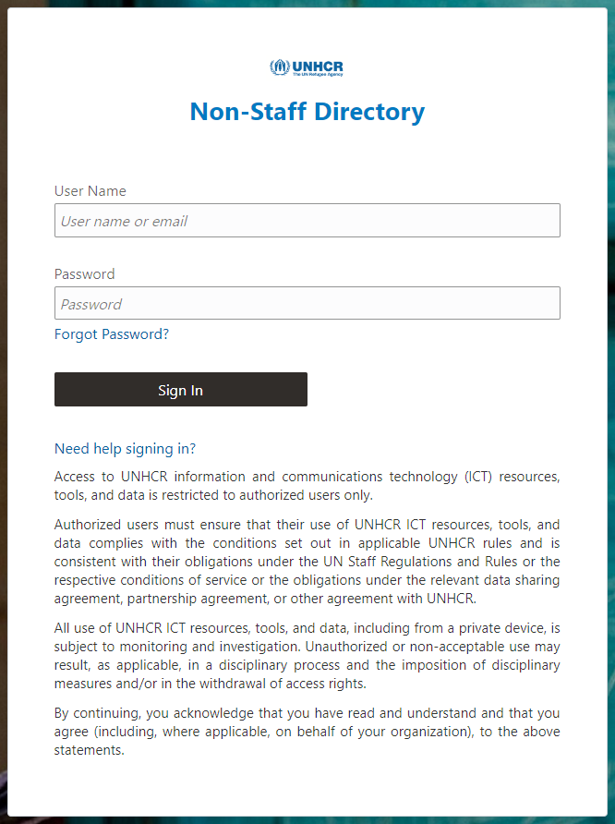
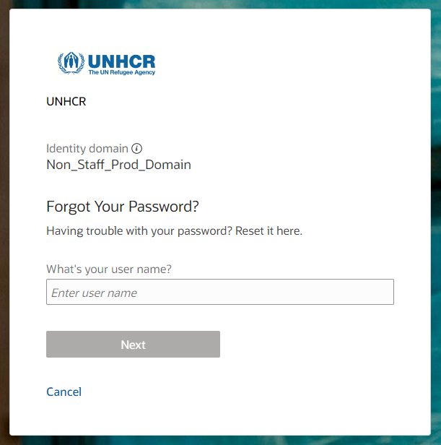
2.7 Forgotten password
If you have forgotten your password, Open https://supplier-portal.unhcr.org/ and please take the following steps:
Step 2: Enter registered email address
Step 3: Tick Forgot password
Step 4: Click on Next button
Step 1: Click on Forgot Password link

Slide 40
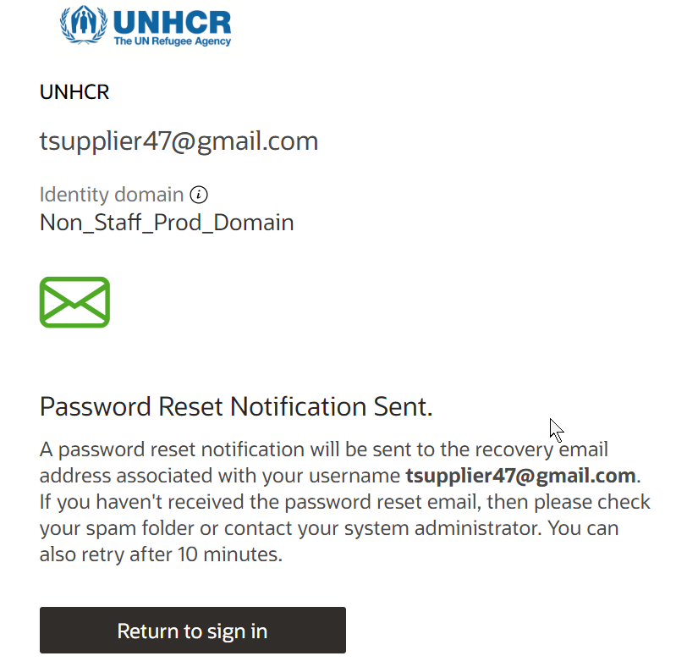
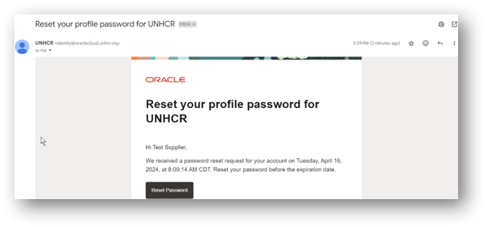
Password reset notification
Company LLC
Company LLC
2.7 Forgotten Password
A password reset notification email was sent to the email address associated with your Supplier Profile
Step 5: Verify your email Inbox/Spam (Junk) mailbox of your email address and identify the email with the Password Reset Link.
Step 6: Click on Reset Password Button in the email.

Slide 41
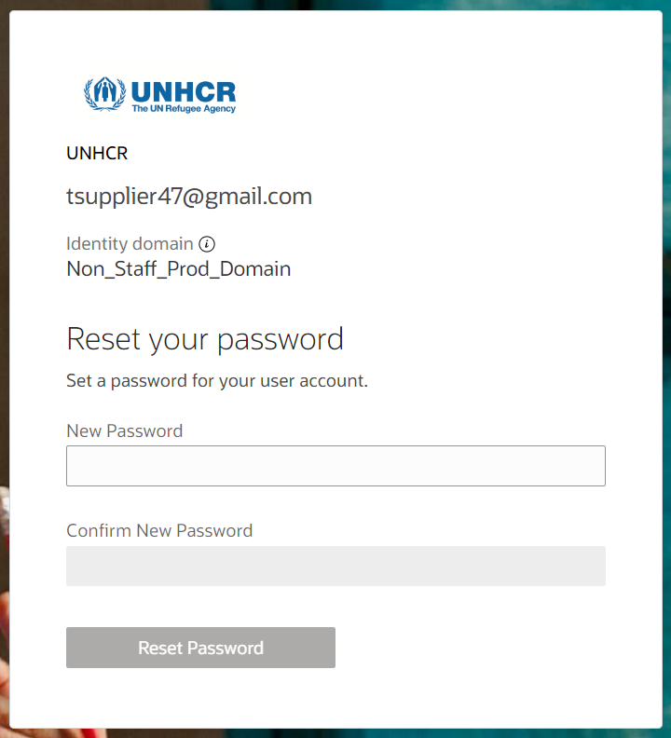
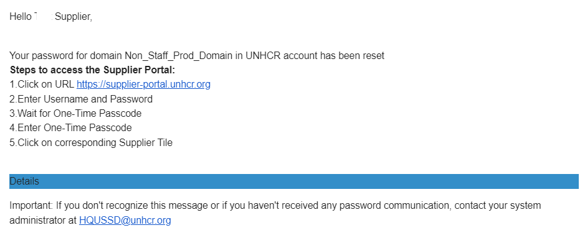
Password reset page
2.7 Forgotten Password
Step 7: Enter the new Password. Confirm Password.
Step 8: Click on Reset Password page
Login Page will be displayed.
You will receive an email confirming that your password has been reset.

Slide 42
3.1 Search for negotiations
3.2 Subscribe to a negotiation
3.3 Prepare/submit negotiation
3.4 View a bid response
3.5 Edit the bid response for an on-going negotiation
3. Submission of offer

Slide 43
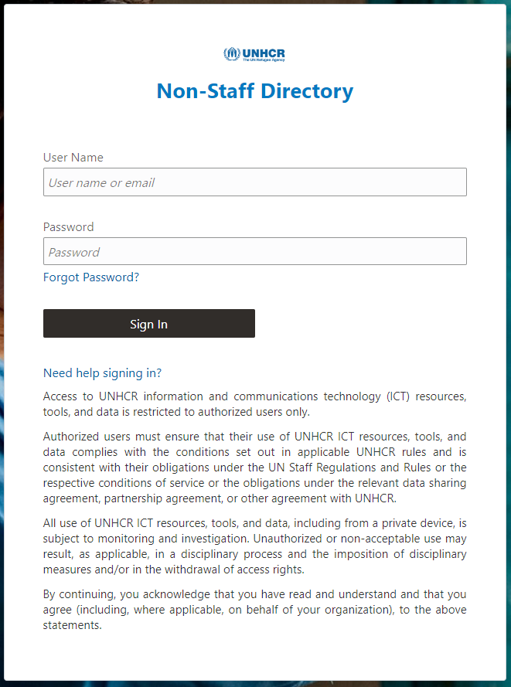

3.1 Search for negotiation
Enter User ID
Enter Password
Click on Sign In
Click on https://supplier-portal.unhcr.org
Click on PROD External IDCS
Enter the User ID (email address) and Password
Click Sign in to login to the Cloud ERP application

Slide 44
Home page of Supplier Portal
Click on Supplier Portal
3.1 Search for negotiation
IMPORTANT:
If your company is invited to participate in the negotiation, you will receive an e-mail notification.
Click on Supplier Portal tab
Supplier can see all pending actions from Things to Finish section

Slide 45

Home page of supplier portal
3.1 Search for negotiation
Click on View Active Negotiations
Go to Negotiations section
Click on View Active Negotiations

Slide 46

Active Negotiations page
IMPORTANT: ** means at least one is required.
Search active negotiation
3.1 Search for negotiation
Click on Search
TIP:
If you don’t have any specific number of negotiation, you can select “Invitation Received” as “No”. When you click on Search button, you can see all available and active negotiations.
On the Active Negotiation page, enter all relevant information and find the active negotiation
Click on Search

Slide 47


Downloading negotiation
3.1 Search for negotiation
Click on the negotiation line
If you want to see the pdf version of negotiation, go to Actions > View PDF

Slide 48


Acknowledge Participation
3.2 Subscribe to a negotiation
TIP
It’s very important to subscribe to an ongoing negotiation that you are interested to participate. This is the only way to receive automatic email notifications with the information on any changes related to that negotiation.
If you want to participate in selected negotiation, you can Accept Terms and Acknowledge Participation.

Slide 49

Create response
3.3 Prepare/Submit negotiation
In order to submit a bid, Supplier must complete 4 main actions (4 train stops).

Slide 50







Train stop 1: Overview
3.3 Prepare/Submit negotiation
Company LLC
Review negotiation document and requirements – Click on Actions > View Negotiation
Ask questions if applicable – Click on Messages
Check submission deadline – Time remaining
Enter bid validity period – It must meet the negotiation requirement (i.e.: 90 calendar days)

Slide 51

Going to next train stop
Use Save button to save or continue the registration at a later time.
When you complete to fill Overview page, click on Next button to go for next train stop.
3.3 Prepare/Submit negotiation
TIP
The system times out after a certain time of inactivity and any unsaved changes will be lost. To save the data entered at any moment prior to completing the registration and to be able to continue working on the registration later, please click the Save button.

Slide 52

Official communication channel: Online Messages
3.3 Prepare/Submit negotiation
If you have any questions regarding the open negotiation, you can use message function in order to communicate with buyer.
Click on + button to open Send Message box
Enter meaningful Subject (i.e.: RFQ 1366 – Clarifications on the requirement)
Enter questions in Message box that you want to clarify about negotiation and then click Send.

Slide 53


Sections under Requirements
IMPORTANT: * means mandatory field to be filled.
3.3 Prepare/Submit negotiation
In Requirements Train stop, enter response for the requirements.
Add Attachments for the requirements wherever Applicable and click on + button to add.
For going to next section, click on button on top or bottom of the page.
Requirements
Section 1: Mandatory Certifications
Sections 2: Technical Specifications
Sections 3: Financial proposal
IMPORTANT
Depending on the nature of negotiation, questions and numbers of Requirements and Sections will be different.

Slide 54

IMPORTANT: This action is applicable only for two stage negotiation method.
Unlock Stage: Commercial
3.3 Prepare/Submit negotiation
Click on Actions > Manage > Unlock Stage: Commercial to open the financial offer section
IMPORTANT
The two-step negotiation method is utilized to keep the financial offer sealed until the supplier passes the technical evaluation stage. For example: When Request For Proposal method is used.

Slide 55

Download attachments
IMPORTANT: * means mandatory field to be filled.
3.3 Prepare/Submit negotiation
Download annexes and attachments to fill out if applicable

Slide 56



Train stop 3: Lines
3.3 Prepare/Submit negotiation
Enter per quantity Price
Enter Promised Delivery Date
If you want to edit your offer, click on Actions > Edit Line Details

Slide 57




Train stop 4: Review
3.3 Prepare/Submit negotiation
Company LLC
Review all entries and revise if necessary
Go to Actions > View Response PDF
Click on Actions > Validate button in order to check compliance
If there is no missing information, Confirmation box will pop-up.

Slide 58

Submission confirmation
Company LLC
3.3 Prepare/Submit negotiation
Click on Submit button to complete the submission.
Confirmation box will pop-up on your screen informing you that the bid response was submitted.
IMPORTANT
Be aware that saving your bid for later does not submit it in the system. To submit your bid, you must click on Submit button.

Slide 59


3.4 View a bid response
Home button
Enter the User ID (email address) and Password in ERP system
Click Sign in to login to the Cloud ERP application
Click on Home button
Home page of Supplier Portal will appear
Click on Supplier Portal icon

Slide 60

Search submitted response
There are 2 different search options to find the submitted response
3.4 View a bid response
On the Home page of Supplier Portal, select Negotiation Response from dropdown menu.
Select Response Number
Insert Response number
Go to Negotiations section
Click on Manage Responses

Slide 61

Response Status
3.4 View a bid response
Draft – Bid responses which were saved as draft but not submitted
Active – Submitted for ongoing negotiation
Awarded – Awarded bid response
Disqualified – Bid responses which were disqualified during the evaluation process
Pending award – Bid responses which are awaiting award decision
Rejected – Bid responses that were not successful and not awarded
Resubmission required – Have to be resubmitted because the negotiation was amended

Slide 62


3.5 Edit the bid response for an on-going negotiation
Select the line with draft or completed response
Click on Revise button
IMPORTANT
Revision is permitted until the negotiation is closed.

Slide 63

Review/edit bid response
Company LLC
3.5 Edit the bid response
To view and edit the data entered in different sections of your bid response (Overview, Requirements or Lines), click on the appropriate step of the response. Once you implemented the changes, click the Submit button to post your revised bid response.
Or you can Revert to Active Response.
IMPORTANT
Be aware that saving your bid for later does not submit it in the system. To submit your bid, you must click on Submit button.

Slide 64
4.1 Manage order
4.2 Review receipts
4.3 View payment
4. Manage order

Slide 65


4. Manage order and invoice
IMPORTANT
This chapter is applicable only for Spend Authorized suppliers who have active contracts and agreements with UNHCR.
This dashboard shows supplier’s negotiation status or reminds action to be taken.
These options are found under the Tasks sections of the Supplier Portal page.
4.1 Manage Orders
4.2 View Receipts
4.3 Create Invoice
4.4 View Invoices
4.5 View Payments

Slide 66

4.1 Manage orders
PO STATUS
Open: The PO is open for receiving and invoicing
On Hold: The PO is on hold and no transactions can be created
Closed for Receiving: The PO is fully received
Closed for Invoicing: The PO is fully invoiced
Cancelled: The PO is cancelled but not deleted
Pending Change Approval: The PO has a change request that is sent for approval
Navigate the Tasks on the Supplier Portal icon and follow the steps below:
Click on Headers/Schedule
Enter the Purchase order number or select All Orders option
Use Search or Advanced search function
Click on PO number to preview the PO
Click Life cycle icon for PO dashboard

Slide 67


Actions
UNHCR
4.1 Manage orders
Supplier can Export the list of POs to excel sheet
Click on Acknowledge button to send acknowledgement
Click on View PDF button to generate PO in pdf version
IMPORTANT
It’s prohibited to change the Purchase Order from Supplier side in the system. Please discuss with procurement focal person first.

Slide 68

Order Life Cycle page
Purchase order Life Cycle details:
Order Number
Supplier Name
Supplier Site
Supplier Contact
Ordered Amount
Shipped Amounts
Received Amount
Invoiced Amount
Receipts Details
Delivered Amount
Invoices Details
In-Transit Shipments
Bar-Chart for PO transactions
Company LLC
4.1 Manage orders

Slide 69

4.2 Review receipts
Navigate the Tasks on the Supplier Portal icon and click on View Receipts:
Enter the Purchase order number
Select All Receipts option
Click on Search or Advanced search function
Click on Receipt number to review the receipt

Slide 70



Receipt page
Company LLC
4.2 Review receipts
Click on View Transaction History button
Click on Quantity
Quantity Details will be displayed

Slide 71


View Payments page
Company LLC
Click View Payments on the supplier portal main page
Use any of the following search options to retrieve the existing Payments:
Payment Number
Supplier name
Payment Status
Supplier Site
Payment Amount
Payment Date
Click on Search
The Payment details will be retrieved in the Search Results table
4.3 View Payment

Slide 72
5.1 Technical assistance
5.2 FAQs
5.3 Glossary
5. Helpdesk Support

Slide 73

5.1 Technical assistance
If you experience technical issues with the registration or bid submission process, please contact the respective buyer as indicated in the negotiation document of the negotiation you wish to bid as soon as you can.
Resolving the technical issue would take time and UNHCR will not be held liable for any delays. UNHCR will respond during official business hours.
To ensure your case is resolved as quickly as possible, when requesting support, it is always recommended to share the following details:
Your User ID and Company name
The negotiation ID you are participating in (if applicable)
Screenshots of any error or warning messages
A brief description of the steps you took before encountering any errors or issues
IMPORTANT
Do not postpone registration and bid submission till the last minute.

Slide 74
5.2 Frequently asked questions
Q: How will suppliers be registered in the system? A: The suppliers can register through self-service registration in the Supplier Portal.
Q: Can suppliers apply directly via their supplier portal? A: Yes, the supplier portal allows suppliers to apply directly.
Q: How can we register ourselves in rural areas where there is no accessible private 2G or 3G internet service for the public? A: In such cases, the procurement focal point can assist for registration process wherein UNHCR will register them.
Q: Can suppliers participate in RFQ, ITB, and RFP processes through the supplier portal? A: Yes, suppliers need to participate in these processes through the supplier portal.
Q: Will the supplier's payment depend on the INCOTERM or the receipt? A: The procedure won't change much. INCOTERMS are determined as part of the purchase order, and payment is processed based on the receipt.
Q: Will centralizing supplier validation and approval result in delays? A: Supplier management requires specialized review and centralizing this information.
Q: Will fiscal documentation be requested in tenders? A: Suppliers will be required to upload fiscal documentation on the supplier portal as per specified in the negotiation requirements.

Slide 75
Q: Will suppliers be able to update their information in the portal? A: Yes, suppliers can update their information in the portal, but material changes require validation and approval by the central team.
Q: What happens if a supplier changes bank information during the generation of a purchase order? A: If the change request is approved before printing the purchase order PDF, it will be reflected; otherwise, the purchase order needs to be reprinted post-approval.
Q: How will supplier clarifications/questions during the negotiation period be handled? A: Suppliers can communicate with UNHCR through Supplier portal using Message button.
Q: Do suppliers have access to the ERP system for purchase order acknowledgment? A: Yes, you will receive notification and suppliers have access to the ERP system for purchase order acknowledgment through supplier portal.
Q: Is the Supplier portal environment just in English or it will provide an access in other UN languages? A: At the beginning the portal will be activated in English and slowly other languages will be added to the system.
Q: For suppliers who have been correctly migrated in the Cloud ERP. Will supplier need to also self-register to be able to receive negotiations or will we be notified about negotiations because we are already registered? And in case, how will we know how to have access to our portal account? A: Those who have been correctly migrated won’t have to self-register again. Suppliers will be able to participate in tenders, suppliers can go into the portal, and suppliers will have access to the available information for open negotiations. The contact information data (emails, telephone, etc) are paramount to be able to contact the suppliers and provide suppliers with guidelines to access your portal account with your credential (email) and then reset your own password.
5.2 Frequently asked questions

Slide 76
Q: Is the Cloud ERP going to be connected to the (UN Global Marketplace) UNGM portal? A: Not at the moment.
Q: What happens if the supplier name in the bank details is different from the beneficiary name? A: The bank account should always be in the name of the beneficiary. We cannot make payments to third parties.
Q: Is it possible to save a registered supplier as a draft before submitting it for approval? How does the approval process work? A: Yes, it is possible to save the registered supplier as a draft before submission for approval. The approval process involves HQ reviewing and approving all requests.
Q: Can supplier perform a check to see if a supplier already exists in the database before creating a new one, specifically checking if the company name is already registered? A: Yes, the system includes a duplicate validation check that prevents the addition of a new supplier with the same email as an already registered supplier. Additionally, you can contact the procurement focal point and get your registered information. The registration process will undergo an approval process at HQ.
Q: Do suppliers need to fill up the vendor registration form? A: Yes, the vendor registration form will still need to be filled out, but there will be a new format that will be delivered soon. The new format will provide updated information and requirements for the vendor registration process.
Q: How long does the approval process take after creating the supplier? A: The specific duration of the approval process has not been specified yet. However, the processing time will depend on the accuracy and completeness of the mandatory details provided during the supplier registration.
5.2 Frequently asked questions

Slide 77
Q: How will we know the city code when entering Supplier details? A: For city codes, you can enter any name to refer to the city. The code will be reviewed by the Master Data Management team during the approval process. As for the country, if you enter the initial letters, the code will appear automatically, assisting with the selection of the correct country code.
Q: If the Swift code is not visible and IBAN is not used in some countries, what alternative options are available for entering bank account details? A: In cases where the Swift code is not visible and IBAN is not applicable in certain countries, an alternative option is to enter the Account Number instead of IBAN. This allows for the inclusion of relevant bank account details specific to those countries during the supplier registration process.
Q: Is it mandatory for every supplier to have a DUNS number for registration? A: No, having a DUNS number is not mandatory for all suppliers. It’s applicable for suppliers who were already assessed and scored by Dun & Bradstreet business credit profile in order to check the business credit scores and assess the company's financial health. If a supplier does have a DUNS number, the supplier can provide their TAX ID or TAX Registration number as an alternative identifier.
Q: If the supplier is a proprietor, should their tax ID be used during registration? A: Yes, if the supplier is a proprietor, their tax ID should be used as the identifier during the registration process.
Q: Can we create a supplier with an address from a different country code? A: Yes, it is possible to create a supplier with an address from a different country code. The system allows for multiple addresses within a supplier profile, and these addresses can be differentiated using address names.
5.2 Frequently asked questions

Slide 78
Q: When selecting the country, will the bank information details displayed be specific to that country or are they the same for all countries? A: The bank information details displayed will be specific to the selected country. For example, if you select Hungary, the system will show you banks, and branches located in Hungary. Similarly, if you select Afghanistan, you will only see banks and branches relevant to Afghanistan. The displayed bank information is country-specific and tailored to the banking options available in each respective country.
Q: Where can we add the Swift code? A: The Swift code is associated with the setup of banks and branches within the system. You don’t have to provide it.
5.2 Frequently asked questions

Slide 79
5.3 Glossary
Awarding: Awarding is the phase during a Procurement action in which based on the evaluation of the bids/proposals received (tender offers) an award of one or more relevant contracts is made. Usually at this stage the eligibility and evaluation of the proposals have been concluded, so it remains to choose the one that got the one(s) to be awarded with a contract.
Inspection: Inspection is the process by which goods are checked for quality, compliance with technical specifications, and accuracy. Types of Inspection include factory audit, pre-delivery inspection, loading inspection, post-delivery inspection, laboratory testing.
Inventory (INV): Inventory includes all stockable items.
Item: Items are products or materials with specific Item Attributes, e.g. a laptop of a certain model. Each item is assigned an ID which can be selected in transactions.
Last Mile: The last leg of a journey comprising the movement of goods to a final destination.
Low Value Procurement (LVP): Low Value Procurement - also referred to as Shopping - is the purchase of readily available off-the-shelf goods and simple services, for a cumulative value at or below the threshold for making use of an RFQ (threshold set at USD 4,000 for the same or similar items within a short period of time, usually 90 days (about 3 months) depending on the nature of the item concerned).
Purchase Order (PO): A Purchase Order is a contractual agreement with an external Supplier, an Individual Consultant or Contractor, or a CBI funding commitment. Purchase Orders are raised when you already know the details of the goods or services to be purchased, including the estimated costs, quantities, delivery schedules, and Chart of Accounts (CoA) coding. Purchase Orders generate a budgetary obligation.

Slide 80
Receipt: Receipt is the confirmation that goods or services were received in accordance with the specifications of the Purchase Order (PO). It serves as the basis for settling the Suppliers is invoice.
Scoring: Scoring is a step in the Request for Proposal (RFP) process, which - as part of the evaluation process - covers the rating of each proposal submitted by the Bidders. A scoring method can also be used in RFQs and weighted ITBs to determine technical compliance with a set of requirements.
Spend authorized supplier: Suppliers who are ready to be awarded or receive payments and transaction from UNHCR.
Trade Operation (TO): Trade Operations are used to capture Landed Cost charges associated with Purchase Order (PO) Receipts.
5.3 Glossary

Slide 81
THANK YOU!

